Slide 1
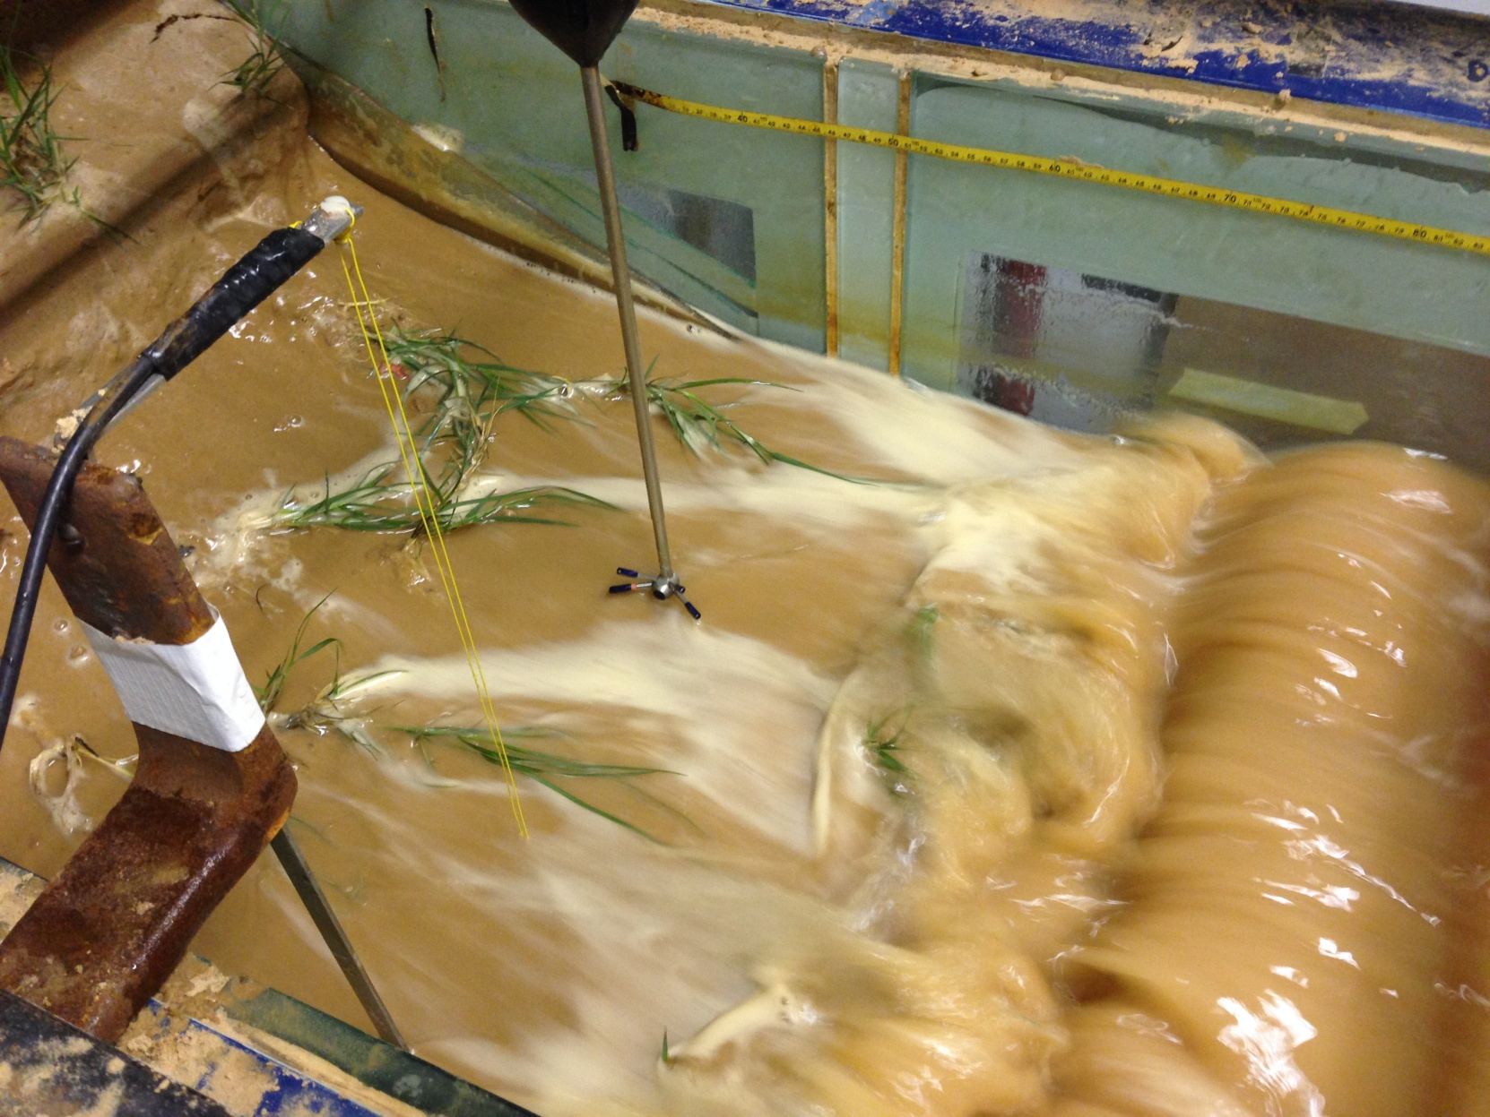
Influence of above- and below-ground vegetation parameters on swash zone flows and vegetated dune erosion
By Jacob Sigren, Jens Figlus, and Anna Armitage

Slide 2
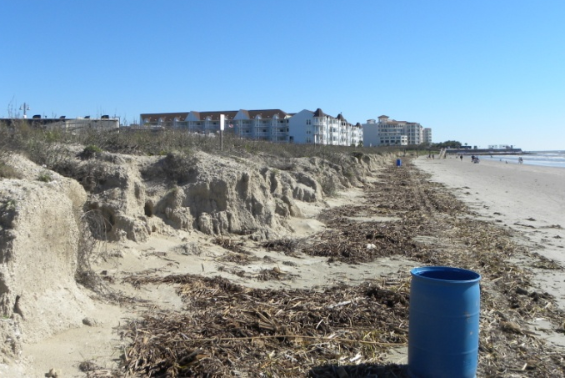
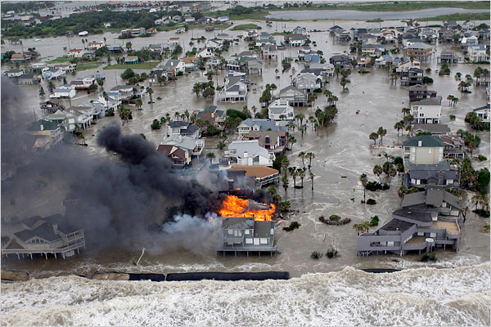
Introduction
Dune vegetation reduces erosion in flume studies (Kobayashi et al. 2013, Sigren et al. 2014, Silva et al. 2016)
Different species of vegetation varying alter erosion patterns in dunes (Charbonneau et al. 2017)
The question remains: By what biophysical mechanisms do plants modify erosion and what aspects of plants are important during these biophysical interactions?
Relevant to dune restoration, management, and storm mitigation
Notes:
Left Picture, erosion to a dune system in Galveston from a minor storm
Right Picture, massive damage inflicted on homes

Slide 3
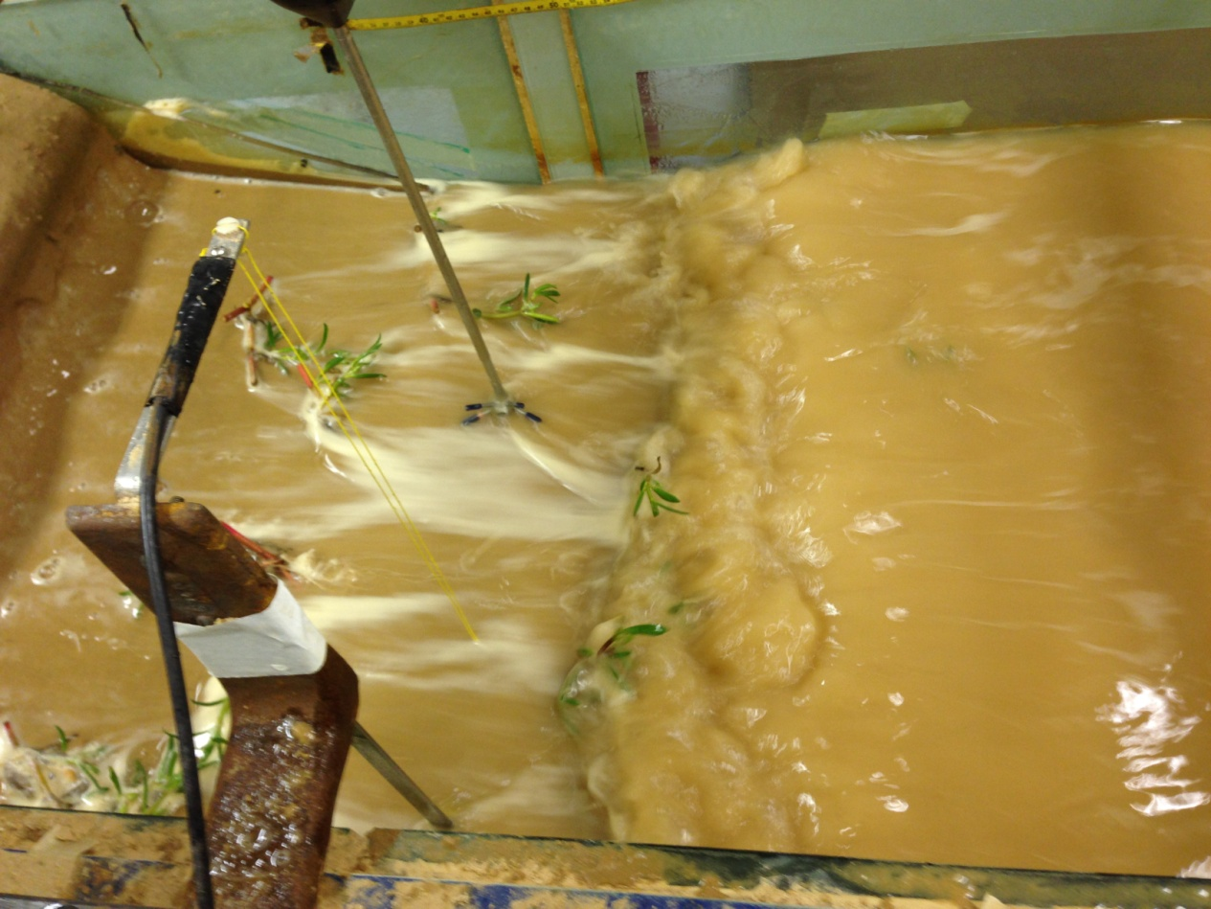
Above-Ground Biophysical Interactions
Emergent plant stems and leaves reduce turbulence, water flow velocity, and wave energy in coastal ecosystems (Leonard and Luther 1995, Yang et al. 2012)
This reduction depends on plant rigidity and size/surface area of structures (Bouma et al. 2005, Augustin et al. 2009)
Notes:
When you have a swash come in contact with plant structures in a dune system, there will potentially be modifications turbulence, water velocities, wave energy dissipation

Slide 4
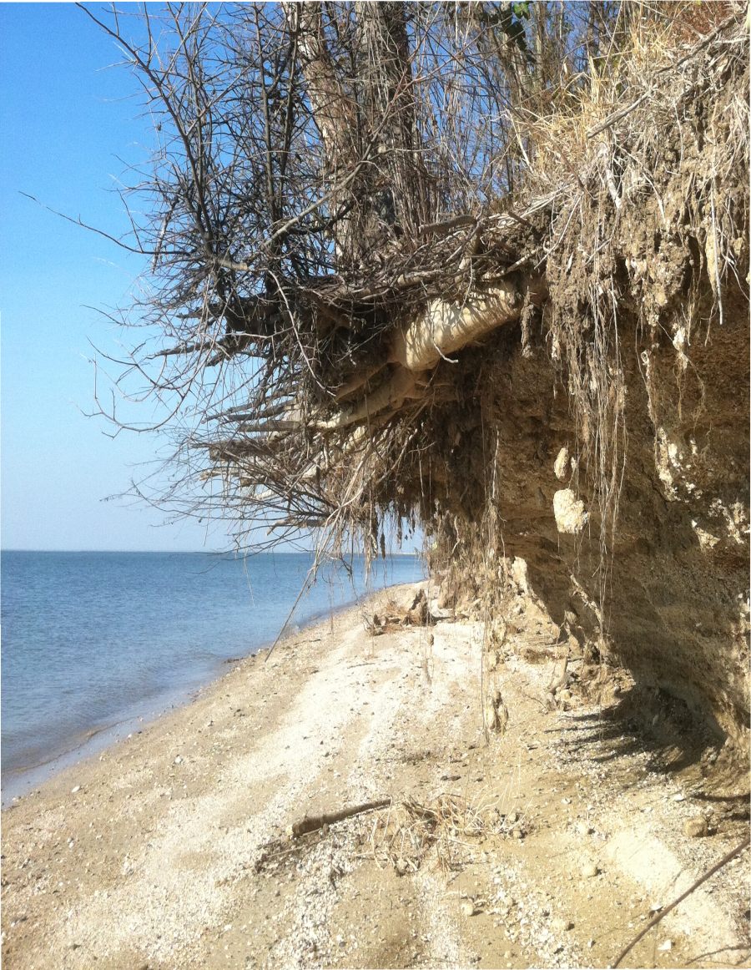
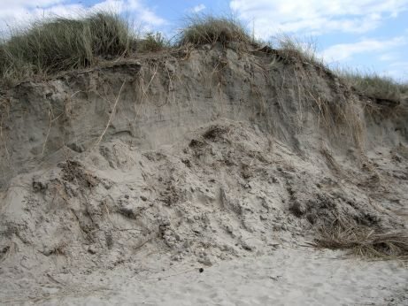
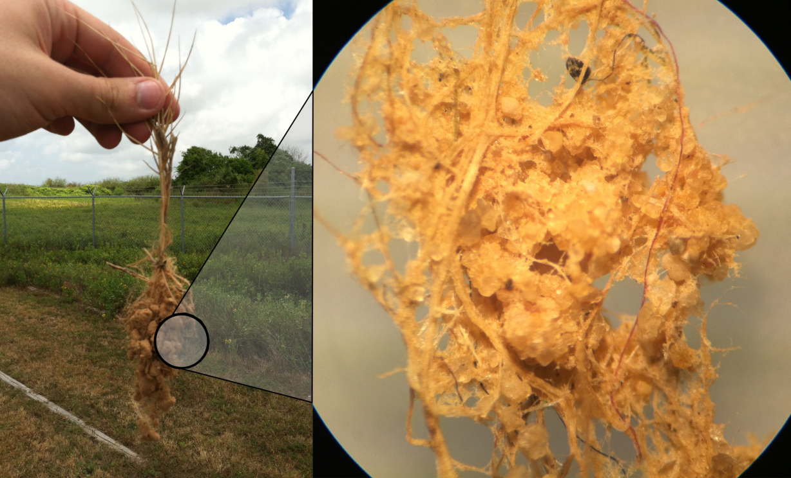
Below-Ground Biophysical Interactions
Plant roots reinforce the soil matrix to resist shearing (De Baets et al. 2006)
Plant roots and microbes bind soil particles together into larger conglomerates (Miller and Jastow 1990)
Notes:
Plant roots modify soil substrate. Shear reinforcement could reduce the occurrence of slumping of dune scarps. Soil binding could alter the “effective grain size” of dune sediment if conglomerates hold up during storm conditions and if a large amount of sediment is bound together in this manner.
Top left: scarp on pelican island (shell and sand soil, not a lot of clay), this would not be supported in this manner if tree and shrub roots were not present. It would have slumped a long time ago if not for plant roots
Top right: Picture of a slumped dune scarp (doesn’t have as many roots), pure sandy soils more prone to slumping
Bottom: Sand gains bound together by plant roots, fungus

Slide 5
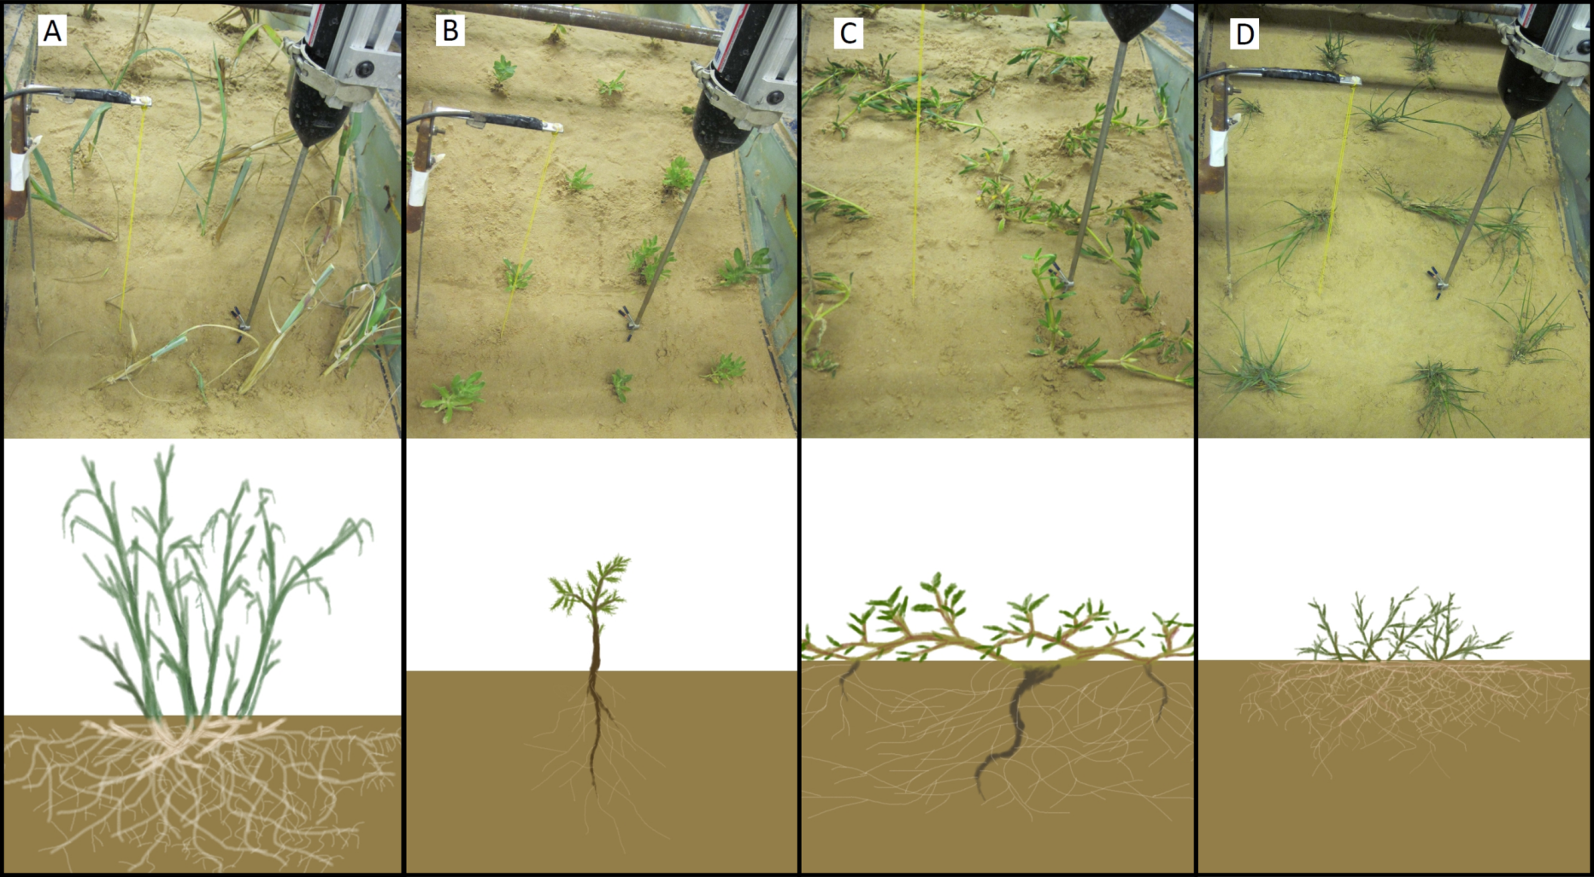
Objectives
Test multiple species of dune plants at multiple growth intervals in a controlled wave flume setting
Collect and statistically model vegetation, hydrodynamic, sediment, and erosion variables
Vegetation Parameters → Hydrodynamic/Sediment Properties → Erosion
Panicum amarum
Rayjacksonia phyllocephala
Sesuvium portulacastrum
Sporobolus virginicus
Notes:
4 species tested, each grown for 3,6, and 9 weeks. This tested a wide range of variability which could lend statistical support to the biophysical mechanisms of dune erosion reduction. Basically a way to evaluate all of these biophysical interactions in one single experiment. Potted plants were transplanted from a greenhouse to the flume.

Slide 6
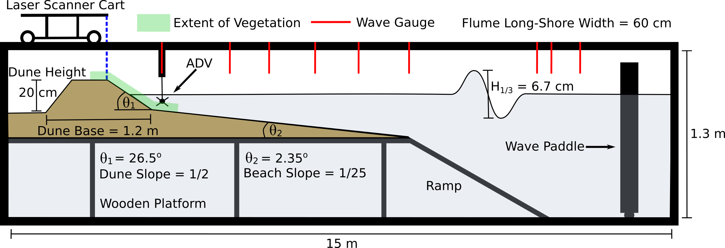
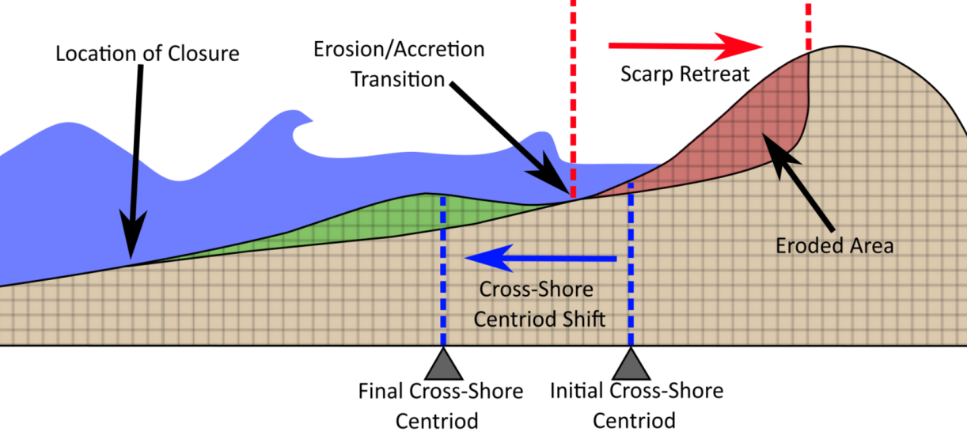
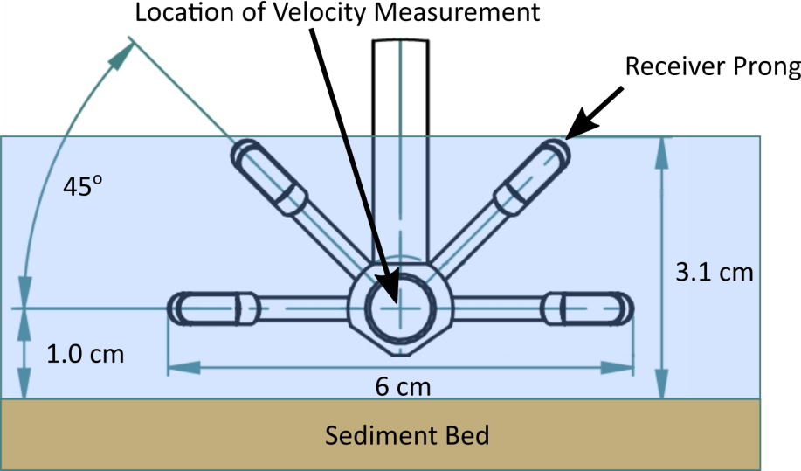
Methods
TAMUG coastal wave flume was used
15 total trials, 12 wave runs (each 210 secs) per trial
Data Collected:
Vegetation: Plant Surface Area, Stem Rotational Stiffness, Fine Root Biomass, Coarse Root Biomass, Mycorrhizal Activity
Hydrodynamic: Turbulent Kinetic Energy, Swash Velocity, Wave Reflection
Sediment: Sediment Shear Strength, Effective Sediment Grain Size
Morphological Change: Eroded Volume, Scarp Retreat, Offshore Centroid Shift
Notes:
Walk-through schematic of flume and how erosion was evaluated. Vegetation biomass obtained by drying and seperating out root biomass. Surface area was quantified using digital photography and spectral analysis. Rotational stiffness obtained by applying force to anchored stem and measuring angle of deflection. Mycorrrhizal activity measured by staining roots. TKE and swash velocity measured using vectrino plus sidelooker. ADV was located roughly at the erosion/accretion transition point (sediment bed shifted slightly, was compensated for in statistical modeling). Wave reflection measured with wave gauges. Shear strength measured using a rudimentary shearer designed by researcher. Effective sediment grain size measured using a “slosh” table and a submerged seive tower.

Slide 7
Results - Plants Under Wave Attack
Panicum amarum
Rayjacksonia phyllocephala
Sesuvium portulacastrum
Sporobolus virginicus
Notes:
PA hardly moves at all but is too tall, most of the plant is not in the scaled-down swash zone.
RP moves a moderate amount, but not too much in the way of structure surface area
RP A lot of surface area but very flexible, not much resistance
SV Moderate surface area, also very flexible

Slide 8
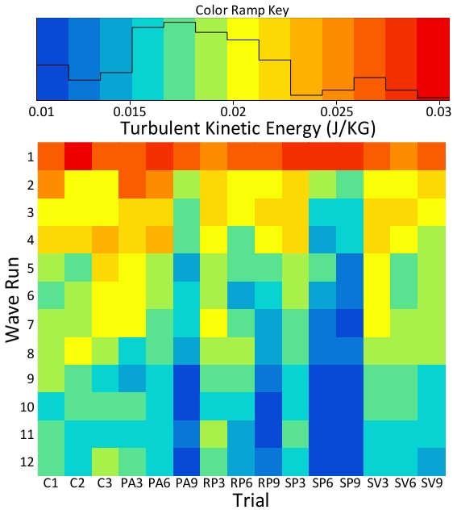
Results - Turbulent Kinetic Energy (TKE)
TKE significantly decreased with increased wave exposure
TKE depended on ADV distance from sediment bed (+) and wave height (+)
TKE also significantly decreased with increased above-ground plant structure surface area (p value = 5.44e⁻¹⁶)
Plant Surface Area → Turbulent Kinetic Energy
Notes:
Chance of this pattern arising and plant surface area correlating to TKE from random variation, even when compensating for wave run, ADV distance from sediment bed, and wave height variation between runs, is 5.44 in ten quadrillion.

Slide 9
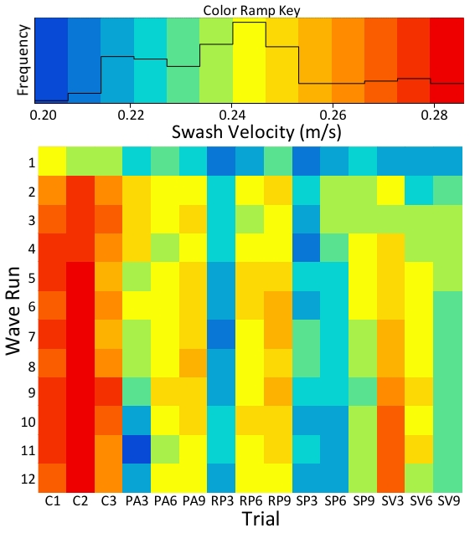
Results - Cross-Shore Swash Velocity
Swash velocity significantly related to ADV distance from sediment bed (-), beach slope (+), time of wave exposure (-), and sand bar size (-)
Swash velocity also significantly decreased with increased above-ground plant structure surface area (p value = 8.23e⁻⁰⁷)
Plant Surface Area → Swash Velocity
Notes:
Again, chance of this strong of a correlation occurring between plant surface area and swash velocity by random variation, even compensating for all these other variables, is 8.23 in ten million.

Slide 10
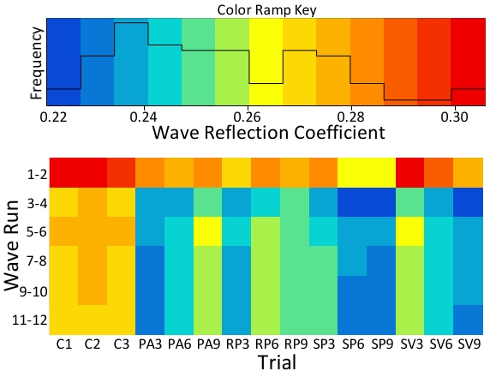
Results - Wave Reflection
Wave reflection significantly related to beach slope (+), time of wave exposure (-), sand bar distance from dune (-), and sand bar size (-)
Wave reflection also significantly decreased with increased above-ground plant structure surface area (p value = 9.64e⁻⁰⁹)
Plant Surface Area → Wave Reflection
Turbulent Kinetic Energy
Plant Surface Area
Wave Reflection
Swash Velocity
Notes:
Chance of plant surface area correlating to wave reflection by random variation is 9.64 in a billion.
Point out blue arrows mean - relationship, red mean +
Additionally, TKE and swash velocity also significantly predict wave reflection (positive interactions). To me this makes sense, wave reflection roughly equates to how dissipative a shore is. A dissipative shore will have a high turbulent dissipation rate, meaning at any given point of measurement, the TKE should be lower. So lower TKE means lower wave reflection, higher TKE means higher wave reflection. Also, energy is passed onto plant structures from the swash (as plant structures move, this energy has to come from somewhere), leading to lower swash velocity. Any energy that moves plant structures is energy that isn’t reflected offshore. So higher swash velocity means higher wave reflection. Lower = lower. The full picture begins to come together.

Slide 11
Results - Slumping
Notes:
After slumping occurs, erosion happens quickly as the slumped sediment is attacked by waves

Slide 12
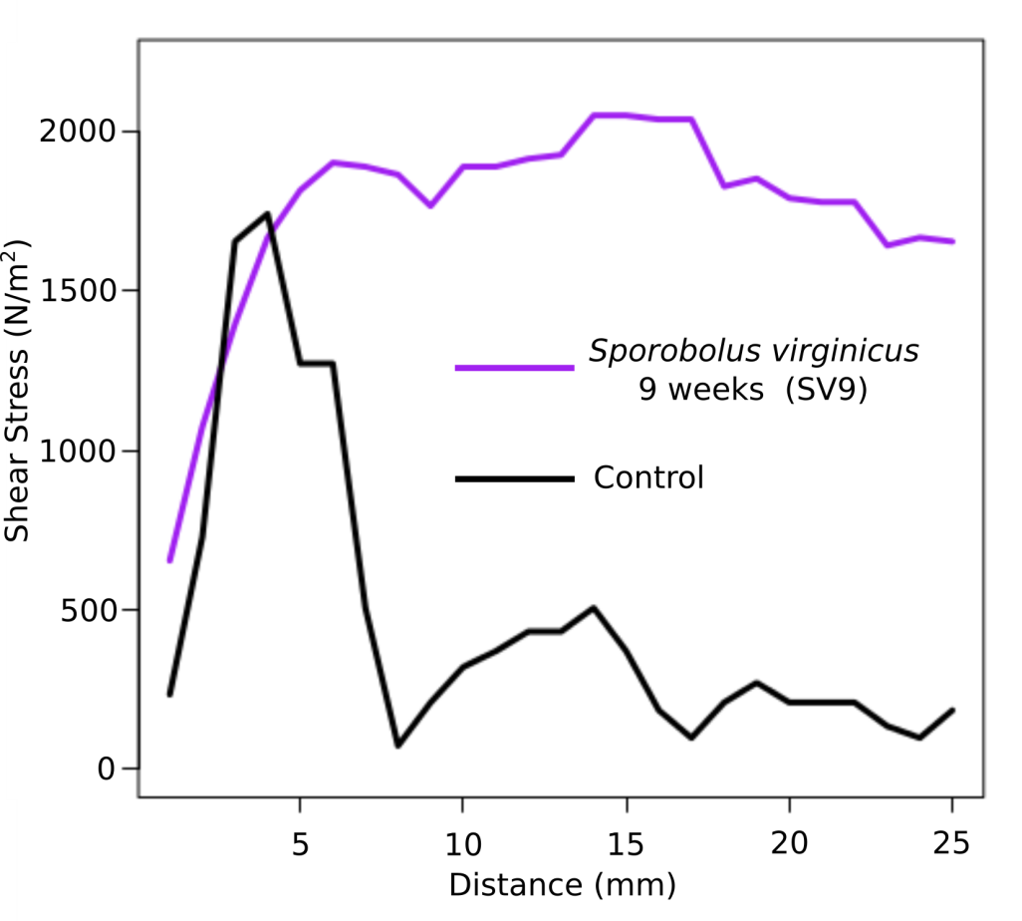
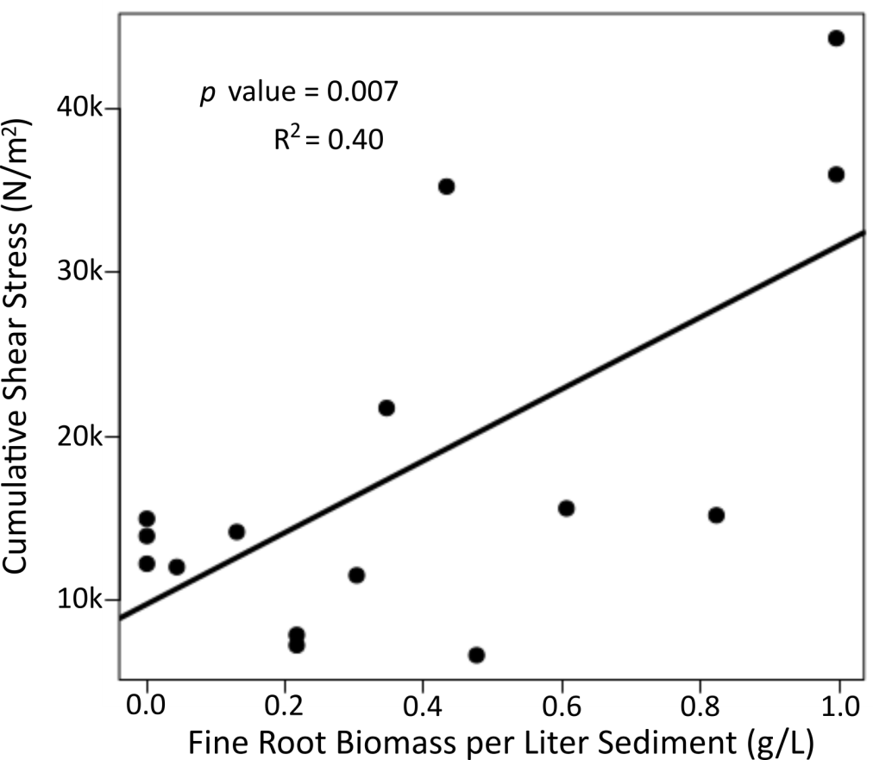
Results - Sediment Shear Strength
Fine Roots increased cumulative shear strength
Likely prevented slumping of sediment into attacking waves
Fine Root Biomass Density → Shear Strength
Notes:
We found that fine roots don’t increase peak stress, but the process of shearing is slower, less violent.

Slide 13
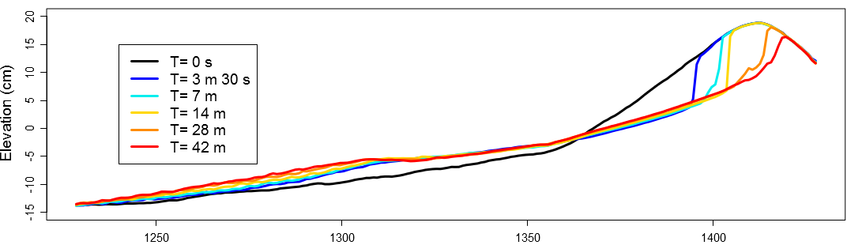
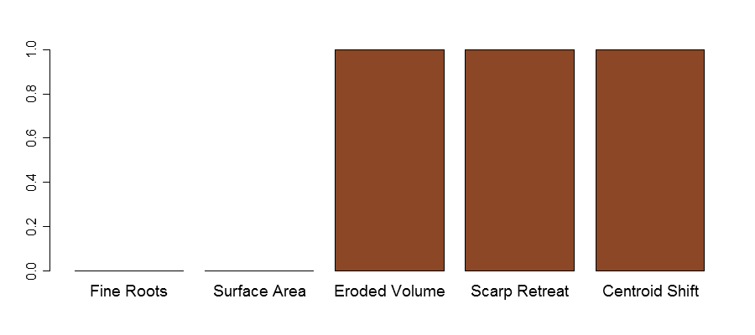
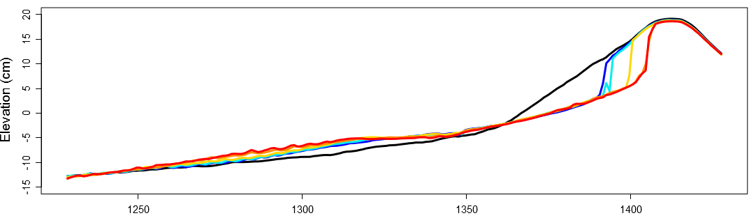
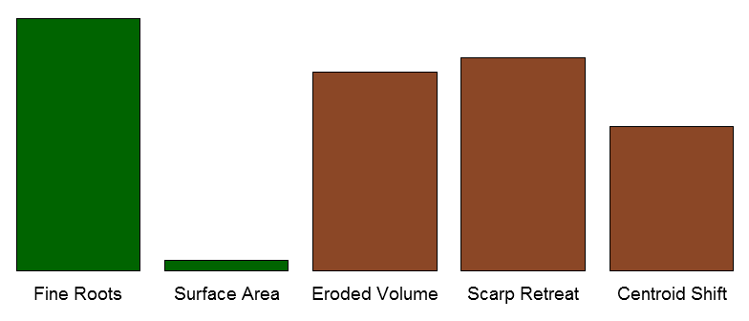
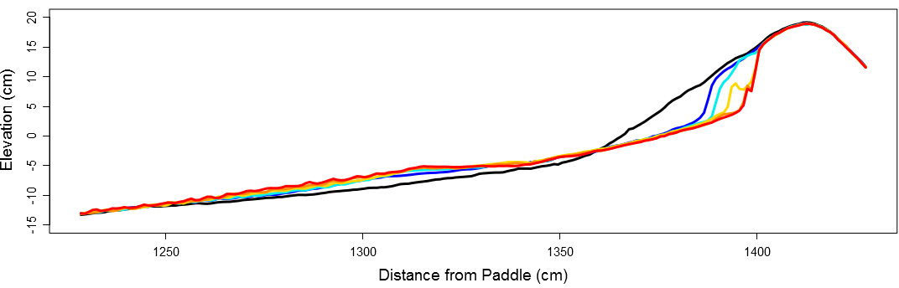
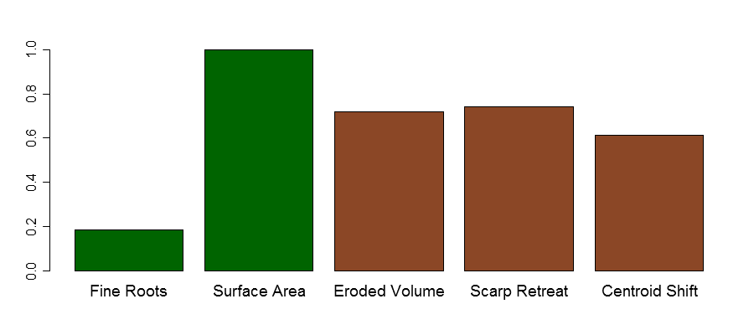
Results - Erosion
Above-ground plant surface area and fine root biomass significantly reduced erosion, scarp retreat, and centroid shift.
Control 1 (C1)
Panicum amarum at 9 weeks (PA9)
Sesuvium portulacastrum at 6 weeks (SP6)
Notes:
When there are no plants (control), there is maximum erosion across all three dune/beach morphological change metrics. When there are a lot of fine roots (PA9), erosion is reduced. When there is a lot of plant surface area above-ground (SP6), erosion is also reduced. These are the results of only 3 trials, but all 15 trials fit this narrative in a signifcant and meaningful fashion (average model p value = 0.0017). Note that plants reduce erosion, not prevent it (factor of 1/4 or 1/3)
Basically, I think showing all 15 would be overwhelming, 3 is a little easier to process. Bar plots show relative values.

Slide 14
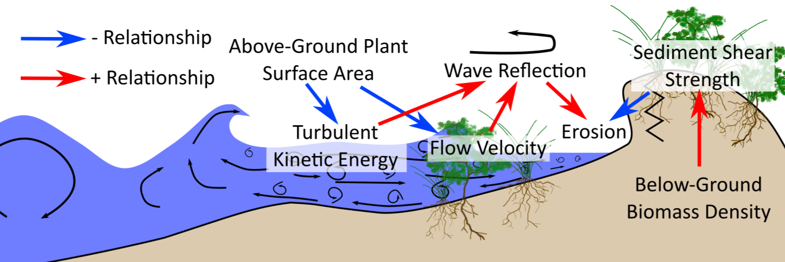
Results - Statistical Model Linkage
Plant surface area and fine root density were the significant determinates of sediment, hydrodynamic, and morphological variation in this flume setting and experiment
Plant surface area reduced swash velocity and turbulence, increasing wave energy dissipation to reduce erosion
Fine root density increased sediment shear strength, reducing slumping and erosion
Notes:
Summarizing all of these statistically significant models.
Plant surface area reduced swash velocity and TKE, in turn that creates a more dissapative shore, less erosion occurs.
Fine roots increased sediment shear strength, less slumping and erosion occurred.

Slide 15
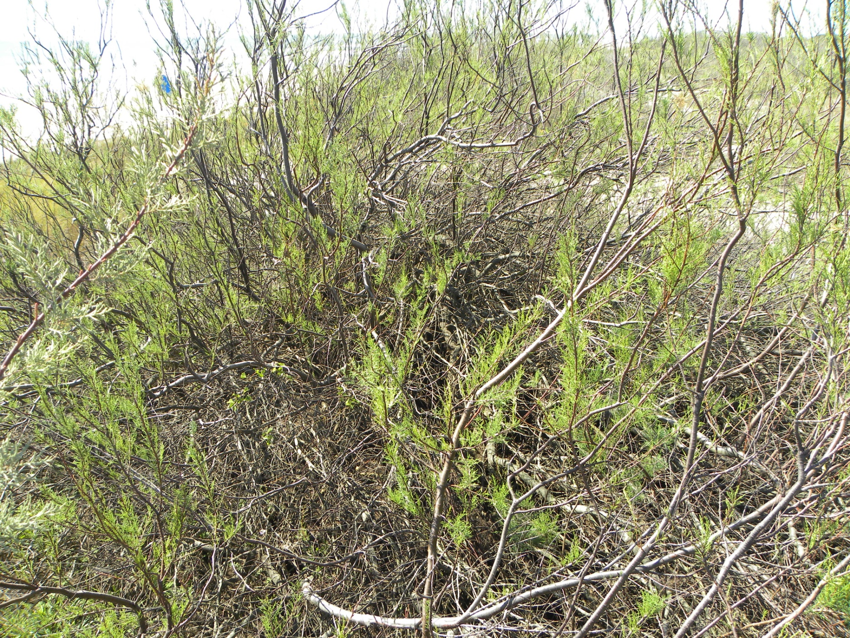
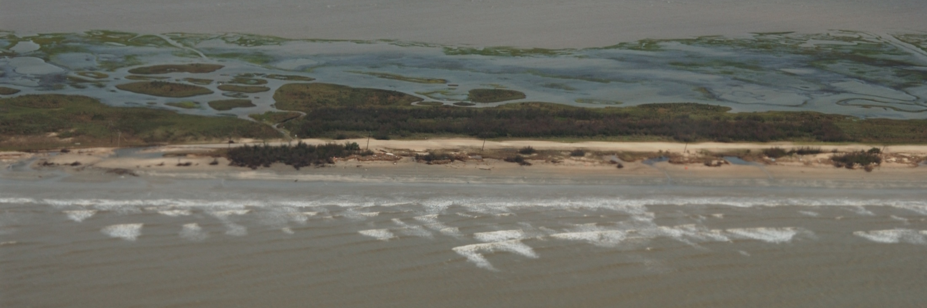
Research Outlook
Scale limitations, future testing needs to be done at larger scales
This research could be used to determine which plant species would offer the most protection
Dune Bioengineering: high above-ground surface area on dune front, high root density on dune ridge and slope
May create conundrum from coastal engineers and ecologists
Tamarix gallica
Exotic and Invasive
Road Damage
Vegetation Clusters
Notes:
Summarizing all of these statistically significant models.
Plant surface area reduced swash velocity and TKE, in turn that creates a more dissipative shore, less erosion occurs.
Fine roots increased sediment shear strength, less slumping and erosion occurred.

Slide 16
Questions? References
Augustin, L.N., Irish, J.L., & Lynett, P. (2009). Laboratory and numerical studies of wave damping by emergent and near-emergent wetland vegetation. Coastal Engineering, 56(3), 332-340.
Bouma, T.J., De Vries, M.B., Low, E., Peralta, G., Tanczos, I.C., van de Koppel, J., and Herman, P.M.J. (2005). Trade-offs related to ecosystem engineering: A case study on stiffness of emerging macrophytes. Ecology, 86 (8), 2187-2199.
Charbonneau, B.R., Louise, S.W., Wnek, J.P., Langley, J.A., and Posner, M.A. (2017). A species effect on strom erosion: Invasive sedge stabilized dunes more than native grass during Hurricane Sandy. Journal of Applied Ecology, Online Only.
Kobayashi, Gralher, C., Do, K. (2013). Eects of woody plants on dune erosion and over wash. Journal of Waterway, Port, Coastal, and Ocean Engineering, 139(6).
Leonard, L. A., & Luther, M. E. (1995). Flow hydrodynamics in tidal marsh canopies. Limnology and Oceanography, 40(8), 1474-1484.
Sigren, J., Figlus, J., & Armitage, A. R. (2014). Coastal sand dunes and dune vegetation: restoration, erosion, and storm protection. Shore and Beach, 82(4), 5-12.
Silva, R., Martinez, M.L., Oderiz, I., Mendoza, E., & Feagin, R.A. (2016). Response of vegetated dune-beach systems to storm conditions. Coastal Engineering, 109, 53-62.
Yang, S. L., Shi, B. W., Bouma, T. J., Ysebaert, T., & Luo, X. X. (2012). Wave attenuation at a salt marsh margin: a case study of an exposed coast on the Yangtze Estuary. Estuaries and Coasts, 35(1), 169-182.

