Slide 1
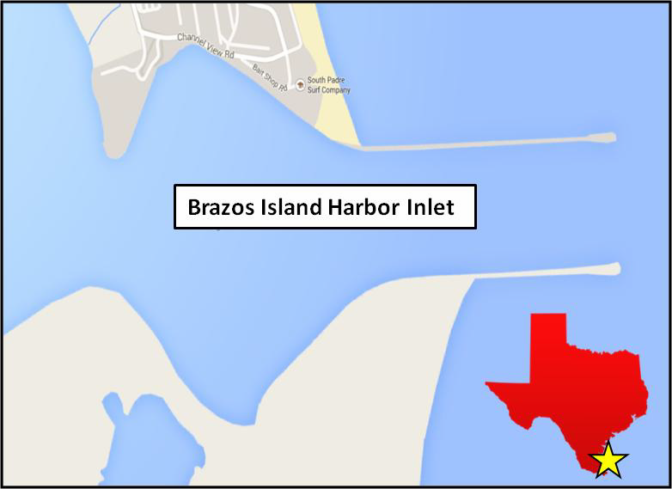
Brazos Island Harbor Inlet Study
Primary Research Team: Tahirih Lackey, Richard Styles, David King, Ernie Smith, Mary Bryant
Field data collection: William Butler, Jarrell Smith, Thad Pratt, Naveen Ganesh
Galveston District: Rob Thomas, Kim Townsand, Chip Worley
Interns: Ryan Visperas (USACE SPL)
Nathan Mays (JSU)
Products:
TN:“Shoaling Analysis at Brazos Island Harbor Inlet, Texas ”
TR: “Brazos Santiago, Texas Inlet Sedimentation Study (Sept 30)
CIRP Seminar (Sept 27)

Slide 2
BIH Inlet Study: Background
Lower Laguna Madre system is a complex hydrodynamic environment.
System includes Port Mansfield and Mansfield Pass to the north and Brazos Island Harbor Inlet (BIH) to the south.
The BIH serves as an entrance for the Brownsville Ship Channel to the Port of Brownsville
Flow through Mansfield and Brazos Island Harbor Inlet impacts the overall transport dynamics of the system.
The alongshore transport of sediment is northward
Port Mansfield
Mansfield Pass
Longshore transport direction
Brownsville Ship Channel
BIH Inlet
Port of Brownsville

Slide 3
BIH Inlet Study: Background
Port Mansfield
Mansfield Pass
Longshore transport direction
Longshore transport of sand provides a sediment source for shoaling within the jetty expansion
Brownsville Ship Channel
BIH Inlet
Port of Brownsville

Slide 4
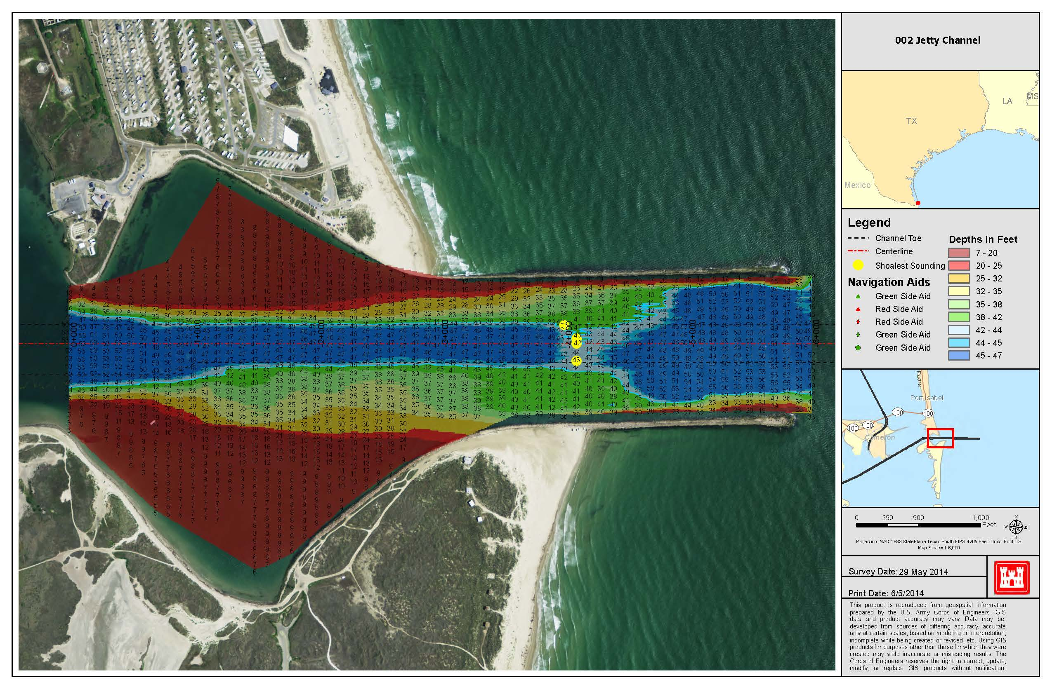
BIH Inlet Study: Motivation
The Port of Brownsville, the only deepwater port located on the U.S. and Mexico border, provides a full range of services to ensure efficient and time cargo delivery worldwide.
Unfortunately harbor pilots have frequently reported increased shoaling within the Brazos Island Harbor Jetty Channel.
The shoaling, has resulted in implementation of 35 to 36 ft draft restrictions 9 to12 months after maintenance dredging
The increased frequency of channel shoaling has posed a challenge for the USACE in maintaining the currently authorized depth of 44 ft MLT, resulting in vessels being sent to other ports
Annual cost of over $5.7 million per year for a 38 ft draft restriction and could escalate to over $19.4 million for a 35 ft draft restriction
Brazos Island Harbor Inlet Bathymetric Survey
Dredge depth = 44 ft

Slide 5
BIH Inlet Study: Objective
Determine if inlet shoaling patterns have changed during the time when the inlet has been maintained at its current design configuration (1992 to present)
Understand the shoaling process in BIH Inlet and provide the Galveston District with suggested sand management alternatives to reduce inlet maintenance dredging costs.
Included in the formulation of reduced dredging cost alternatives is the understanding of the continuing need to provide beach-quality sediments to the South Padre Island gulf shoreline.

Slide 6
BIH Inlet Study: Approach
Task | Dates
Background Investigation and PMP Development | FY14
Application of the Navigation Shoaling Analysis Tool (NSAT) | FY14/15
1YR Field Data Collection | FY14/15
Numerical Modeling : Hydrodynamics and Wave | FY15
Numerical Modeling : Sediment Transport | FY15/16
Alternatives Investigation | FY16
Final Documentation | FY16

Slide 7
Historical Dredging Frequency Analysis
Navigation Shoaling Analysis Tool (NSAT) was used to analyze historical dredging data.
Trends show an increased frequency of dredging over the last 20 years.
Prior to 1995, dredging was sometimes performed as infrequently as every 3 years or more.
In the last five years especially dredging has increased to approximately 1.25 years with one occurrence of 0.75 years in 2011.
Little change in the total volume of material to be dredged

Slide 8
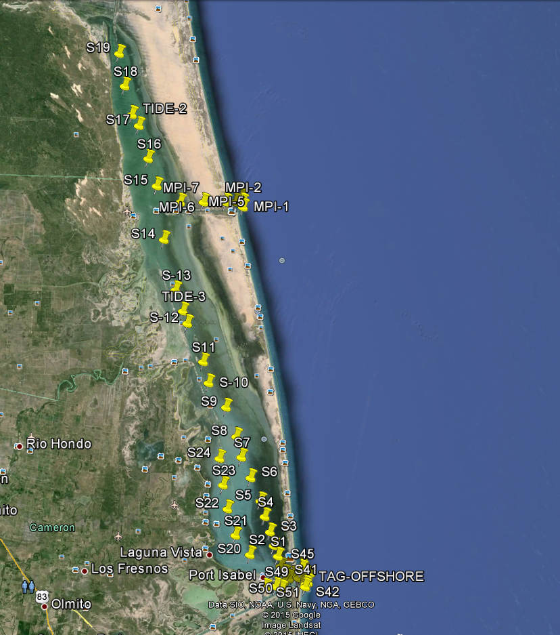
Field Data Collection
1-year Field Data Collection effort:
Wave and current (AWAC) measurements offshore of the inlet
Tidal gages collected water levels at 7 stations at BIH and Laguna Madre at strategic locations around the inlet and offshore. One station included a weather station.
Multi-beam surveys performed around the inlet and north and south of jetties
Bed sample collection (grain size and organic content) were performed at 60 stations
Sediment Collection Map

Slide 9
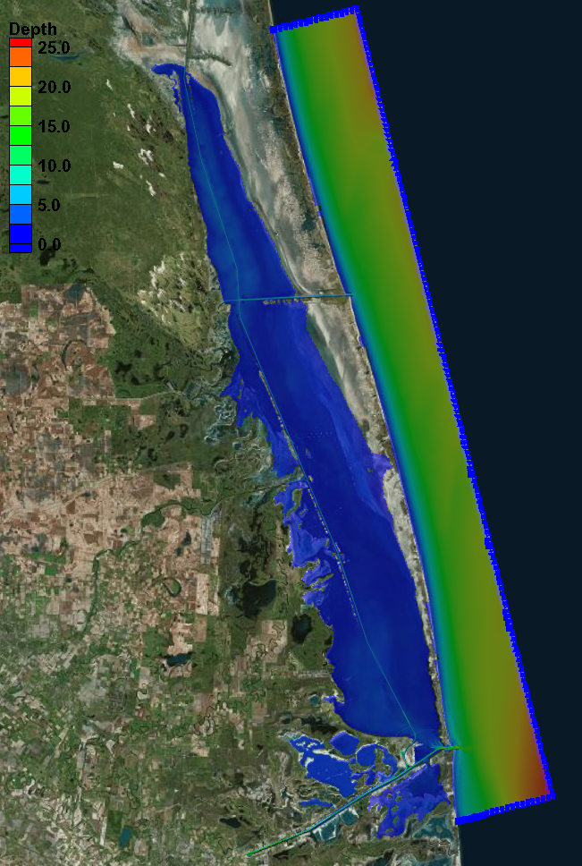
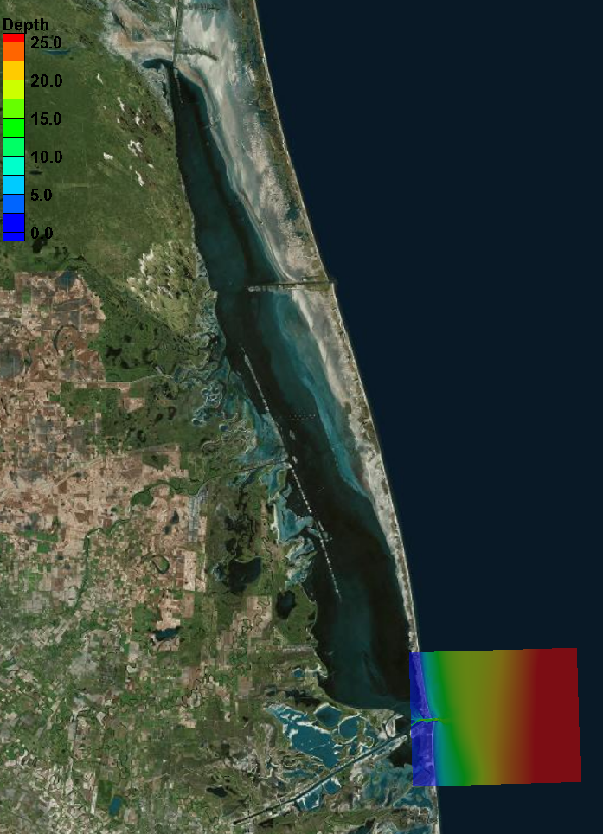
CMS Numerical Modeling
CMS – 2D coupled wave/flow/morphological model.
CMS Flow
CMS Wave
Notes:
9/10/14 – 9/12/14

Slide 10
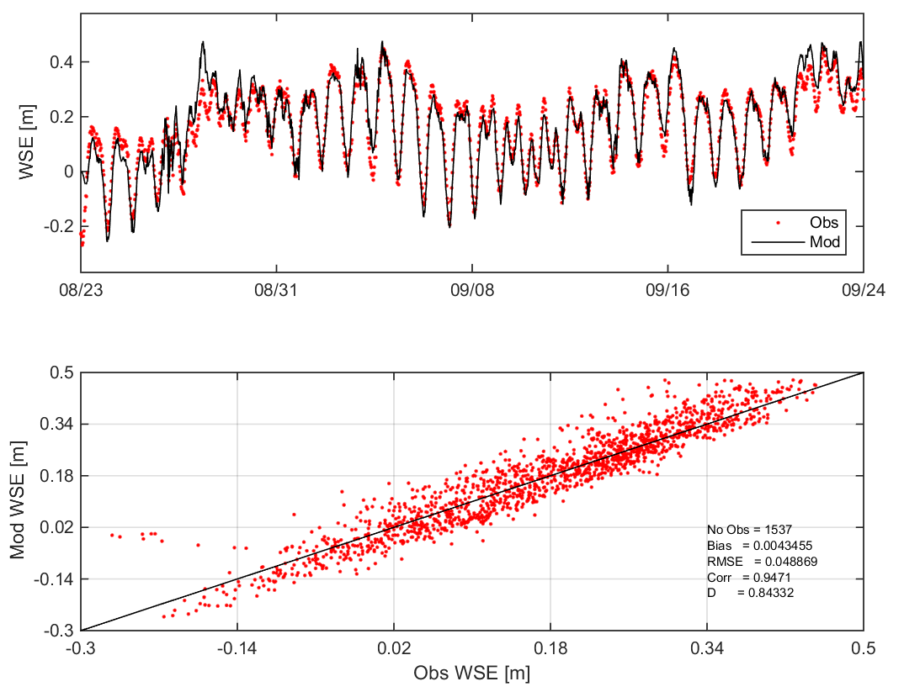
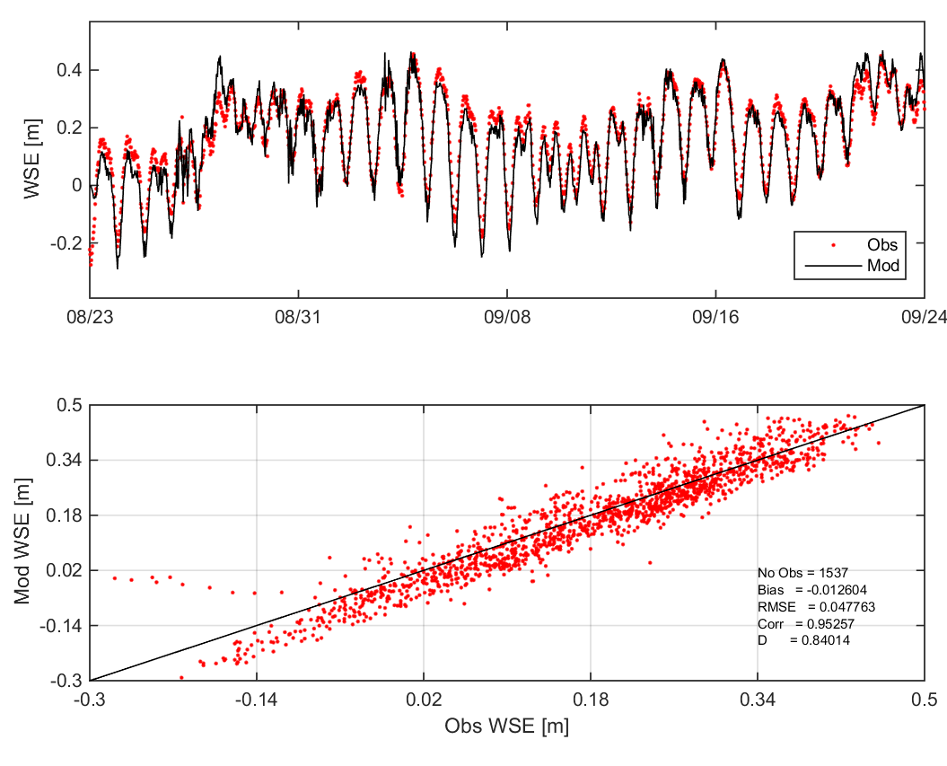
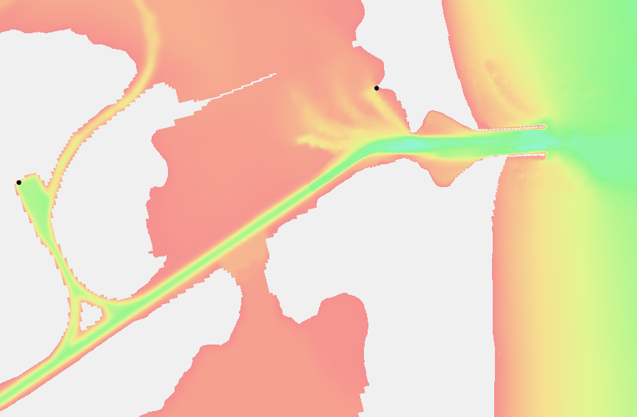
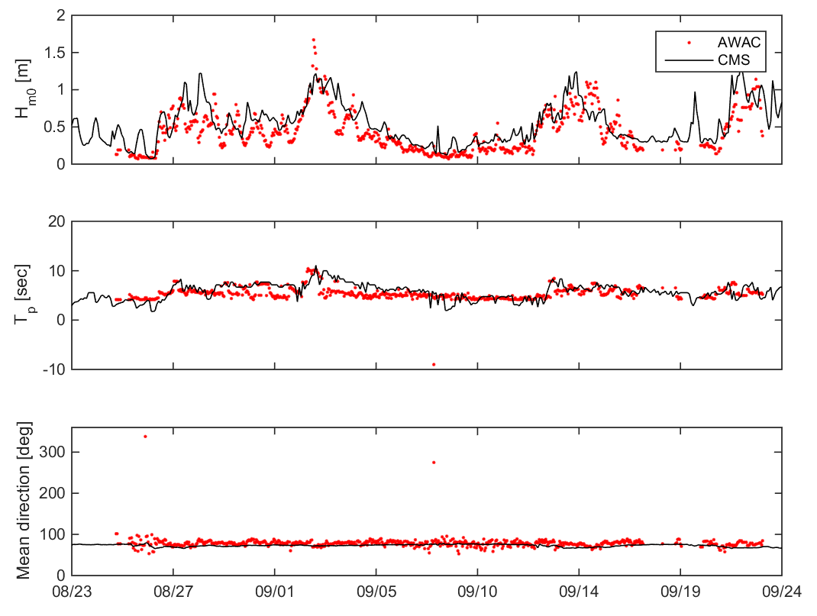
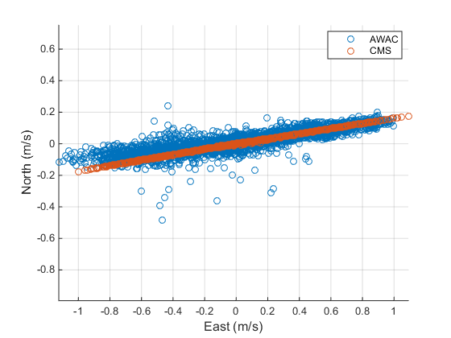
CMS Numerical Comparison with Field Data
2
1
3

Slide 11
CMS Numerical Modeling Results
Largest velocities approximately 1.5m/s
Longshore transport appears to be northward
Recirculation region visible north of jetties
Apparent transport pathway south of jetty into channel.
Velocity vectors and contours of velocity magnitude (m/s) at Inlet (2 weeks). Vectors indicate direction only.

Slide 12
Alternative Investigation
Influence of Mansfield Pass
Mansfield Pass closed
Mansfield Pass deepened (from 12 ft to 20 ft )
Structural Changes to the Jetty
Seaward jetty Extension
Interior Jetty Realignment
Jetty Height Modification
Dredging Specific Changes
In-Channel Sediment Trap
Dedicated Dredging Plant
Mansfield Pass
Indicates that numerical modeling was performed

Slide 13
Mansfield Pass Alternatives
During winter months there is a counter-clockwise circulation with net flow coming in through Mansfield Pass, then south down the Laguna Madre and exiting into the Gulf of Mexico through Brazos Santiago Inlet.
This net flow reverses direction during the summer months and becomes stronger.
In 2011, the USACE discontinued maintenance dredging because Port Mansfield was designated as recreational, rather than commercial (a source of contention between USACE and locals, contacted by National Parks Service).
Mansfield Pass alternatives:
Mansfield Pass closed
Mansfield Pass deepened (from 12 ft to 20 ft )

Slide 14
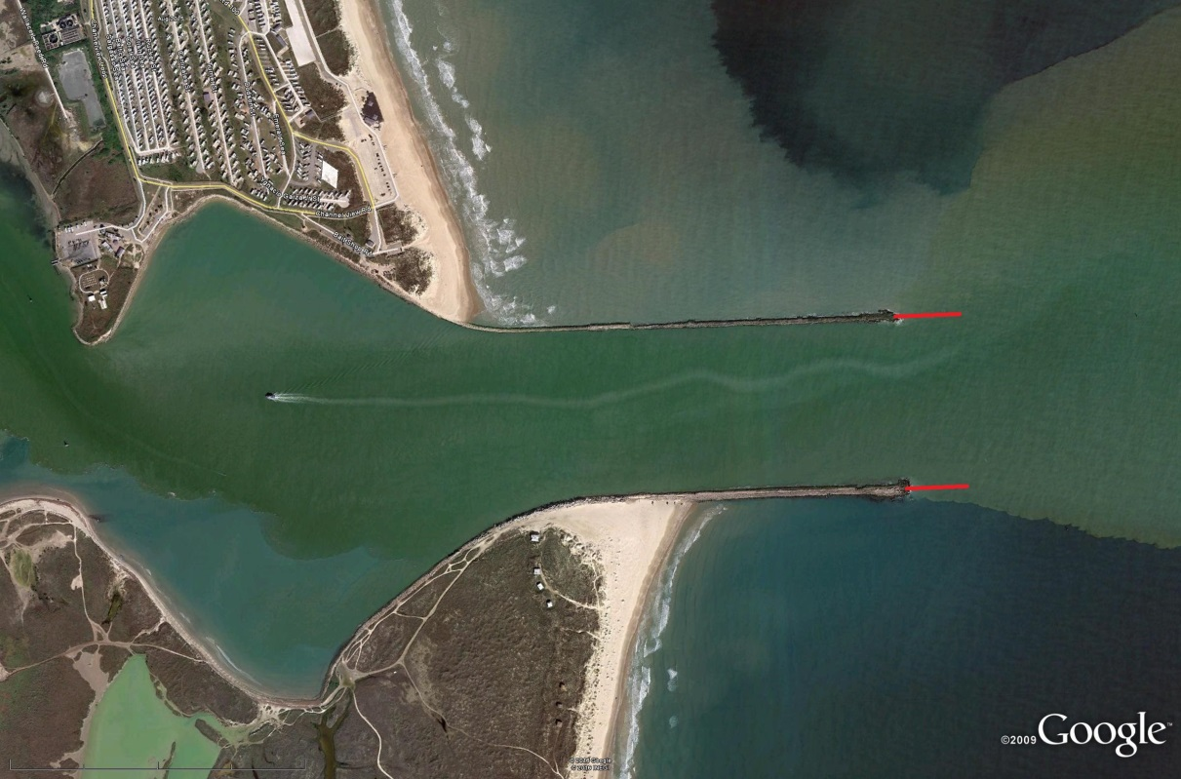
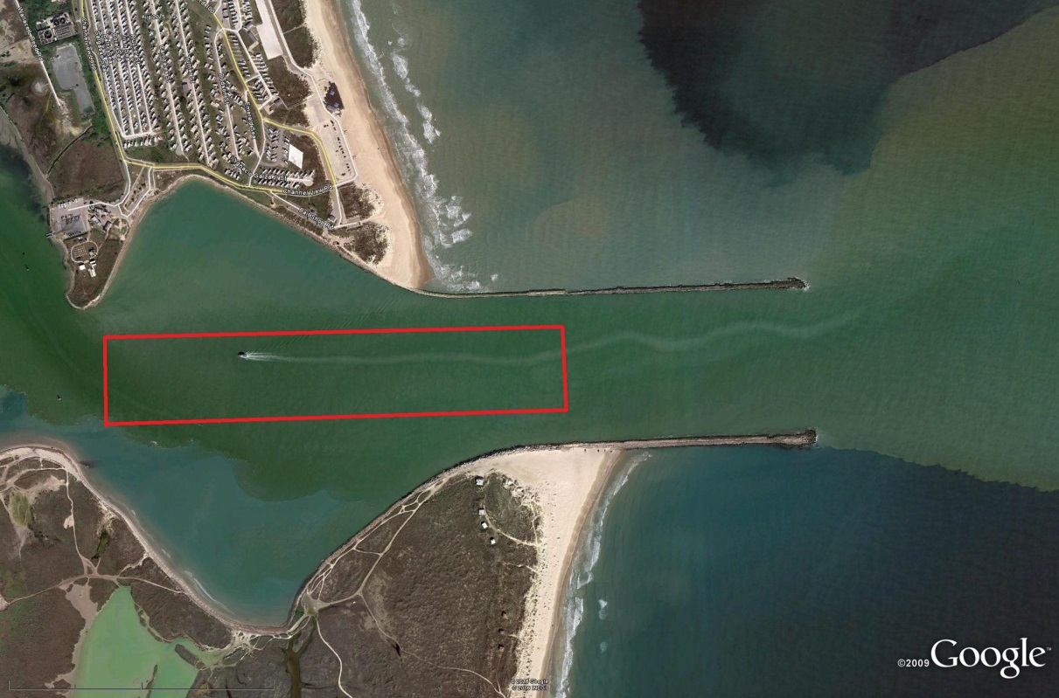
Alternatives Description (cont)
Extend Jetty
In-channel Sediment Trap (holds 200,000 cy of material)
Realigned Jetty

Slide 15
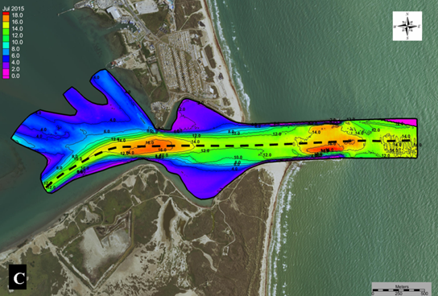
Bathymetric Profiles
Bathymetry profiles were extracted along the channel centerline.
Surveys conducted in:
Sept-2014
March-2015
July-2015

Slide 16
Comparison of Bathymetric Profile of Base Case to Alternatives
Deposition height is larger after 1 year
Deposition height is smaller after 1 year

Slide 17
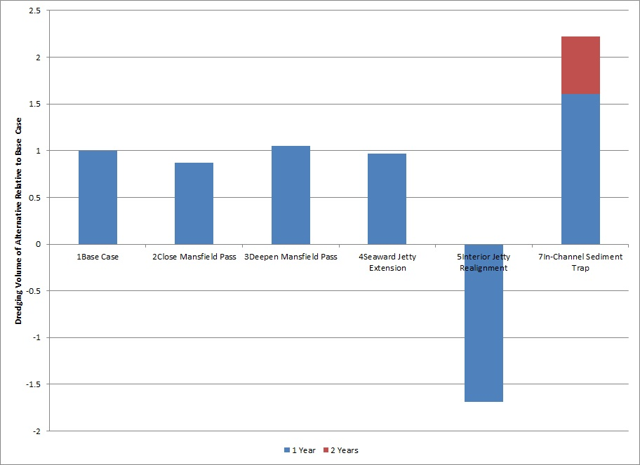
Comparison of the volume of sediment deposited
Values close to 1, indicate little change.
The realigned jetty option actually shows erosion at specified location
The sediment trap option shows larger deposition rate, but material deposits into a hole, so deposition height may still be lower
Accumulated Sediment Volume Deposited (Ratio to base case)
Notes:
Change vertical title to Accumulated Sediment Volume Deposited (Ratio to based)

Slide 18
Assessment of Alternatives
Alternative | Shoaling Rate Impact | Additional Positive Considerations | Additional Negative Considerations
Close Mansfield Pass | Minor decrease |  | Serious negative environmental impacts. Local opposition likely.
Deepen Mansfield Pass | Minor increase | Favored by locals. Environmental benefits. | Unstudied impacts on downdrift beach erosion.
Seaward Jetty Extension | Minor decrease |  | Significant construction costs are anticipated.
Interior Jetty Realignment | Major decrease | Potential beneficial uses for the abandoned portions of the channel. | Likely shift of flood shoal location; increase beneficial use cost.
In-Channel Sediment Trap | Minor increase | Increases time between required dredging Implementation straight-forward. | Channel deepening may require congressional authorization.

Slide 19
Assessment of Alternative
Alternative | Initial Assessment
Close Mansfield Pass | Not recommended for further consideration.
Deepen Mansfield Pass | Worth additional study
Seaward Jetty Extension | Not recommended for further consideration.
Interior Jetty Realignment | Worth additional study
In-Channel Sediment Trap | Worth additional study **
Dedicated Dredge Plant and Distribution System | Worth additional study
Heighten Jetties | Worth additional study

Slide 20
FY17 Plans
Journal Paper focused on Hydrodynamics
Wind Driven Hydrodynamics at a Two Inlet System; Lower Laguna Madre, TX
Journal Paper focused on Alternatives

