Slide 1
Galveston Bay Bottom Ecosystem System Features
Eddie Irigoyen
3 November 2016

Slide 2
Galveston Bay Submerged Aquatic Habitat ER
Data needed related to previously mined holes from oyster shell mining operations in Galveston Bay.
Evaluation of sediment and biological characteristics of previously mined pits in Galveston Bay.
¿Questions have come up regarding if maintenance material dredged from the channel could be placed in these holes?
ER opportunity to identify, develop, and recommend a bay bottom habitat restoration plan through application of innovative concepts and EWN-RSM principles

Slide 3
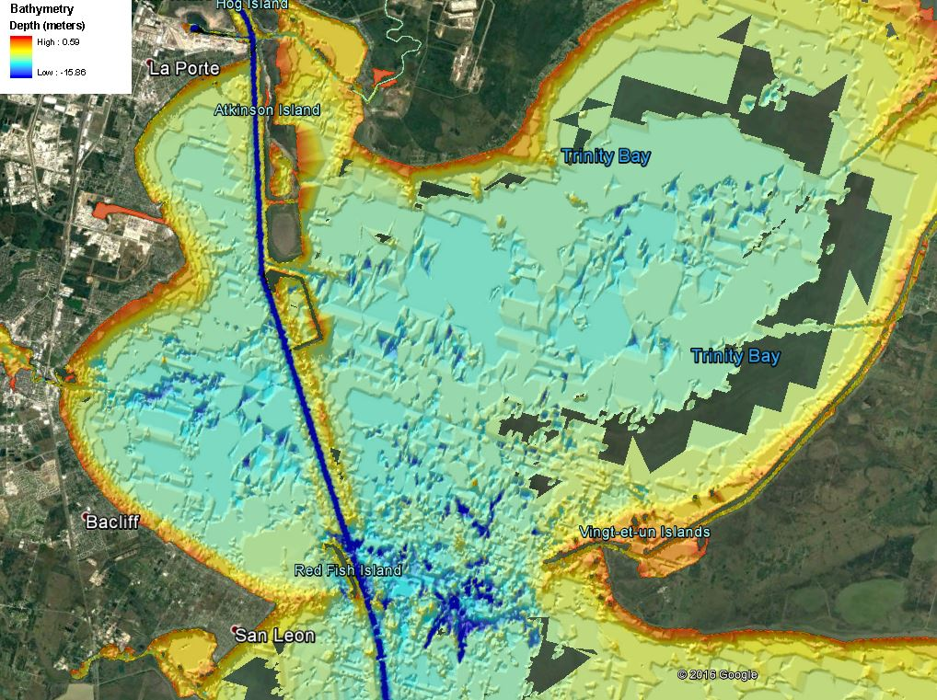
Galveston Bay Submerged Aquatic Habitat ER

Slide 4
TYPE OF Sediments and impacts
What Kind of sediments exists in these holes?
Galveston Bay is a shallow brackish estuary with a large supply of mobile, fine-grained sediment.
What kind of impacts would result by open bay disposal of maintenance material in these holes?
These former holes are probably filled with material that is very similar to the proposed maintenance dredge material form the Huston Ship Channel.

Slide 5
Next Step
Does any information already exist regarding these areas?
No Current data exist.
Working with ERDC through a DOTS Request to gather data to quantify site conditions so that a project to fill or cap these mines can be developed.
What would be the procedure for filling holes?
Dredged materials would be harvested and placed at select bay bottom sites for restoration of bay bottom elevations and compositions conducive to habitat ER
Restored submerged aquatic habitat would be suitable for colonization of oysters and seagrasses with return to functionality for fish and wildlife

Slide 6
Galveston Bay Bottom ER Investigation Approach
An approved Sec 1135 project for construction would be coordinated with ongoing operations and maintenance to ensure consistency and compatibility
The plan will also be developed for consistency and compatibility with commercial navigation and existing recreation usage in the bay
Estimated total project budget is $10 M

Slide 7
Continue Authority Program
Program Authority | Description
Section 204 | Regional Sediment Management and beneficial uses of dredged material from new or existing Federal projects for ecosystem restoration, FRM or HSDR purpose.
Section 206 | Aquatic ecosystem restoration.
Section 1135 | Modification of USACE constructed water resources projects to improve the quality of the environment. Also, restoration projects at locations where an existing Corps project contributed to the degradation. 7

Slide 8
Cap authorities
Program Authority | Description
Section 14 | Emergency stream bank and shoreline protection for public facilities, such as roads, bridges, hospitals, schools, and water & sewage treatment plants, that are in imminent danger of failing.
Section 103 | Protection of public and private properties and facilities against damages caused by storm driven waves and currents by the construction of revetments, groins, and jetties and may also include periodic sand replenishment.
Section 107 | Improvements to navigation including dredging of channels and widening of turning basins.
Section 111 | Prevention of mitigation of erosion damages to public or privately owned shores along the coastline when the damages are a result of a Federal navigation project.
Section 204 | Regional Sediment Management and beneficial uses of dredged material from new or existing Federal projects for ecosystem restoration, FRM or HSDR purpose.
Section 205 | Local protection form flooding by non-structural measures such as flood warning systems, or flood proofing; or by structural flood damage reduction features such as levees. Diversion channels, or impoundments.
Section 206 | Aquatic ecosystem restoration.
Section 208 | Local protection fom flooding by channel clearing and excavation, with limited embankment construction by uses of materials from the clearing operation only.
Section 1135 | Modification of USACE constructed water resources projects to improve the quality of the environment. Also, restoration projects at locations where an existing Corps project contributed to the degradation.

Slide 9
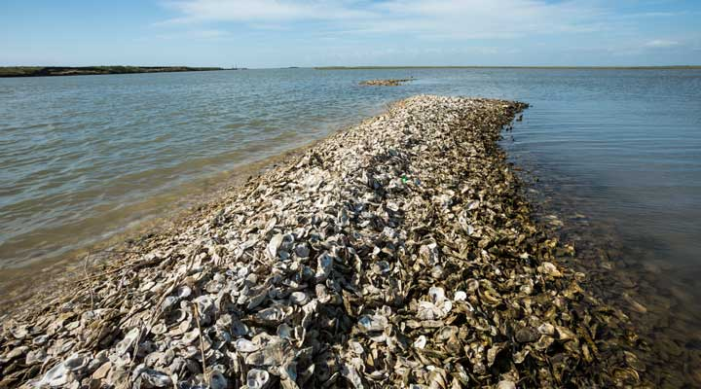
Eddie Irigoyen
Project Manager
US Army Corps of Engineers
Galveston District
eduardo.irigoyen@usace.army.mil
409-766-3130

