Slide 1
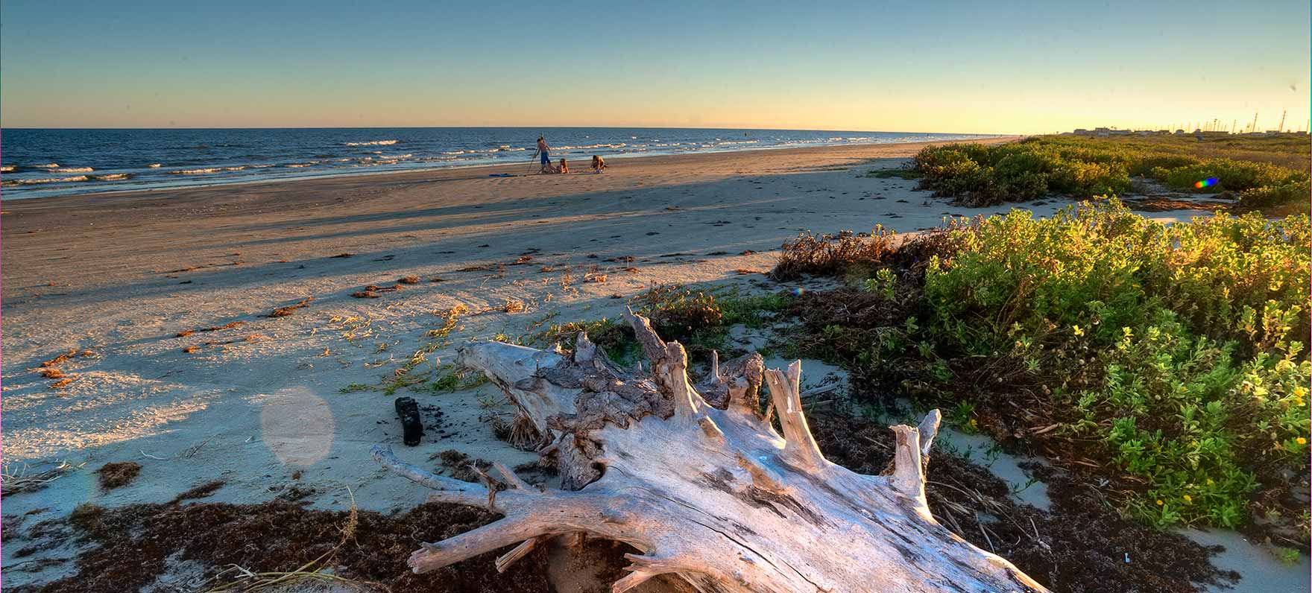


Coastal Field and Lab Research Capabilities Relevant to SPI Nearshore Berm Projet
Department of Ocean Engineering
Texas A&M University – Galveston Campus
USACE – TAMU OCEN Partnering Workshop, November 3rd, 2016, South Padre Island, TX

Slide 2
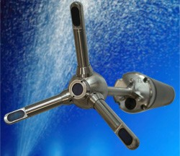
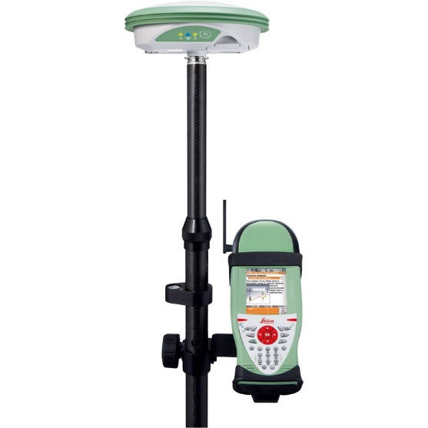
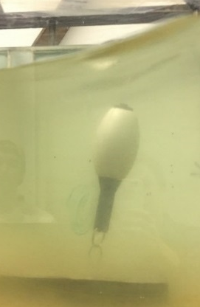
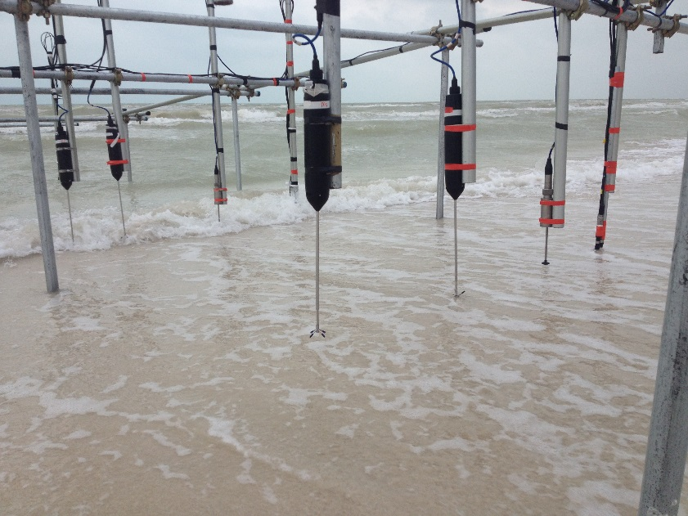
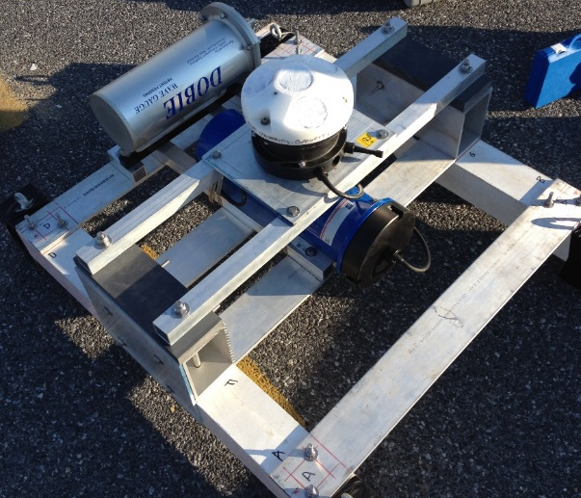
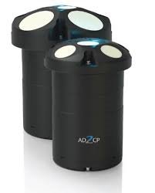
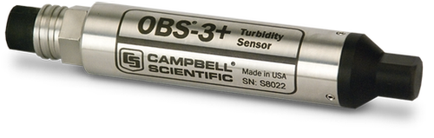
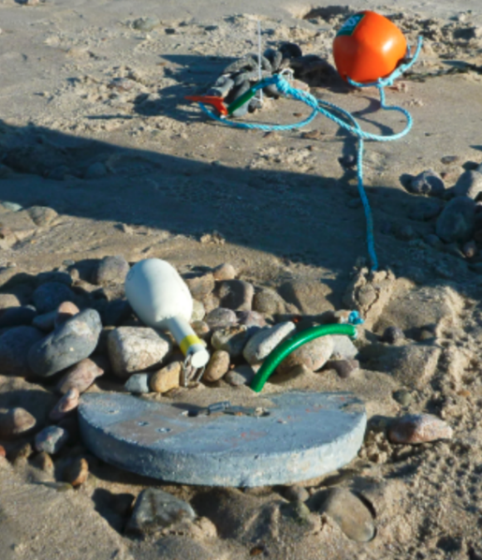
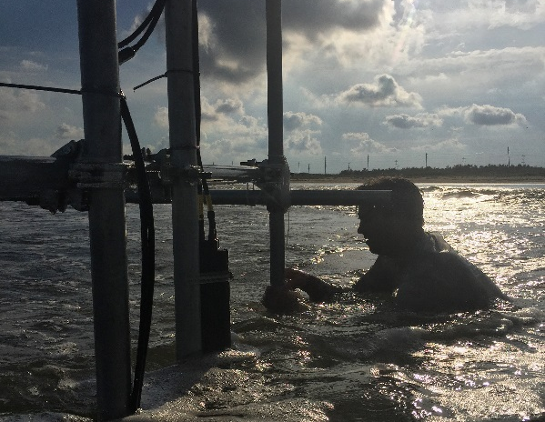
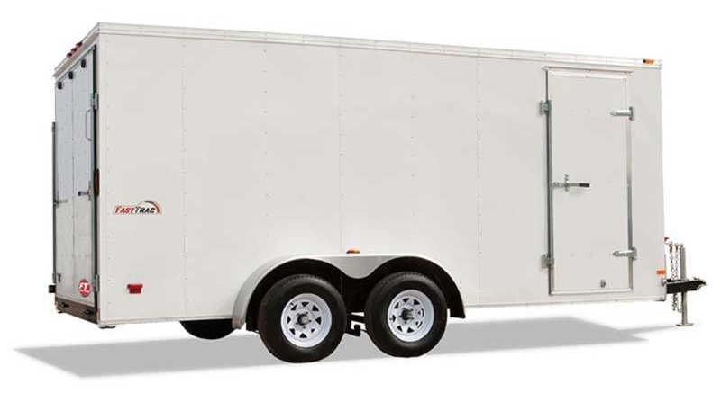

Slide 3
Available Hydro and Sediment Field Instrumentation:
1 Nortek Signature 1000 (directional waves, current profile, turbulence)
1 Nortek 2MHz Aquadopp (directional waves, current profile)
1 Nortek 1MHz Aquadopp (directional waves, current profile)
1 Nortek Vector (3D point velocities, turbulence)
2 Nortek Vectrino II Profiler (3D velocity profile over 3 cm, wired)
1 Nortek Vectrino Sidelooker (3D point velocities near bed, wired)
7 Lowell Tilt Current Meters (360-Deg. current velocity vectors)
3 RBR Solo D Pressure Transducers
2 RBR Solo D-Wave Pressure Transducers
5 Campbell Optical Backscatter Sensors (suspended sediment concentration)
Additional Systems:
1 Leica RTK GPS Rover system (incl. radio antenna)
2 Quad-copter UAV systems (incl. digital camera and GPS)
1 Field Control Center Trailer (18 ft, enclosed)
2 Research Kayaks
1 Research Pontoon Boat
1 Alumacraft Research Vessel (14.5 ft, 25hp, V-Hull)

Slide 4
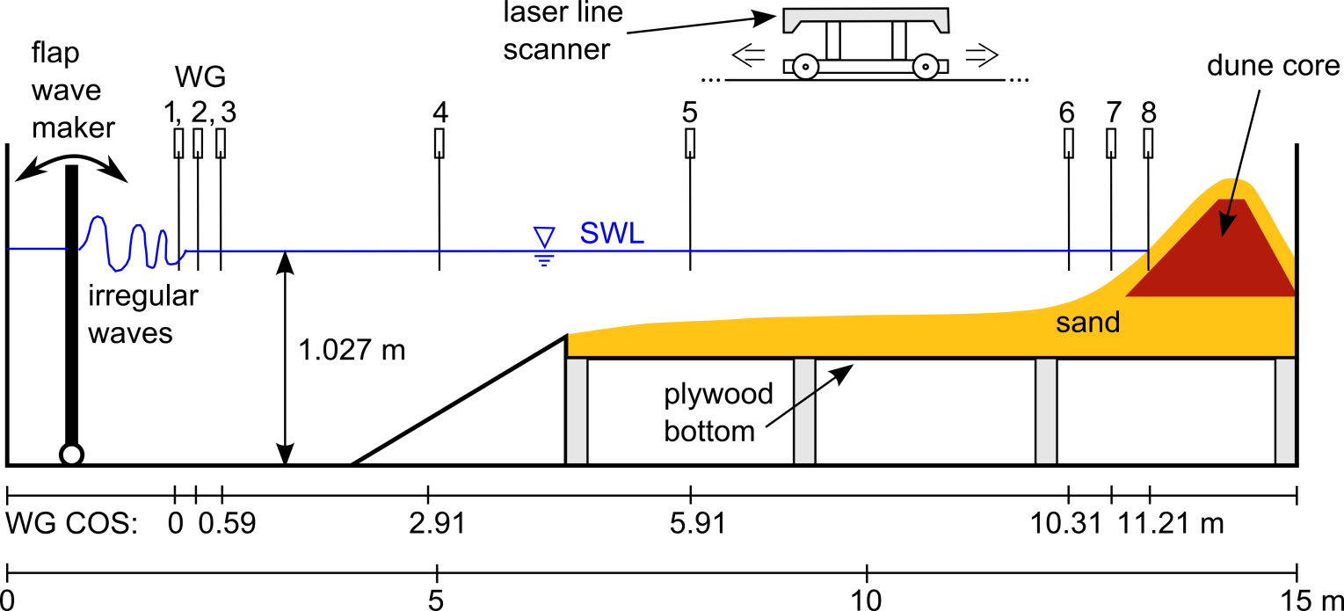
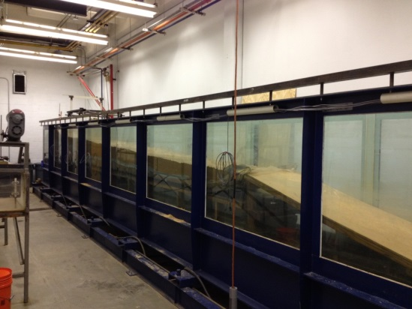
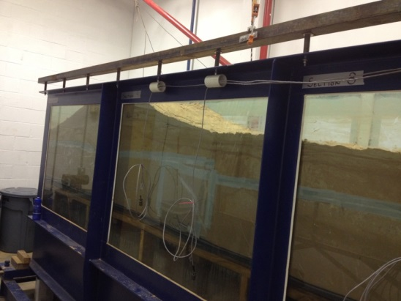
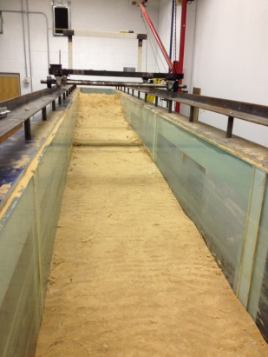
Conduct physical model studies in moveable-bed wave flume.

Slide 5
Available Lab Testing Capabilities:
1 Moveable-Bed Wave Flume (15m, flap, spectral waves, LabView-controlled)
9 Capacitance Wave Gauges
2 Nortek Vectrino II Profiler (3D velocity profile over 3 cm, wired)
1 Nortek Vectrino Sidelooker (3D point velocities near bed, wired)
3 GE/Druck Pressure Transducers
1 CCD Laser Line Scanner (3D profile evolution)
1 Flow Re-Circulation System (Flow Meter, Pump, Piping for Overtopping Meas.)
Sediment Analysis Capabilities (Sieves, Settling Tubes, Malvern Mastersizer)

