Slide 1
Establishment of Novel Texas Gulf Coast Beach Erosion Management Best Practices
Rueben Trevino
Coraggio Maglio
3 November 2016

Slide 2
Galveston Bay Submerged Aquatic Habitat ER
Data needed related to previously mined holes from oyster shell mining operations in Galveston Bay.
Evaluation of sediment and biological characteristics of previously mined pits in Galveston Bay.
¿Questions have come up regarding if maintenance material dredged from the channel could be placed in these holes?
ER opportunity to identify, develop, and recommend a bay bottom habitat restoration plan through application of innovative concepts and EWN-RSM principles

Slide 3
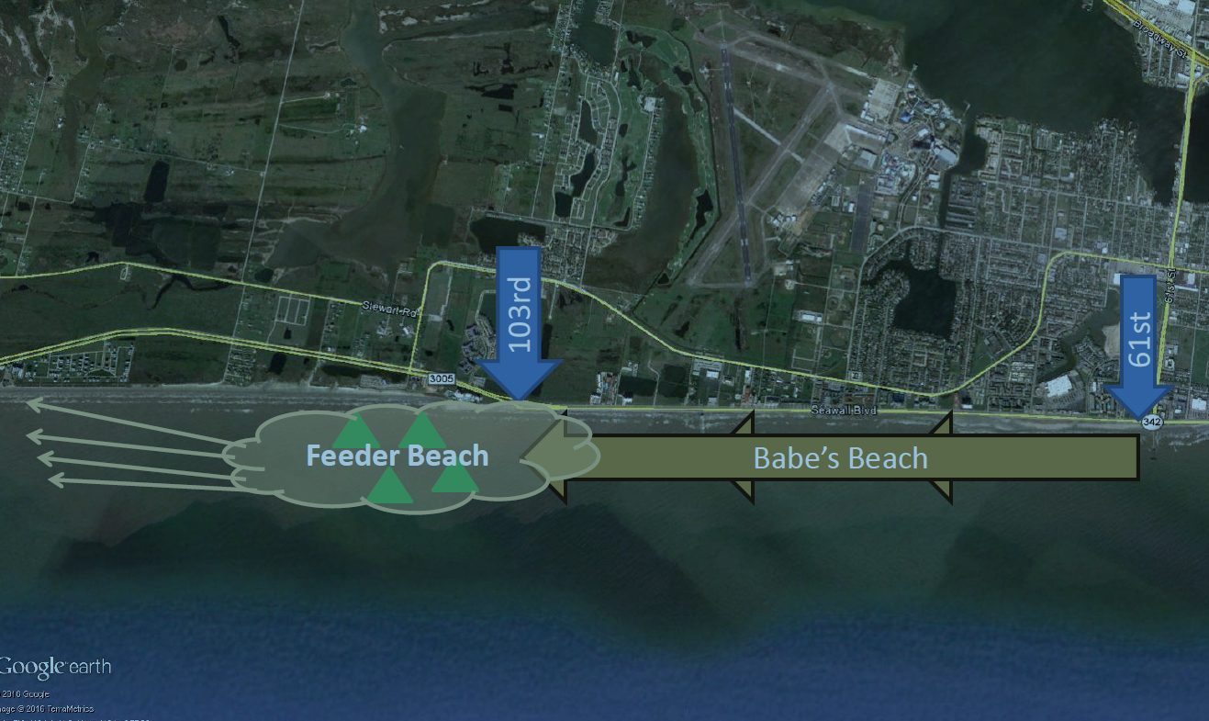
Galveston Seawall Feeder Beach

Slide 4
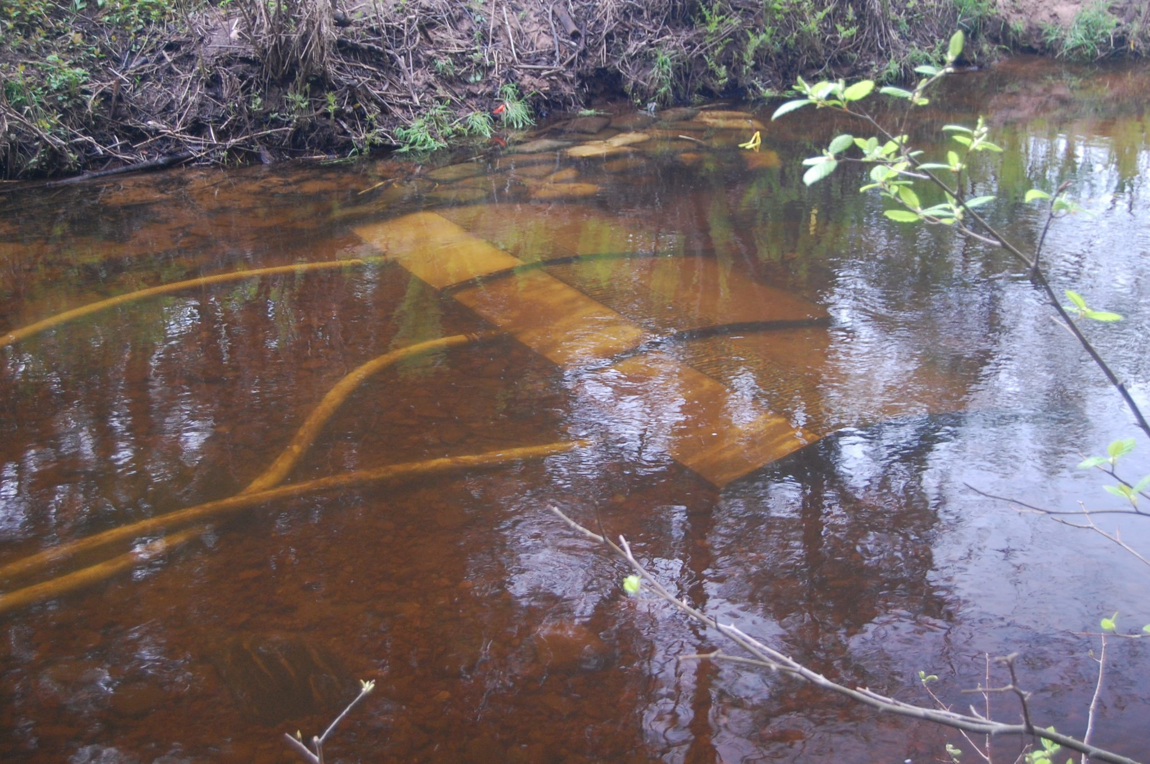
Sand Management Plan Update
http://streamside.us/products/sediment-collector/

