Slide 1
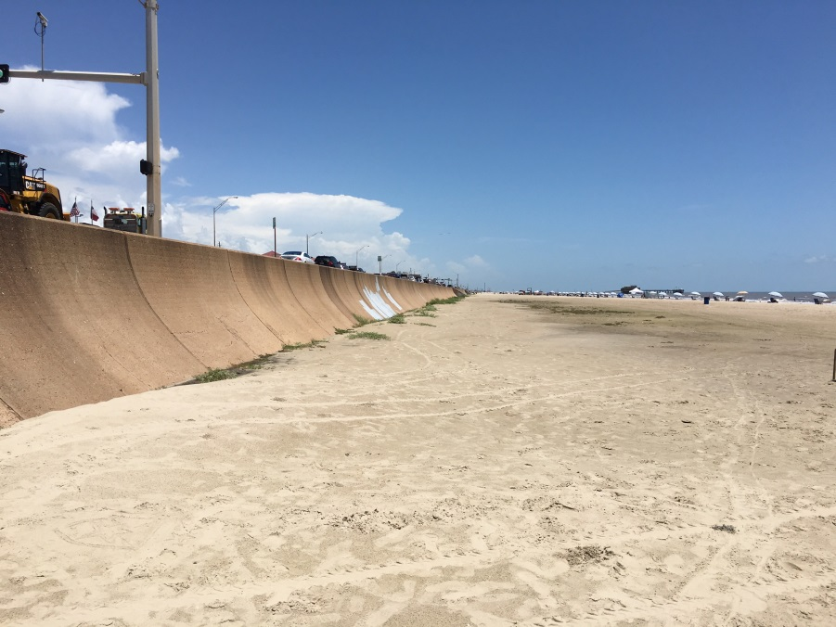


Engineered Dune Field Research:
Innovative Technology Seabale Dunes (CEPRA)
Dune Volume/Geometry Relation to Hydrodynamic and Beach Profile Parameters
USACE – TAMU OCEN Partnering Workshop, November 3, 2016, South Padre Island, TX

Slide 2
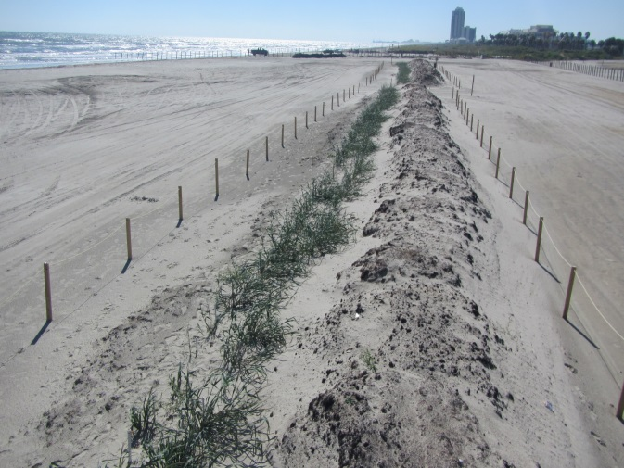
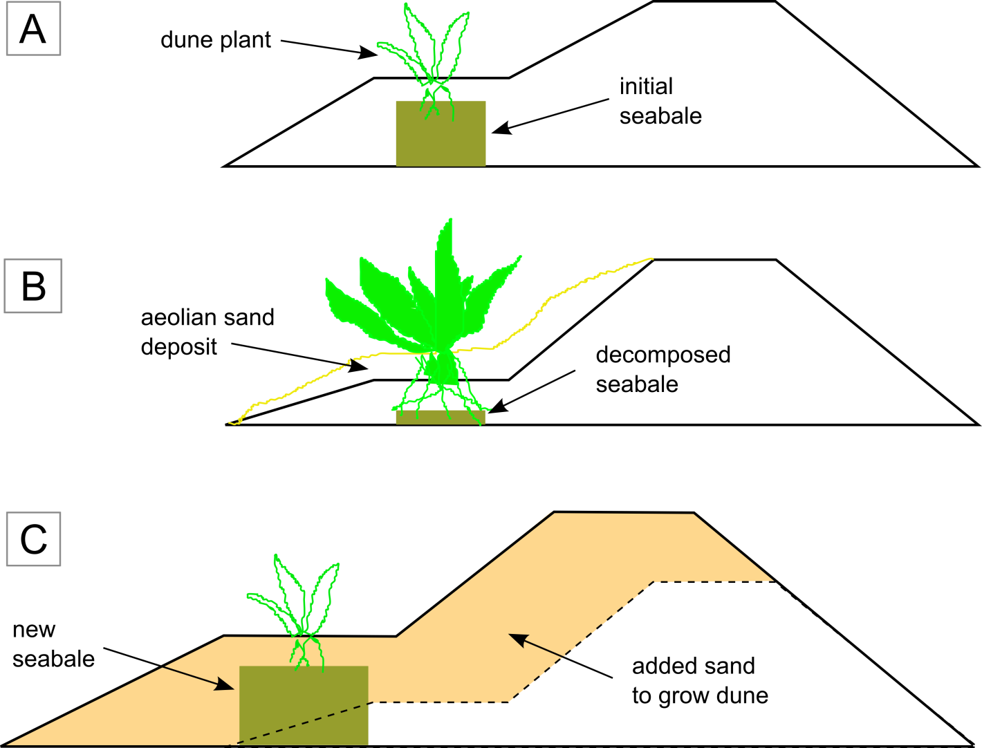
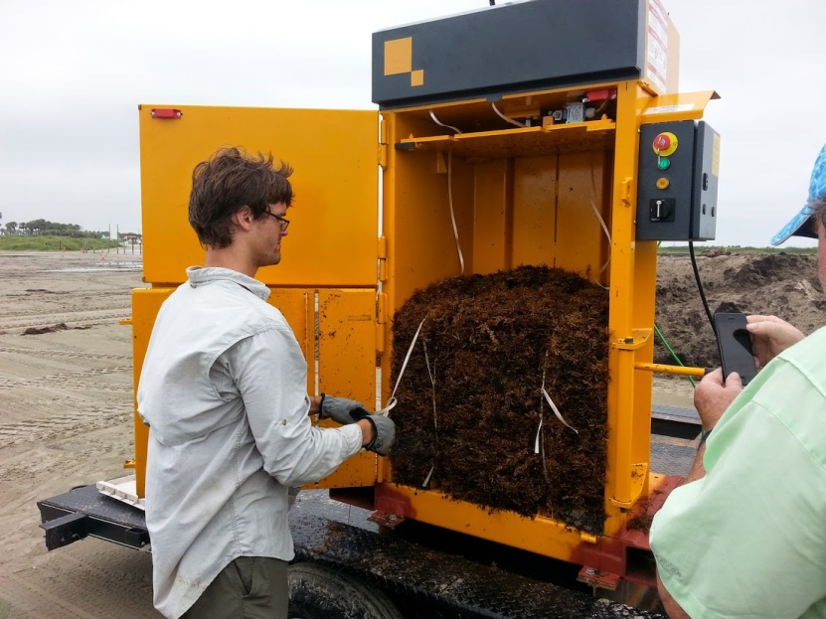
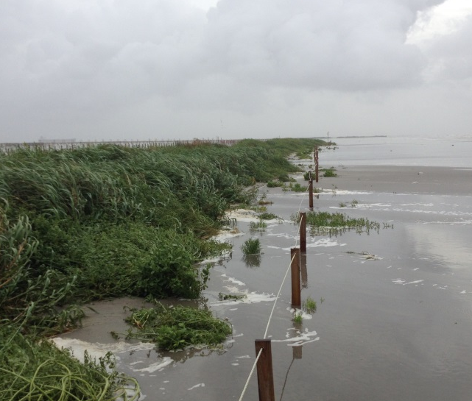

Slide 3
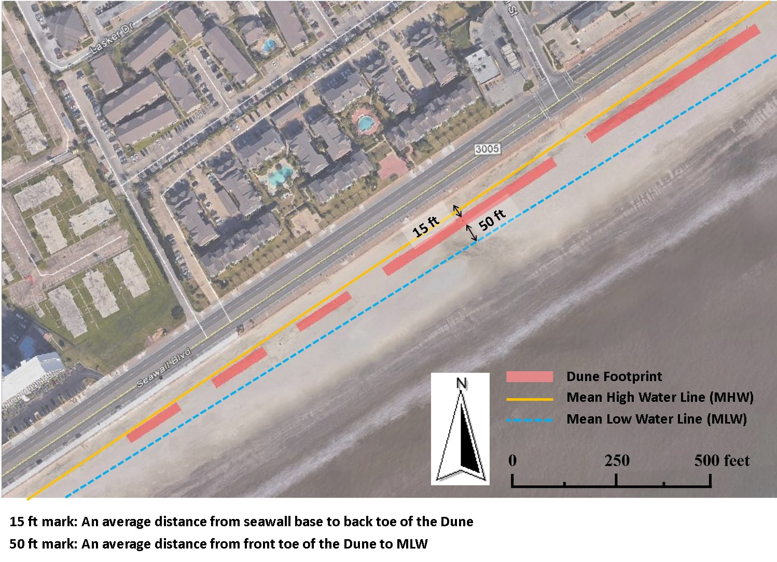

Slide 4
2015 Galveston Seawall Beach Expansion
Pre-Project vs Post-Project
C. Maglio, USACE SWG

Slide 5
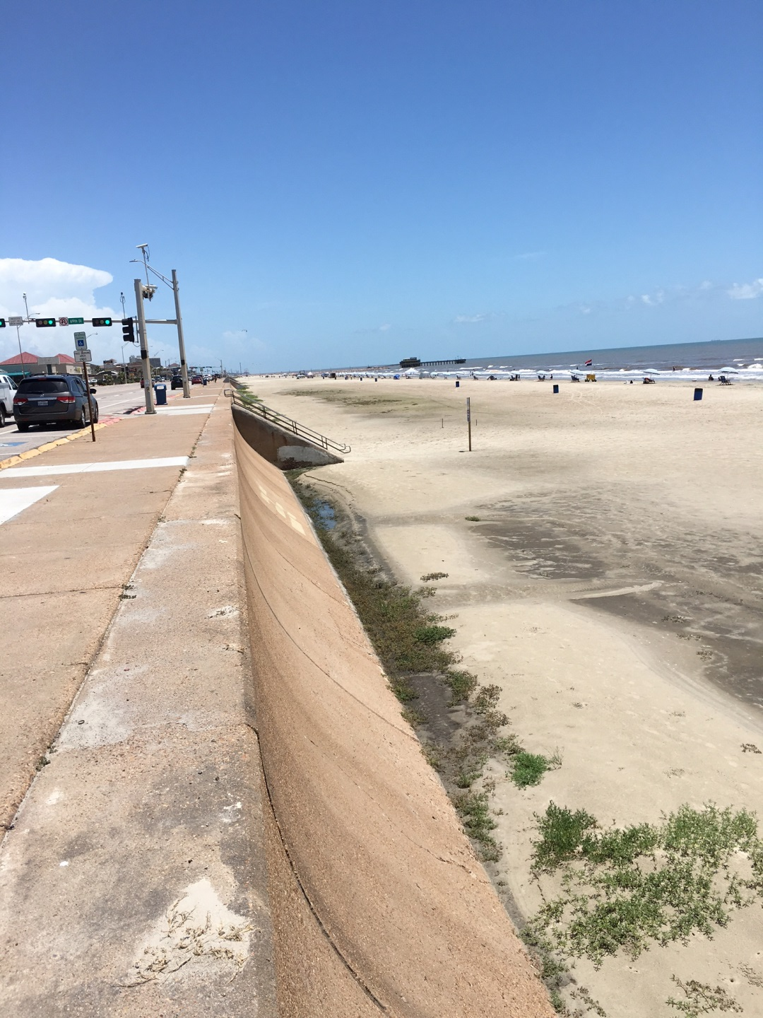
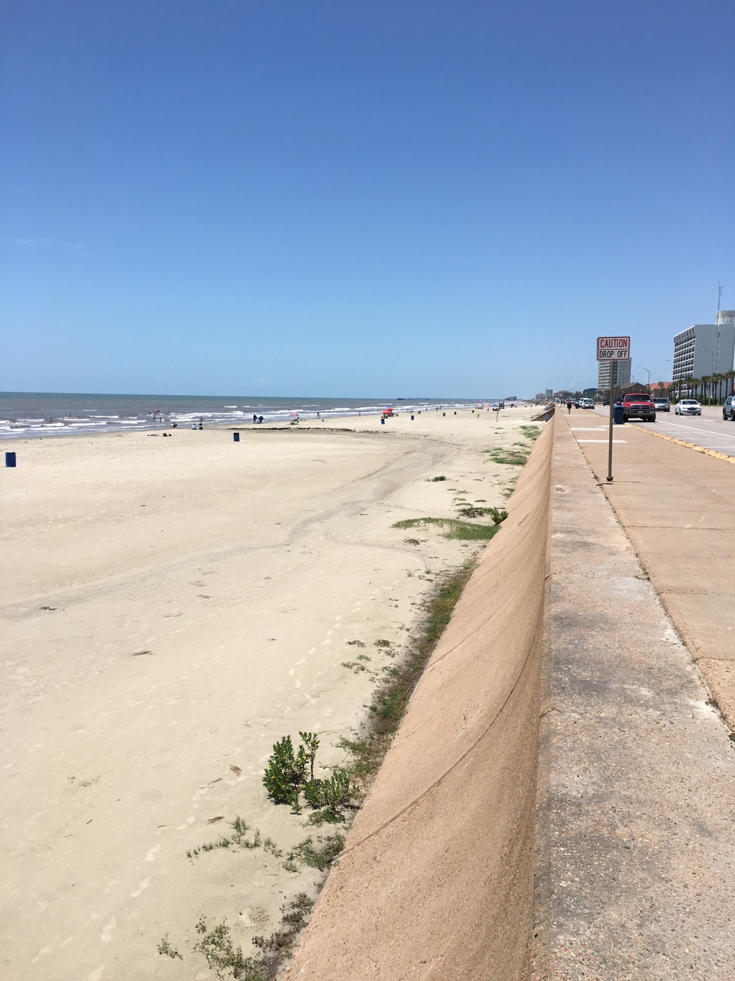
69th Street

Slide 6
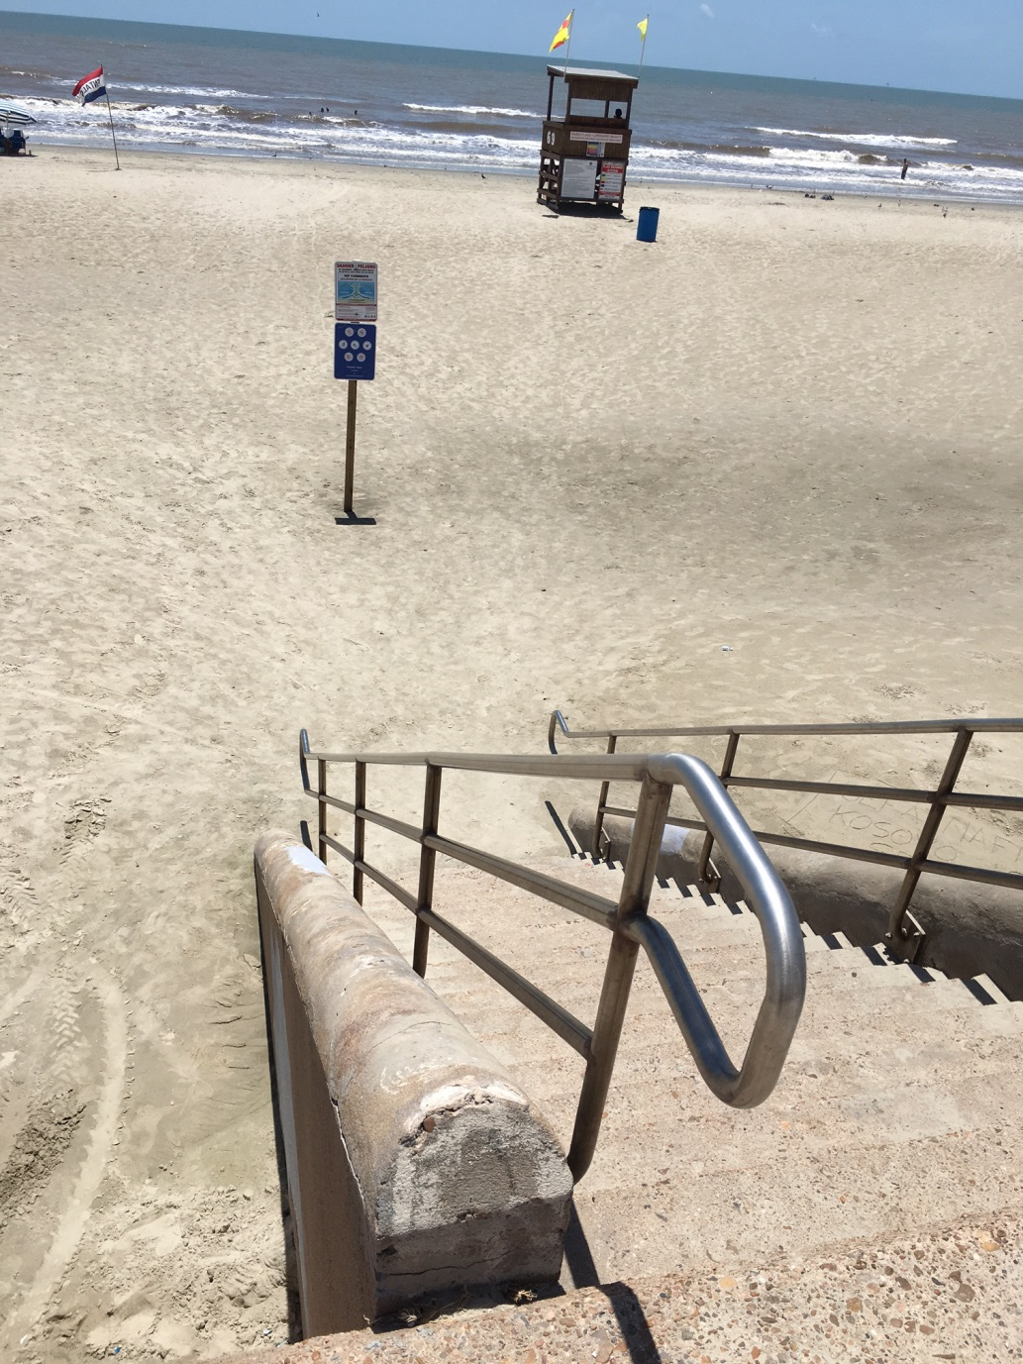
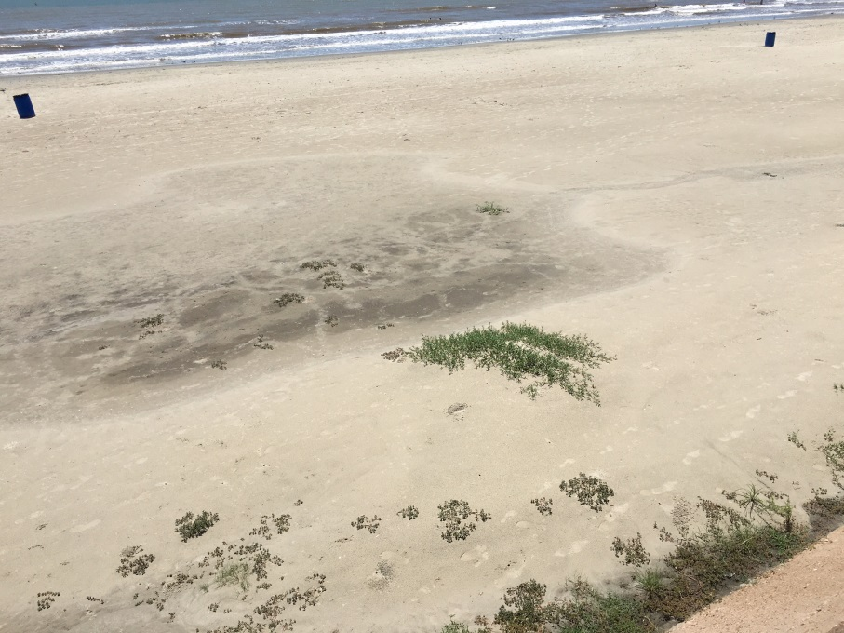
69th Street

Slide 7
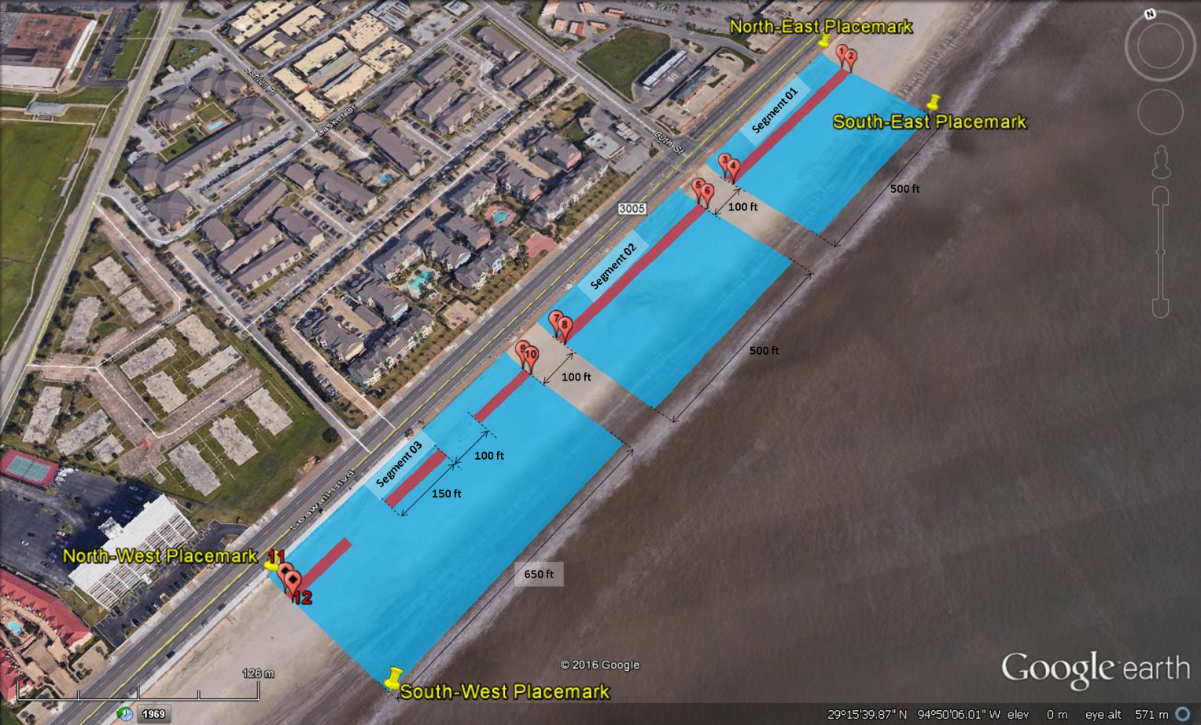

Slide 8
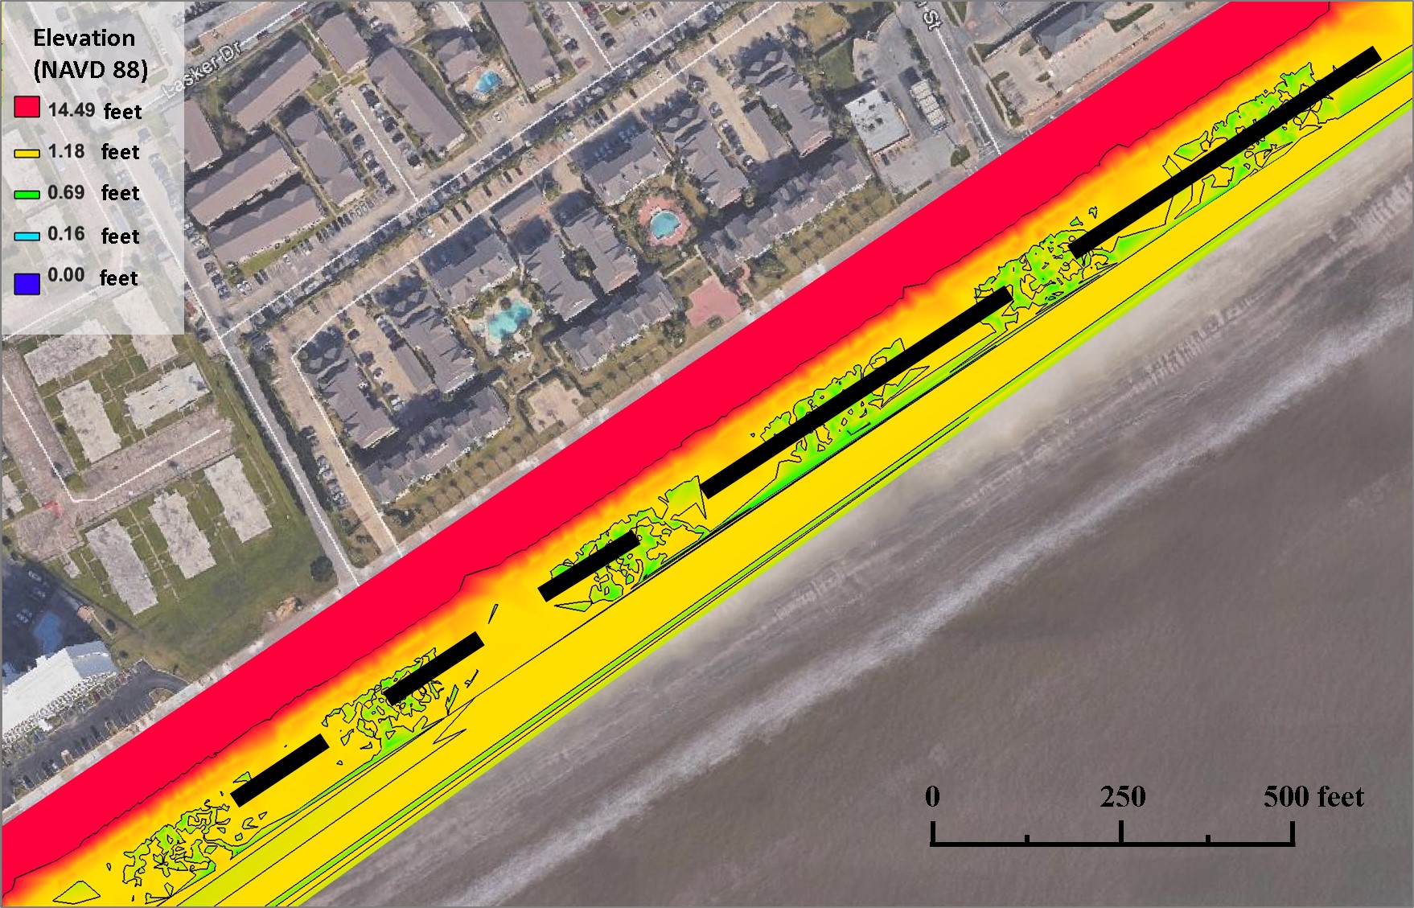

Slide 9
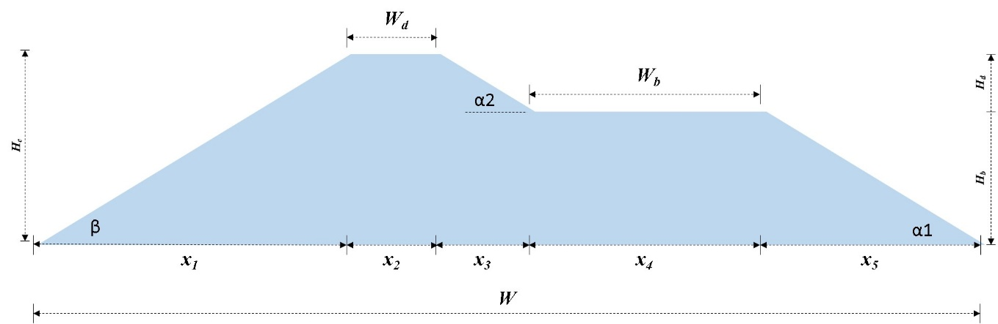
Dune Cross-Section

Slide 10
 | Type Dunes
Parameters | Pilot Dune |  | Segment 01 | Segment 02 | Segment 03-1 | Segment 03-2 | Segment 03-3 |  | Note
 |  |  | 100% volume | 100% volume | 75% volume | 50% volume | 25% volume
L | 800.0 | 800.0 | 500.0 | 500.0 | 150.0 | 150.0 | 150.0 |  | length of dune
W (ft) | 22.0 |  | 25.0 | 25.0 | 21.8 | 17.8 | 12.5 |  | total width of dune base
H_{c} (ft) | 5.5 |  | 6.3 | 6.3 | 5.4 | 4.4 | 3.1 |  | heigh of dune crest above base
a | 3.5 |  | 3.5 | 3.5 | 3.5 | 3.5 | 3.5 |  | proportional constant defining Hb (i.e., Hb:Hd = a:b)
b | 2.0 |  | 2.0 | 2.0 | 2.0 | 2.0 | 2.0 |  | proportional constant defining Hd (i.e., Hb:Hd = a:b)
tan(α1) | 0.7 |  | 0.7 | 0.7 | 0.7 | 0.7 | 0.7 |  | frontal slope of berm Hb/x1
tan(α2) | 0.7 |  | 0.7 | 0.7 | 0.7 | 0.7 | 0.7 |  | frontal slope of dune Hd/dx3
tan(β) | 0.7 |  | 0.7 | 0.7 | 0.7 | 0.7 | 0.7 |  | back slope of dune Hc/x5
W_{b} (ft) | 5.0 |  | 5.7 | 5.7 | 4.9 | 4.0 | 2.8 |  | width of berm crest = x2
W_{d} (ft) | 2.0 |  | 2.3 | 2.3 | 2.0 | 1.6 | 1.1 |  | width of dune crest = x4
H_{b} (ft) | 3.5 |  | 4.0 | 4.0 | 3.5 | 2.8 | 2.0 |  | height of berm above base
H_{d} (ft) | 2.0 |  | 2.3 | 2.3 | 2.0 | 1.6 | 1.1 |  | height to the dune crest above Hb
x1 (ft) | 7.9 |  | 8.9 | 8.9 | 7.8 | 6.3 | 4.5
x2 (ft) | 2.0 |  | 2.3 | 2.3 | 2.0 | 1.6 | 1.1
x3 (ft) | 2.9 |  | 3.2 | 3.2 | 2.8 | 2.3 | 1.6
x4 (ft) | 5.0 |  | 5.7 | 5.7 | 4.9 | 4.0 | 2.8
x5 (ft) | 5.0 |  | 5.7 | 5.7 | 4.9 | 4.0 | 2.8
A (ft^3/ft) | 71.7 | 68.0 | 92.6 | 92.6 | 70.1 | 46.7 | 23.2 |  | area of dune cross section or volume per unit length (L=1)
V (ft^3) | 57371.4 | 54400.0 | 46303.1 | 46303.1 | 10514.1 | 7002.4 | 3472.7 |  | volume of entire dune (sand only)
V (yd^3) | 2124.9 | 2014.8 | 1714.9 | 1714.9 | 389.4 | 259.3 | 128.6 |  | volume of entire dune (sand only)
volume ratio (%) |  |  | 100.0 | 100.0 | 75.7 | 50.4 | 25.0
Subtotal |  |  |  |  |  |  |  | 4207.2
Total |  |  |  |  |  |  |  | 5100 | with 20 % margin, rounded up

Slide 11
Specific CEPRA Project Tasks:
  Modify existing beach raking equipment for optimized Sargassum pick-up and compaction into bales or utilize existing equipment to pick-up and compact Sargassum.
  Collect and compress Sargassum wrack with minimal beach sand disturbance.
  Restore/build 800-ft long prototype dune section on Galveston Island for continued research and monitoring regarding re-application of seabales.
  Survey and monitor the project location over the 1.5-year duration of the project (video monitoring, quarterly beach and dune profiles, and hydrodynamic forcing conditions). Beach profiles will be collected in cooperation with a professional TX licensed surveyor.
  Sample dune sediment and vegetation quarterly to track sediment composition, seabale compaction and plant growth.

