Slide 1
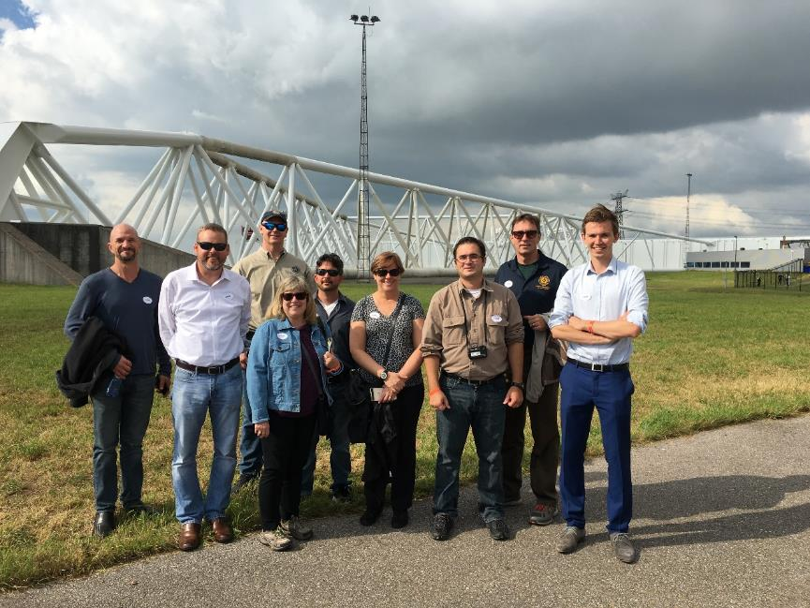
Netherland SWG and GLO Trip discussion
Netherlands Coastal Defense Systems Trip 17-20 Sept 2016
Prepared by:
Coraggio Maglio, P.E. and
Andrew Weber, PE
For Coastal Texas Engineering Workshop
20 October 2016

Slide 2
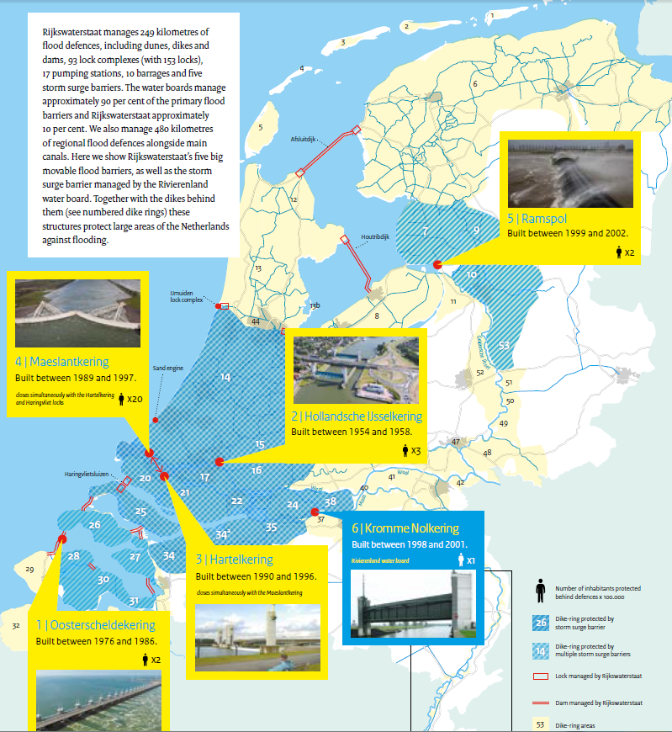
Rijkswaterstaat: Dutch Infrastructure ministry
Maeslant Storm Surge Barrier
Scheveningen Boulevard Flood Defenses
Sand Motor
Katwijk Coastal Barrier
Haringvliet Dam
Brouwersdam
Storm Surge Barrier Eastern Scheldt
Hollandse Ijssel Storm Surge Barrier
https://staticresources.rijkswaterstaat.nl/binaries/Working%20on%20storm%20safety_tcm21-91237.pdf

Slide 3
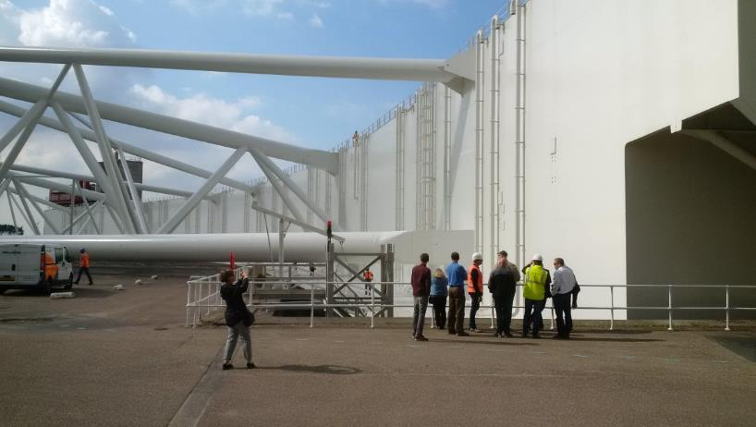
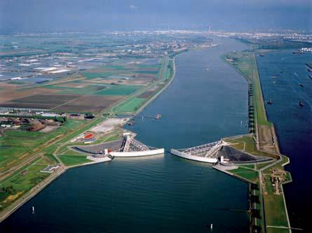
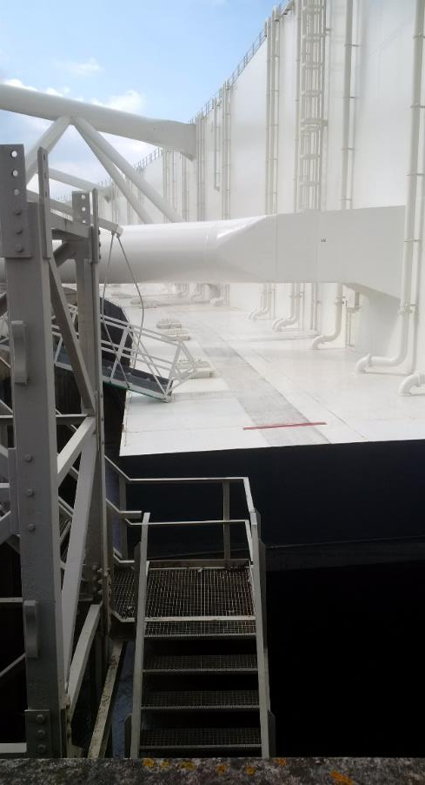
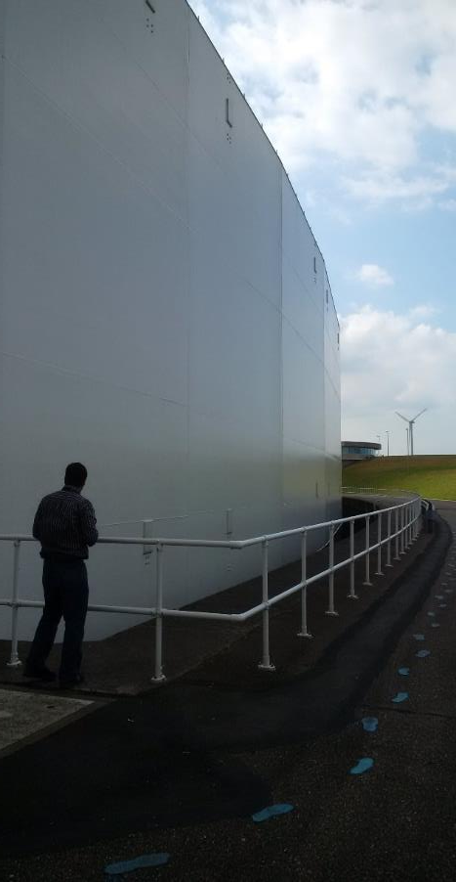
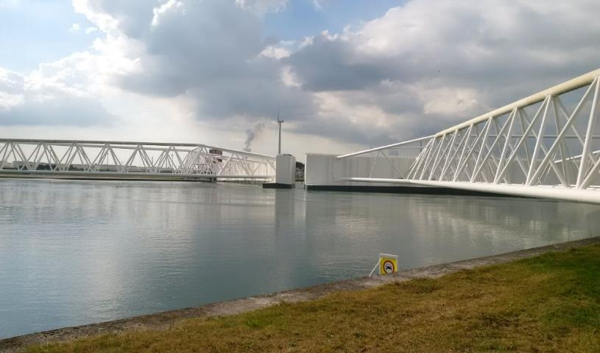
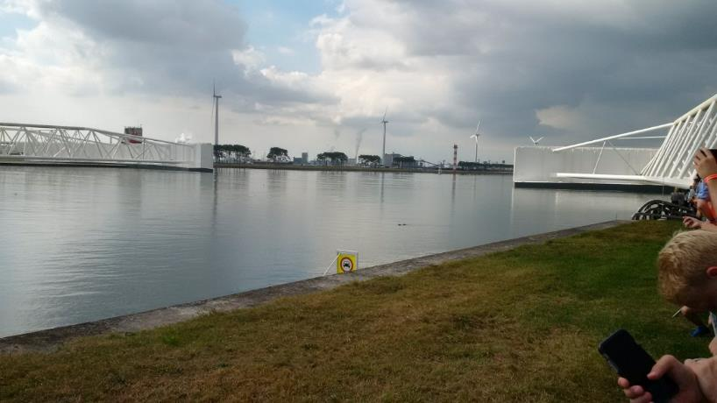
Maeslant Storm Surge Barrier
CLOSING OF BARRIER
17 Sept. 2016 Observed the yearly test closure of the barrier in advance of their storm season, 1 Oct. thru 15 April
The “BOS” computer system controls water level prediction and operational closing of the barrier and summoning staff
8 hr before closing Port is informed
4 hr before closing barrier’s dry dock flooded – all shipping is informed
2 hr all traffic through barrier halted
0.5 hr gated are floated into position with 1m gap between
0 hr the barrier’s chambers are filled by pumps controlled by the “BOS” and sunk evenly until 3m above bottom
1.5 hr into closing barrier is slowly sunk till about 1m above sill, higher velocities clean the sill of sediment and debris
2.5 hr barrier is positioned on clean sill sealing off waterway
OPENING OF BARRIER
2 hr water is pumped out of gates and they are floating
2.5 hr gates are returned to dry dock

Slide 4
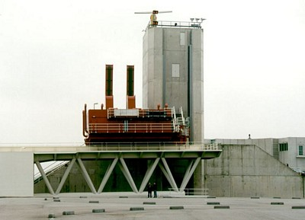
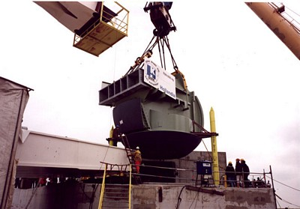
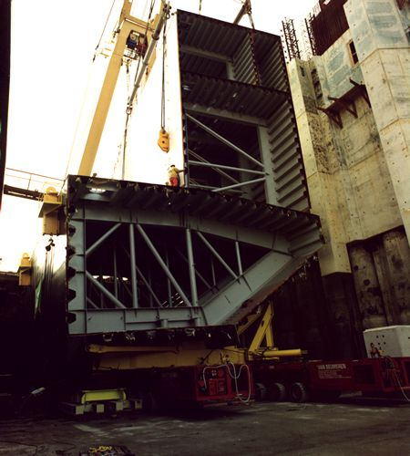
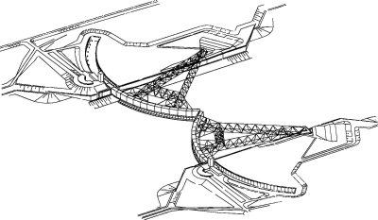
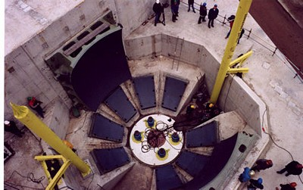
Maeslant Storm Surge Barrier
DESIGN OF BARRIER
Rigid structural steel leaf that rotates about a 10 m diameter ball and socket joint. This socket is designed to handle oceanside loading but could be damaged by riverine loads
Physical modeling of the barrier indicated that seiching of the barrier would be possible during the presence of high currents while sinking the barrier, the leading edge was thus chamfered
The barrier is coated with an silica and titanium dioxide epoxy coating that has been sufficient for 20 years of life
Barrier sill is at -17m NAP with a crest at 5m NAP (~72 ft)
The closure criteria was 3m and has been lowered to 2.6m
80,000 vessel movements through the gates per year, but only 4 or 5 collisions but not have damaged the structures
Closure width is 360 meters (1181 ft)
COSTS
Total cost was reported to be approx. 660M euros of which about 450M euros was the barrier
http://www.deltawerken.com

Slide 5
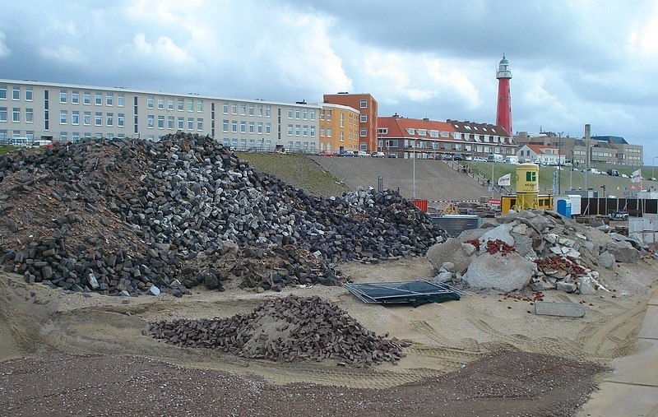
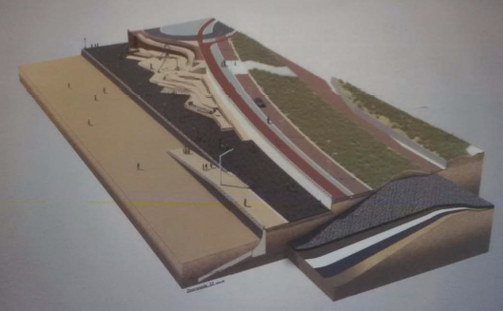
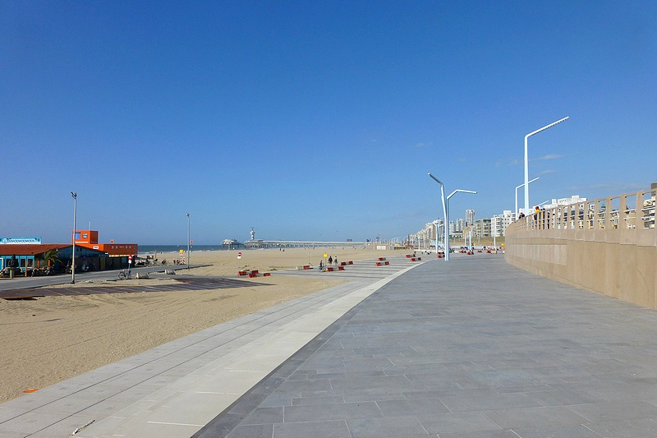
SCHEVENINGEN BOULEVARD FLOOD DEFENSES
NOTES
These flood defenses are designed for the 1/10,000 year event by law
This project combined coastal storm protection and recreational amenities into the design
Dike built inside a dune
And a dike built inside a seawall
Recreational features
http://www.flooddefences.org/scheveningen.html

Slide 6
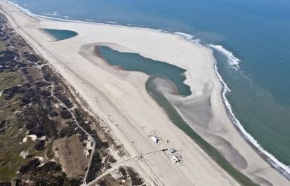
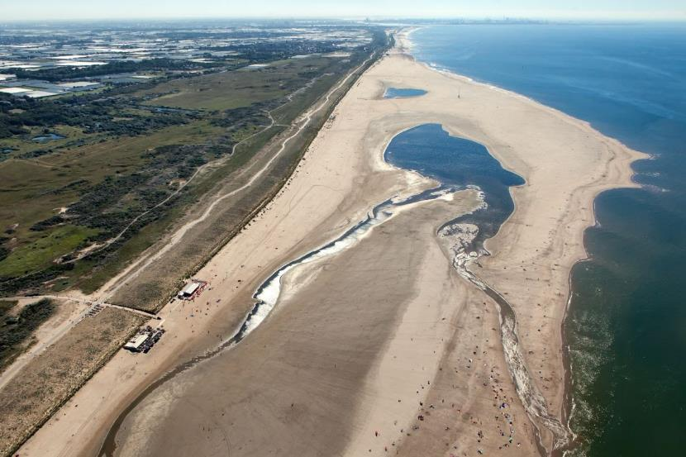
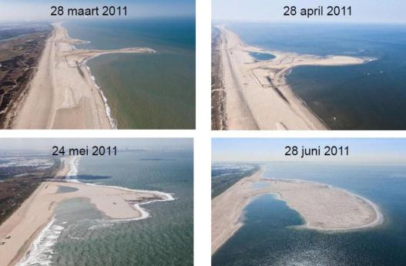
Sand motor
2013
NOTES
The sand engine was constructed of 21.5 million cubic meters of sand and included two designed lakes
The project was begun in 2011 and cost per cubic yard were very low given the realized economy of scale
2016
http://deltaproof.stowa.nl
www.dezandmotor.nl

Slide 7
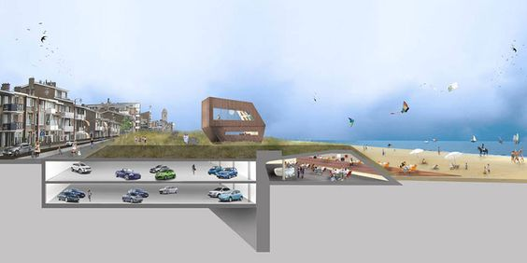
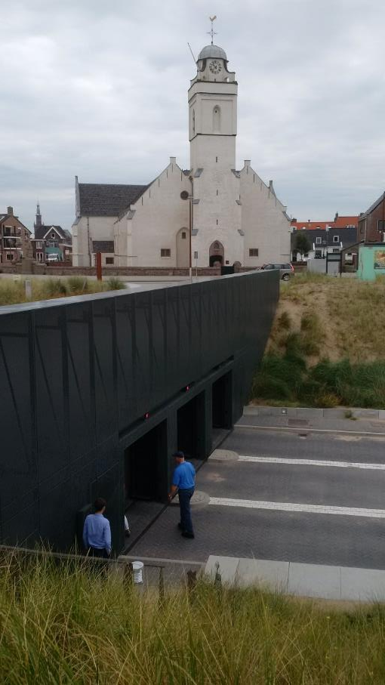
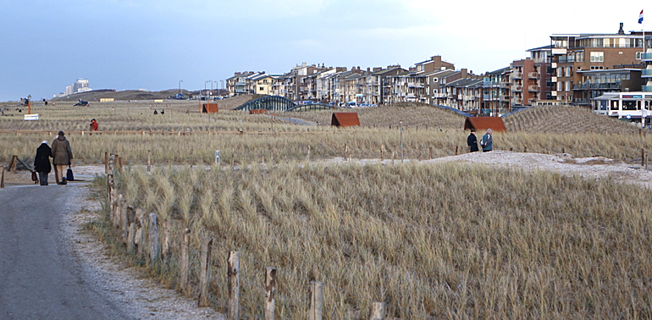
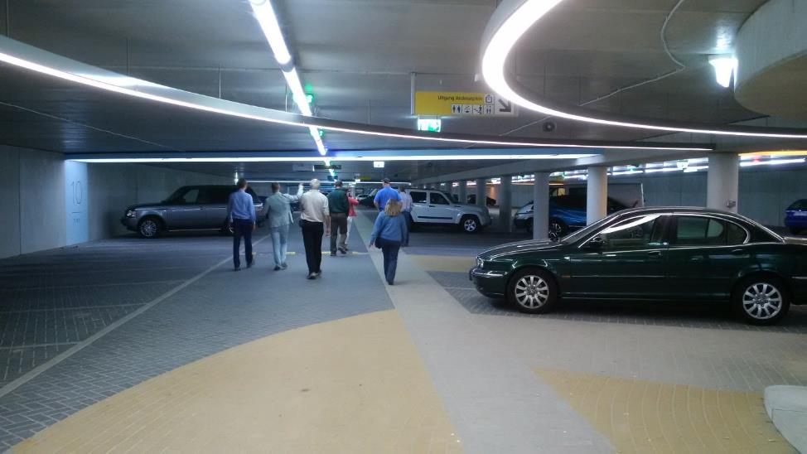
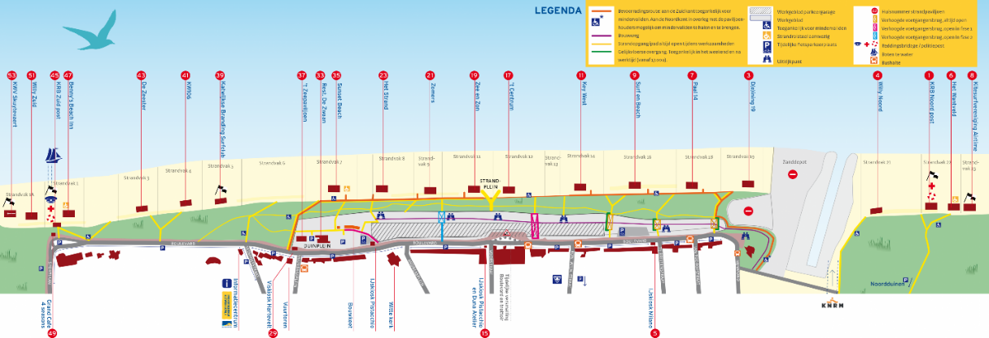
KATWIJK SEA SHORE PROTECTION
NOTES
This project combined a coastal barrier for storm protection, amenities, and a parking garage into the overall flood protection dune design
It protects from a 1/10000 event of +9m NAP. 29% of the property protected is below NAP
New dike elevation is +7.5m NAP with dunes from 8 – 12m
The garage and amenities, were funded by the locals
Total cost was 670M euros including taxes. The dike in dune feature added about 9M euro with about 19M just for the beach and dike
dutchwatersector.com
www.kustwerkkatwijk.nl

Slide 8
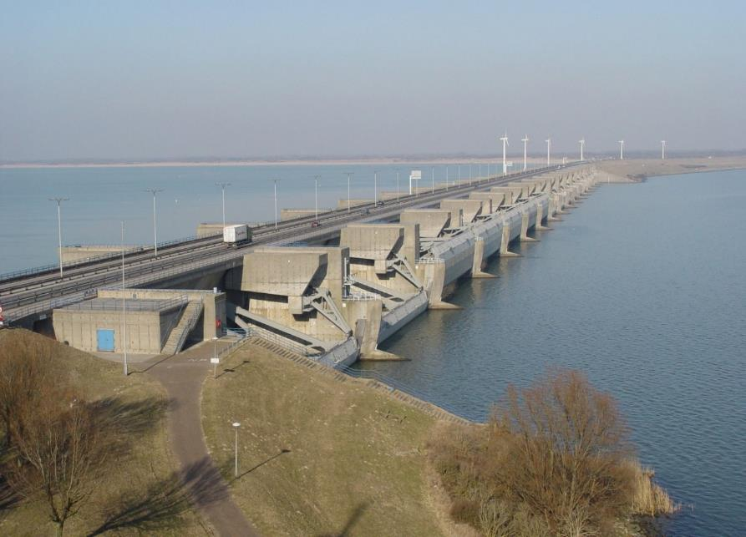
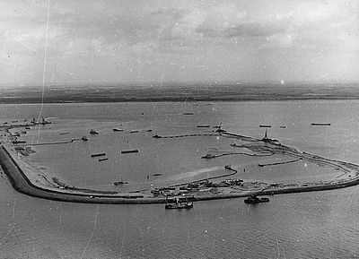
HARINGVLIET DAM
DESIGN
This project was completed in 1971, it drains the water flowing from the two largest river in the Netherlands, the Rhine and Maas
The design is basically a double sided sluice gate (17 sluices) capable of holding back and storm surge or regulating riverine releases
The seaward sluice is not as tall as the lake side sluice and it is designed to trip storm waves thus dissipating their energy and the interior sluice then only has to protect up to a still water level not taking into account wave impacts.
This project created a large fresh water lake where a estuary once existed
Includes a shipping lock.
Total sluice width is 1,000 m
Overall dam width 4.5 km
beeldbank.rws.nl
http://www.deltawerken.com

Slide 9
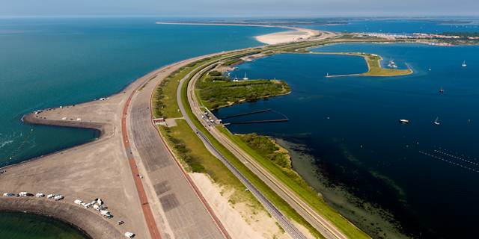
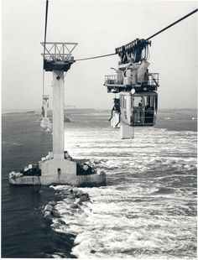
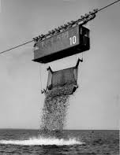
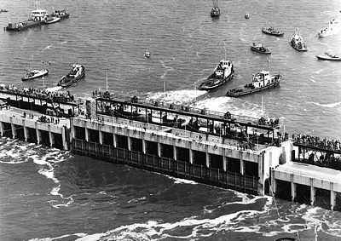
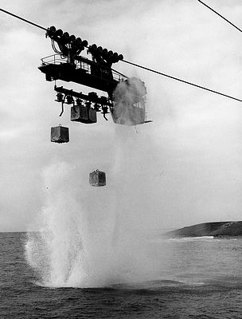
BROUWERSDAM
DESIGN AND CONSTRUCTION
This project was completed in 1971, The dam is 6.5 km in width and up to 30 m depth
During construction two natural sandbars were raised into islands
Northern gap was closed by caissons.
Southern gap was closed by cableway cradles that plunged 240,000 2.5 ton concrete blocks to the bottom of the sea.
1981 a sluice was built to let salt sea water pass
http://Rijkswaterstaat.nl http://www.deltawerken.com

Slide 10
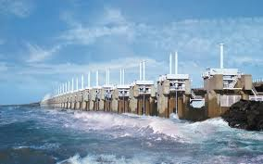
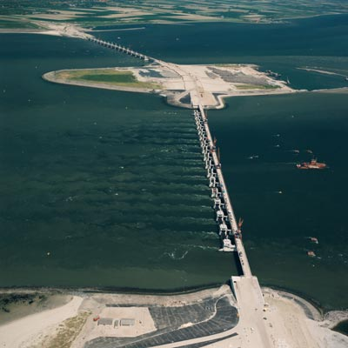
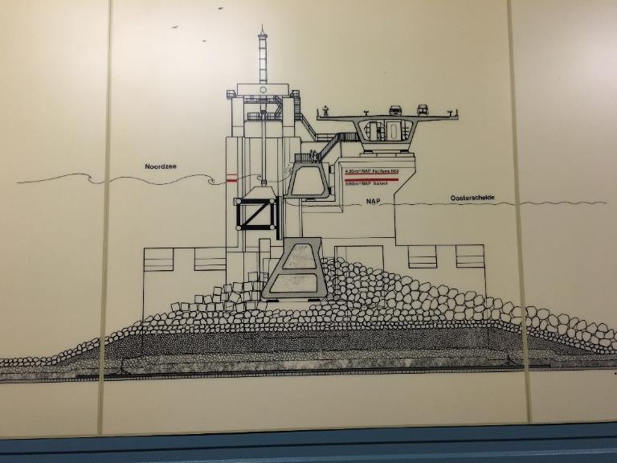
STORM SURGE BARRIER EASTERN SCHELDT (Oosterschelde)
NOTES
These storm surge barriers have a combined length of 3 kilometers, using 65 pre-fabricated concrete piers and 62 steel gates, with 5 km of earthen dam
When all the gates are open, approximately ¾ of the tidal exchange is maintained
The cross sectional area of the inlet was reduced from 80,000 m2 to 18,000m2. This has resulted in a tidal range reduction from 3.4 to 3.25 m
It has driven a change in equilibrium sediment transport conditions in the estuary. Major geomorphologic shifts have been occurring, resulting in less relief in the topography. Deep channels are getting shallower and shallow shelfs are getting deeper resulting in a flatter, less diverse estuary
COSTS
Construction cost was 2.5 billion euros, when officially opened by Queen Beatrix on October 4th 1986
Maintenance cost are estimated at 30M euro per year
http://Holland.com
http://www.cultuurwijs.nl

Slide 11
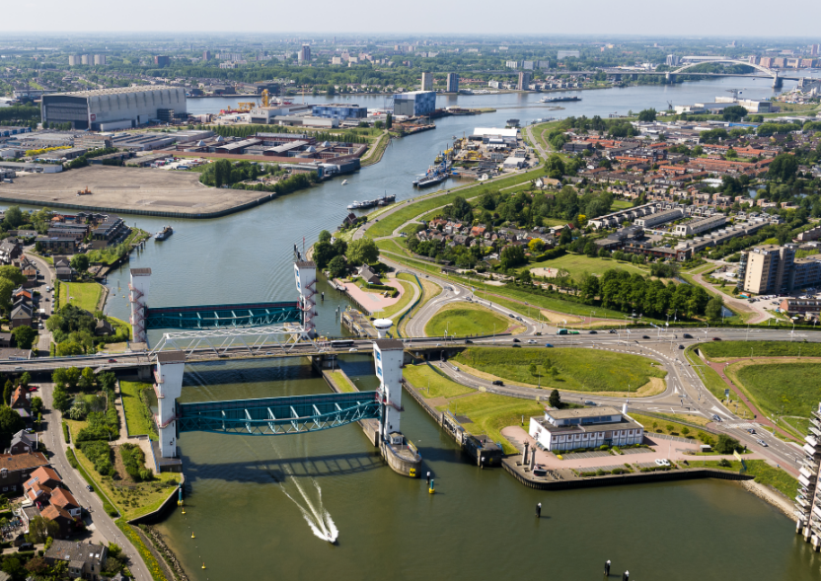
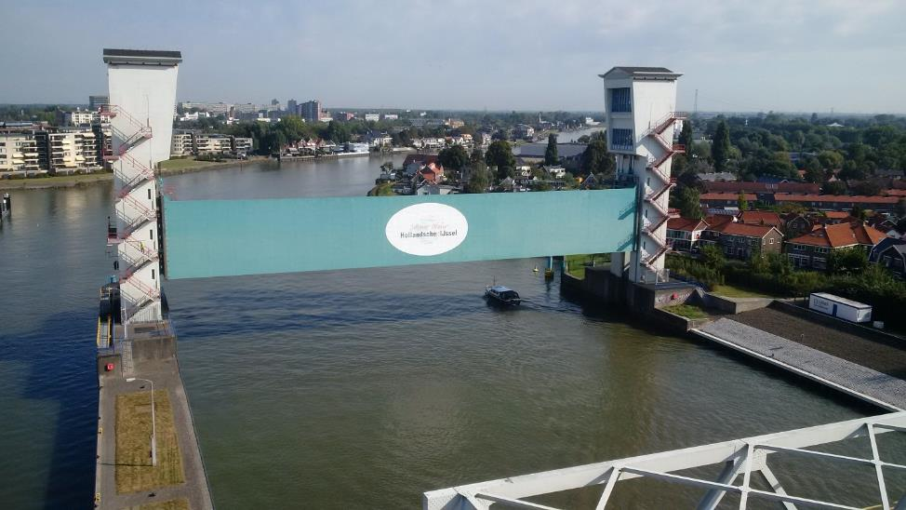
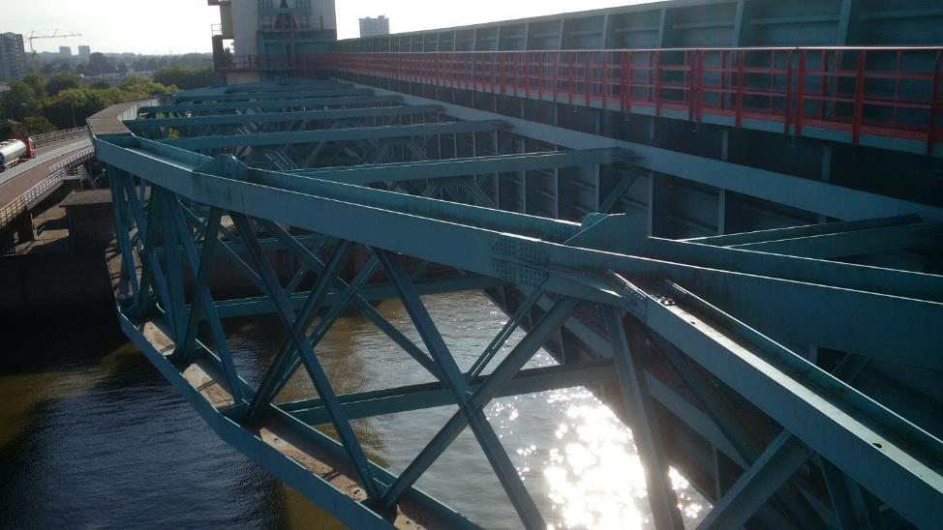
HOLLANDSE IJSSEL STORM SURGE BARRIER
DESIGN
This barrier is a double redundant system with two separate lowerable barriers and a navigation lock for ships too tall to pass under the barrier
The two towers work like an elevator with counter weights.
This is a very low maintenance system due to its simplicity
The gate design is a structural steel truss system
The sill is at -6m NAP with the crest at +5m NAP (36 ft)
Locks are 24m wide (78 ft)
COSTS
Maintenance costs are estimated at 400,000 euro per year. 3 people work 8 hours per day on site but they also cover other barriers
This barrier protects some of the lowest lying land in the Netherlands approximately 6 meters below sea level.
www.rijkswaterstaat.nl
www.dezandmotor.nl

Slide 12
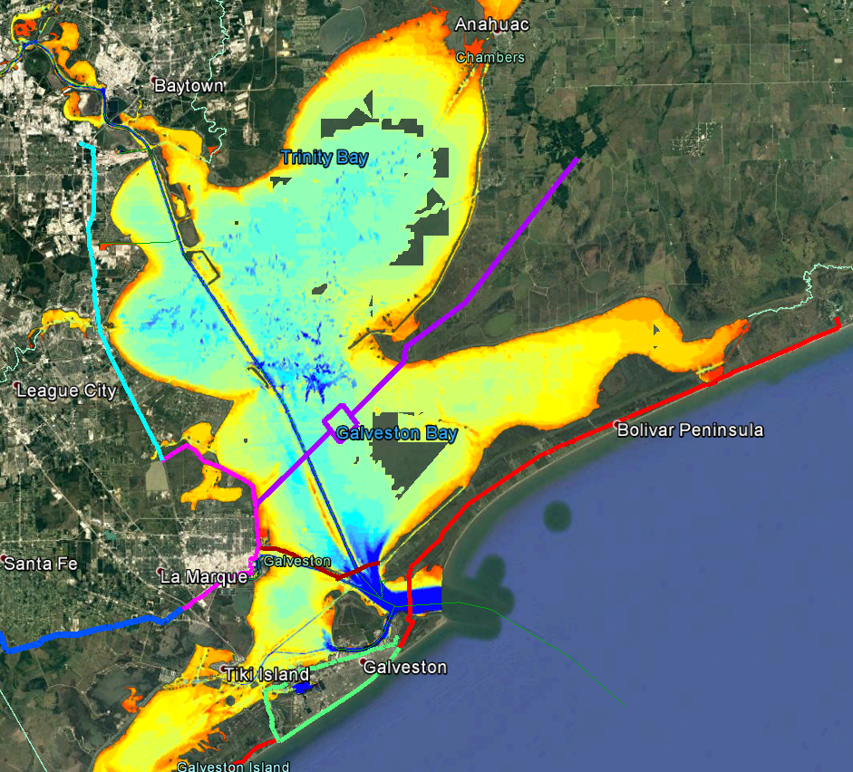
Coastal Texas Engineering Meeting 18-21 Oct 2016
GENERAL NOTES
Barrier alignments
Mid bay
Texas City Dike (new)
Bolivar Roads (Coastal Spine)
Levees
Galveston ring levee
Raise and extend Texas City Dike
HWY 146 dike
Sand sources may be the main cost driver of the Coastal Spine possibly more than Gate
GLO might identify locally preferred plan
BARRIER DESIGN
Initial ADCIRC modeling indicated 40% tidal prism loss does not effect salinity appreciably
Barrier design to resist hurricane loading may be worse than North Sea – overtopping
Can Galveston Bay be used for storage?

