Slide 1
Coastal Science and Engineering Center CSEC
Ideas for involvement of TU Delft
Nov 4, 2016

Slide 2
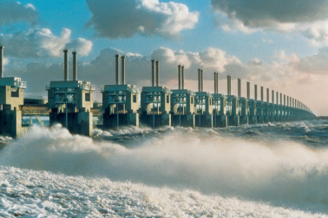
TU Delft
Hydraulic Engineering
Key areas: coastal management, flood risk reduction, hydraulic structures, ports
Closely working other groups (geo, architecture, policy, ecology) to develop integral approach for coastal management and design
> 100 Msc students per year (1/4 international)
Focus on science – engineering – design, strong “application” orientation
Working in tradition of Dutch delta works and initiating recent innovations e.g. sand engine
MoA with Texas A&M Galveston since 2012

Slide 3
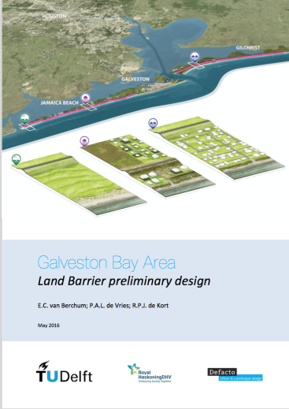
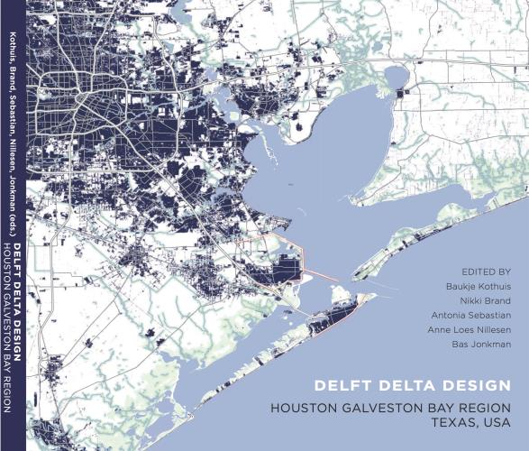
TU Delft - Texas involvement
Multiple exchange visits
Delta Interventions studio (2014 / 2015)
Student projects: 20 Msc thesis, 3 PhD; PDEng, Multidisciplinary project teams
PhD exchange (Fulbright from Rice University)
Since: 2016 NSF-PIRE ‘Coastal Flood Risk Reduction Program’ partnership – 5 TU Delft co-PI’s
‘Texas meets Texel’ student workshop Building with Nature – 20 multidisc. NSF-PIRE & TUD students
2014 / 2015: involved in barrier and coastal levee explorations
2016: Multiple Lines of Defense – System optimization research project (MODOS)

Slide 4
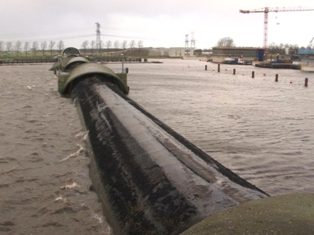
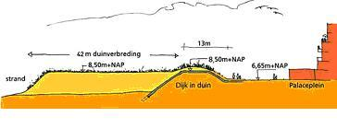
Ramspol storm surge barrier
Flood Risk Reduction
Expertise & interests
Storm surge barriers:
Design and parameters
Management and operation (With RWS)
Hybrid structures (performance, design, evaluation)
Flood risk and reliability evaluation:
Probabilistic design
Multiple lines of defence – systems optimization
Muli-level planning, strategy formulation and evaluation
incl. delta-urbanism, emergency management and governance
Multiple lines of defence (Lopez)
Levee in dune: Deltares Wiki

Slide 5
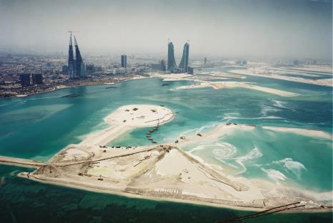
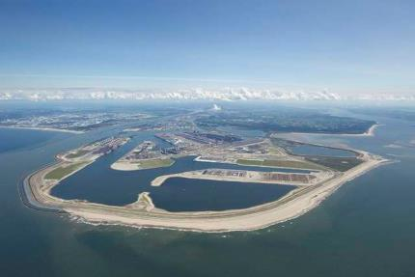
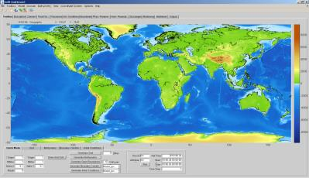
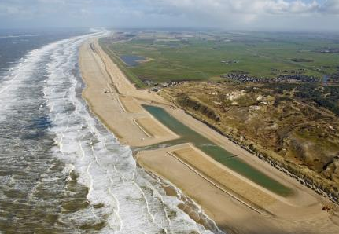
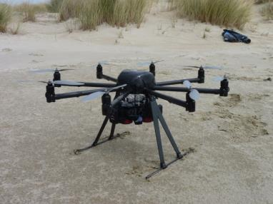
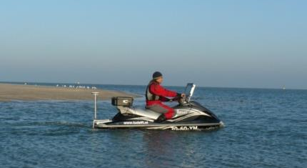
Coastal Engineering
Expertise & interests
Land reclamation Bahrain (UAE)
Domain: shorelines, estuaries, coastal seas
Range of solutions for engineering / design / CZM:
Soft: Beach (sand nourishment, landscaping)
Hybrid (levee in dune)
Hard (coastal structures)
Physics based modelling of interscale sediment dynamics (Delft3D, XBeach, Aeolis)
Innovative measurements (satellite, video, radar, lidar, laser, jetski, coastal observatories), data-driven modelling
Maasvlakte, NL
Delft Dashboard, (Deltares)
Hondsbossche en Pettemer
Sea Defense

Slide 6
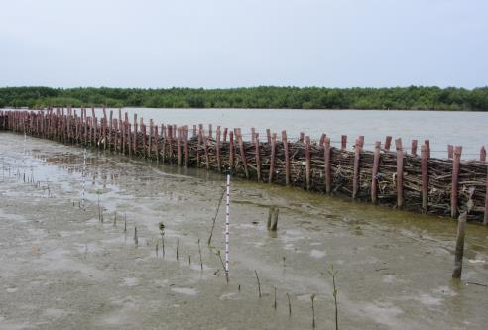
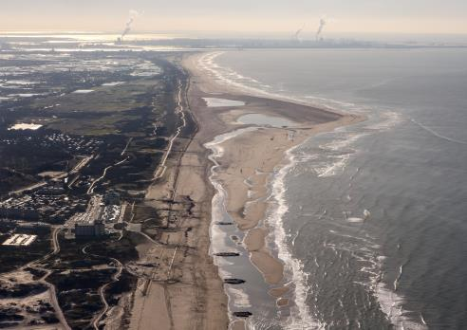
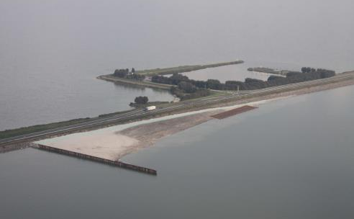
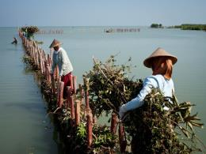
Building with Nature
Expertise & interests
Design and implementation of marine infrastructure – with benefits for nature, society and economy
Multi-disciplinary approach (engineering, ecology, governance)
Strategic research programs linked to full-scale pilot cases (Sand Motor Delfland, natural foreshore Houtribdijk, mangrove shoreline Indonesia)
Close links with USACE (Engineering with Nature) and USGS
Education TUD: Course BwN (5 ects), MOOC (since 2016)

Slide 7
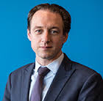
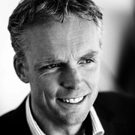
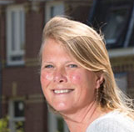
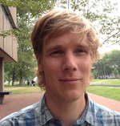
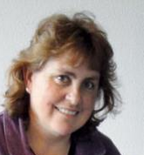
Key staff involved
Bas Jonkman, professor of hydraulic structures and flood risk
Stefan Aarninkhof, professor of coastal engineering
Baukje “Bee” Kothuis, researcher & liaison TAMUG - TU Delft
Sierd de Vries, assistant professor of coastal engineering
Jill Slinger, lecturer coatal engineering & associate professor of
technology, policy & management

Slide 8
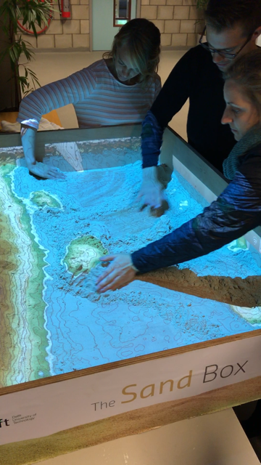
General / other / closing remarks
Mechanism / ideas:
>50 Msc’s per year in the coastal and flood risk groups at TU Delft -> involve in projects?
Comparison studies: NL – TX
‘Sand Box’-tool student R&D
Field and monitoring pilots
(online) education for professionals
Next steps:
Identify joint interests
Plan formulation
Joint workshop in 2017?
Look for ways to support action
and exchange

