Slide 1
Integrating multiscale models for projecting population dynamics of species under intense disturbance regimes
Todd M. Swannack, Candice D. Piercy, Michael E. Kjelland, and Tahirih Lackey
US Army Engineer Research and Development Center
Vicksburg, MS, USA

Slide 2
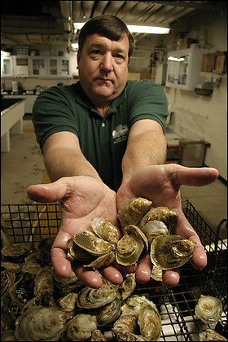
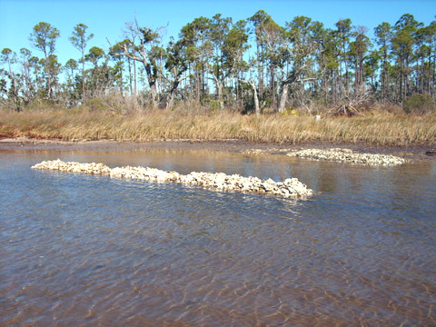
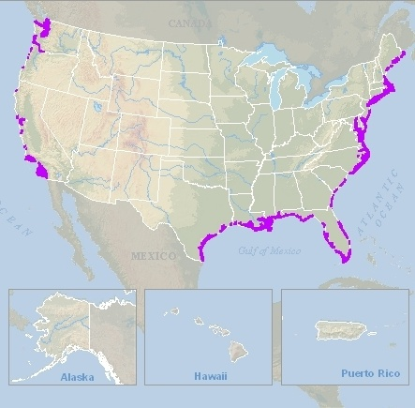
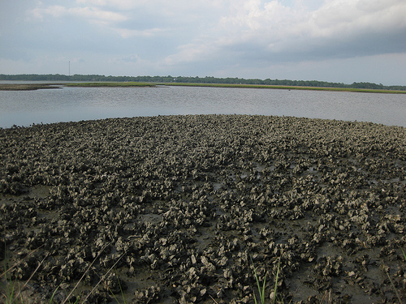
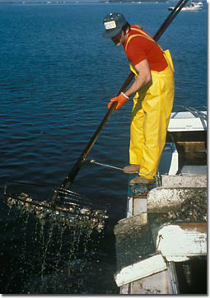
Eastern Oyster Fishery
Fishery is $100+ million USD/annually
Oyster reefs provide tremendous environmental benefits
Different viewpoints on how to restore oysters and maintain fishery

Slide 3
Oyster Management in Chesapeake Bay (case study)
Two management strategies
  Permanent Sanctuaries
      Never harvested (no fishery)
      Maximize environmental benefits
      Schulte et al 2009 (Science): introduced new density-based restoration technique
  Rotationally Harvest
      Harvest reefs on 3 year cycle
      Maintains fishery
      Reduces long term environmental benefits
Long-term impacts of both not well understood

Slide 4
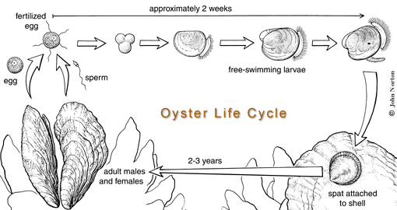
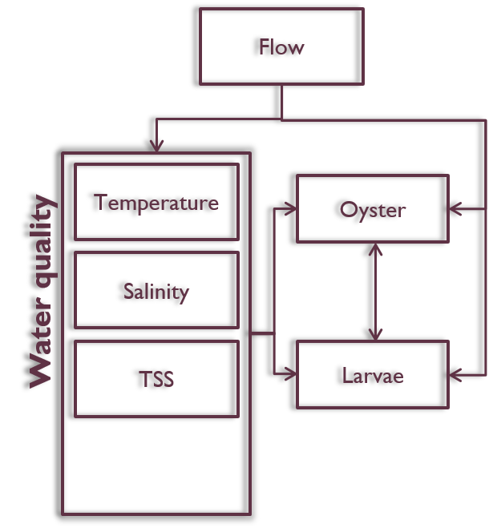
Oyster life history
Oysters have complex life cycle
Flow, water quality (temp, DO, salinity) affect both life stages
Aquatic
Sessile

Slide 5
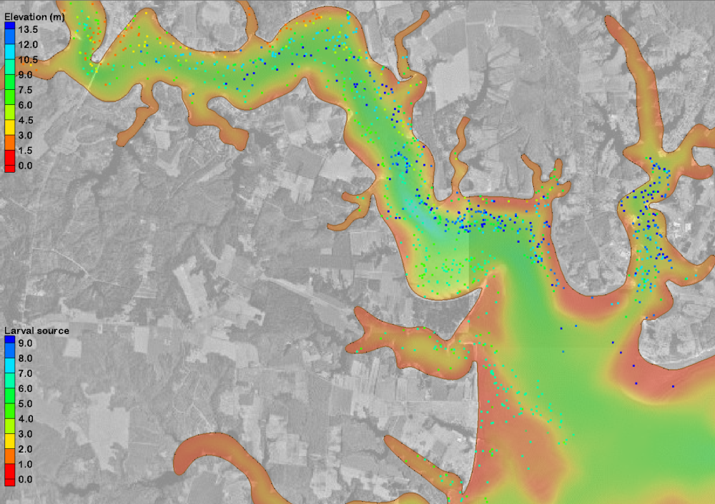
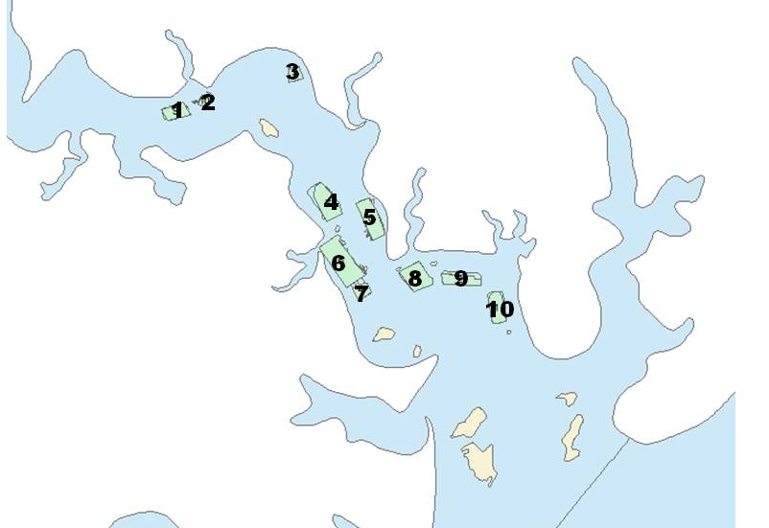
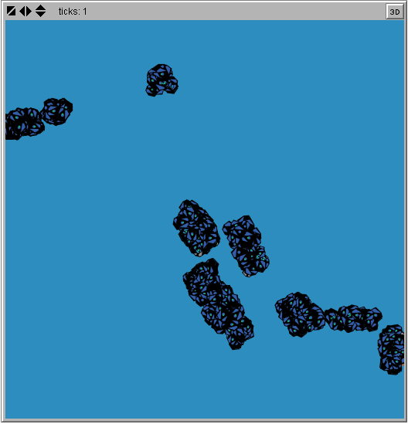
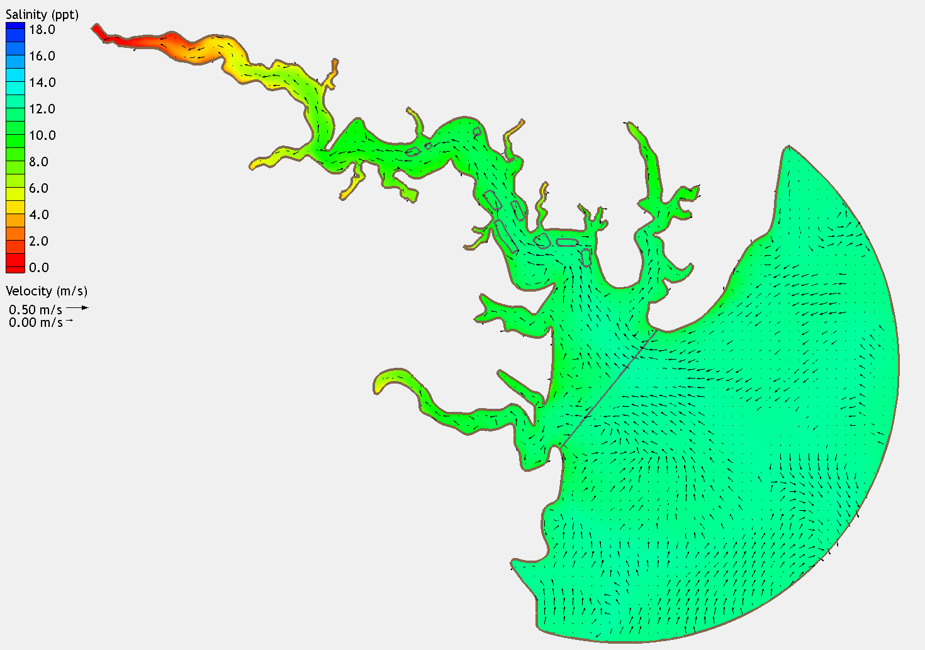
Integrated Model
PTM
GIS
Great Wicomico
River
Oyster reefs
Ingram
Bay
ADH
Chesapeake
Bay
Population
dynamics

Slide 6
Adaptive Hydraulics
  Unstructured finite-element hydro model
  2-D Shallow water equations
  Calibrated against gauges
  Ran model for 8 years
  Flow, water quality, water level
    Inputs to PTM & Pop models
Spatial Scale
  Improved over previous model
  14000 nodes
    25000 Elements
    40 m – 335 m
    Finer resolution on oyster reefs
Mesh can adapt as needed during simulation

Slide 7
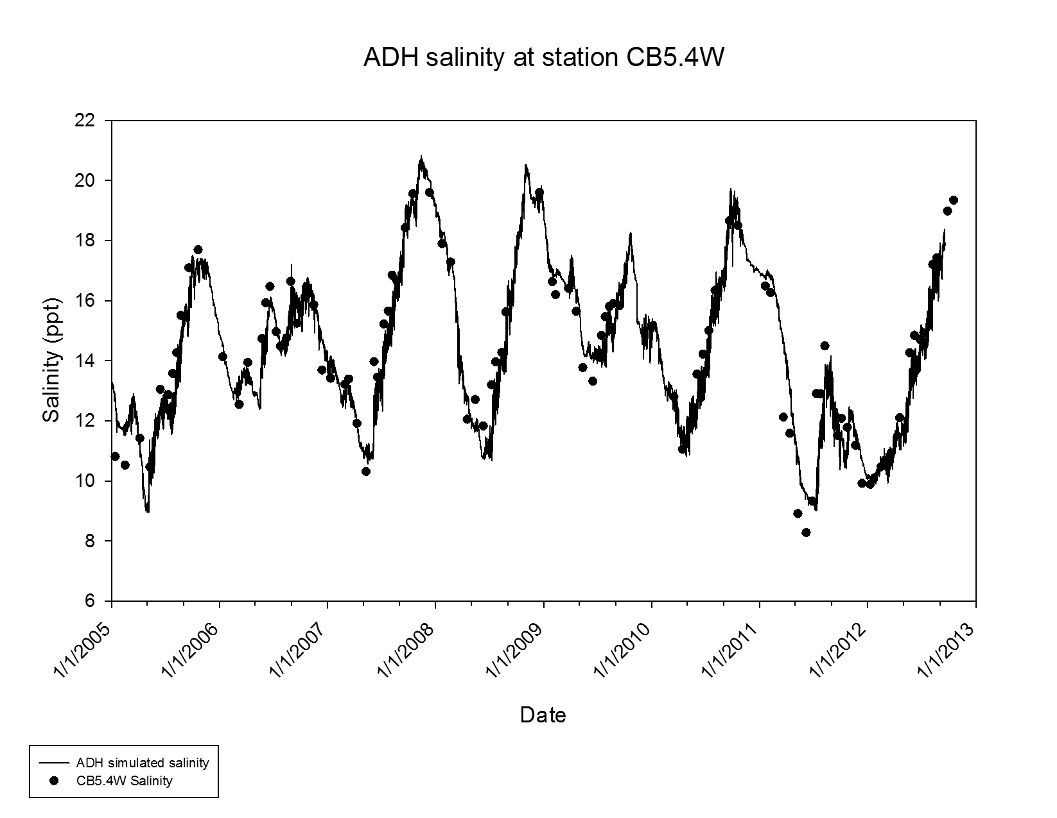
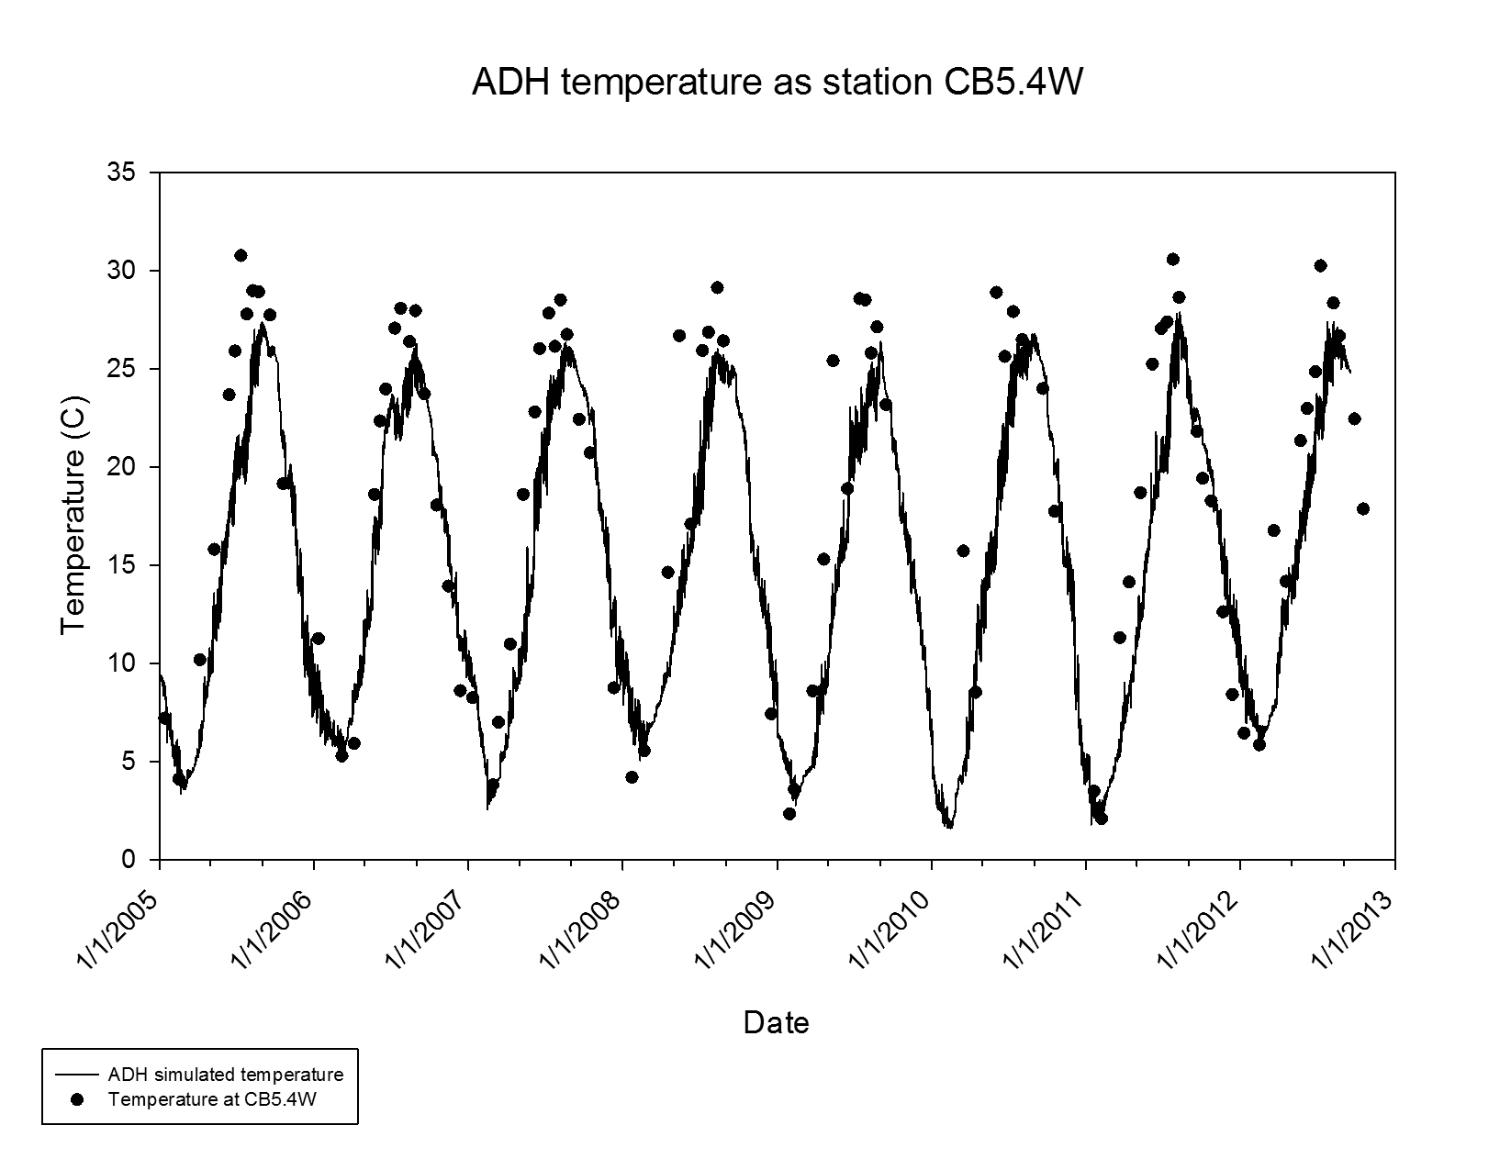
Model Evaluation
ADH Salinity & Temp
Notes:
Using salinity: good indication that hydro is correct

Slide 8
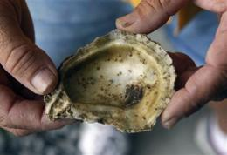
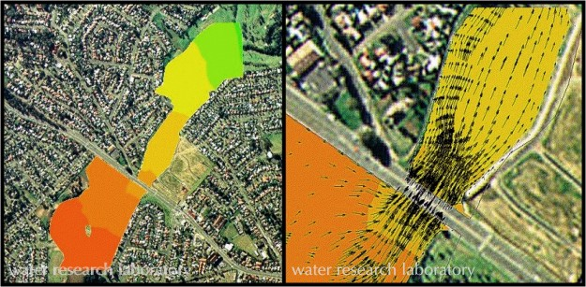
Larval Dispersal
Larval dispersal poorly understood, yet critical for connectivity & recruitment among reefs
Langrangian particle tracking model (PTM)
Uses H₂O level and current estimates from ADH to predict where discrete constituents are transported (used for sediment)

Slide 9
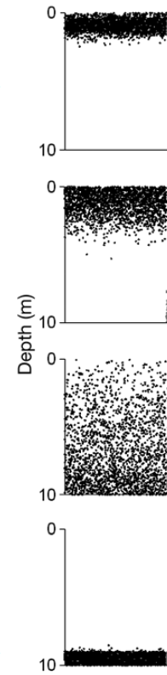
Larval Tracking Model
Day 2
Larval Tracking Model
  Modified PTM with oyster larvae behaviors (Based on North et al. 2008)
  Neutrally buoyant
  Advection-distributed
  After 14 days, migrated downward
    If they found suitable substrate, the settled
    If not, they died
Day 4
Day 12
Day 16

Slide 10
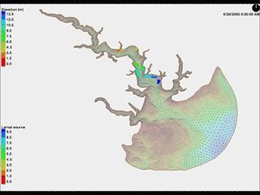
3
2
1
4
5
6
8
9
7
10
LTM generates connectivity matrices
1 per year, eight total
= Oyster Reef

Slide 11
Model evaluation
LTM results for Great Wicomico
Self-recruitment rates from North et al. 2008

Slide 12
Population Dynamics Model
Spatially-explicit, agent-based model
  Agents were “supra-individuals”
  Bioenergetics-based growth
  Stage-specific reproduction and mortalities
  Environmental conditions affect growth, reproduction, & mortality
  10 georeferenced reefs
  Daily time step
Programmed in Netlogo

Slide 13
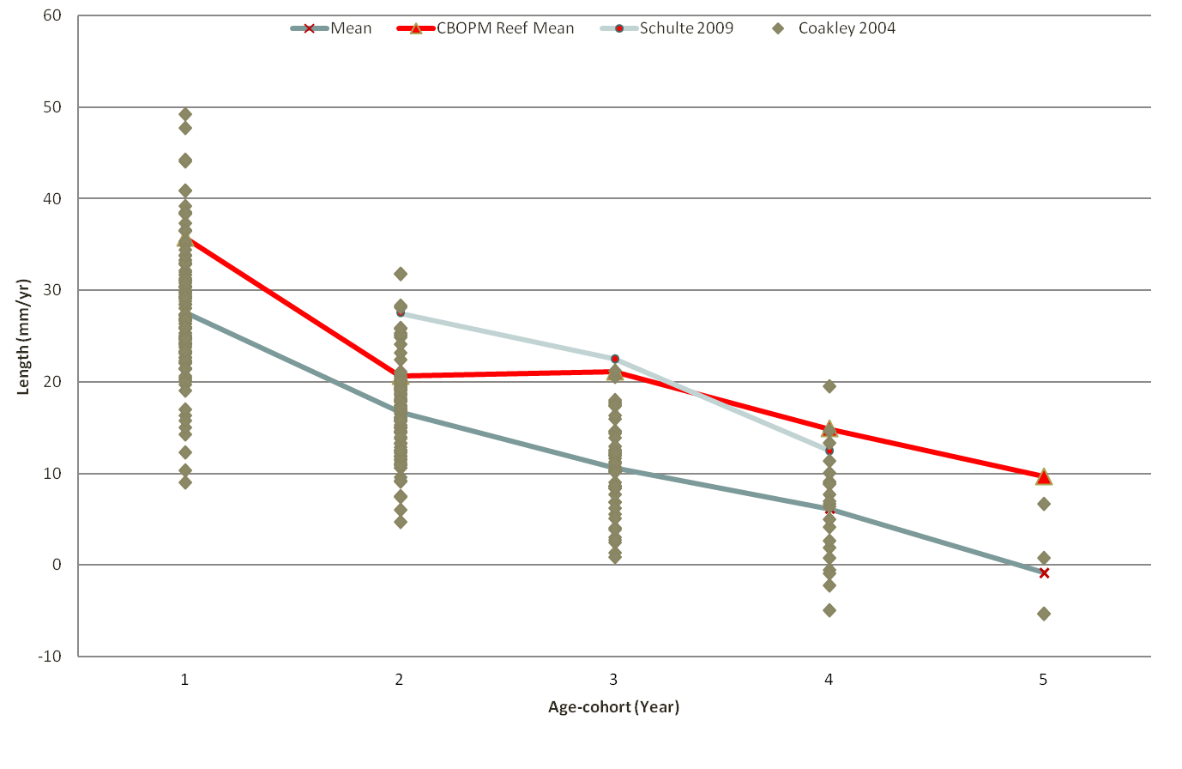
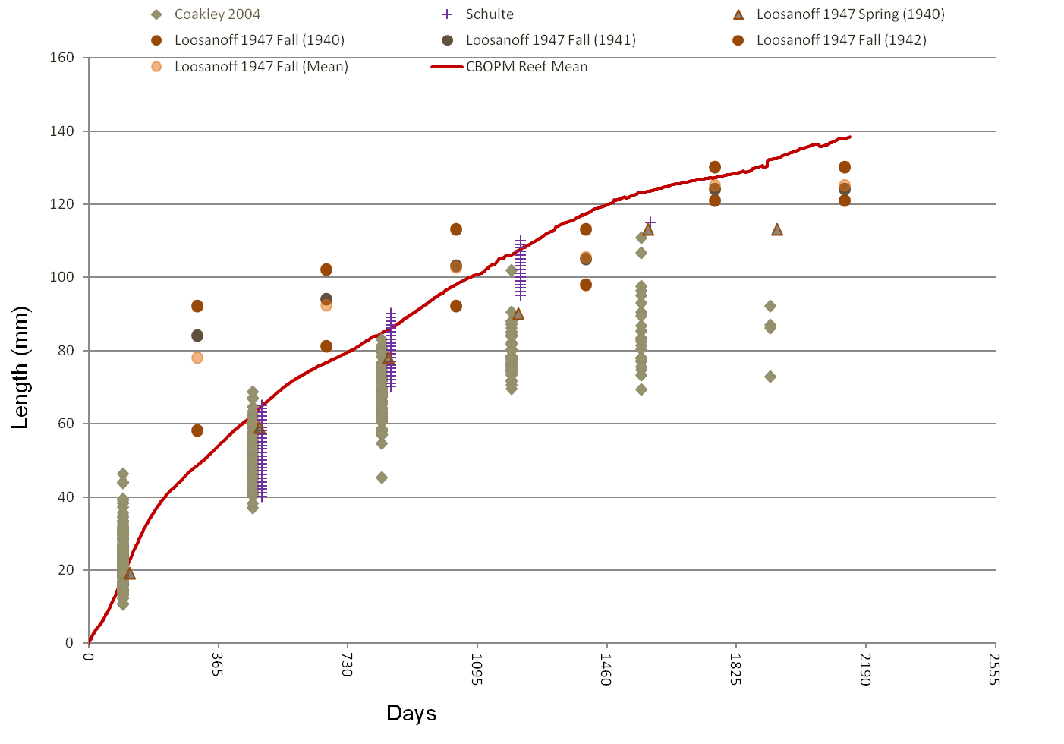
Model Evaluation
Oyster growth rates & lengths

Slide 14
Model Application
Sanctuaries vs Harvesting Scenarios
  Sanctuary only (Higher densities)
  Traditional reefs w/o harvesting (low-relief)
  Harvest every reef annually
  Rotational harvest of every reef (each reef harvested once every three years. 3, 4, 3 pattern)
  6 rotational reefs, 4 sanctuaries (randomly chosen)
  6 rotational reefs, 4 sanctuaries (downstream)

Slide 15
Results

Slide 16
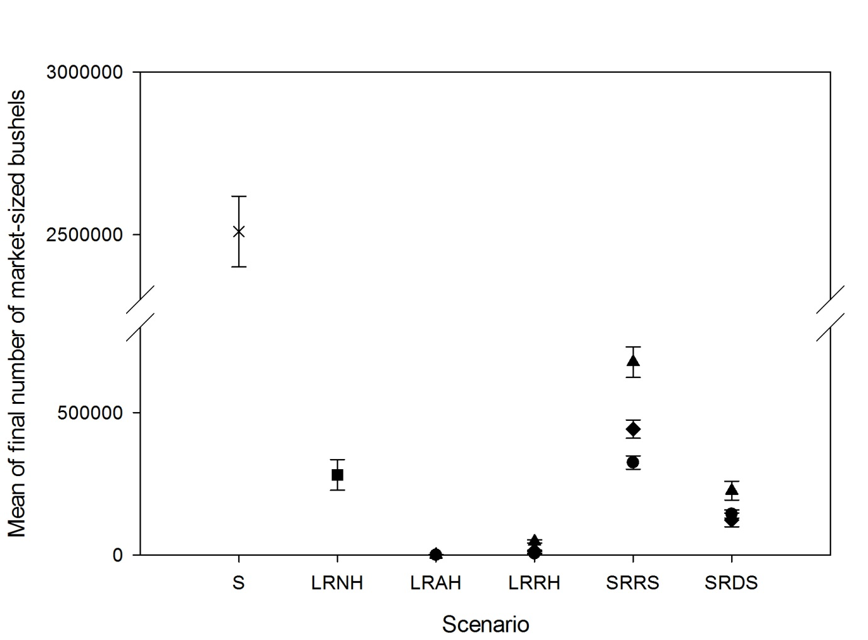
Results con’t.
Abundance after harvest
10% spat remain
50% spat remain
50% all remain

Slide 17
Discussion
Integrated modeling is a more robust approach for capturing scale-dependent processes
  Fine-scale hydro/WQ drive dynamics in the bay
    Modeling approach captured those processes
  Integrates engineering and ecological approaches
Future research
  Expand to other systems
  Determine optimal spatial configuration of oyster reefs
  Dynamic coupling/feedback of models
  Consider disease resistance

