Slide 1
Plans for USACE briefs to new TAMU OCEN students
21 Oct. 2016 – SWG EN attended career fair at TAMUG
31 Oct. 2016 – Mr. Maglio presented to Dr. Tom Linton’s Coastal Zone Management class about USACE SWG beneficial use projects
15 Nov. 2016 - Rueben Trevino (Galveston Parks Board) and USACE Mr. Maglio presenting coastal and riverine projects to Sam Houston State University - 400-level course on geomorphology
17 Nov 2016 – Mr. Rob Thomas discussing what the USACE does at Dr. Figlus class
1 Dec. 2016 - Mr. Maglio presenting to Dr. Kim and Dr. Bob Randall OE Seminar class about USACE SWG Coastal Texas Mega-Study
Jan 2017 - Mr. Byron Williams presenting PM roles at the USACE for the Dredging Course at TAMU College Station
24 Mar 2017 – Attended TAMU Galveston Career Fair
20 Apr 2017 – Mr. Michael Garske presenting water resource engineering to the American Water Resources Association, Student Chapter, Texas A&M University College Station
TBD Sept 2017 - Presenting to Senior-level Capstone students in MASE406/407
TBD (No POC) - Presenting to Sophomore students in the introductory OCEN200

Slide 2
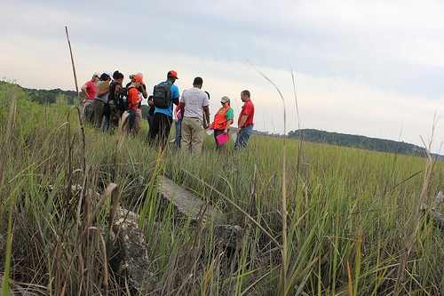
Pathways Program
USACE SWG has 9 summer pathway hire actions
Offers employees at all career levels the potential to build skill sets through the Pathways Program
Programs present clear paths to internships for students from high school through post-graduate and to careers for recent graduates
Provides significant training and career development opportunities to those beginning their Federal career
More Information:
https://www.usajobs.gov/StudentsAndGrads

Slide 3
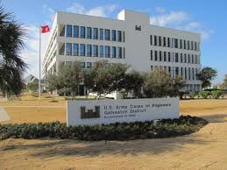
Pathways Summer Hires Program
Temporary Summer positions NTE 120 days (May – Sept)
Appointment will not exceed 120 days and extensions are not authorized
Candidates with previous summer hire positions, must re-apply for permanent jobs under other Pathways Intern and/or Pathways Recent graduate positions
Provides students in high schools, colleges, trade schools with paid opportunities to work in agencies and explore Federal careers

Slide 4
Pathways Internship Program
Program replaces the Student Career Experience Program (SCEP) and Student Temporary Employment Program (STEP)
Designed to provide students enrolled in a wide variety of educational institutions, from high school to graduate level, with opportunities to work in agencies and explore careers within USACE while still in school and while getting paid for the work performed.
May work part- or full-time, while gaining valuable work experience directly related to career goals or field of study
May be noncompetitively converted to a career, career-conditional, or term appointment at the completion of their degree—diploma or certificate—if they have successfully completed at least 640 hours of work for the agency

Slide 5
Pathways Recent Graduates Program
Designed to prepare employees who have recently graduated from qualifying educational institutions or programs for subsequent advancement in professional, administrative, and technological fields.
Employees will receive an Individual Development Plan (IDP) designed to track career planning, professional development, and training activities. This IDP will be used to provide training through mentorship, on-the-job training and formal classroom instruction.
Participants must have obtained a qualifying degree, or completed a qualifying career or technical education program, within preceding 2 years.
Veterans having military service obligations must be appointed within 6 years of obtaining a qualifying degree or completing a qualifying program.
Candidates must meet Office of Personnel Management (OPM) qualification requirements for the position being filled.

Slide 6
Benefits
Sample Salary Ranges*:
GS-3: $29,052 - 37, 767
GS-4: $32,614 - $42,398
GS-5: $36,489 - $47,435
GS-7: $45,200 - $58,761
GS-9: $55,289 - $71,870
GS-11: $66,893 - $86,961
GS-12: $80,179 - $104,232
GS-13: $$95,343 - $123,951
*Note: Above salary ranges are based on the 2016 General Schedule salary table Houston. Actual amounts will vary by locality pay area.
Competitive annual salaries with cost of living increases
Promotion opportunities
Vacation and sick leave
Health and life insurance
Retirement plan
401K equivalent, with up to a 5% matching government contribution
10 paid Federal holidays
Family Friendly Leave
Flexible hours and alternate work schedules
Telework arrangements may be available
Possible student loan repayment
Recruitment and Relocation Bonuses may be awarded for difficult to fill positions.

Slide 7
How to Apply
Steps for applying using USAJOBS:
http://jobsearch.usajobs.gov/a9arcoe.asp
Input search criteria in the “Keyword Box”, such as: “Pathways”, “Biologist”, or “Ranger”. You can also search on specific job skills, the Vacancy Announcement Number, or geographical location, “Galveston, Texas.” Make sure that the search field is selected for US Citizens not Federal Employees
→ Click on the blue “Search.” Box
→ Click on the Job Announcement
→ Click on “Apply Online” on the right side of the page.
→ Sign in to USAJOBS account.
→ Check box for statement that begins “I certify…”
→ Click button at bottom that says ‘Apply for this position now!’
You must have a current resume in the USAJOBS database before you can apply for a position. After you your resume in the system, select the “Apply Online” button located at the bottom of the vacancy announcement to which you wish to apply

Slide 8
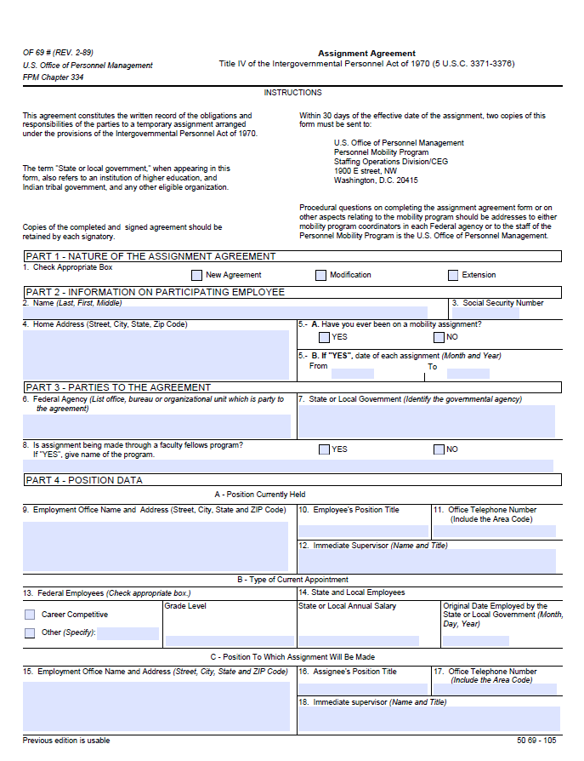
IPA for TAMU Professor
16 September ‘16 - funding vehicles are available - ERDC RM
19 September ‘16 - Edmond Russo and Ashley Frey CHL provided letters of recommendation I spoke to RM on
October ‘16 – Dr. Bert Sweetman’s IPA application completely approved through TAMU
Prove benefit to ERDC – nearly complete
Bert, SWG, and CHL must agree with the terms of the IPA agreement
Final version to the ERDC Office of Counsel for their initial review
Approved thru CHL's chain, then back to TAMU
TAMU approves agreement
Ultimately ERDC legal review, RM review, HR review, and finally to the ERDC Executive Office
Estimated time remaining 2-3 months.

Slide 9

CSEC WORKSHOP
Vicksburg
19-21 April 2017
USACE Study and Project Need
&
CAPSTONE PROJECTS

Slide 10
Proposed Projects for Senior Students
Bolivar Roads gate structure
- Hydraulically invisible - highly conductive
- Maintaining tidal prism, etc…
Sediment Bypassing
- Bedload collector
Sand Motor
- West end of seawall Dellanera Park
Beneficial Use 61st (Babes Beach 2015)
- Geomorphic evolution
Erosion and consolidation rates of hydraulically constructed berm
Structural evaluation of oyster substrate for stability and wave attenuation
Multifunction reef at end of Galveston seawall

Slide 11
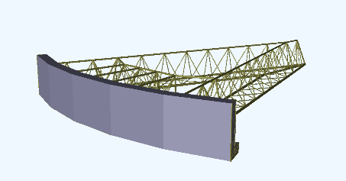
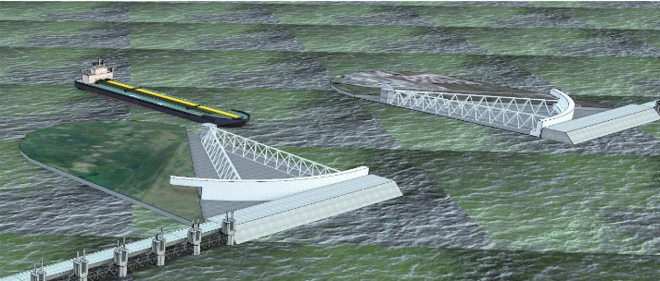
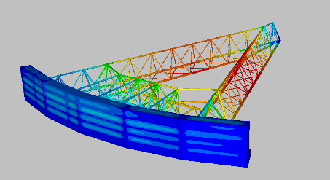
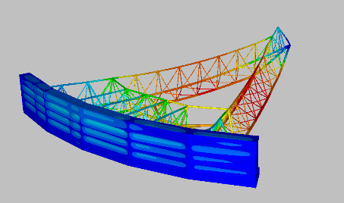
Example:
Current Project in development in collaboration with USACE, Galveston
Gate design concept
Structural Analysis

Slide 12
CAPSTONE PROJECT REQUIREMENTS
Minimum content in the engineering analysis: (Slide 1 of 2)
FIRST - SENIOR SEMESTER (MASE 406)
Technical and economic feasibility study of project alternatives
Detailed Design Plan of the selected alternative to be executed in second semester
SECOND - SENIOR SEMESTER (MASE 407)
Determination of the environmental loading (wind, wave, current, etc..)
Hydrostatic and Hydrodynamic analysis,
Structural analysis of most important components,
Geotechnical analysis for foundation or mooring system,
Detailed economic analysis and
Environmental impact.

Slide 13
CAPSTONE PROJECT REQUIREMENTS
Minimum content in the engineering analysis: (Slide 2 of 2)
Areas thoroughly covered:
Structural and Hydrodynamic
Example:
Structural analysis (using finite element analysis) to design specific members of the structure with several cycles through the design spiral.
Hydrostatic and hydrodynamic stability analysis.
Environmental loading (obtain extreme values of wind, waves, etc. following a Gumbel, Weibull distribution, etc. obtained from site recorded data);
Geotechnical (sediment/soil shear strength, etc.), foundation, piling and mooring systems

