Slide 1
Establishment of Novel Texas Gulf Coast Beach Erosion Management Best Practices
Rueben Trevino
Coraggio Maglio
20 April 2017

Slide 2
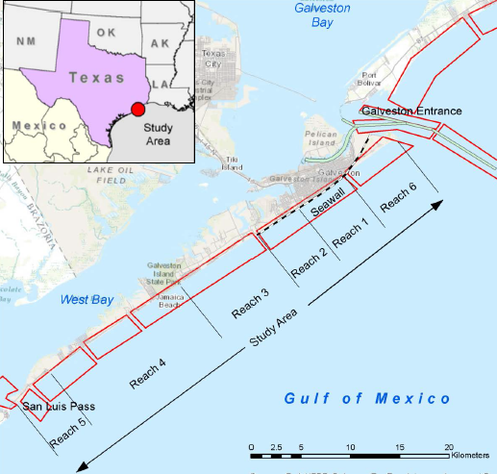
Sand Management Plan Sediment Options
Identify sand sources
Big Reef
East Beach
Offshore
2. Deposition basin off East Beach
3. Reduce trans. through S. jetty
4. Reduce Aeolian sand transport
5. Sand backpass system

Slide 3
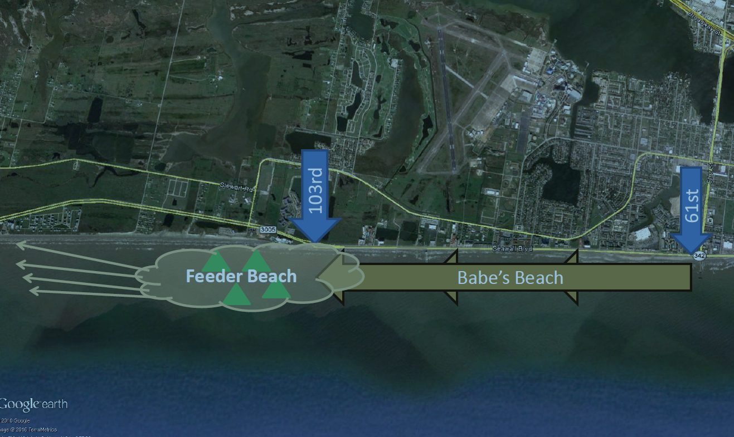
Galveston Seawall Feeder Beach

Slide 4
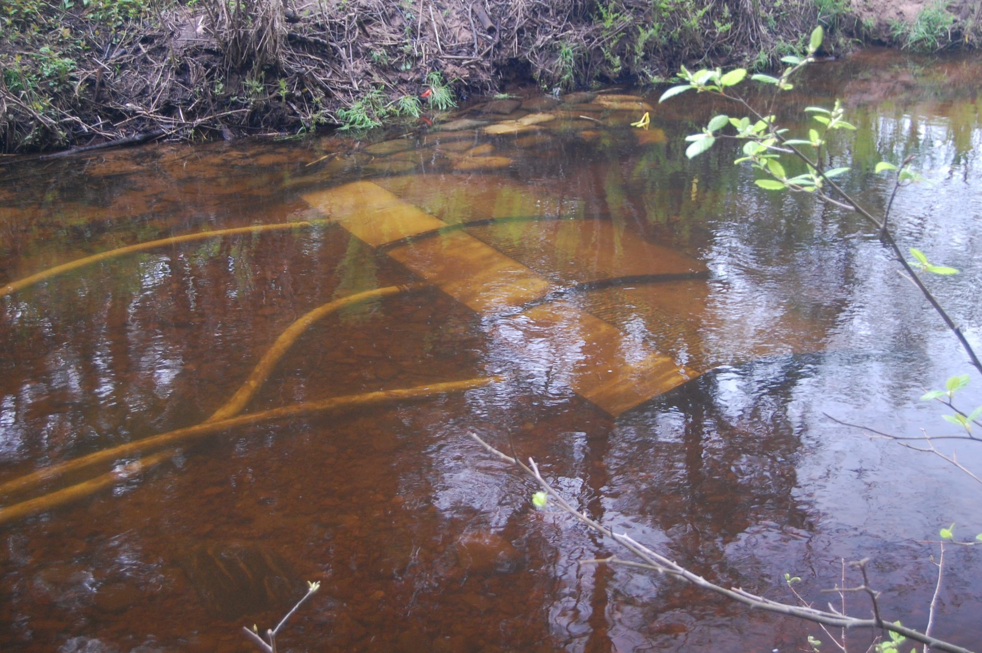
Sand Management Plan Update
Parks Board will be putting out a contract within the month to perform a bedload transport collection test – scaled demonstration
http://streamside.us/products/sediment-collector/

Slide 5
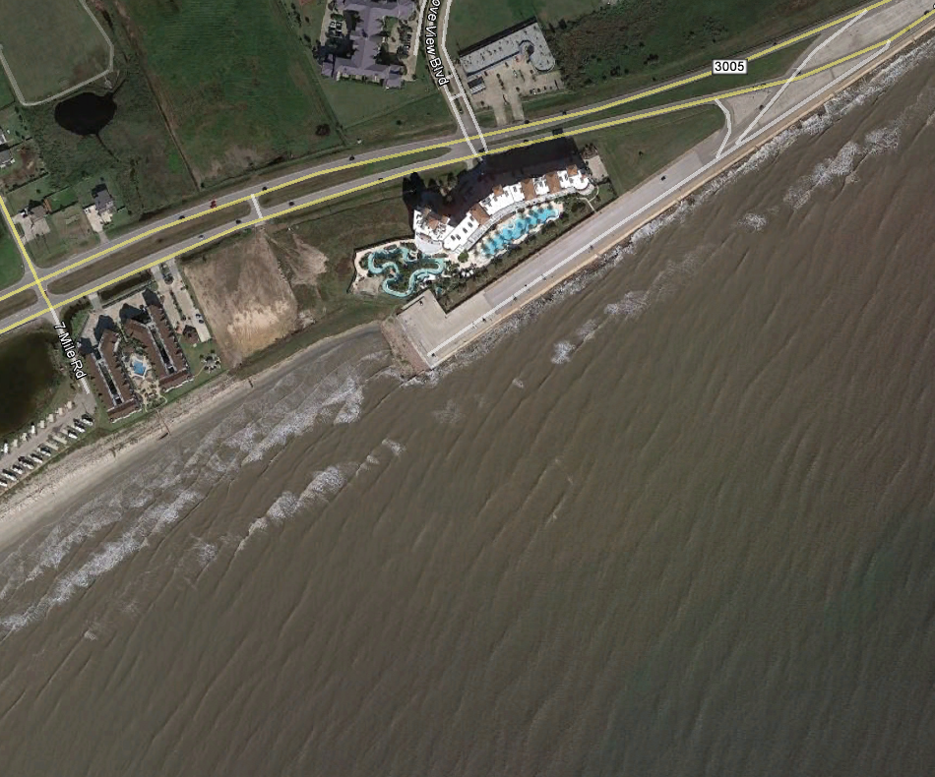
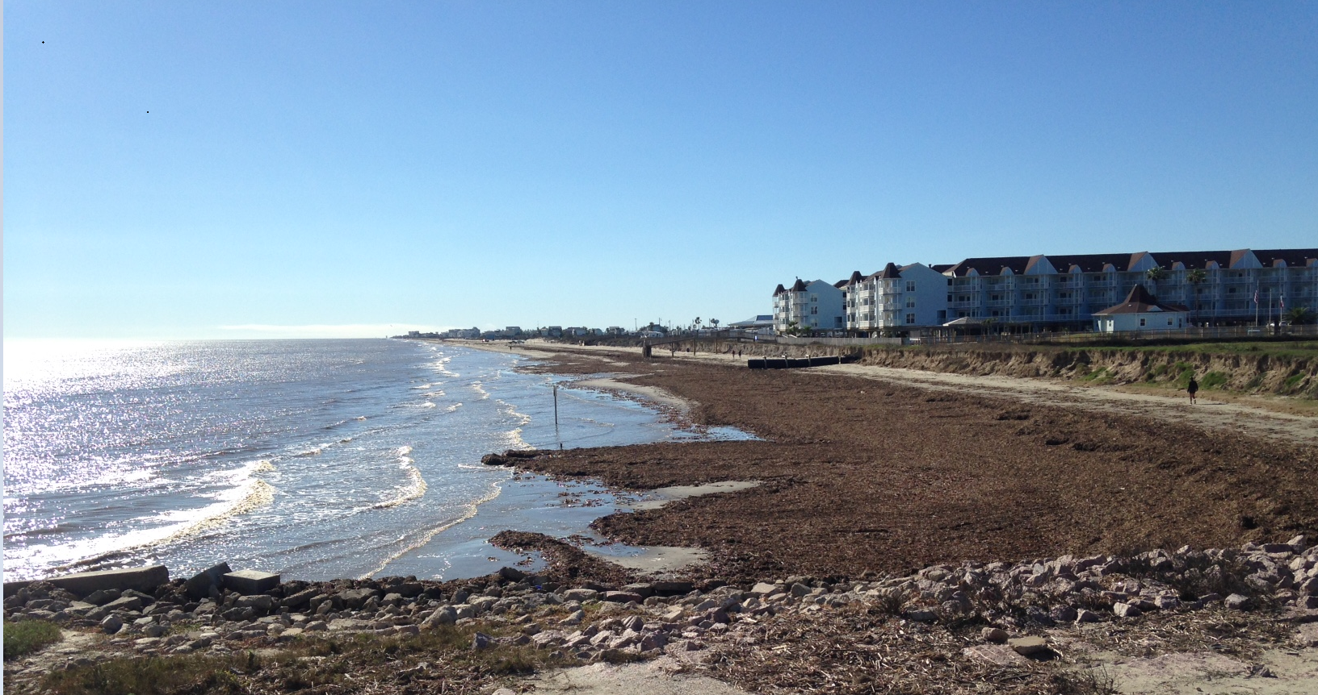
Sand Management Plan Update
End of seawall structural solution
Multipurpose reef –submerged breakwater
Enhance fishing/surfing

Slide 6
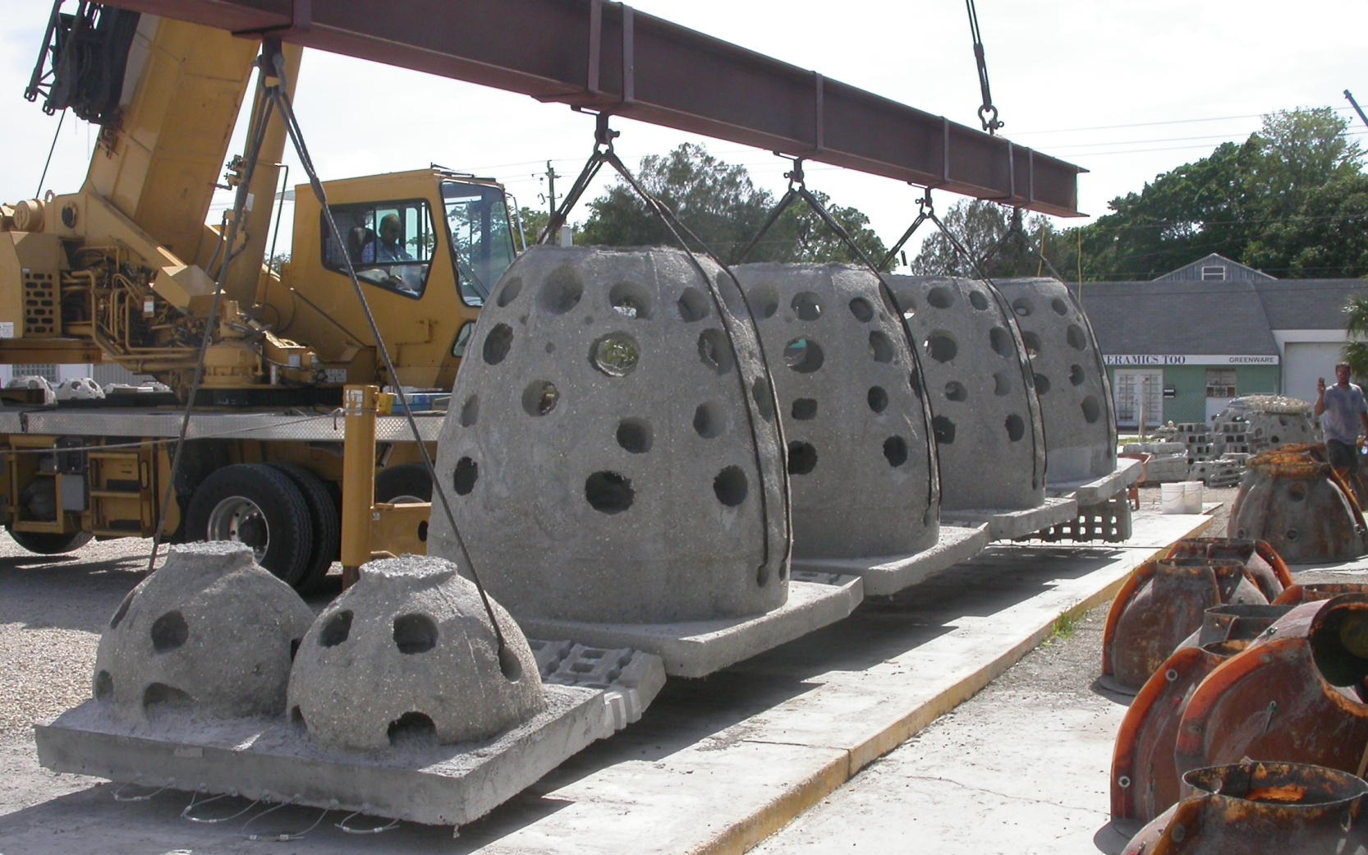
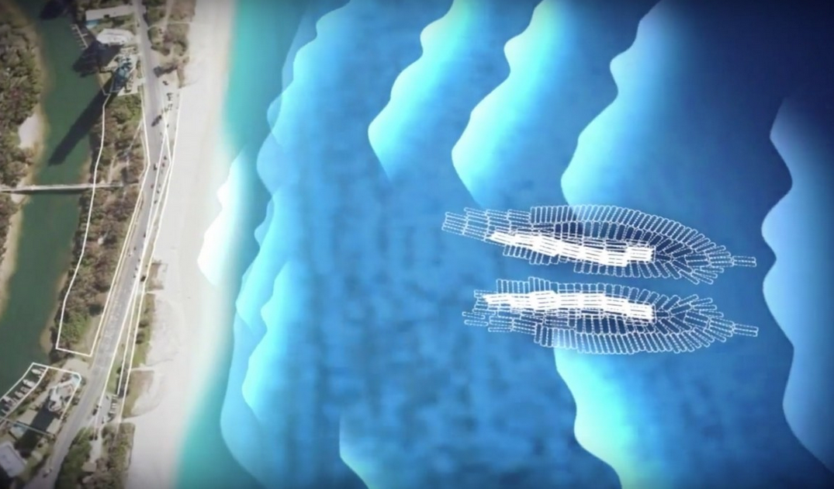
Sand Management Plan Update
Multipurpose reef
SMART Reef – Bill Curtis’ Reef
Geotextile sand filled monolith

Slide 7
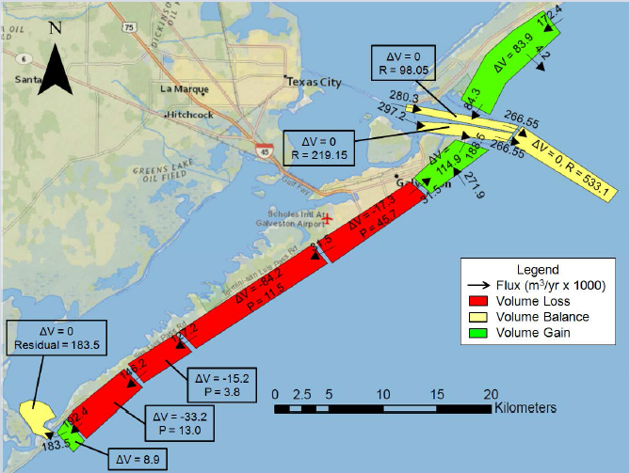
Sand Management Plan Update
CEPRA Grant
Production scale – bedload collection test
Design the entire full scale process
Initial Costs Est.
Permitting
O&M

