Slide 1


Dune Vegetation and Evolution Modeling:
Linking Remote Sensing to Habitat Change and Ecological Process
Safra Altman, Ph.D.
Todd Swannack, Ph.D.
Molly Reif, GISP
Environmental Laboratory
Jim Westervelt, Ph.D.
Construction Engineer Research Laboratory
See instructions for customizing these images on slide 3.

Slide 2
Ecological Modeling for Landscape Change Analysis
Ecosystem services, well-being, wealth, poverty
Landscape
Research
Nested multi-
scaled dynamics
Ecosystem stewardship
Ecosystem change and society
Plieninger et al 2015
Notes:
From recent review of European landscape research
Schematic summary of six areas of recent progress in landscape research that can contribute to the three focal areas of ecosystem change and society.
1) Stewardship, 2) people-environment linkages, 3)structure and intensity of use, 4) longterm history, 5) driving forces , processes, actors 6) values and meanings

Slide 3
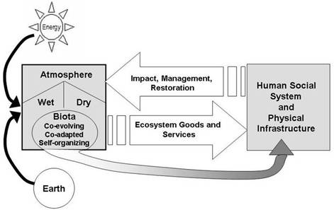
Ecological Modeling for Landscape Change Analysis
Miller et al 2010
Notes:
Human infrastructure and biological “world” linked through feedback, EGS can add to social system/physical infrastructure, but societal side can also influence atmospheric/biotic side through management and can even strengthen/enhance EGS generated.

Slide 4
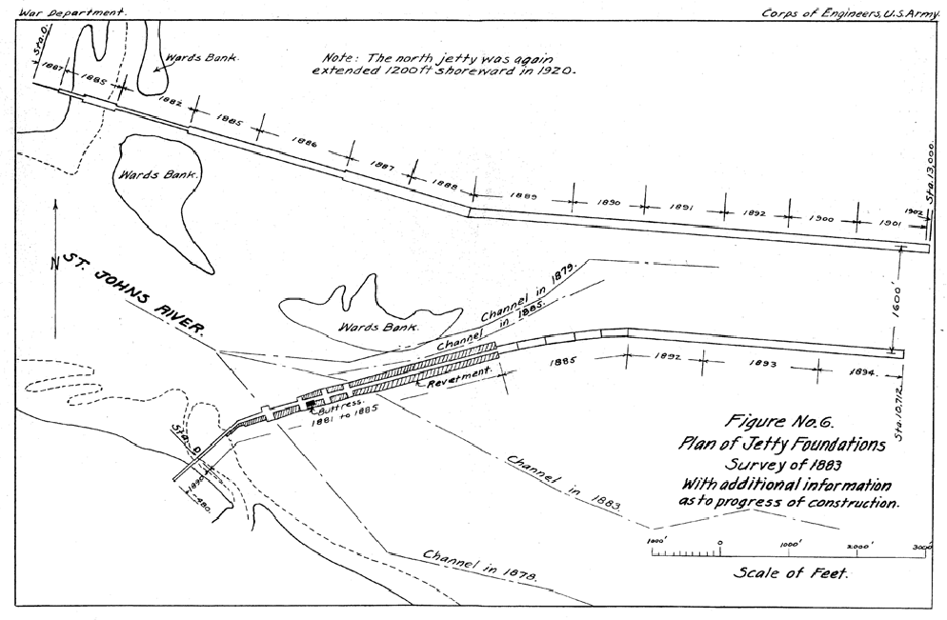
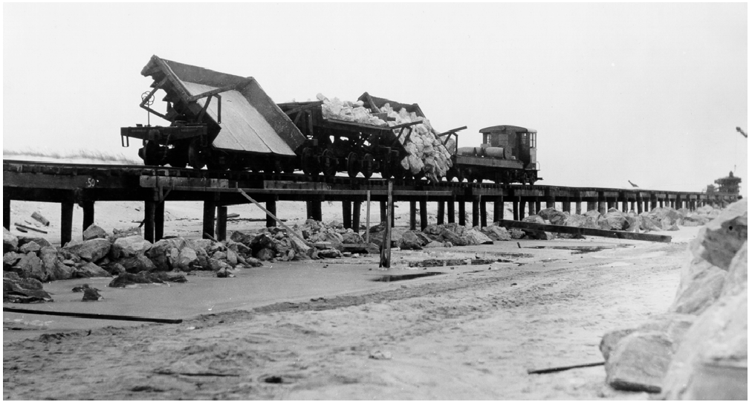
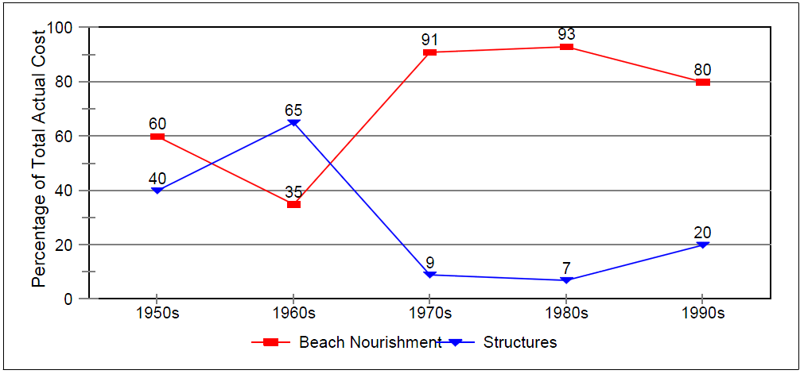
Coastal defense: USACE perspective
1824 – First Corps of Engineers coastal project: Long Beach in Plymouth, MA
1878 – Captain James B. Eads developed converging jetty design for St. Johns River, Jacksonville, FL
early to mid-20th century – Coastal development and structures proliferate (breakwaters, groynes, jetties, seawalls, dikes)
mid to late 20th century – shift to beach nourishment and artificial dunes
Early 21st century – shifting away from traditional engineering approach towards a systems approach
“…triangular frames of timber filled in with stones, around and over which the sand gathers and forms a new brest. In other places large bodies of brush are laid, which have produced the desired effect, accumulating sand into cliffs and helping the growth of beach grass.” –Howard P. Barnes 1958

Slide 5
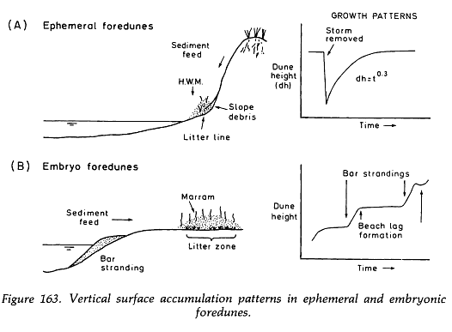
Dune Development
Sediment - type and supply
Wind field – wind presence above sediment entrainment threshold
Vegetation - provide initial stabilization, growth
Vertical and horizontal dune growth relies on interaction of these
3 factors
Local controls
  Topography
  Wave climate
  Tidal range, tidal litter
  Sea level
Limiting factor
  Nitrogen
Vertical surface accumulation patterns in ephemeral and embryonic foredunes. Carter, 2013.

Slide 6
Ecological Modeling for Landscape Change Analysis
  How do we link landscape pattern to process?
  How do we optimize planning and operations activities with respect to ecological processes?
Goals:
Synthesize remote sensing imagery, landscape analyses, and ecological simulation
  factors that influence landscape change
  model how landscape structure will change as a result of project activity
  model how ecological processes will change
Notes:
My initial suggestion would be to include a slide or two at the beginning to set the larger context for this work, information answering such questions as: What are the problems or interests motivating this work? What use would be made of the developed capability? Why is this work important in the US and worldwide?

Slide 7
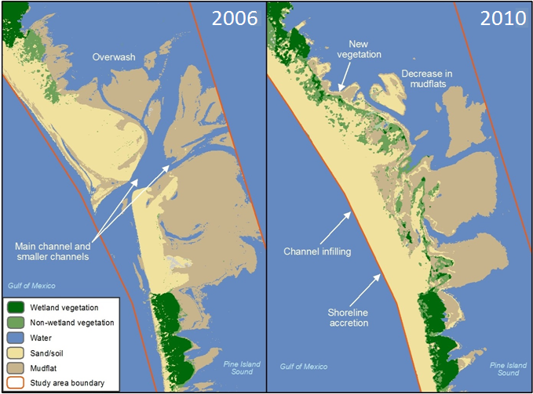
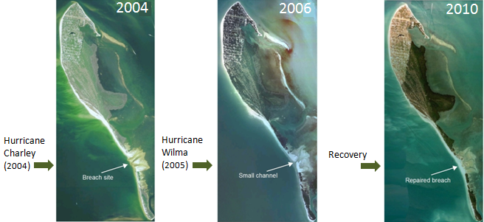
Ecological Modeling for Landscape Change Analysis
Identify changes to habitat
  multi-temporal imagery
  Light Detection and Ranging (Lidar) data
Breach
Channel
Recovered Breach

Slide 8
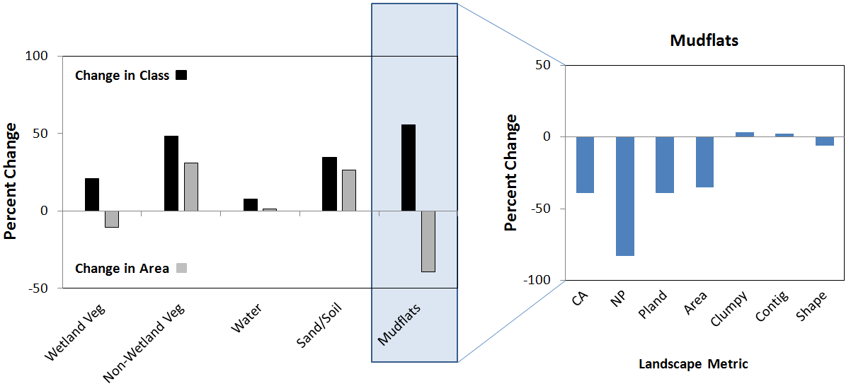
Ecological Modeling for Landscape Change Analysis
2) Derive landscape metrics associated with landscape patterns

Slide 9
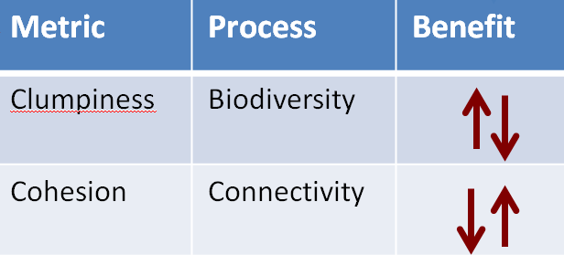
Ecological Modeling for Landscape Change Analysis
3) Integrate with ecological simulation
Better understand factors influencing change
Assess project level impacts & benefits
Change in Landscape Pattern
Change in Ecosystem Function

Slide 10
Ecological Modeling for Landscape Change Analysis
1) Identify changes to habitat
2) Derive landscape metrics
3) Integrate with ecological simulation
Change in Landscape Pattern
Change in Ecosystem Function

Slide 11
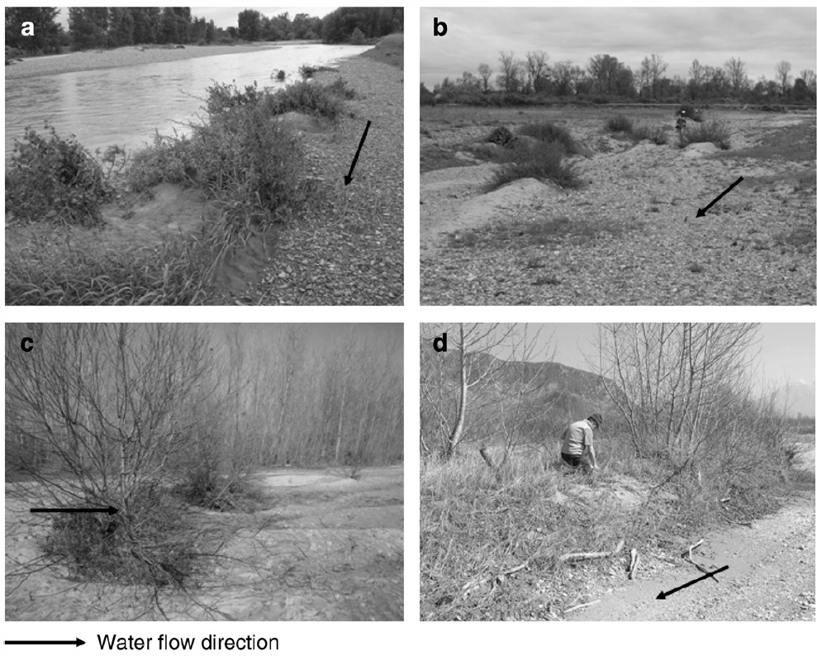
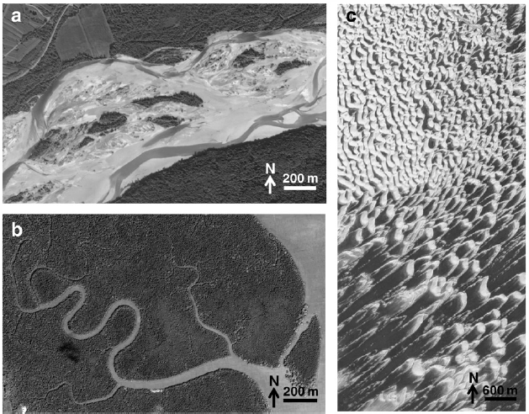
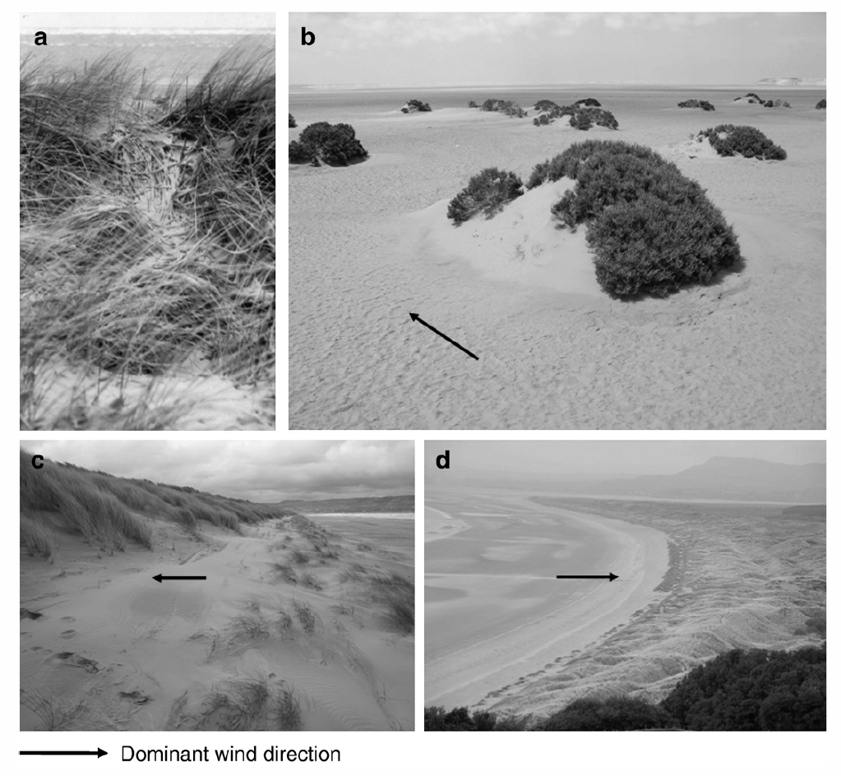
Vegetation shapes landscapes in dynamic environments
Islands
River networks
Desert dunes

Slide 12
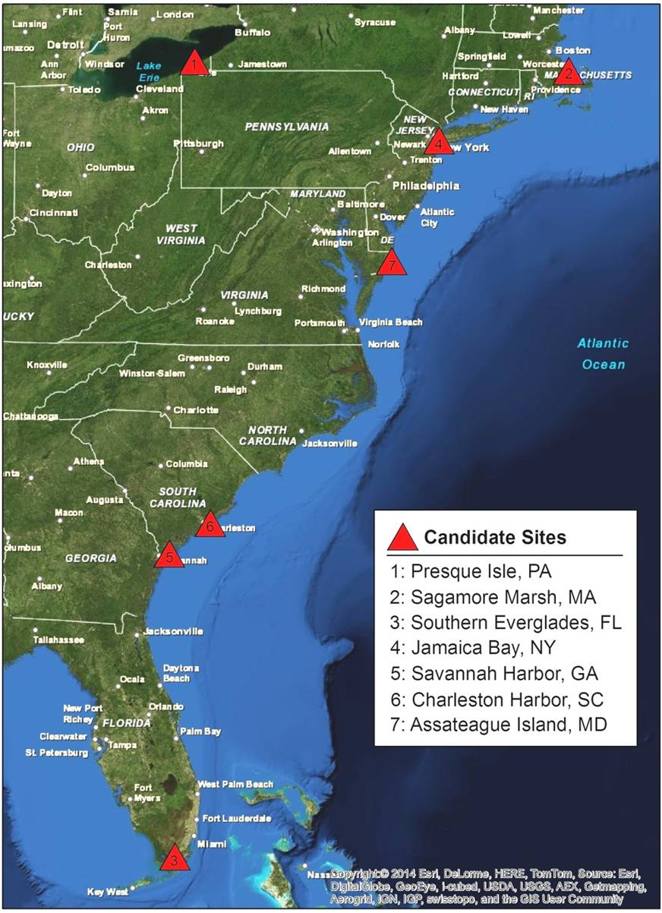
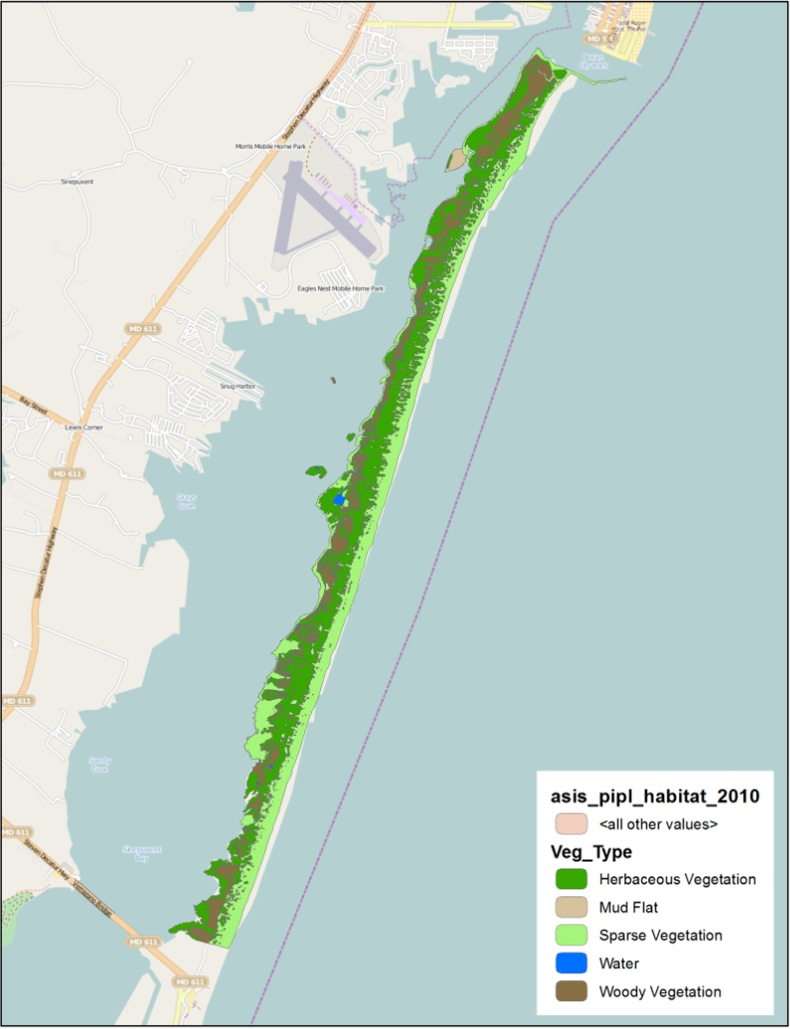
Site Selection
Site selection criteria:
  Coastal and dynamic
  O&M
  Ecosystem restoration
  Long project history
  Landscape changes
  Typical coastal project
  Site: Assateague Island, MD
  Rich data and historical evaluation
  Time series of lidar data
  Habitat classification by the U.S. National Park Service
Notes:
Site selection involved requests to the Coastal Working Group and the Environmental Chiefs, in which we asked the group to provide candidate sites meeting the criteria listed …
We received a lot of great feedback from coastal districts including the following 7 sites recommended for consideration. From there we conducted online reviews of information and held conference calls with the districts for several of the sites that best matched the criteria. After further review, two sites stood out, including Assateague Island, MD and Presque Isle, PA. Data searches were conducted including online data repositories as well as the district data. Northern Assateague Island resulted as the primary site since it is fairly data rich and has been studied and documented before. Included in the data repository is a history of both lidar elevation data and habitat classification data.

Slide 13
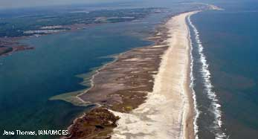
Site History
Assateague Island

Slide 14
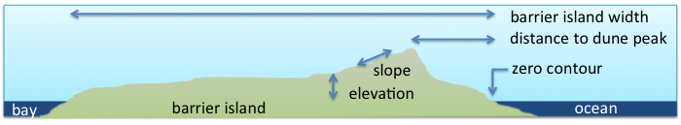

Metrics Development
    Metrics identified from literature reviews
    Developed from lidar data (2000 - 2012) collected by the U.S. Geological Survey, NASA and The USACE National Coastal Mapping Program
    Focused on 6 metrics
Barrier island width
Distance to dune peak
Slope
Distance to
zero contour
Elevation
Elevation change
Notes:
This is the list of critical parameters influencing vegetation growth and distribution. The red box highlights those that can be extracted from spatial data, primarily lidar and habitat related information. They include things like, elevation, slope, beach and barrier island width, distance to the zero contour, distance to the dune crest, and densities of different types of vegetation communities. Some examples of the extracted parameters from the lidar data are shown on the right, such as elevation and distance to the 0 contour for the area of interest in the northern extent of the island. We’re currently wrapping up the extraction of lidar parameters from datasets ranging between 2000 to present. As part of that effort, we’re developing model narratives, which describe each parameter with a basic list of quantitative methods from various literature reviews for analyzing those parameters, and summary statistics to identify elevation-based relationships to the habitats of interest. The National Park Service conducted habitat mapping surveys from the same years and we’re comparing the two datasets to find trends and patterns that can be used to simulate future conditions in the draft model interface.

Slide 15
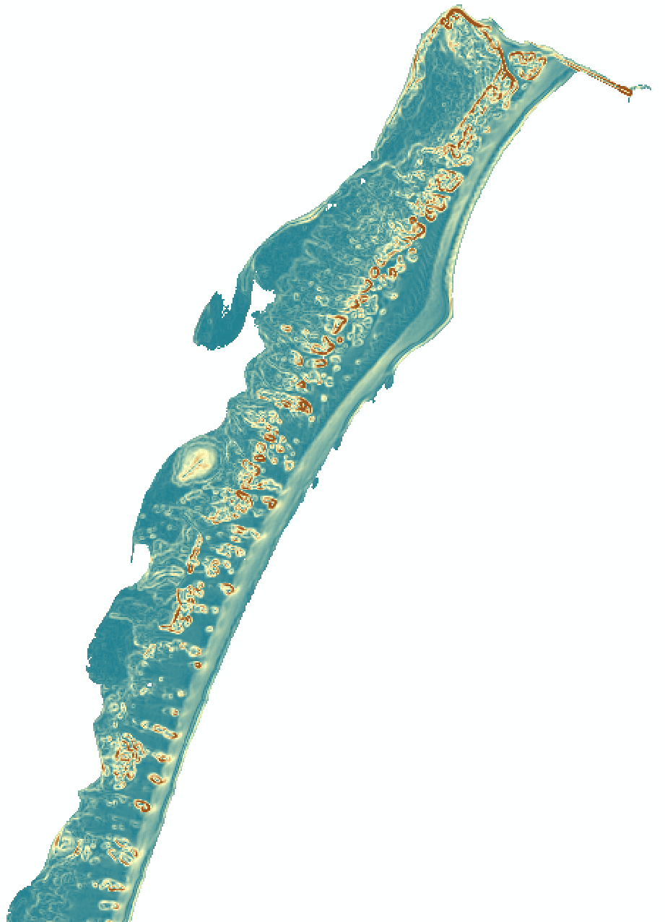
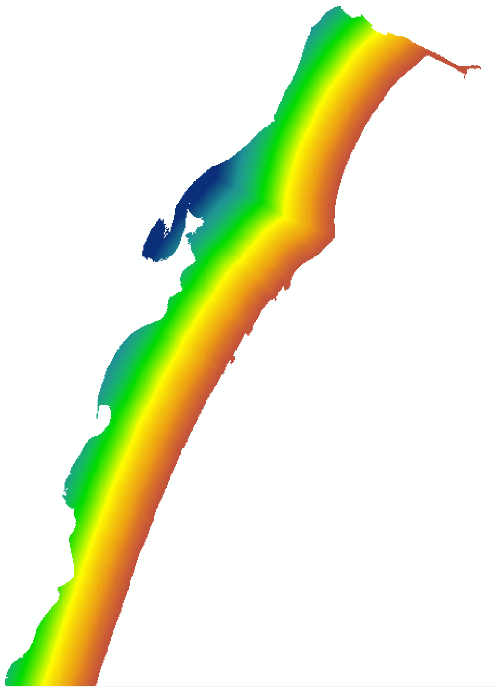
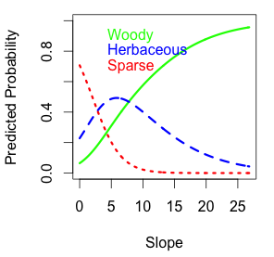
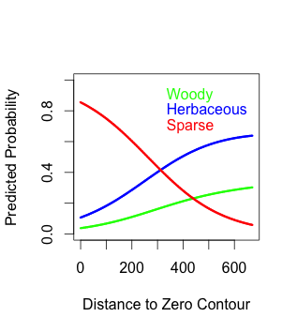
Metrics Analysis
  Predicted probability of vegetation type determined using multinomial logistic regression
  Influence of interactions between metrics investigated
  Relationships incorporated into spatial model
Slope
Distance from Zero Contour

Slide 16
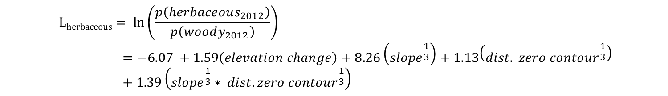
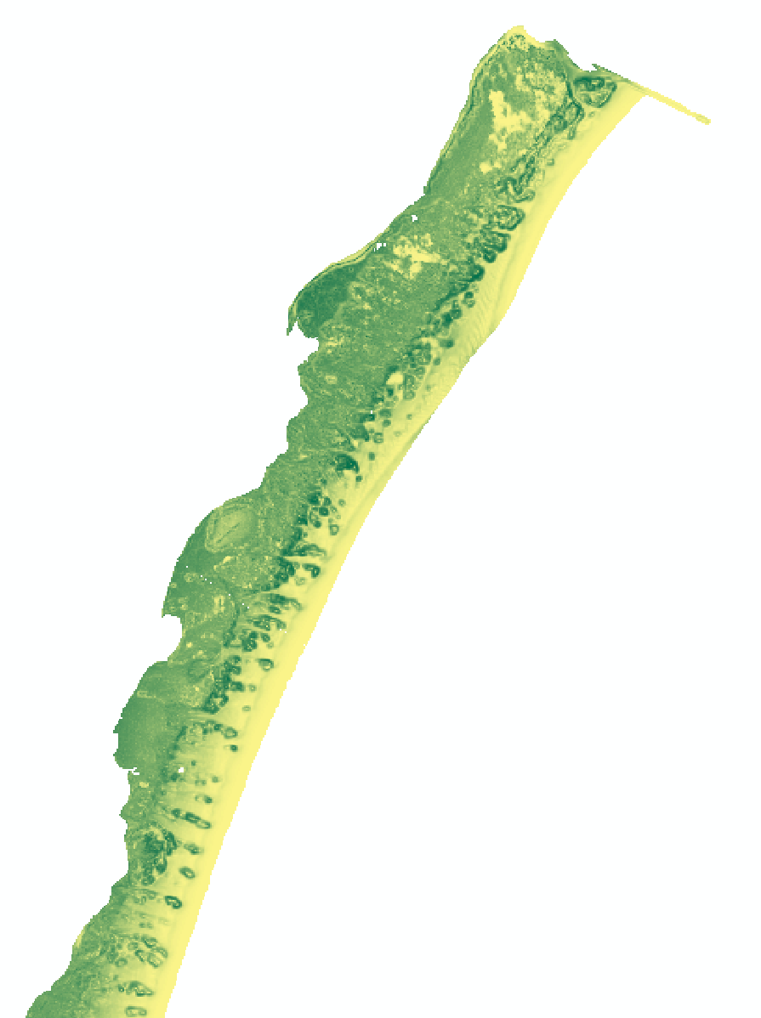
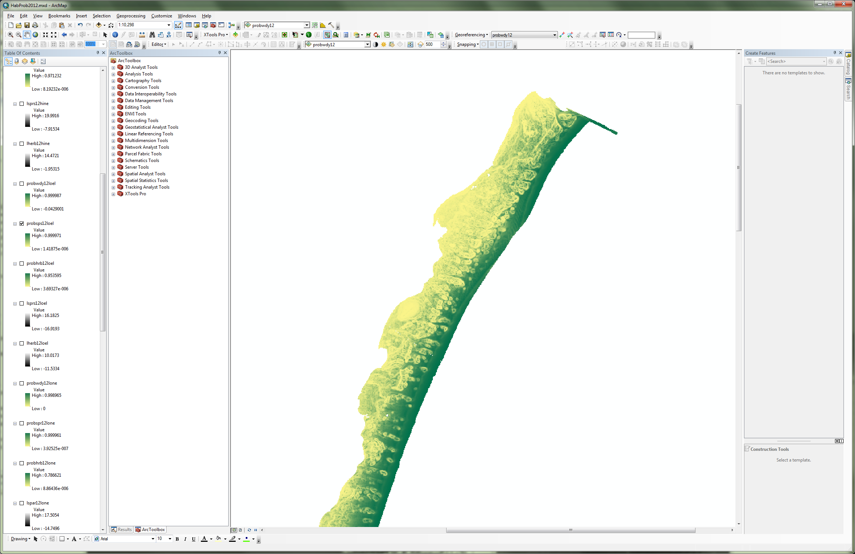
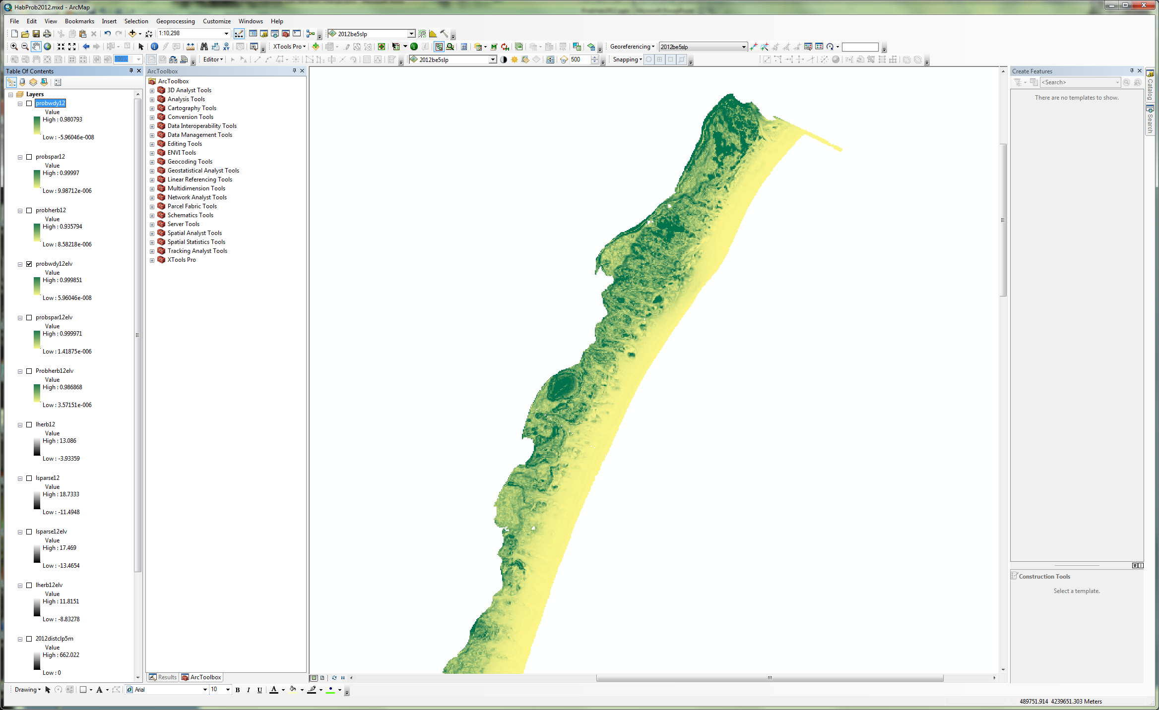

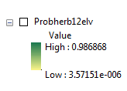
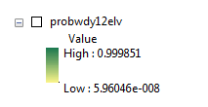
Probabilities
Barrier island width
Distance to dune peak
Slope
Distance to
zero contour
Elevation
Elevation change
Probability
Sparse
Probability
Woody
Probability
Herbaceous
Probability(herbaceous)=
Notes:
This is one of the model equations resulting from a multinomial logistic regression. This type of regression allows us to predict the probabilities of different possible outcomes of a categorically distributed dependent variable, given a set of independent variables. In this case we are able to predict the probability of vegetation class (herbaceous, sparse, woody) given the independent variables id’ed (elevation change, slope, dist to zero contour). Regression analysis finds a model equation (with intercept and coefficients) for each category outcome relative to a reference outcome. In our case, we used ‘woody’ as a reference. The top equation shows the model output with intercept and coefficients for log odds of herbaceous/woody. The equation includes these independent variables: elevation change, slope, dist. to zero contour, and the interaction between slope and zero contour. Some variables were cube root transformed to address concerns with data distribution.
How to interpret the coefficients:
A one-unit increase in the variable elevation change is associated with a 1.59 increase in the log odds of being herbaceous vs. woody. (clumsy, I know)
The log odds equations can then be converted to probabilities for each vegetation class. We show the equation for P(herbaceous) here. Similar, related equations give us P(sparce) and P(woody)

Slide 17
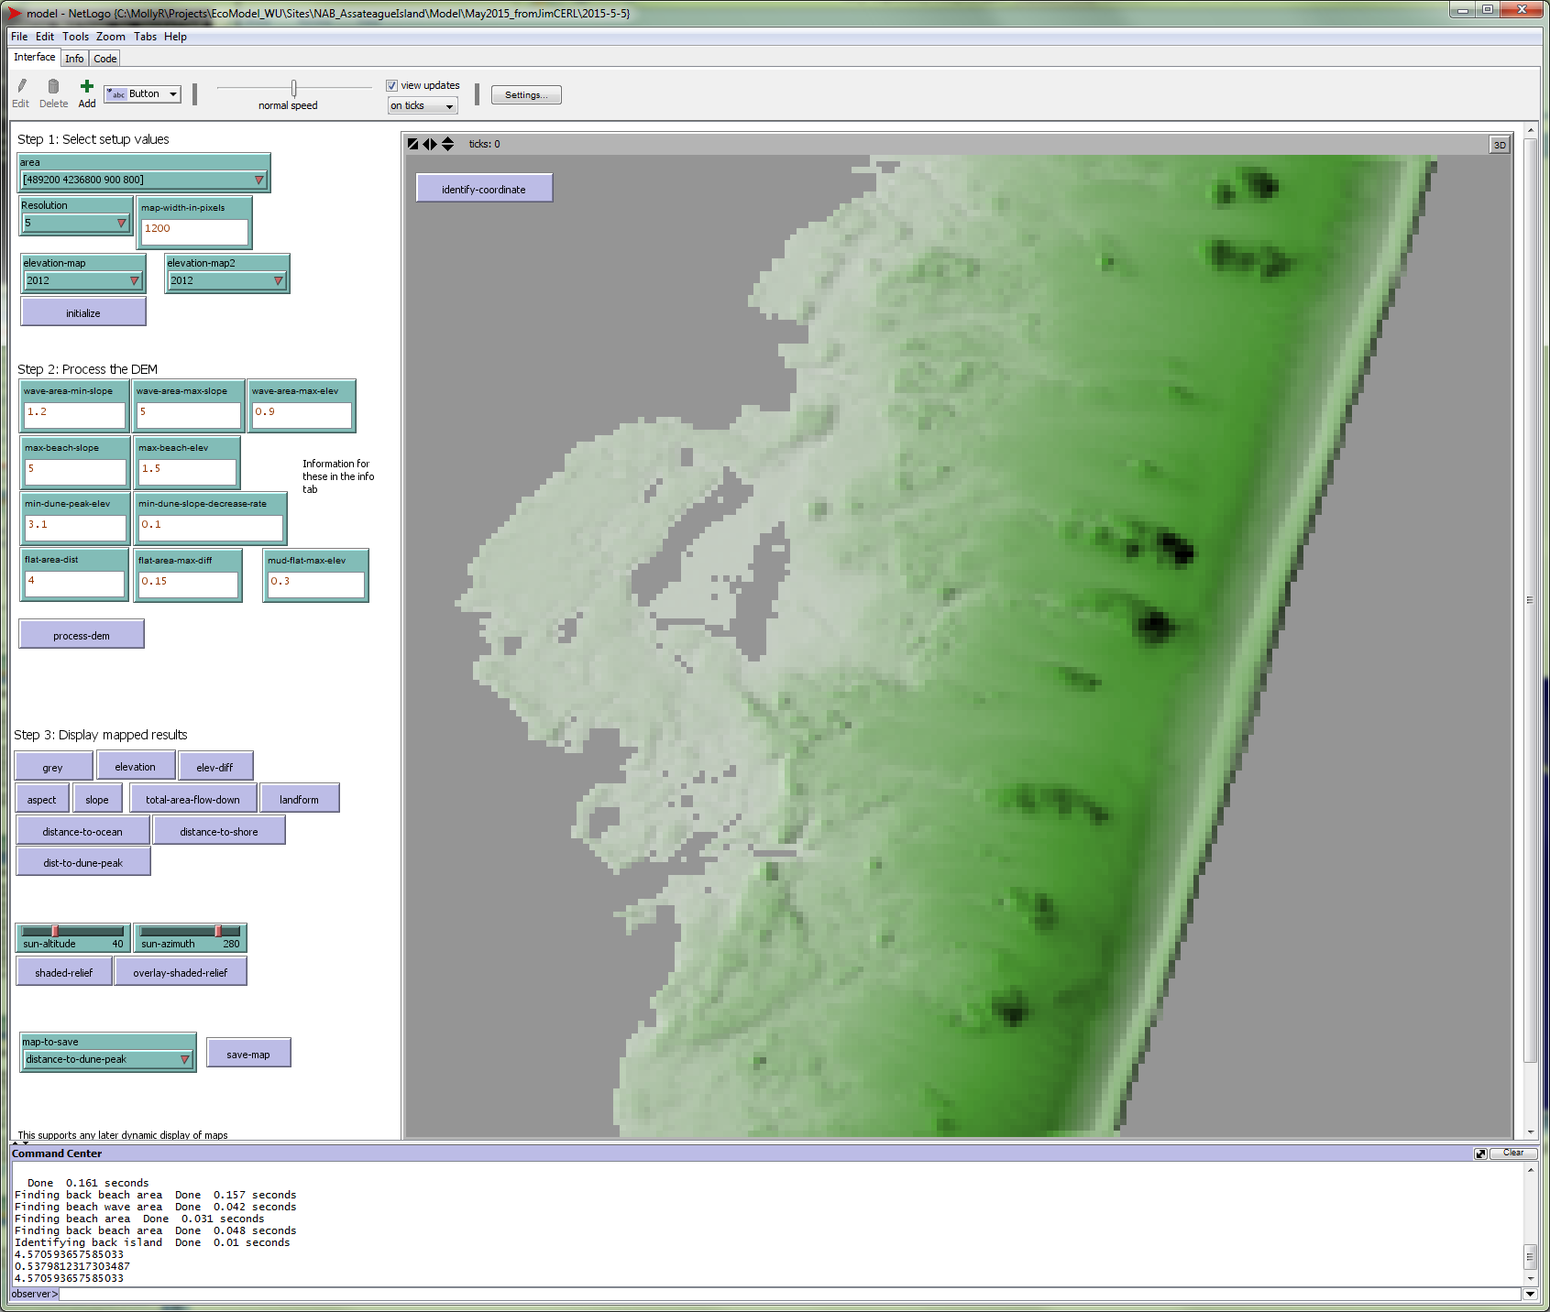
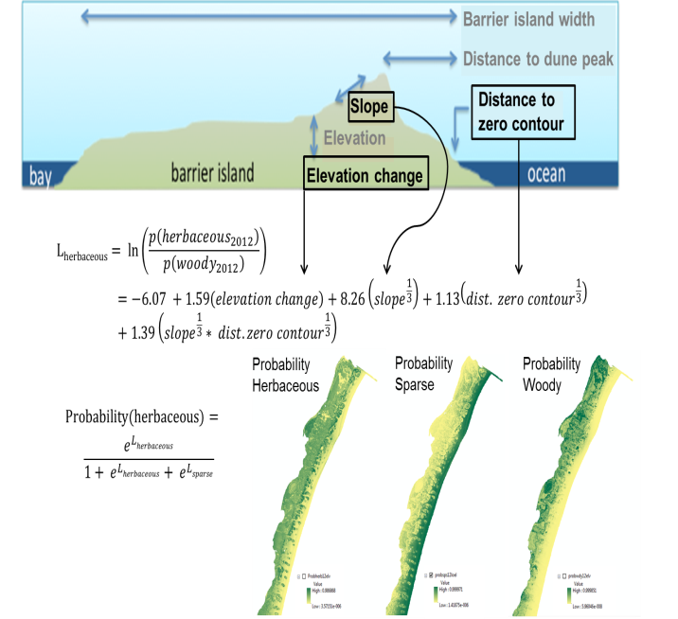
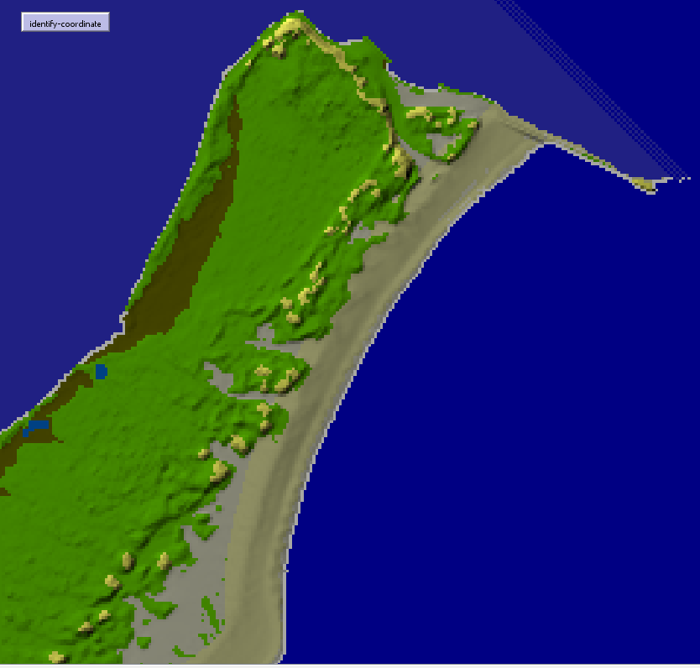
Model Evolution

Slide 18
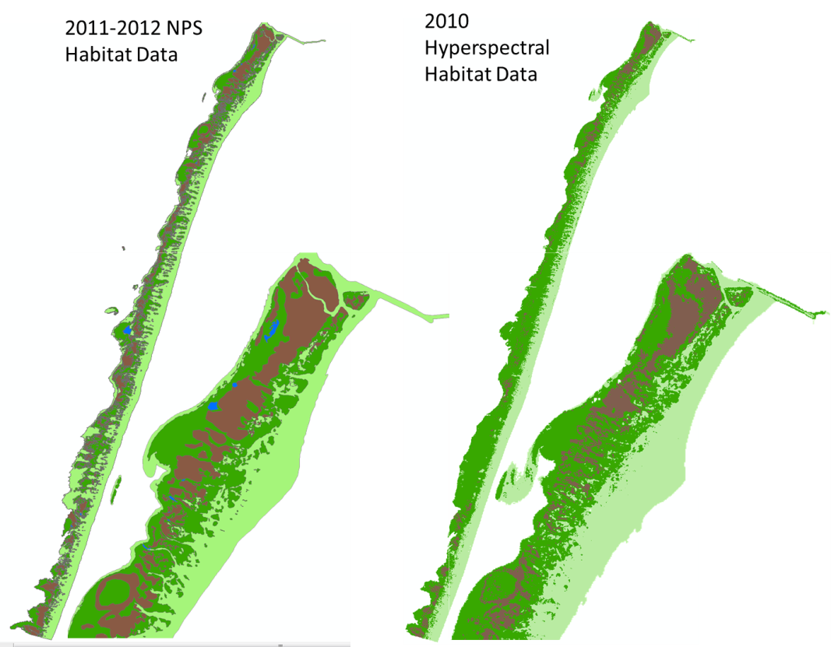
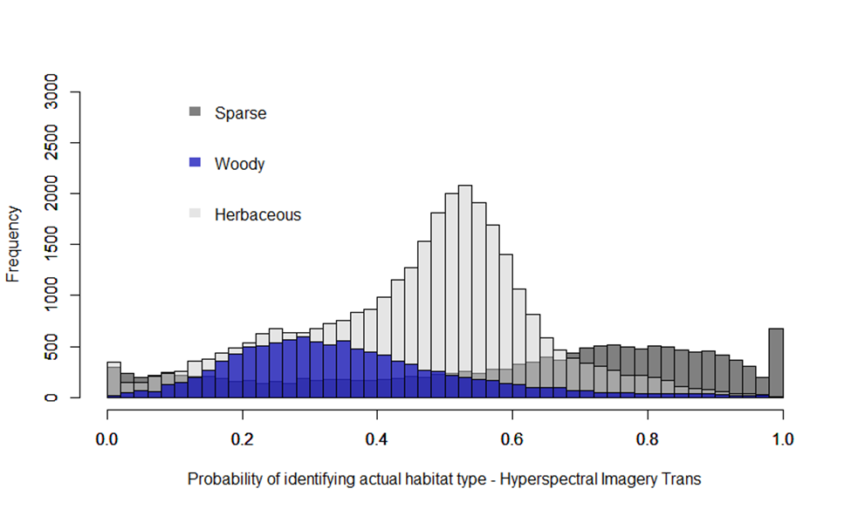
Validation Analysis
  Created additional Hyperspectral dataset to classify habitat types
  Compared habitat probabilities across years and across data type
  Standard statistical and sensitivity analysis
Notes:
issue: NPS polygons may be including multiple habitat types, causing problems for the probabilities particularly for woody and herbaceous; a pixel based classification would provide another point of comparison for results

Slide 19
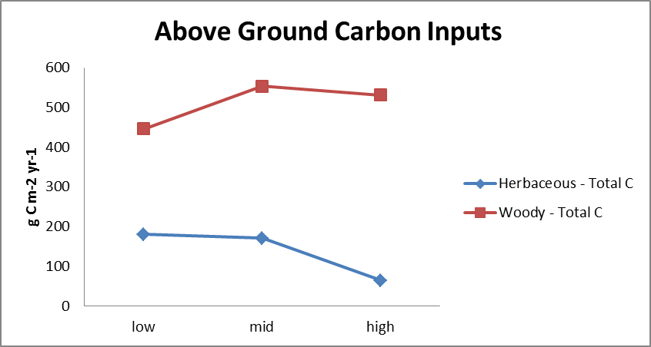
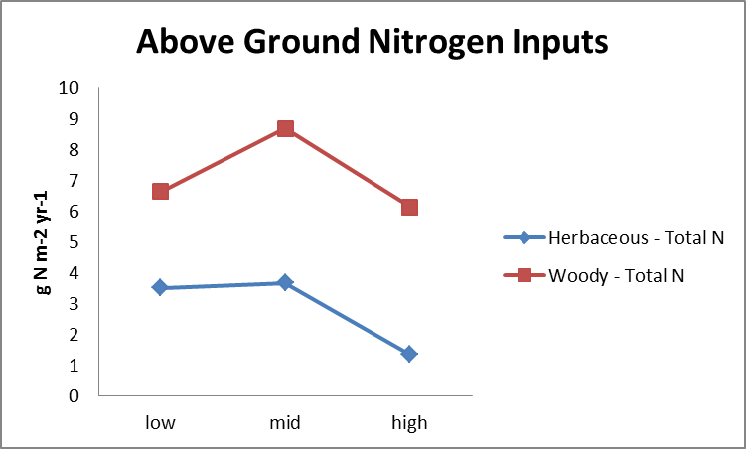
Incorporating Ecological Processes
Site specific analysis of pedogensis and hydromorphology (Rossi, 2015)
Estimates Carbon and Nitrogen sequestration based on habitat and elevation
Notes:
Add N and C figure?

Slide 20
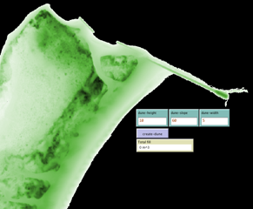
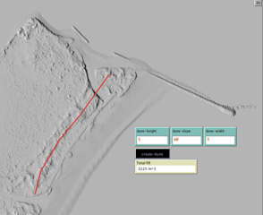
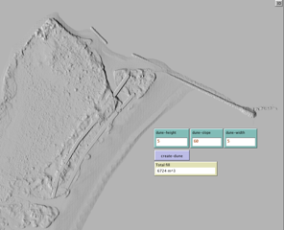
Operations tool
User controlled
  Height, Slope, Width
  Location and Length
Creates feature and new Digital Elevation Model
Updates landscape parameter values, vegetation probabilities, and C and N storage in project footprint
Impact – insert screen shot of change in veg or change in C or N following change in dune
Notes:
This slide will be updated with better visuals and next slide will show simulations and change in N and C

Slide 21
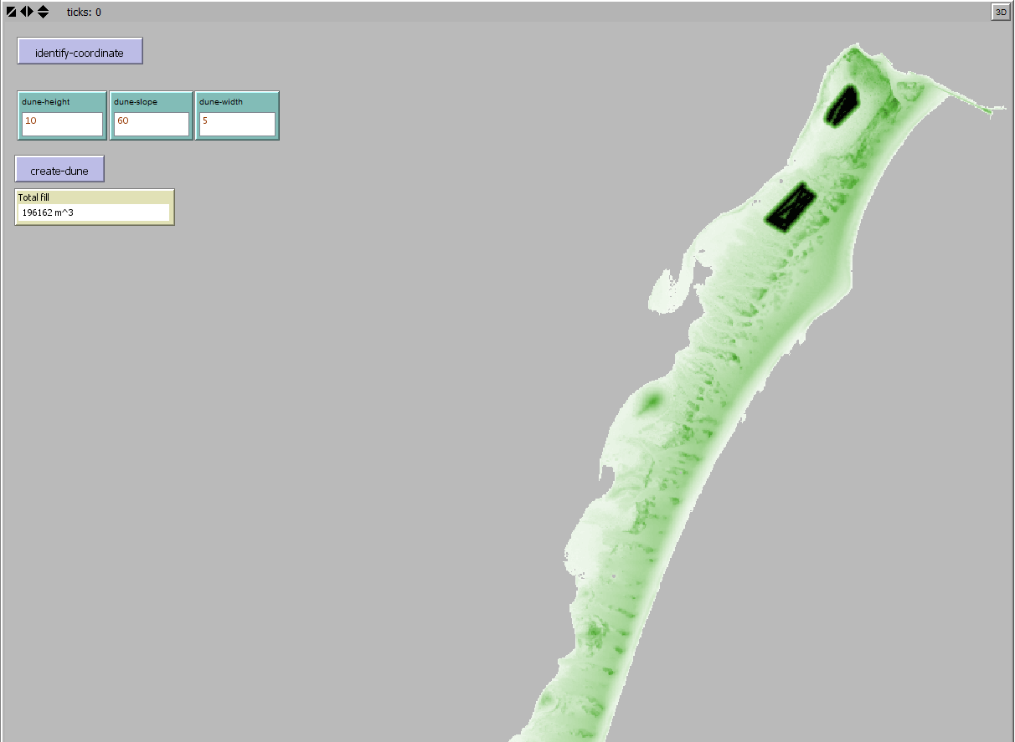
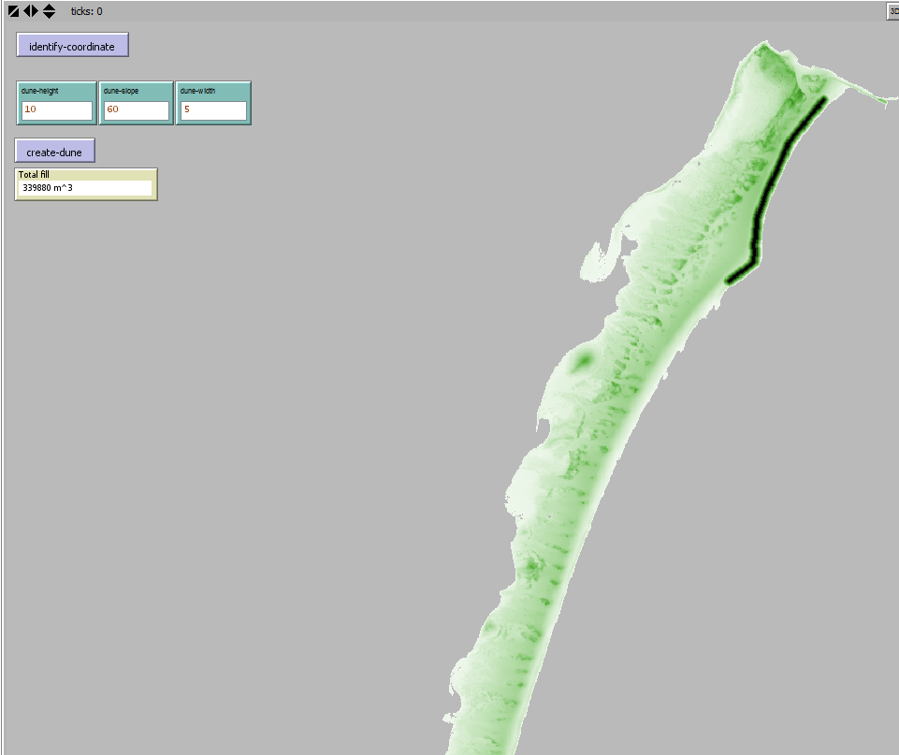
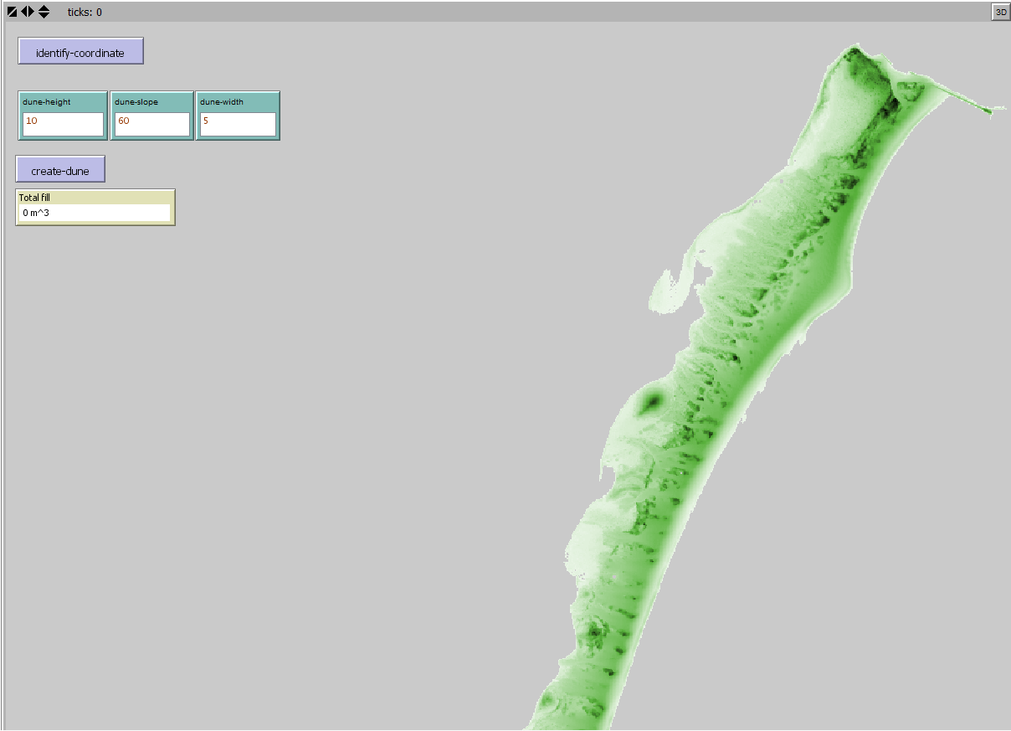
Creating feature
Notes:
Darker color = higher elevation. Can control the dune height, slope, and width. Can also keep track of volume of material used. Left image is baseline. Middle image is increasing elevations inland to create tree islands. Right image is building a dune. Images are in the same order in the next slide.

Slide 22
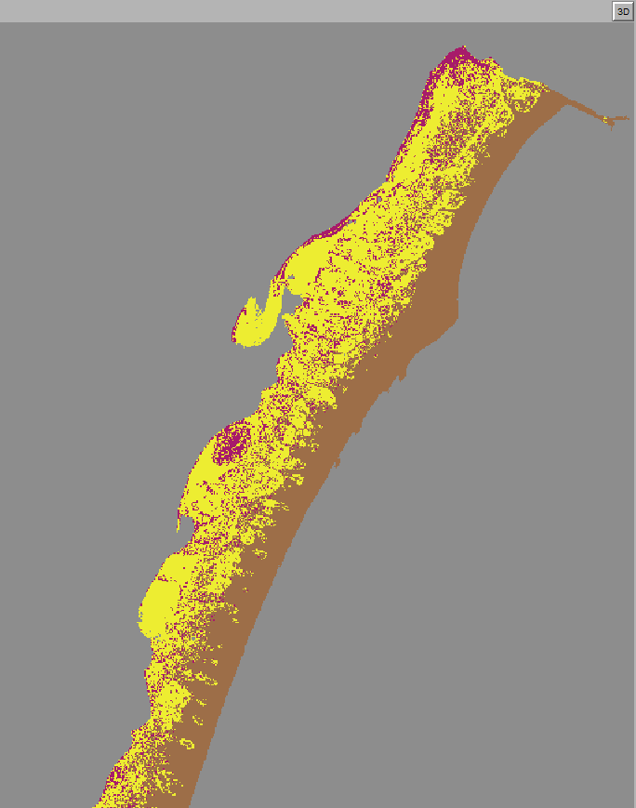
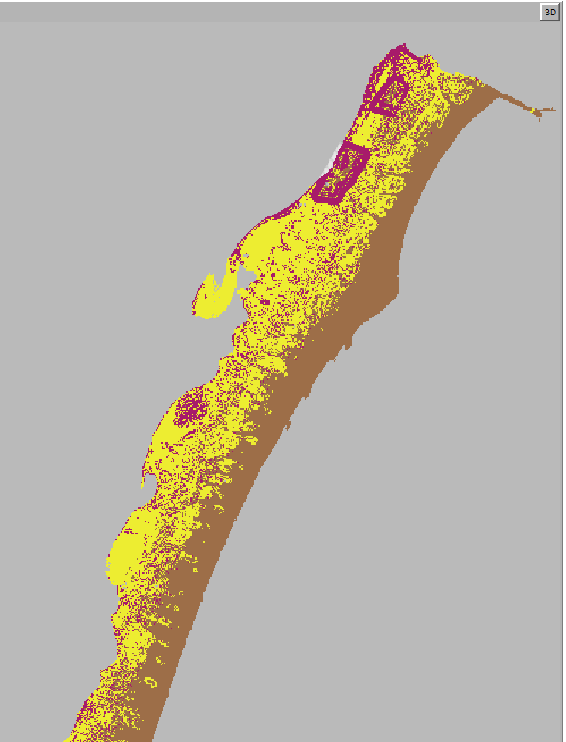
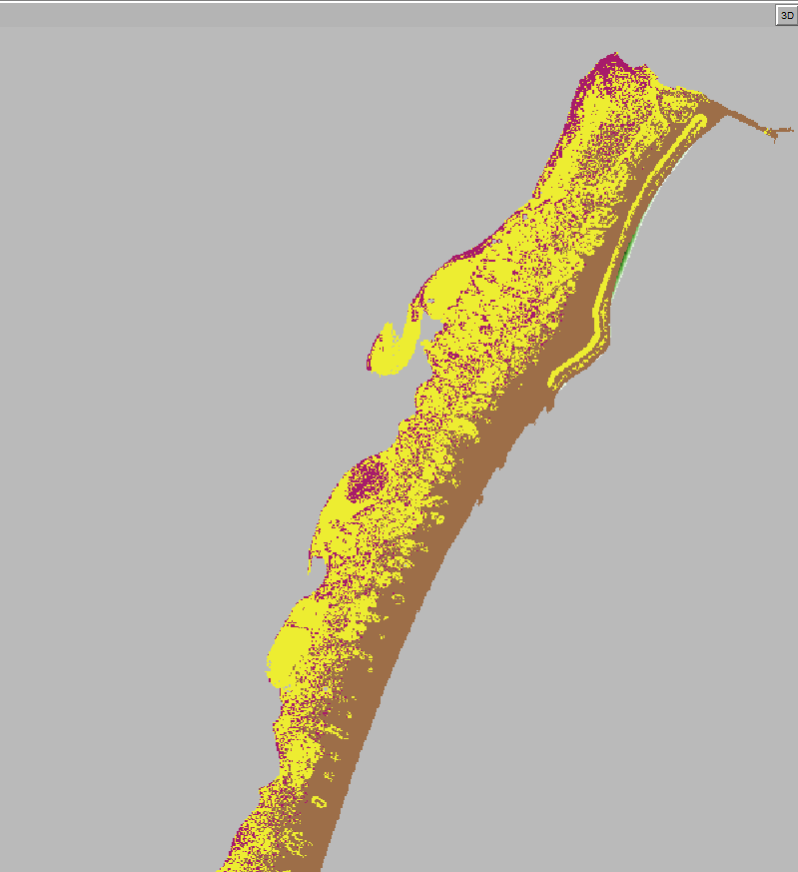
Creating vegetation
Notes:
Purple = woody, yellow = herbaceous, and brown = sparse

Slide 23
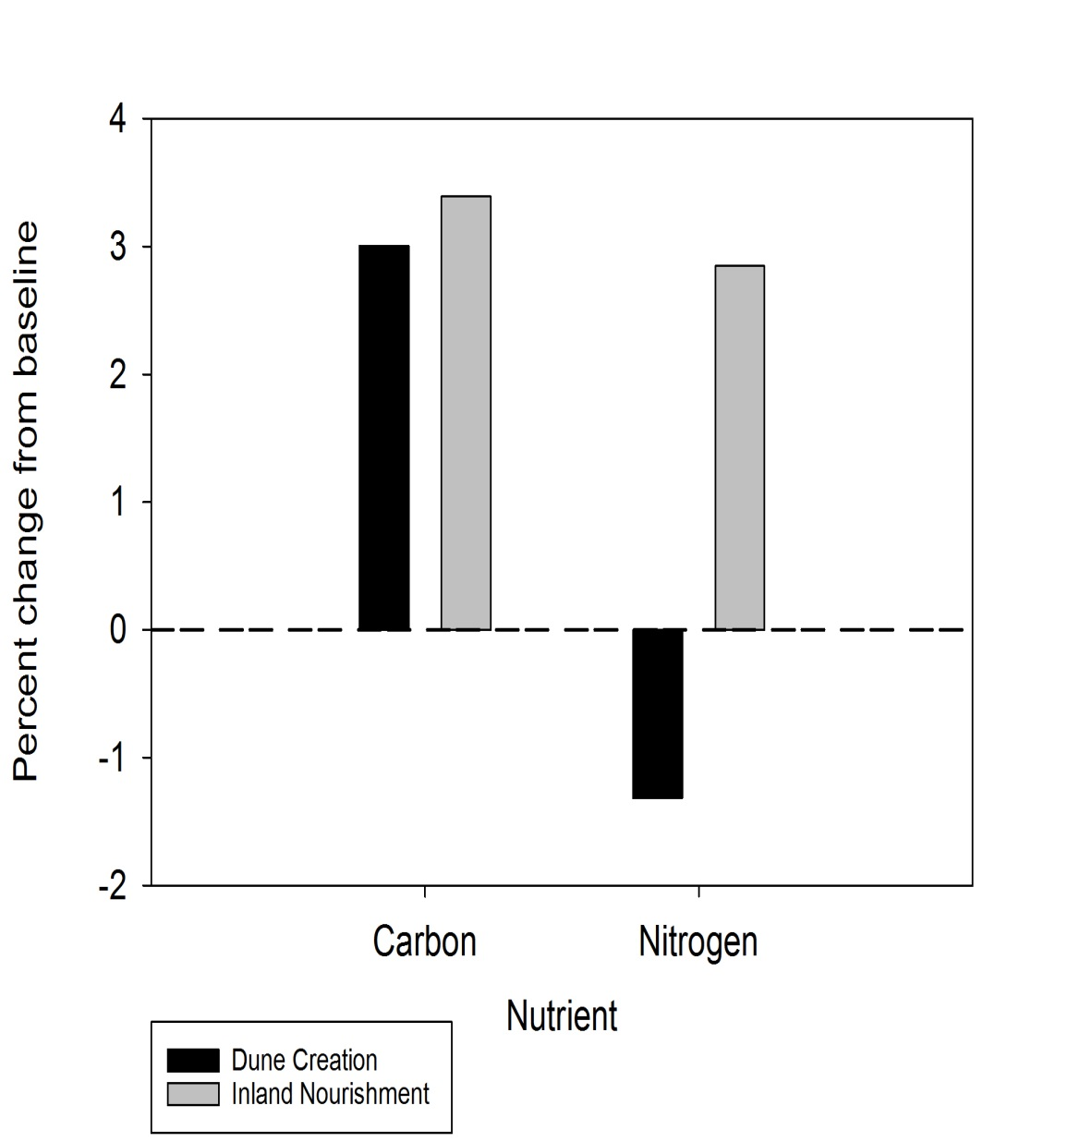
Nutrient sequestration as result of nature-based features on landscape

Slide 24

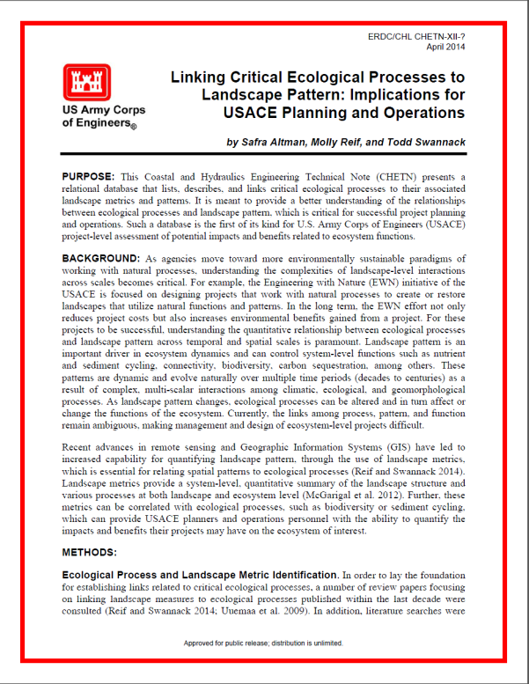
Project Value
  Operations: evaluate potential impacts of operational activities to increase environmental benefit
  Planning: evaluate alternatives and describe benefits/impacts outside of habitat unit creation
  Research & Development: evaluate landscapes for better understanding of ecological impacts
Notes:
This slide will be update with global conclusions, less USACE specific.

Slide 25
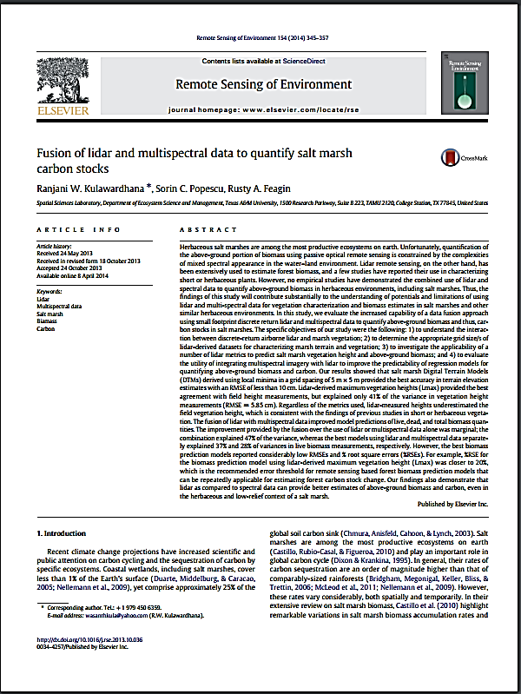
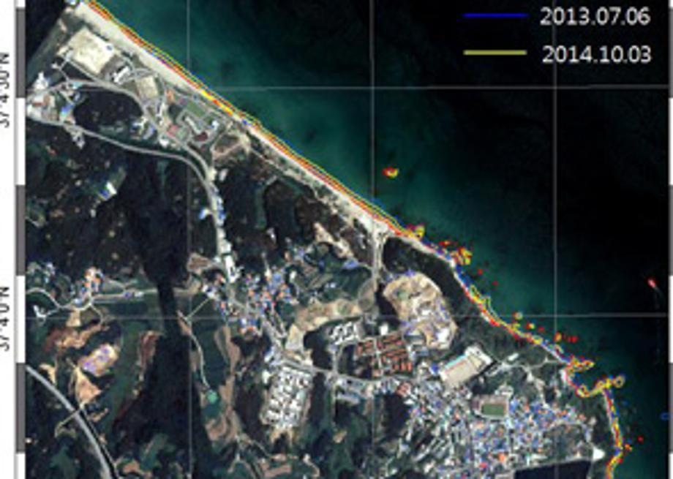
Project Value
Related Research
Carbon sequestration in Salt Marsh (Kulawardhana et. al.)
Balancing ecosystem tradeoffs on the Mekong River (Multiscale Integrated Model of Ecosystem Services, Kaufman et. al.)
Independent development of original technology for the reduction of coastal erosion (KIOST, Jeong et. al.)
Notes:
This slide will be update with global conclusions, less USACE specific.

Slide 26
Project Value
  Operations: evaluate potential impacts of operational activities to increase environmental benefit
  Planning: evaluate alternatives and describe benefits/impacts outside of habitat unit creation
  Research & Development: evaluate landscapes for better understanding of ecological impacts
  Unique: Landscape Ecology Model links metrics, pattern, ecological process and operations
Notes:
This slide will be update with global conclusions, less USACE specific.

Slide 27
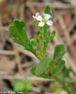

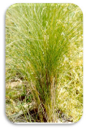

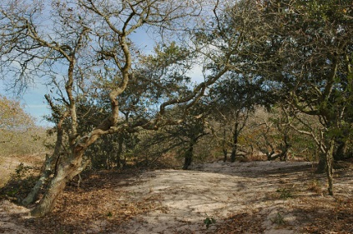
Foredune Vegetation Succession
Sand availability/
Beach Morphology
Distance to dune builder source populations
Disturbance
bare sand
1st Season
Dune initiating plants
Weedy annual colonization
2nd-3rd Season
Dune building plants
Establish/build
4th-5th Season
Stabilizer plants
Build/recruit
c
6th-9th Season
Build/Compete
c
10th-15th Season
Woody Competition
Dune recovery & distance to burial tolerant stabilizer source population
Soil formation and distance to burial intolerant population
Notes:
Dune initiating plants – small grasses or forbs, rapid growth, high salt tolerance, r life history, e.g. Cakile, Sesuvium
Dune building plants – trap and stabilize sand, salt tolerant but less than initiators, a lot of underground biomass and reproduction through cloning, e.g. Ammophila, Unicola, Panicium
Burial tolerant – spartina patens
Burial intolerant – scrubs, shrubs, grasses
Woody plants – quercus (oak), betula (birch) etc.

Slide 28
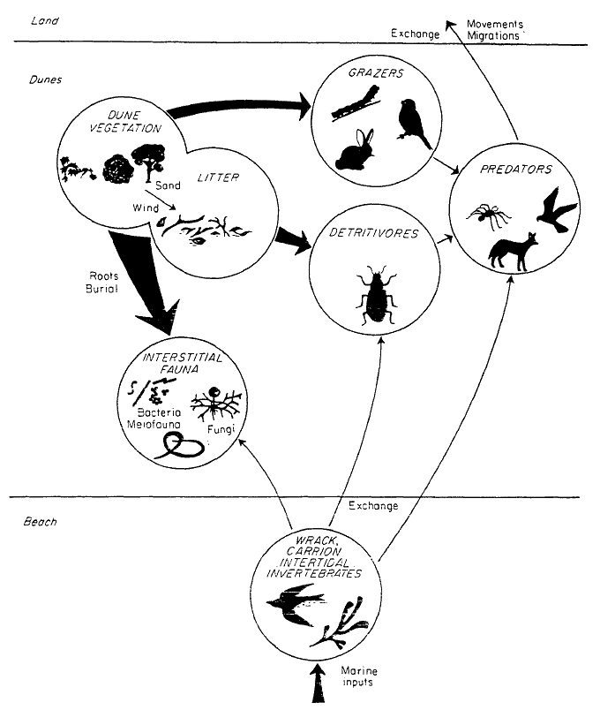

Food Web Dynamics
Vegetation and early succession
Importance of belowground biomass
and microbial community
High diversity and endemism
Connectivity between habitats
Significance of marine inputs
Nesting grounds
Upland
Movements
Migrations
Exchange
Dunes
Grazers
Dune
Vegetation
Litter
Predators
Detritivores
Roots
Burial
Interstitial Fauna
Beach
Exchange
Wrack ,Carrion, Invertebrates
Marine inputs
Modified from McLachlan, 1991
Notes:
High ecological diversity is ‘secret weapon’ for dunes allowing for quick adjustments to changing conditions/disturbance at many scales
Impact of grazing is threefold: 1) grazing act and selective damage to plants, 2) feces leads to soil enrichment, 3)trampling damage. Grazing pressure helps determine plant species composition/diversity.

Slide 29


Role of vegetation in dune storm response and recovery
from Wolner et al., 2013
Vegetation & storms
  Dune erodibility
    Root reinforcement of dunes
    Mycorrizhal fungi
    Organic matter
    Surface protection
  Wave attenuation
Vegetation & dune recovery
  Trapping wind-blown sand particles

Slide 30

Acknowledgements
  Tosin Sekoni, US Army Environmental Laboratory
  Eric Gulledge, Jackson State University
  USACE Baltimore District
  U.S. National Parks Service
Questions??
Barry Long, 2012

