Slide 1
Sediment Retention Characteristics of Tidal Marshes
Brandon Boyd
Coastal and Hydraulics Laboratory, USACE-ERDC

Slide 2
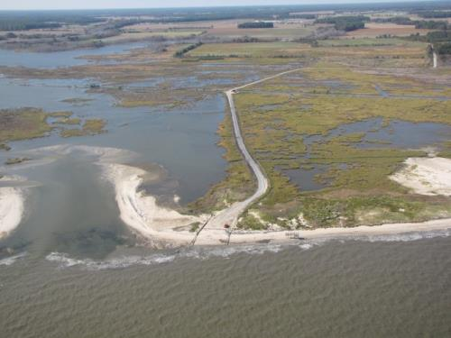
Past Research
Effect of hydroperiod and SSC on vertical accretion (10s to 100s years)
Impounded Unit II
Tidal
Unit I
Accretion dynamics of hydraulically manipulated marshes (10s to 100s years)
Credit: US FWS/ Prime Hook NWR

Slide 3
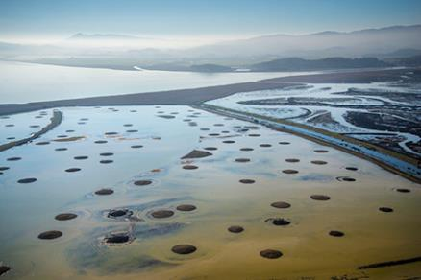
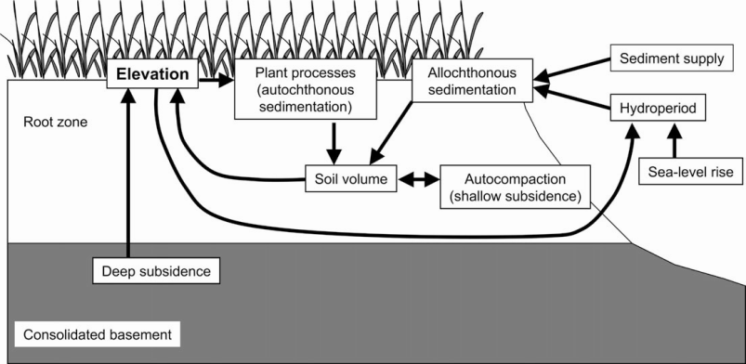
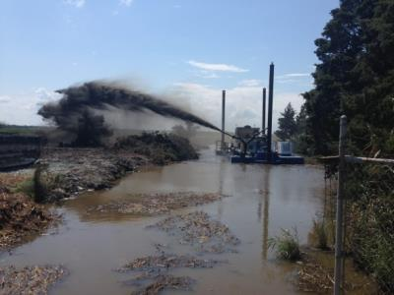
Current Research
Sediment capture and retention ability of restored marshes
How does the accretionary process change over time?
Does it differ based on level of manipulation?
Tidal Range
French (2006) Modified from USGS (1997)

Slide 4
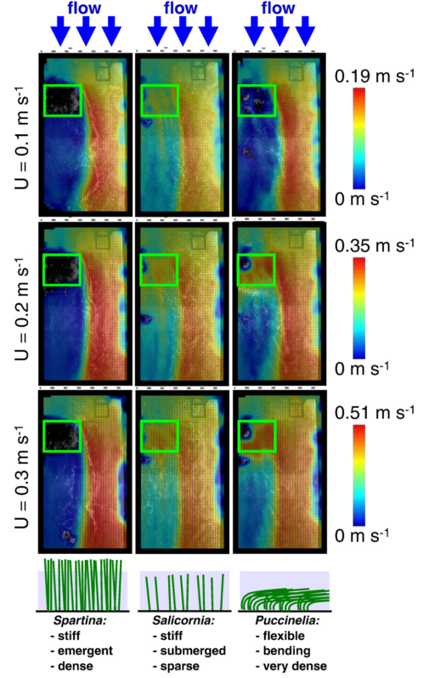
Short time- and small spatial scale
Time: Tidal cycles and storms to years
Distance: near and sub surface
Spartina alterniflora core
Washed Unwashed
(Nyman et al. 2006)
Tidal Range
French (2006) Modified from USGS (1997)
Bouma et al. (2012)

Slide 5
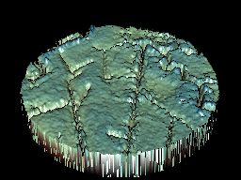
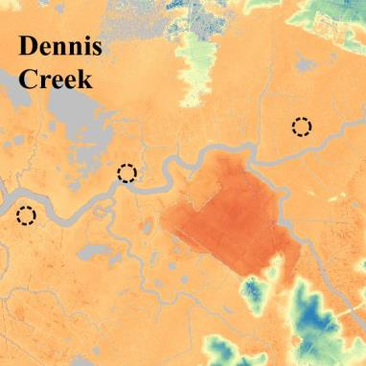
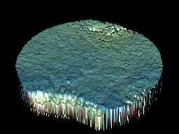
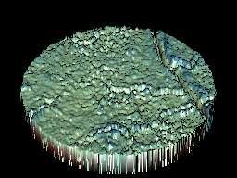
How does variation in topography/hydrology affect soil development?
Decadal time- and 1m-1km spatial scale
Time: years to decades
Distance: Tidal creek to high marsh
Site elevation

Slide 6
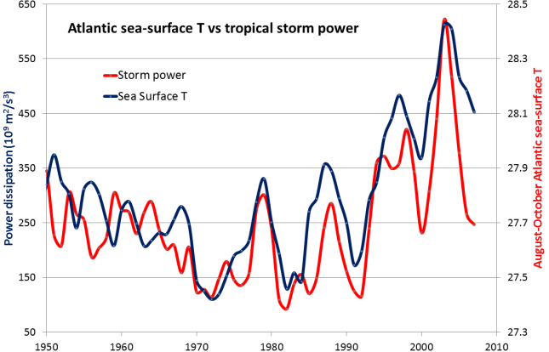
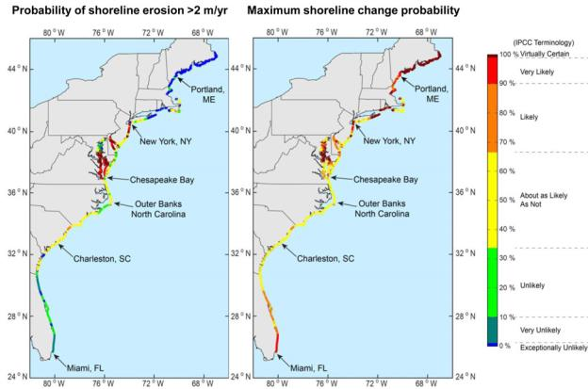
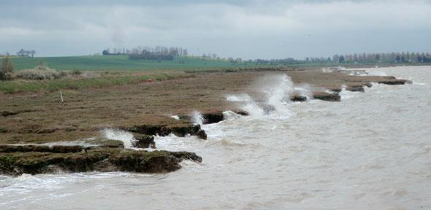
Centurial time- and 10-100km spatial scale
Storm intensity and landfall
Edge erosion
Wind, storm, and ship wave erosion
Freshet and storm SSC

Slide 7
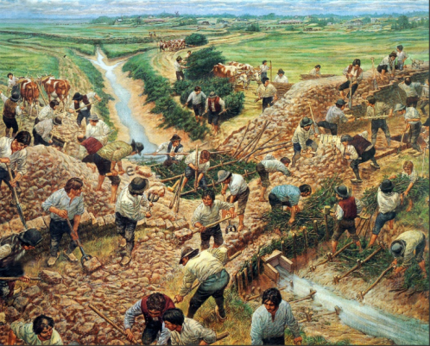
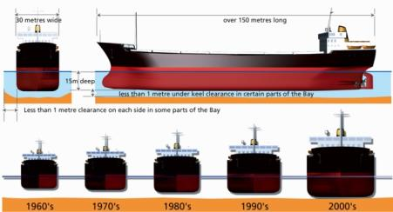
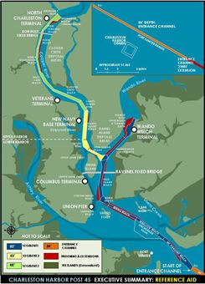
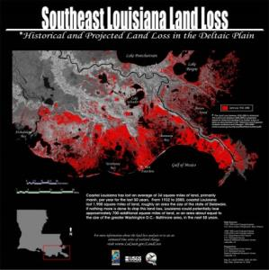
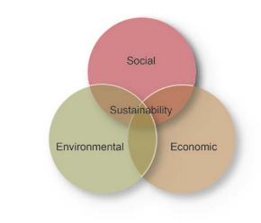
Post 45 Deepening
Charleston, South Carolina
Acadians building dykes and aboiteaux at Grand Pré, shows the collaborative building of dykes at Grand Pré c. 1750 (Lewis Parker)
Past
Present
Future ?

