Slide 1

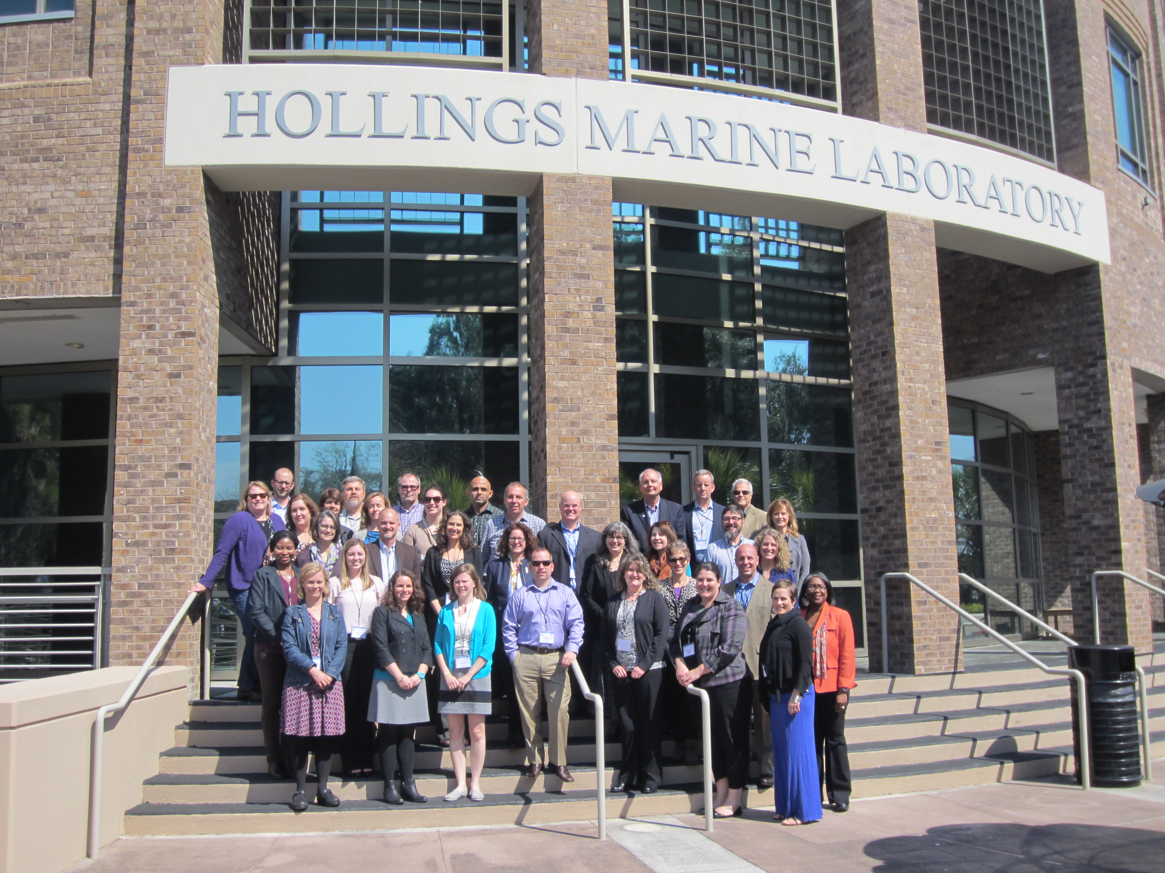
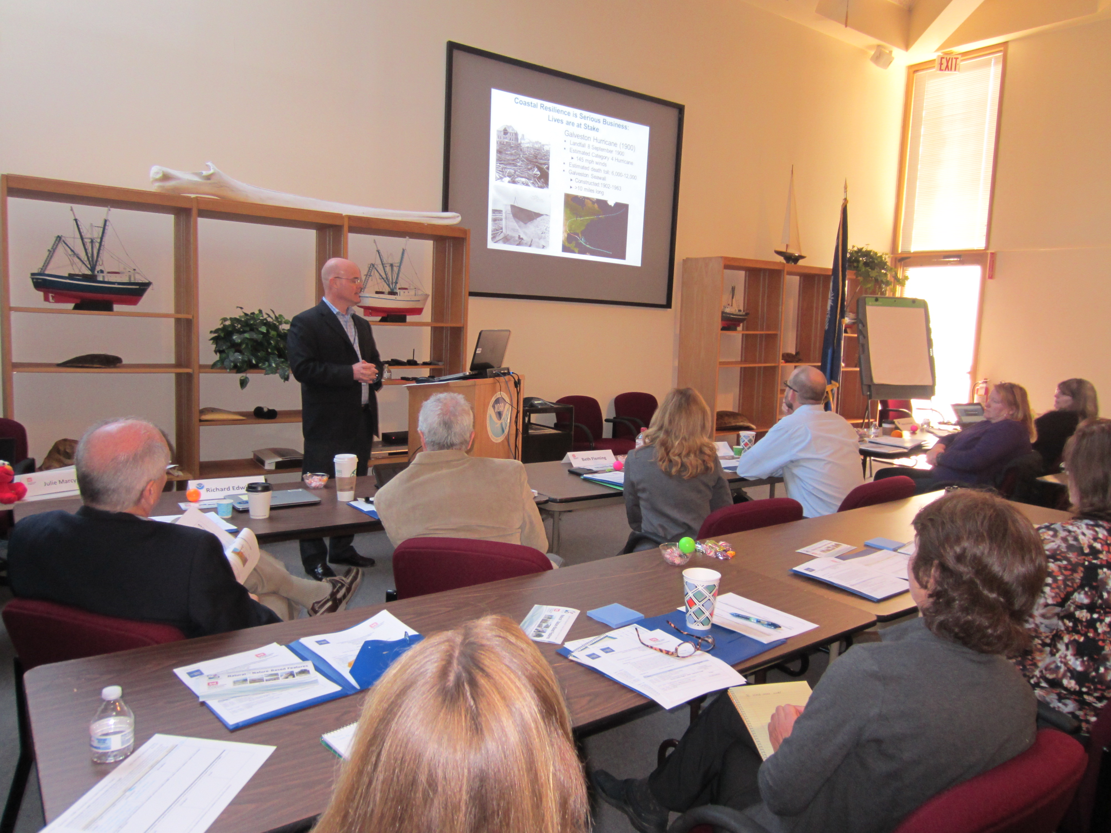
USACE – NOAA Collaboration Workshop on Natural and Nature-Based Features Charleston, SC; 1-3 March 2016
www.engineeringwithnature.org (NNBF)

Slide 2
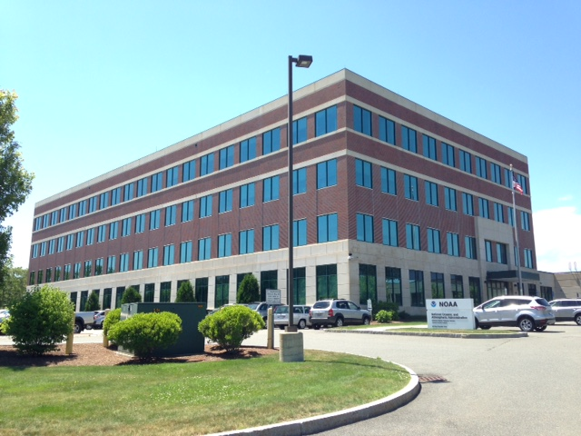
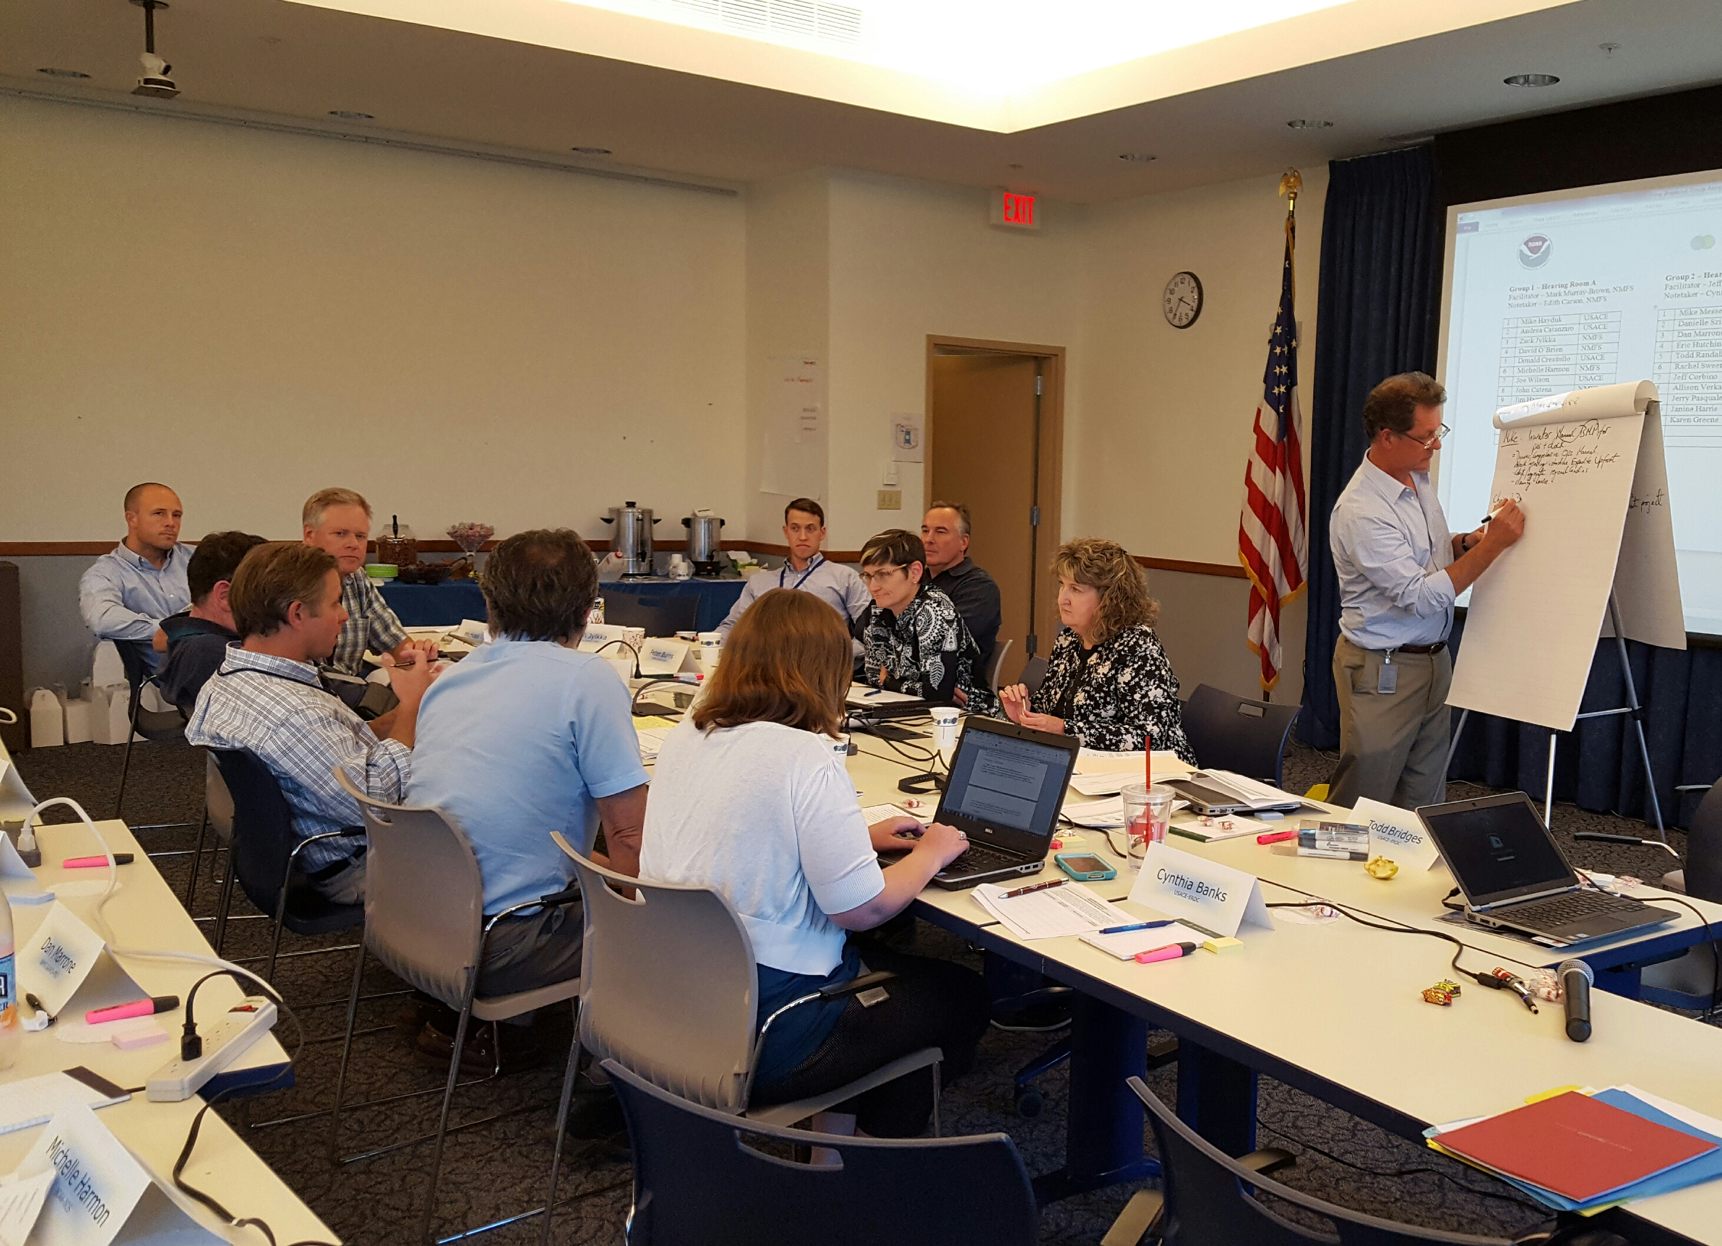
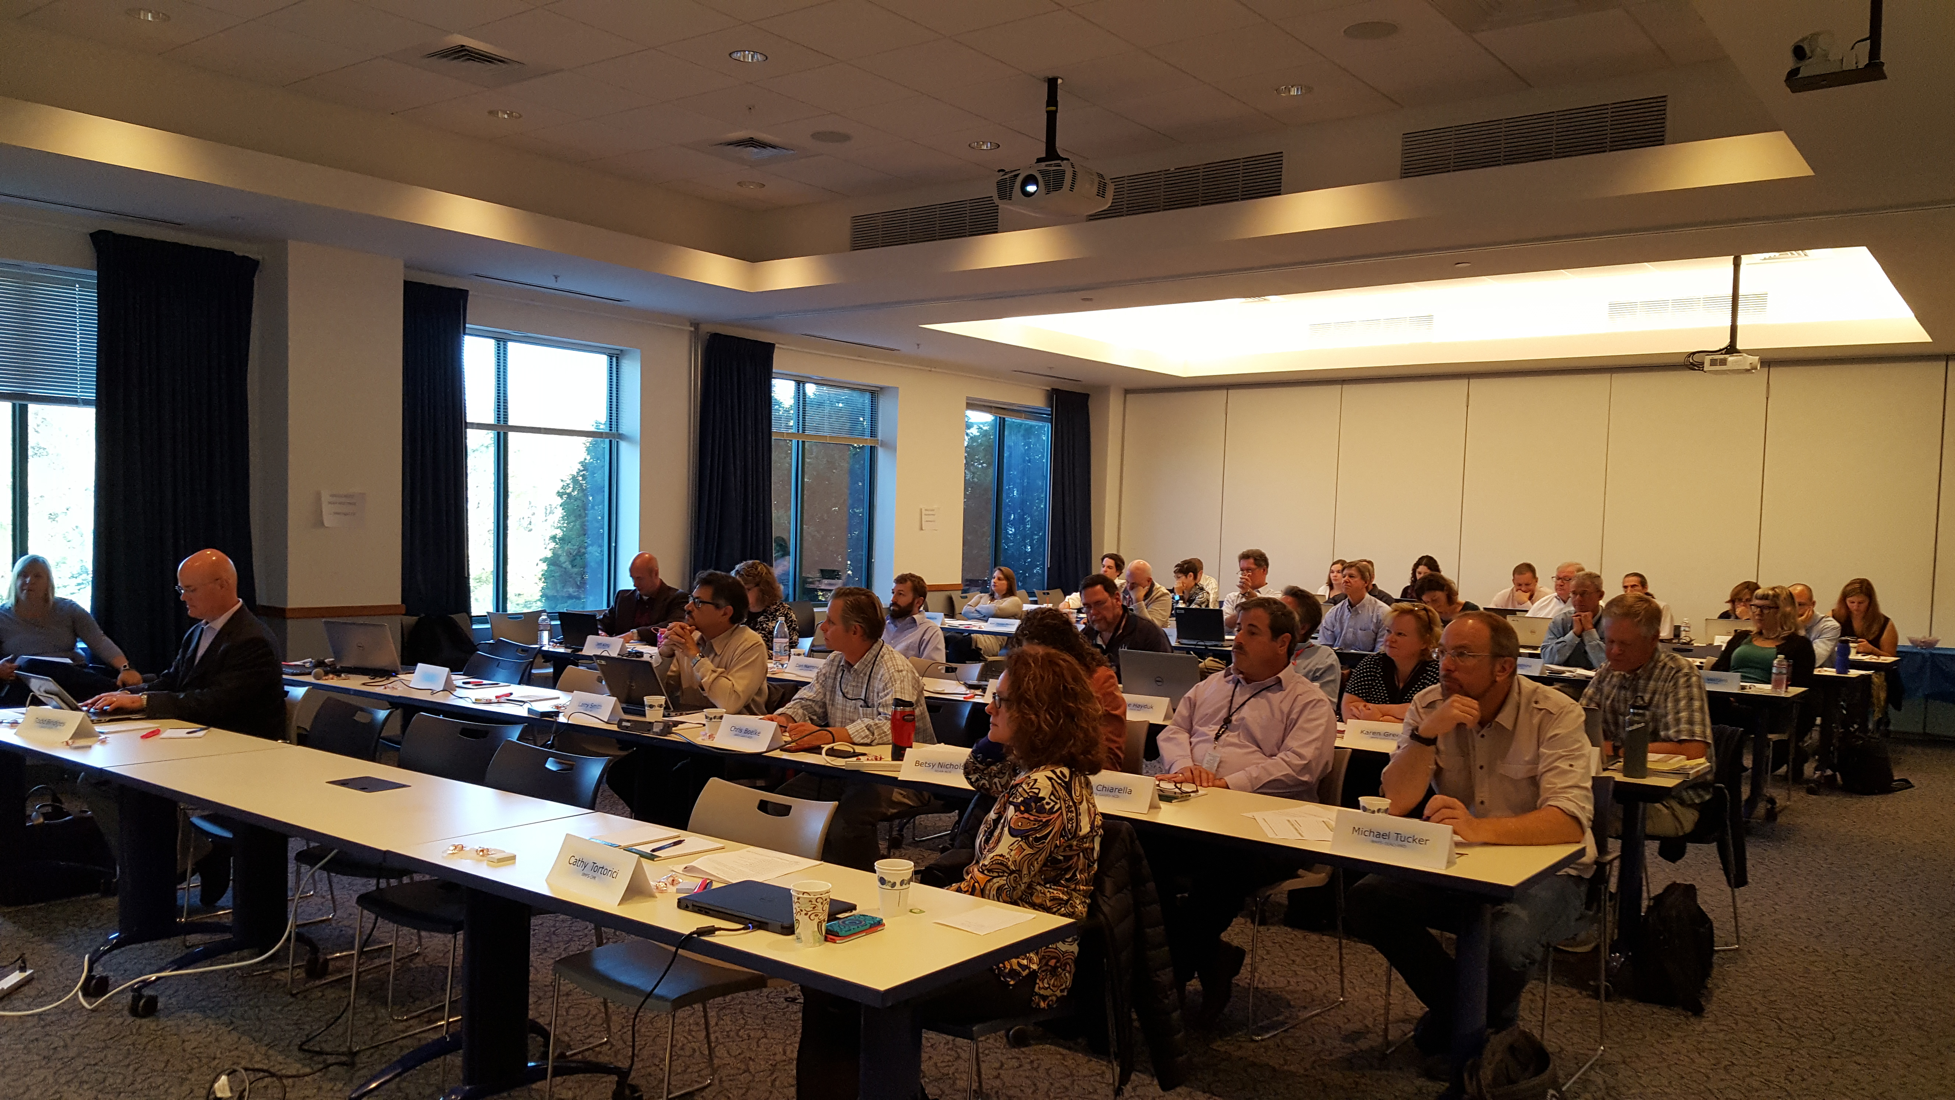
USACE/NOAA-NMFS Collaboration Workshop on Engineering with Nature Gloucester, MA; October 5-6, 2016
www.engineeringwithnature.org

Slide 3
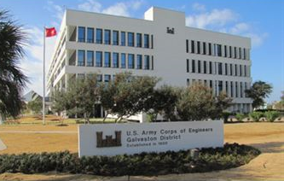
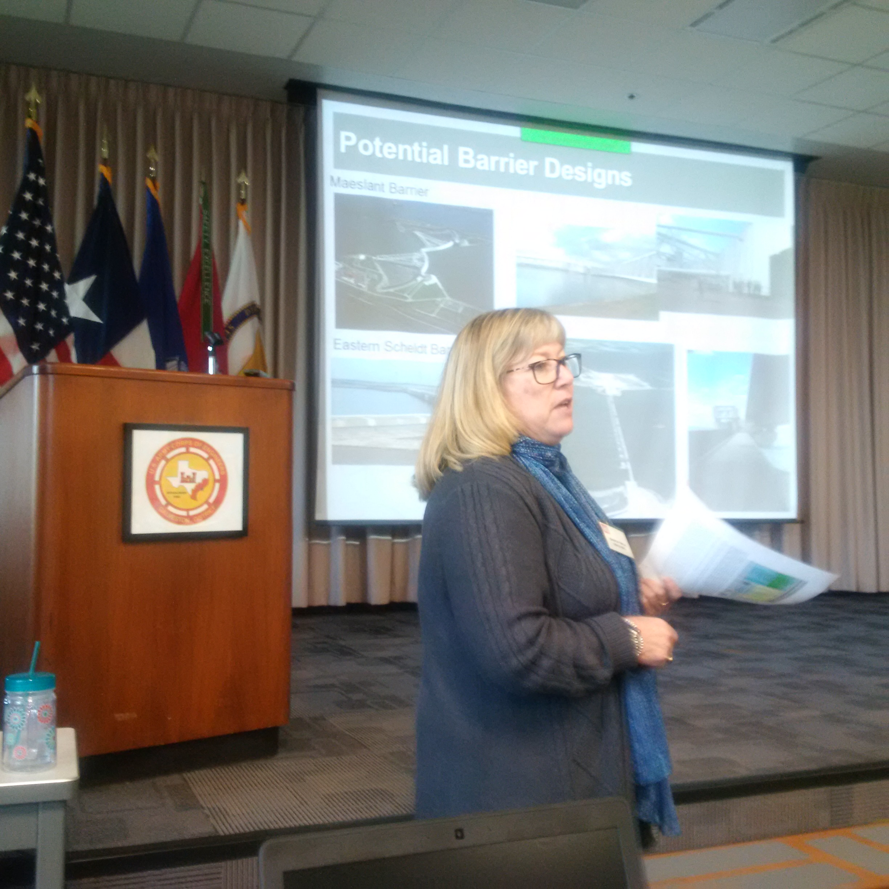
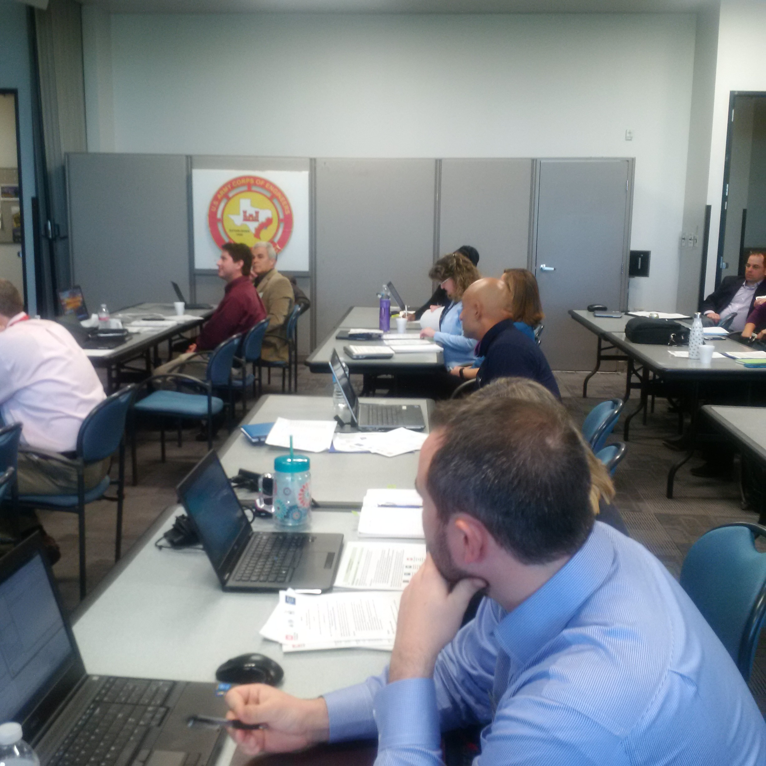
USACE (SWG and ERDC) and NOAA
Collaboration Workshop on Nature and Nature-Based Features (NNBF) Galveston, TX; February 23, 2017
Notes:
Third USACE/NOAA Collaboration Workshop on Natural and Nature-Based Features (NNBF) over the last 12 months.
Attended by 24 participants representing USACE (Galveston District and US Army’s Engineer Research and Development Center) and NOAA’s National Ocean Service (Office for Coastal Management and National Centers for Coastal Ocean Science), and National Marine Fisheries Service (Restoration Center).
Participants included leadership at numerous levels, a variety of roles in USACE and NOAA, and diverse disciplines and programmatic backgrounds.
During the 1-day workshop, the participants gained a greater understanding for how missions are executed and for ongoing/future-anticipated, NNBF-related work within the respective agencies.
The workshop included plenary and breakout group (comprised of a mixture of USACE and NOAA participants) discussions. These discussions resulted in the identification of areas where the two organizations could collaborate along the Texas Coast to address information gaps and advance practice on NNBF.

Slide 4
Potential Collaborative Ideas Identified During SWG Workshop
1. Matagorda Bay West Foreshore Island and Wetland Creation
2. Galveston Bay Subaquatic Ecosystem Restoration
3. South Padre Island Sand Engine and Placement
4. Jefferson County Large Scale Shoreline and Marsh Restoration
5. Creation of Breakwaters along the Galveston Intracoastal Waterway
6. Island and NNBF Creation within Mission Aransas NERRs
7. Identification of Data Gaps Across Agencies with Implementation of Methods
to Improve Data Sharing
Notes:
NNBF-related projects and activities within USACE’s Galveston District were identified as potential opportunities for coordinated action to address the gaps. Workshop participants developed for consideration an initial list of specific, collaborative opportunities within a portfolio that included a mix of more than 25 near to long-term efforts. Specific examples of NNBF project collaboration opportunities in Galveston District included, but were not limited to:
1. Matagorda Bay West Foreshore Island and Wetland Creation
2. Galveston Bay Subaquatic Ecosystem Restoration
3. South Padre Island Sand Engine and Placement
4. Jefferson County Large Scale Shoreline and Marsh Restoration
5. Creation of Breakwaters along the Galveston Intracoastal Waterway
6. Studies of Mission Aransas NERR Beneficial Use Site(s) and Associated NNBF
7. Identification of Data Gaps Across Agencies with Implementation of Methods to Improve Data Sharing
* Mission Aransas NERR / Aransas NWR area holds great potential for leveraging NOAA resources through NERR (Research Reserve) and implementing EWN resilience measure to reduce existing threats and protect coastal marsh, mangroves, and T&E Species. Island Creation is a “Go Big” EWN Opportunity that would generate engineering and ecosystem services benefits.

Slide 5
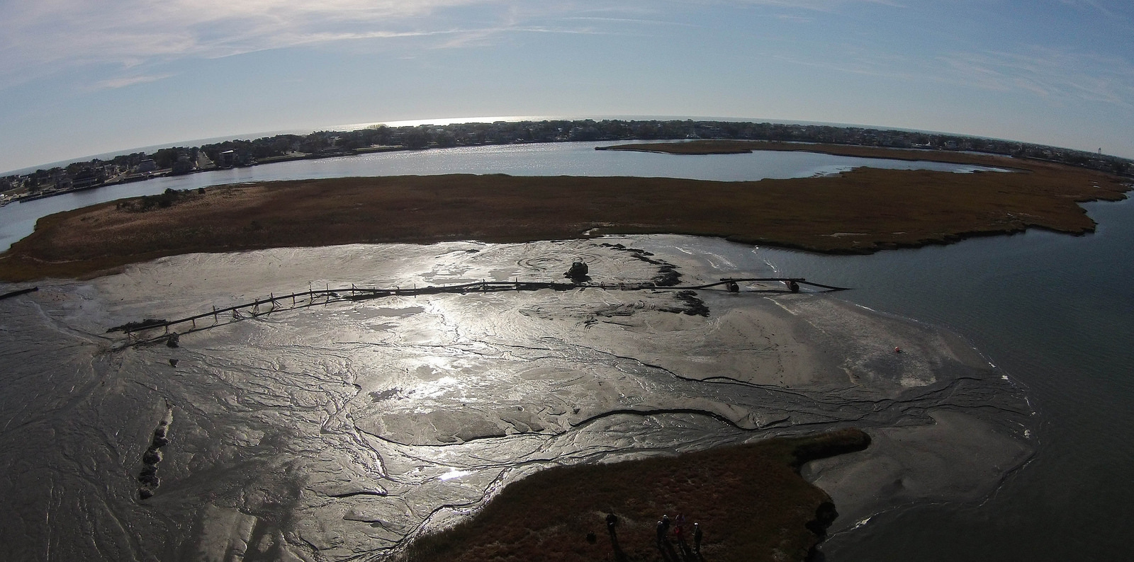
Example Collaboration Initiative: Philadelphia District, ERDC, NOAA
Mordecai Island
Notes:
Example of Existing Partnership with NOAA and how a similar project can develop “Win/Win” Outcomes for Both Agencies. Develop something similar in SWG.
NOAA-NCCOS is prioritizing the program office research portfolio by approving $320K to monitoring of Mordecai to better understand ecosystem service benefits derived from restoration effort. Also, provides much needed monitoring and adaptive management to Corps District while providing data that will inform future island creation/restoration projects.
NAP constructed project and provides engineering, logistics and PAO support.
ERDC-EL provides EWN science/engineering support as well as project oversight/connectivity for partnership; also providing taxonomic identification of benthic invertebrates.

