Slide 1
Coastal Science and Engineering Collaborative (CSEC) Overview Flood Risk Management RARG
Rob Thomas, P.E.
USACE, Galveston District
9 MAR 17

Slide 2
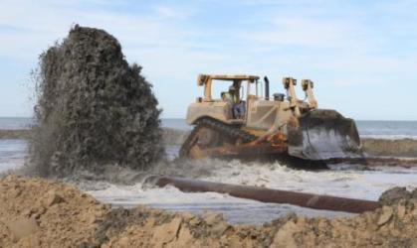
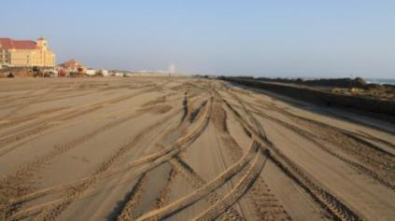
Presentation Overview
Why CSEC?
CSEC Organization
Ongoing Activities
Approach to Statements of Need

Slide 3
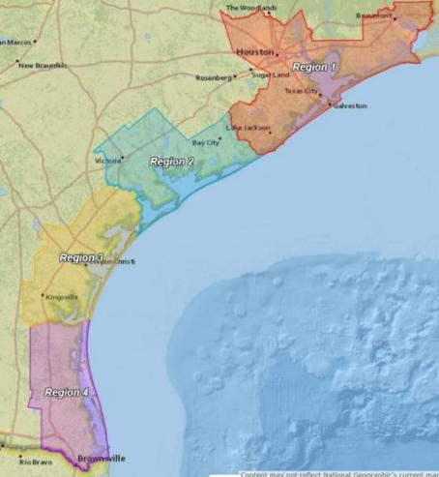
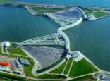
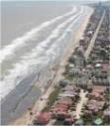
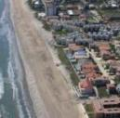
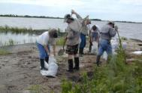
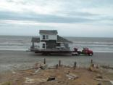
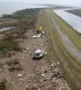
Texas Coast Problems and Opportunities
Economic damage from coastal storm surge
!
Inland shoreline erosion
EROSION
Gulf shoreline erosion
Loss of T&E Critical Habitats
(migratory bird habitat, critical T&E habitat, shellfish habitat)
Loss of Natural Delta Processes
Disrupted Hydrology
Notes:
Why should we do this?
Our reach exceeds our funding.

Slide 4
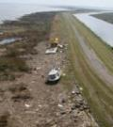
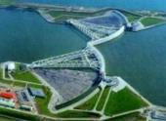
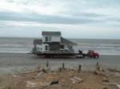
CSEC Objectives
Transfer new science into practice faster
Deliver science and engineering to improve coastal project life cycle systems performance and cost
Develop business collaboratively
Bring together capabilities, resources, and funding from multiple partners for an overall greater value than could be achieved separately
Link academics to practice
Student learning experiences
Cultivate recruiting opportunities
Notes:
What do we hope to gain.
Leading the Coastal Engineering Practice

Slide 5
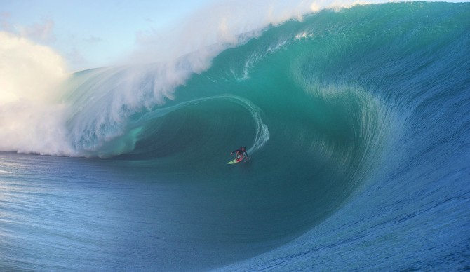
What are we really trying to do?
Build a better Texas Coast
Better prioritize R&D to accomplish that goal
Focus innovation
Hire and build better engineers
Lead Coastal Engineering on the Texas Coast
Notes:
What do we hope to gain.
Leading the Coastal Engineering Practice

Slide 6
CSEC Collaborators
Galveston District (SWG)
Engineering Research and Development Center (ERDC)
Texas A&M University (TAMU)
DELFT University of Technology (TUDELFT)
TX General Land Office (TGLO)
City of South Padre Island (SPI)
US Geological Survey (USGS)
And growing…
Notes:
Discuss formal recognition of csec here

Slide 7
Funding Model
Industry & Others
Galveston District Projects
Immediate project needs funded directly
ERDC/HQ Funded Research
Driven through SONs and personal relationships
TAMU Research
Driven through the BIA and personal relationships
Research letters of support
Others
State and local govt
Industry
Fund TEES
TAMU
CRADA
ERDC
CESU
MIPR
SWG
Notes:
TEXAS A&M ENGINEERING EXPERIMENT STATION (TEES)

Slide 8
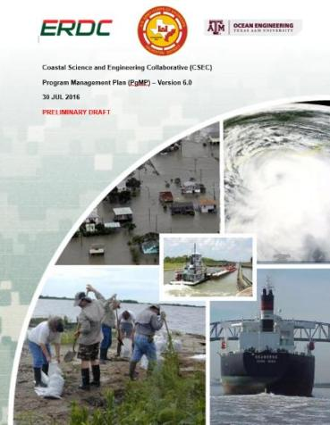
CSEC Program Management Plan
Under Development
Vision
Intent
Strategy
Approach
Goals
Objectives
Intended Capabilities and Products
Path forward

Slide 9
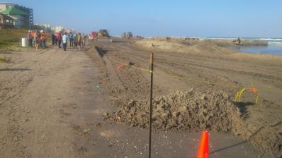
CSEC Workshop Series
Held workshops in AUG and NOV 2016 with next this week!!!
Purpose: Explore and establish common interests for partnering on coastal science and engineering academics, research and development, and practice, for timely infusion of innovative technical products to support lifecycle coastal infrastructure systems management decisions in practice.
Objectives:
Become familiar with each others’ organizations and their future directions
Identify crossover working relationships in coastal science and engineering
Develop a partnering value proposition for achieving mutually held objectives
Identify action items for joint organization follow up with future event planning

Slide 10
Application Focus Area (AFA) 1: Discovering breakthrough science
Statements of Need
(17-F-8) Biophysical System Performance of Natural and Nature Based Features (NNBFs) for Coastal Storm Risk Management (CSRM) SMART Planning Studies.

Slide 11
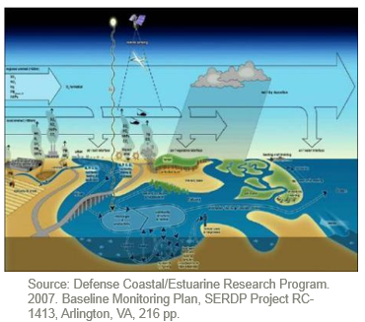
Application Focus Area (AFA) 2: Understanding of flows and circulation of river, estuary, and coastal waters, sediment, and nutrients, with interactions on morphological evolution.
Statements of Need
(17-F-9) Biophysical System Performance of Natural and Nature Based Features (NNBFs) for Coastal Storm Risk Management (CSRM) Pre-Construction, Engineering, and Design (PED)

Slide 12
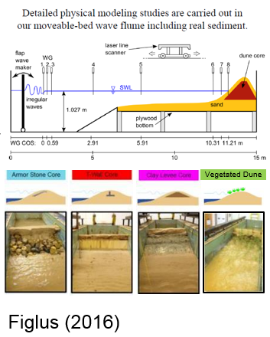
Application Focus Area (AFA) 3: Understanding the future of coastal engineering material properties.
Statements of Need
(17-N-11) Vegetated Stabilization of Erodible Clay Dike for Protection of Dredged-Material Placement Areas

Slide 13
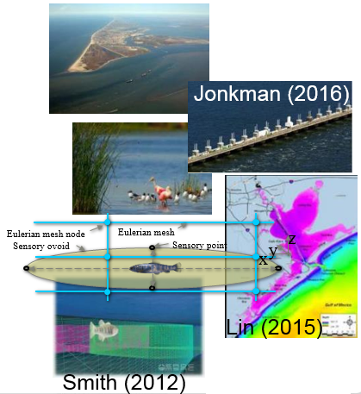
Application Focus Area (AFA) 4: Advancement of reduced order model techniques.
Statements of Need
(17-F-10) Lifecycle Adaptive Management of Biophysical System Performance for Constructed Natural and Nature Based Features (NNBFs) in Coastal Storm Risk Management (CSRM)

Slide 14
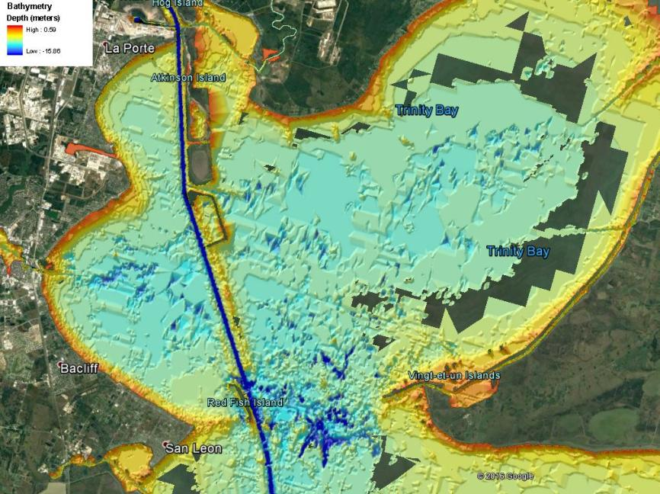
Application Focus Area (AFA) 5: Evolution of engineering and design, construction, operations, and maintenance methods.
Statements of Need
(17-N-2) Environmentally Acceptable Methods for Dredged-Material Disposal in Deep Holes

Slide 15
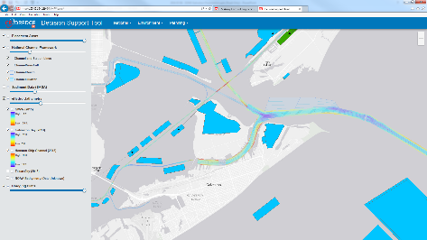
Application Focus Area (AFA) 6: Infusion of principles and practices of ocean and coastal mega infrastructure decision support systems.
Statements of Need
(17-N-12) Decision tools for integration of dredged material management information and analyses

Slide 16
Application Focus Area (AFA) 7: Integration of technology and science with USACE practice and policy.
Statements of Need
(17-N-13) Modern dissemination, access, and approval methods for USACE Engineering Regulations and Manuals

Slide 17
ONLINE
www.swg.usace.army.mil
http://www.swg.usace.army.mil/Business-With-Us/Engineering-Construction-Division/Coastal-Science-and-Engineering-Collaborative/
Connect with Us!

Slide 18
Submitted Statements of Need
(17-F-8) Biophysical System Performance of Natural and Nature Based Features (NNBFs) for Coastal Storm Risk Management (CSRM) SMART Planning Studies.
(17-F-9) Biophysical System Performance of Natural and Nature Based Features (NNBFs) for Coastal Storm Risk Management (CSRM) Pre-Construction, Engineering, and Design (PED)
(17-F-10) Lifecycle Adaptive Management of Biophysical System Performance for Constructed Natural and Nature Based Features (NNBFs) in Coastal Storm Risk Management (CSRM)
(17-N-11) Vegetated Stabilization of Erodible Clay Dike for Protection of Dredged-Material Placement Areas
(17-N-12) Decision tools for integration of dredged material management information and analyses
(17-N-13) Modern dissemination, access, and approval methods for USACE Engineering Regulations and Manuals

