Slide 1
Galveston Bay: Environmental Restoration Opportunities
Thomas E. White, PhD, PE
(Thomas.E.White@usace.army.mil, 409-766-3109)
CSEC Workshop, Vicksburg, MS 19 April 2017
Build containment dikes with clay (Tom White)
Use a variety of vegetation to stabilize dikes (Tosin Sekoni)
Try many combinations of substrates and oyster castles (Tim Clarkin)
Measure extent of “environmental deserts” created by mining oysters (Crawford/White/Maglio/ERDC)
Collect project methods used to fill deep bay holes from Jacksonville, Mobile, and Philadelphia Districts (White/Maglio)
How and where to stockpile sediment for later use (Coast of Texas)

Slide 2
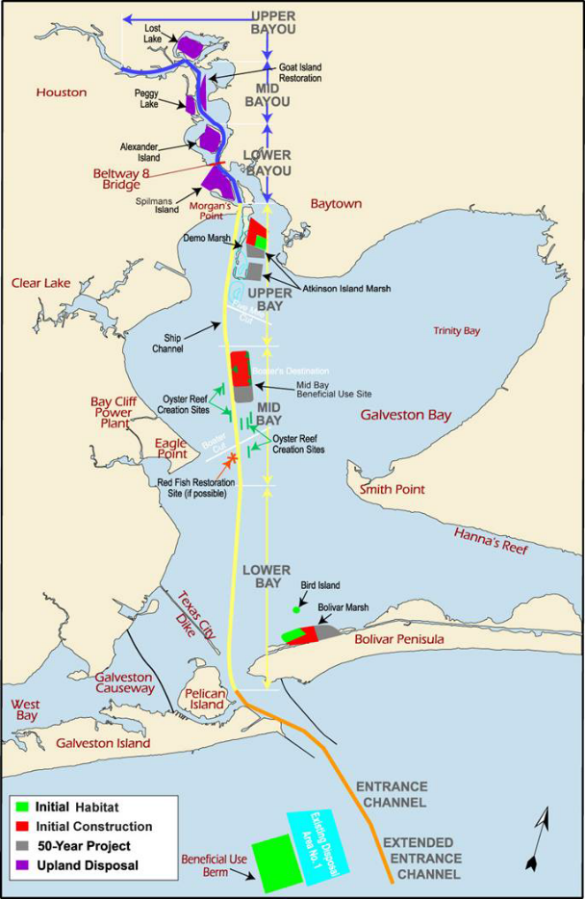
Galveston Bay Placement Areas

Slide 3
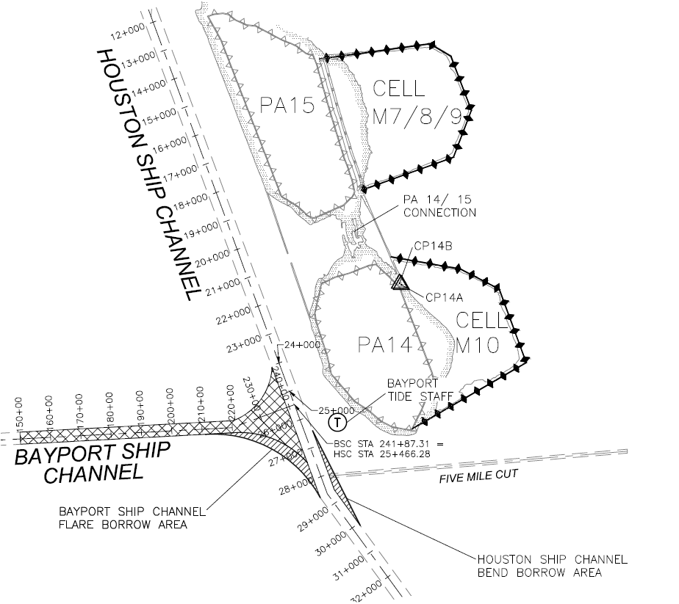
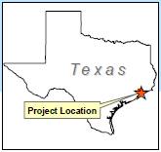
Houston Ship Channel
Deferred Environmental Restoration
  New-work material adjacent to Bayport Ship Channel (BSC) Flare and Houston Ship Channel (HSC) will be used to repair containment dikes at Atkinson Island beneficial use marsh cells M7/8/9 and M10.
Meets authorized project commitments to create marsh in Galveston Bay
Provides additional placement capacity for HSC maintenance dredged material
Provides necessary O&M placement for the Bayport Ship Channel and Flare
Contract was awarded 27 Sep 2016

Slide 4
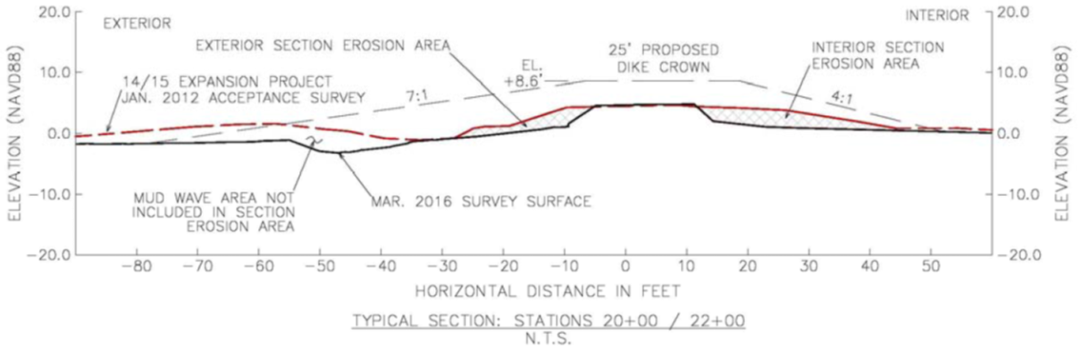
Mud dikes
Construction:
Build a dike to protect
a disposal area &
make a new marsh
Research Questions:
1. Under what conditions does the dike erode?
2. How does a sandy beach form (erosion? winnowing?)
3. Are there critical thresholds (tipping points) of the forcing functions? (storm duration, wave height)
4. What is the impact of storm surge? (duration & height)

Slide 5
R&D Opportunities
(thesis and dissertation topics)
Field 1. Monitor mud winnowing during beach nourishment
(tides, waves, currents, grain size, elevation)
Field 2. Monitor mud dike erosion
(elevations, quantities, grain size, settlement, waves, currents, storm surge)
Field 3. Test many oyster castle designs and substrates
Field 4. Monitor water displacement from a large ship
(mud-wave formation, vertical mixing, side-slope erosion)
Computer 5. Dike erosion modeling (Kobayashi & Weitzner, 2015)
Computer 6. Model salinity changes in a large shallow bay

Slide 6
R&D Opportunities
(thesis and dissertation topics)
Lab & Field 7. Measure marsh grass (Spartina) rates of sediment accumulation as a function of tide, waves, grain size, subsidence, sea level
Lab & Field 8. Compare different methods of measuring sediment erodibility
Lab & Field 9. Try out recipes and methods for flocculating mud “fluff” in bay holes

Slide 7
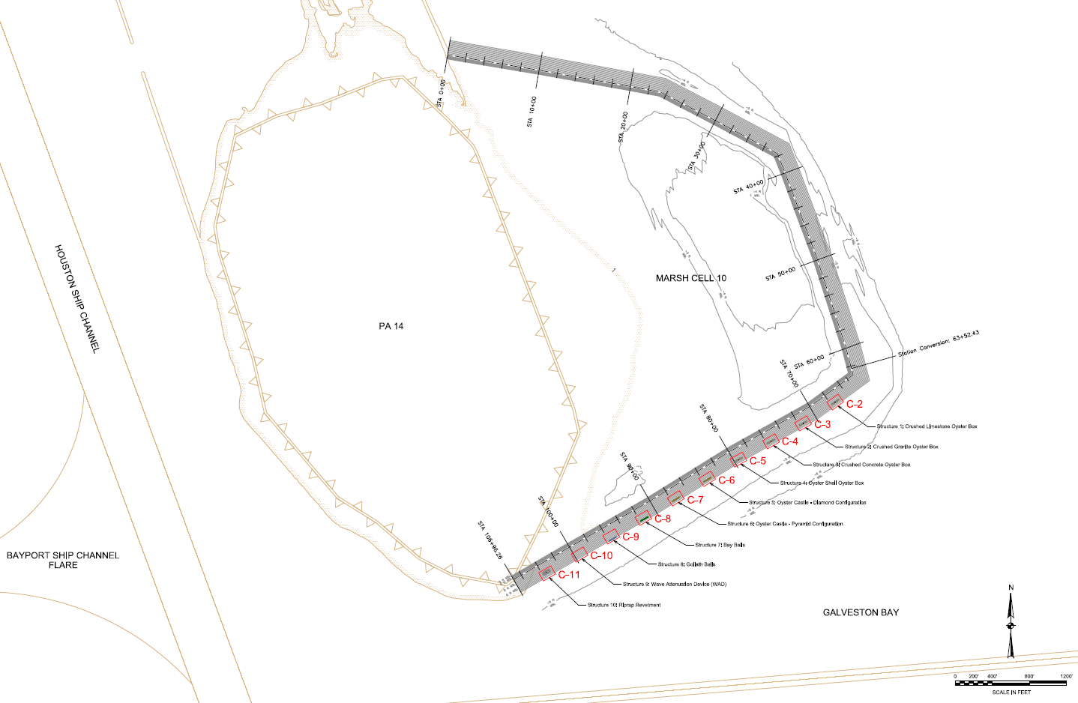
Proposed Oyster Demonstration Project
Design and deploy ten structures at Atkinson Island Marsh Cell 10
Compare performance in erosion reduction and habitat formation
Marsh
Cell 10
PA 14

Slide 8
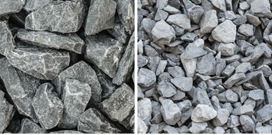
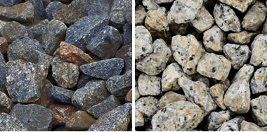
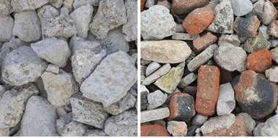
Typical Reef Materials
GALVESTON BAY
Reef Substrate
LEVEE
MARSH CELL
Wave Attenuation
Mean Sea Level
BAY BOTTOM
Limestone
Crushed Concrete
Crushed Stone
Images from: geology.com

Slide 9
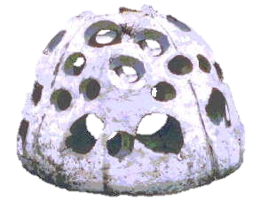
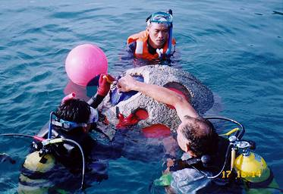
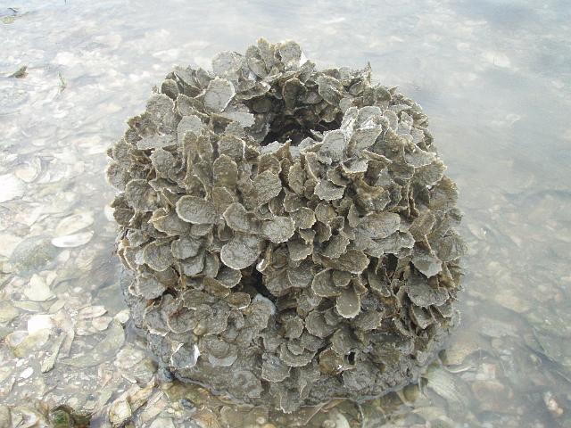
Reef Balls®
GALVESTON BAY
Reef Ball® Breakwater
LEVEE
MARSH CELL
Wave Attenuation
Mean Sea Level
BAY BOTTOM
Reef Ball®
Manual Assembly
Oyster Habitat
Images from: Reef Ball Foundation

Slide 10
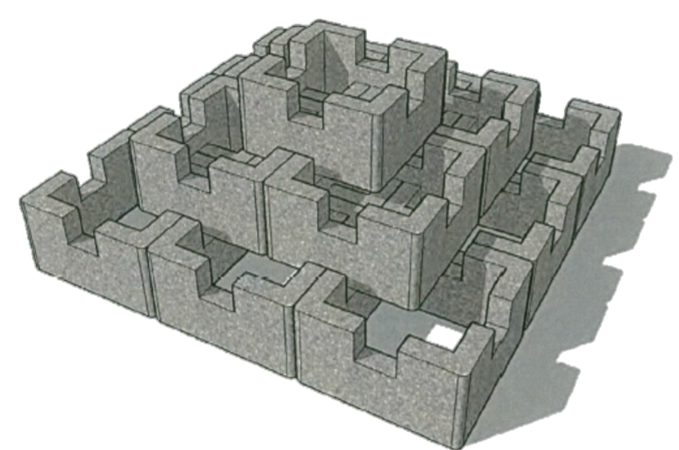
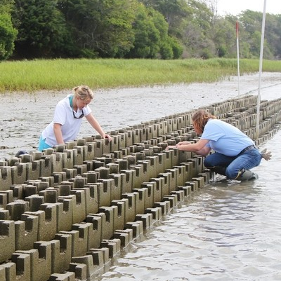
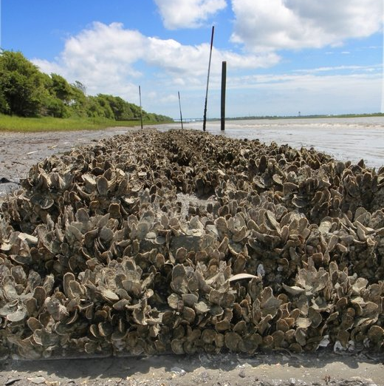
Oyster Castles®
GALVESTON BAY
Oyster Castle® Breakwater
LEVEE
MARSH CELL
Wave Attenuation
Mean Sea Level
BAY BOTTOM
Oyster Castle® Blocks
Manual Assembly
Oyster Habitat
Images from: Allied Concrete Company
Charleston Post and Courier
Charleston Post and Courier

Slide 11
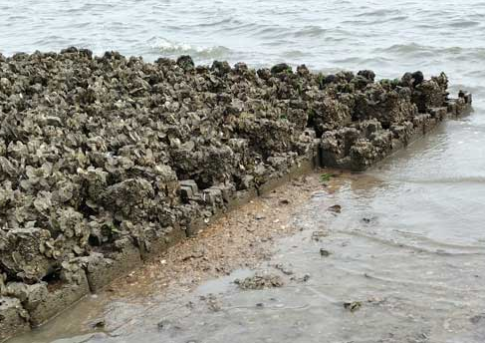
Oyster Boxes
GALVESTON BAY
Oyster Castle® Oyster Box
LEVEE
MARSH CELL
Wave Attenuation
Mean Sea Level
BAY BOTTOM
Build Oyster Boxes
with Oyster Castles®
Fill Oyster Boxes
with Substrate Material
Oyster Habitat
Images from: Allied Concrete Company
geology.com
Charleston Post and Courier

