Slide 1
Application Focus Area (AFA) 1: Discovering breakthrough science
Statements of Need
(17-F-8) Biophysical System Performance of Natural and Nature Based Features (NNBFs) for Coastal Storm Risk Management (CSRM) SMART Planning Studies.

Slide 2
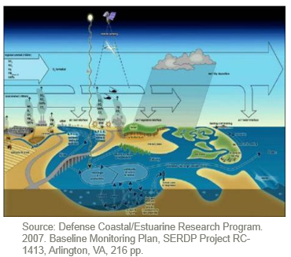
Application Focus Area (AFA) 2: Understanding of flows and circulation of river, estuary, and coastal waters, sediment, and nutrients, with interactions on morphological evolution.
Statements of Need
(17-F-9) Biophysical System Performance of Natural and Nature Based Features (NNBFs) for Coastal Storm Risk Management (CSRM) Pre-Construction, Engineering, and Design (PED)

Slide 3
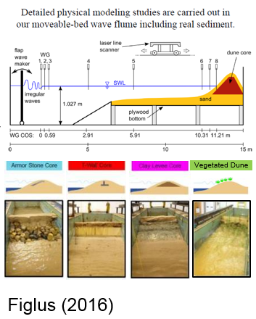
Application Focus Area (AFA) 3: Understanding the future of coastal engineering material properties.
Statements of Need
(17-N-11) Vegetated Stabilization of Erodible Clay Dike for Protection of Dredged-Material Placement Areas

Slide 4
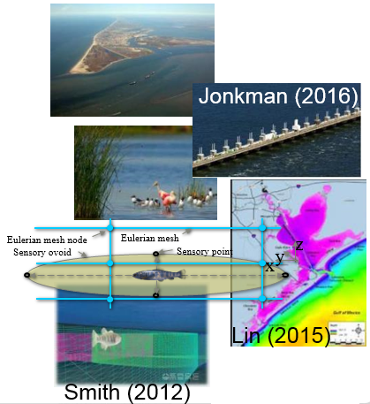
Application Focus Area (AFA) 4: Advancement of reduced order model techniques.
Statements of Need
(17-F-10) Lifecycle Adaptive Management of Biophysical System Performance for Constructed Natural and Nature Based Features (NNBFs) in Coastal Storm Risk Management (CSRM)

Slide 5
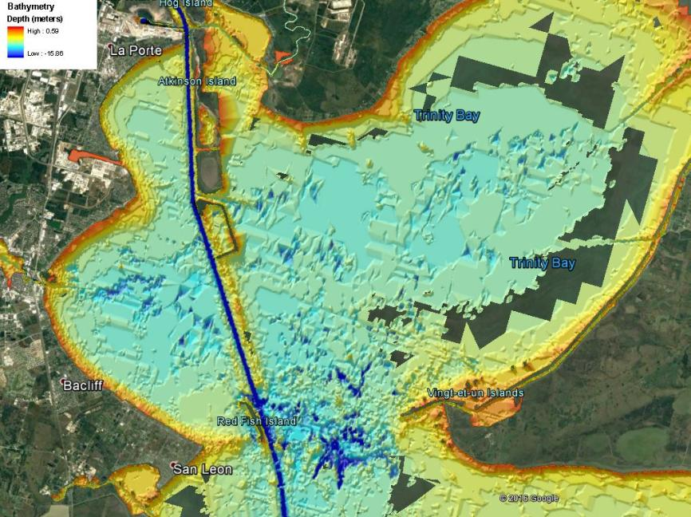
Application Focus Area (AFA) 5: Evolution of engineering and design, construction, operations, and maintenance methods.
Statements of Need
(17-N-2) Environmentally Acceptable Methods for Dredged-Material Disposal in Deep Holes

Slide 6
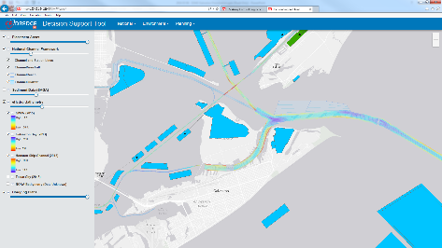
Application Focus Area (AFA) 6: Infusion of principles and practices of ocean and coastal mega infrastructure decision support systems.
Statements of Need
(17-N-12) Decision tools for integration of dredged material management information and analyses

Slide 7
Application Focus Area (AFA) 7: Integration of technology and science with USACE practice and policy.
Statements of Need
(17-N-13) Modern dissemination, access, and approval methods for USACE Engineering Regulations and Manuals

Slide 8
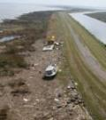
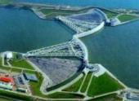
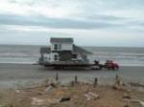
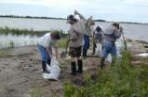
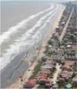
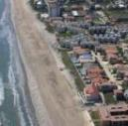
S&T Program for Life Cycle Analysis of Coastal Barriers
Ongoing Coastal TX Study
TX GLO desire for LPP
What research is needed to inform coastal barrier design in the US?
What outreach efforts are already ongoing that we need to integrate?
What research proposal(s) would prepare us to build a coastal barrier?

Slide 9
GIWW RSLR and CSRM Investigations: How do engineered features support long term sustainability and resilience?
Feasibility Study to Review Modifications of the GIWW, Matagorda and Brazoria Counties, TX
Can we change the way we manage the GIWW to better deliver ecosystem and navigation services?
How could RSLC drive management changes?
Can NNBFs protect against projected land changes?
Notes:
calm water shelter for resilient transit and mooring of commercial vessels on the waterway against waves and currents of the open GoM
a reduction to channel sedimentation from GoM open seas for sustainable maintenance scopes, timing, and costs into the future

Slide 10
ONLINE
www.swg.usace.army.mil
http://www.swg.usace.army.mil/Business-With-Us/Engineering-Construction-Division/Coastal-Science-and-Engineering-Collaborative/
Connect with Us!

