Slide 1
Modeling Beach Habitat for Turtles and Birds
Bird POC: Rich Fischer
Turtle team: Lauren Dunkin, Molly Reif, Safra Altman, Todd Swannack
Lauren Dunkin
4/19/2017

Slide 2
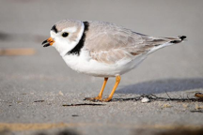
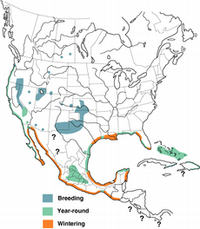
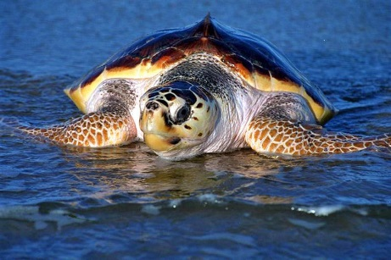
Overview
Salmon, chinook (9 Populations) | $73,851,410
Steelhead (11 populations) | $51,907,342
Sturgeon, pallid | $48,718,484
Salmon, sockeye (2 Populations) | $14,293,621
Flycatcher, southwestern willow | $7,668,176
Salmon, chum (2 Populations) | $6,102,995
Minnow, Rio Grande silvery | $5,787,904
Plover, piping (2 Populations) | $5,339,877
Tern, least | $4,467,906
Salmon, coho (4 Populations) | $3,404,322
Sturgeon, Atlantic | $2,248,191
Vireo, least Bell's | $2,229,661
Sturgeon, shortnose | $1,628,115
Sturgeon, North American green | $1,385,026
Woodpecker, red-cockaded | $1,058,791
Trout, bull | $979,656
Smelt, delta | $586,391
Bat, Indiana | $560,676
Sea turtle, loggerhead | $496,875
Manatee, West Indian | $469,134
700 miles of coastline designated as critical habitat (CH) for loggerhead sea turtle (Caretta caretta) conservation.
FISH
BIRDS
MAMMALS
http://www.fws.gov/northflorida/SeaTurtles/2014_Loggerhead_CH/Terrestrial_critical_habitat_loggerhead.html
REPTILES/AMPHIBIANS
Notes:
This presentation will discuss the demonstration of Sea turtle nesting habitat model using remotely sensed data. Much of the Atlantic and Gulf of Mexico coastlines are designated as critical nesting habitat for loggerhead sea turtle (Caretta caretta) conservation. The terrestrial critical habitat areas include 88 nesting beaches in coastal counties located in North Carolina, South Carolina, Georgia, Florida, Alabama, and Mississippi. Some of these beaches also overlap or are adjacent to areas that have USACE Navigation or Costal Storm Damage Reduction projects. Decision support tools that are founded on morphological and environmental parameters for loggerhead turtle nesting habitat are needed to inform and address integrated resource management concepts.
This presentation will focus on nesting habitat suitability for loggerheads and snowy plovers. Both studies occurred in FL.

Slide 3
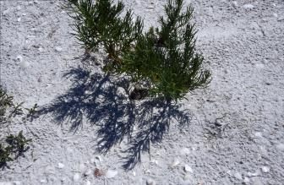
Measured habitat characteristics
Field Method
Distance to high tide line
Distance to primary dune
Distance to nearest vegetation
Distance to nearest structural debris
In front/behind dune line
Presence of shell/rock/debris in nest cup
Visibility of Gulf

Slide 4
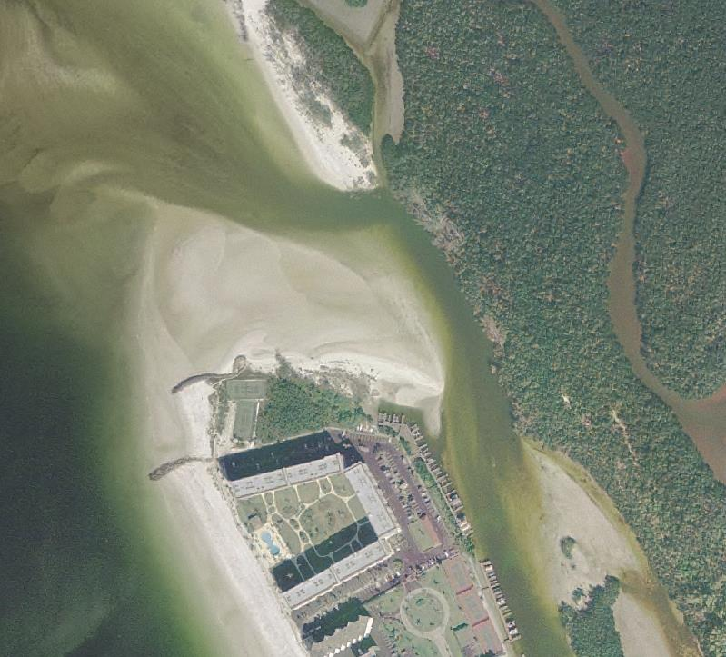
Site-based data on birds and disturbances, by habitat patch
1
Define survey area
Delineate habitat patches (each with unique landform x substrate type)
3
GPS nest locations, measure distance to brood foraging patches
8
2
5
9
Count birds and disturbances at standard tides (low, high) during all seasons
11
10
4
6
Assign each bird and disturbance observation to exact habitat polygon by behavior , age class, disturbance type
Use information to describe habitat use and recreational impacts and to inform adaptive management
7

Slide 5
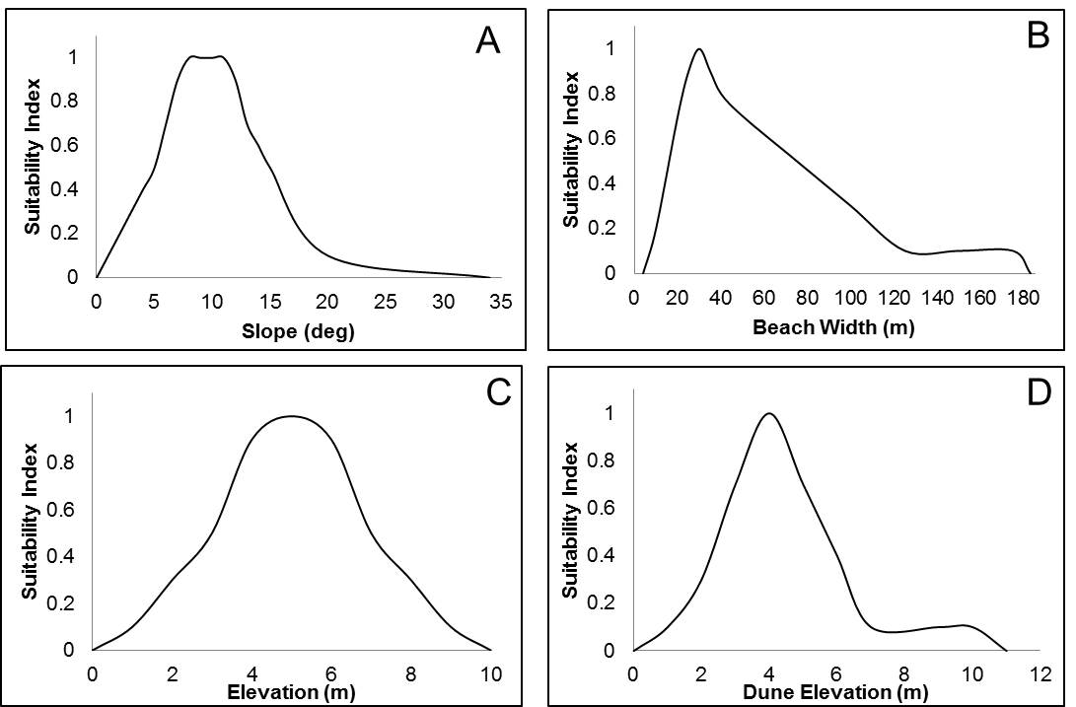
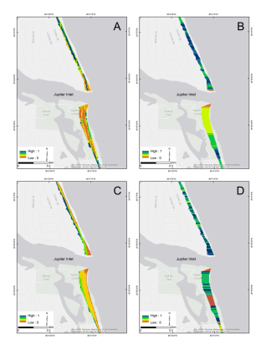
Remote Sensing Based Approach
Focus on parameters extracted from remote sensing data to use as input to the model
Support at regional scale using remote sensing data
Demonstrate relative suitability of selected sites within the critical habitat zone for C. caretta by developing a spatially-explicit ecological model
Nesting Density
CSDR projects
A B
C D
Transition Pts: Regression Analysis, SME, Research
Suitability Curves Model Grids Model Results
Nesting Habitat Suitability Tool
Notes:
The objective of this study is to provide a decision support tool to better address integrated resource management concepts, such as those included in Environmental Operating Principles and Engineering with Nature, for use by Navigation and Coastal Storm Damage Reduction mission areas. More specifically, the goal of the study is to assess the relative suitability of sites within the critical nesting habitat zone for loggerhead turtles by developing a spatially-explicit ecological model for select study areas.

Slide 6
Site Selection
South East FL chosen as study site:
175-km stretch of FL coast
4 counties - Martin, Palm Beach, Broward, and Miami-Dade
Nesting density classified from medium to high
Coastal Storm Damage Risk Reduction projects in area
Navigation Projects in area
Remote Sensing Data:
2009 USACE lidar survey
2009 USACE hyperspectral imagery
Notes:
The southeastern portion of FL was chosen to demonstrate the spatial model. This area was selected b/c it is a medium to high nesting density area and also has USACE navigation and CSDRR projects. The USACE national coastal mapping program surveyed the area in 2009. The concurrent lidar and hyperspectral imagery data is uniquely available to assist with this effort to demonstrate the value of using remote sensing techniques to determine relative nesting habitat suitability. As future surveys become available, the impacts from operations and planning efforts can be observed and used to assess changes to the nesting habitat and highlight successes and identify areas that would benefit from additional support.

Slide 7
A B
C D
Transition Pts: Regression Analysis, SME, Research
Suitability Curves Model Grids Model Results
Nesting Habitat Suitability Tool
Regional datasets are analyzed using the spatial tool developed to streamline nesting habitat suitability using a flexible, multi-criteria model that incorporates regional value ranges to better communicate priorities and evaluate management strategies as a result of changes to the dynamic coastal environment.
Notes:
The tool provides a streamlined approach to working with the regional datasets to determine nesting site suitability and allows for a flexible model that can incorporate regional value ranges for the various parameters. Given the large geographic area designamted as CH, a flexible model that incorporates regional value ranges is essential to better communicate priorities and evaluate management strategies as a result of changes to the dynamic coastal environment. Regional datasets are analyzed using a spatial tool developed to streamline the process of determining nesting habitat suitability using a

Slide 8
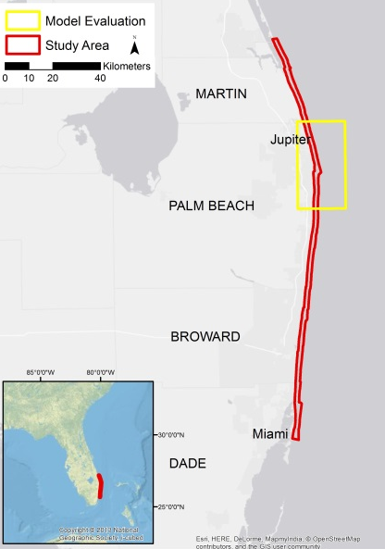
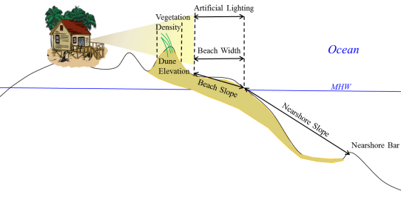
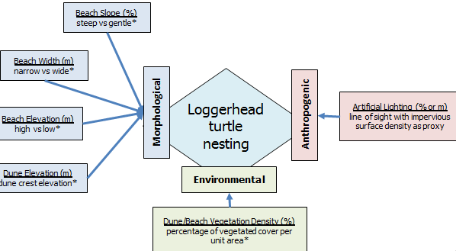
Turtle Nesting Habitat Parameter Analysis
Spatial Parameters
Objective
Demonstrate relative suitability of selected sites within the CH for C. caretta by developing a spatially-explicit ecological model
Approach
Physical parameters extracted from remote sensing data as model input
Multi-criteria, weighted model
Tool streamlines methods & model evaluation
Focused on 4 morphological parameters:
Slope
Beach width
Dune peak
Bare earth elevation

Slide 9
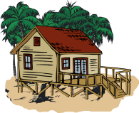
Parameter Analysis – Regression Analysis
Focused on 4 morphological parameters:
Slope
Beach width
Dune peak
Bare earth elevation
Environmental and anthropogenic parameters not included in regression analysis
Dune vegetation and artificial light parameters used as environmental benefit indicators
Veg Density
Artificial Lighting
Dune Elevation
Beach Width
Beach Slope
MHW
Beach Slope
Notes:
Nesting density data obtained from the USFWS was divided into smaller units (low, medium and high categories) to quantify and better evaluate relationships between nesting densities and the four morphological parameters (slope, beach width, bare earth elevation, and dune peak). A suite of individual multinomial logistic regressions for each morphological parameter was developed.
After performing a regression analysis, the 4 morphological parameters listed where found to be the most influential for determining nesting habitat suitability. The environmental and anthropogenic parameters (dune vegetation and artificial light) are used to indicate environmental benefits. These will help refine the results from the morphological parameters and could be used to indicate areas that may benefit from improved environmental changes.

Slide 10
Model Development
Rasterized model grids from suitability curves
Suitability index for each morphological parameter:
0 to 1 (unsuitable to highly suitable)
Regression analysis, value ranges from literature, SME feedback
Notes:
Each parameter is represented as a suitability index ranging from 0 to 1 (unsuitable to highly suitable). The transition points from the regression analysis, value ranges documented in literature, and subject matter knowledge were used to derive the shape of the suitability curves.

Slide 11
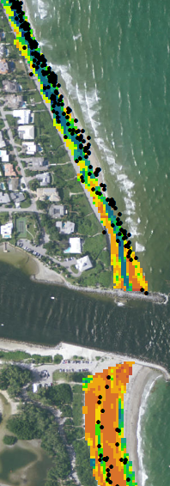
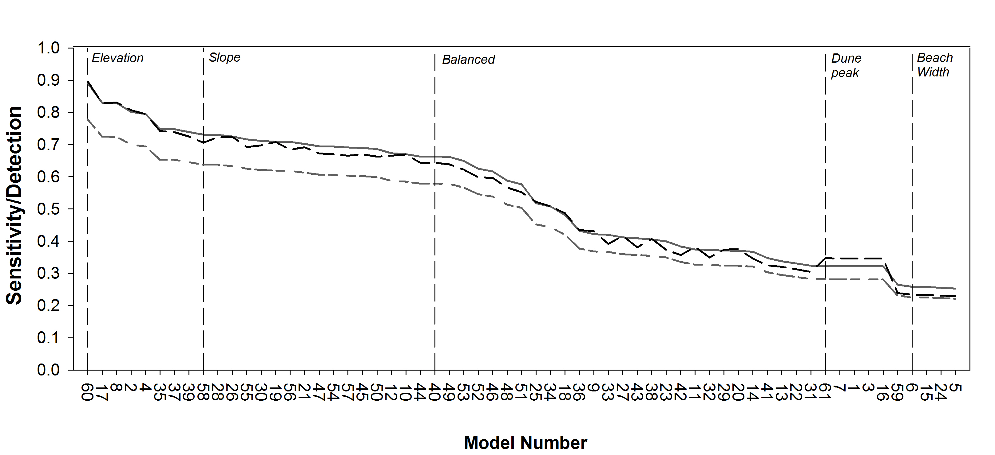
Model Optimization
Detailed nesting data: Palm Beach County
Presence only data available
57 model scenarios w/ adjusted weighting scheme
Sensitivity (true positive rate), detection rate, and detection prevalence
Nest Locations
Notes:
Model optimization included the evaluation of 57 different weighting scenarios for an area in Palm Beach County, utilizing detailed nesting data for the 2008-2009 timeframe.

Slide 12
Model Results
Model | Weighting Structure |  |  |  | Sensitivity | Detection Rate | Detection Prevalence
 | Slope | Beach Width | Elevation | Dune Peak
17 | 0.13 | 0.06 | 0.75 | 0.06 | 0.830 | 0.725 | 0.828
8 | 0.08 | 0.08 | 0.76 | 0.08 | 0.830 | 0.724 | 0.831
2 | 0.06 | 0.06 | 0.75 | 0.13 | 0.802 | 0.700 | 0.807
4 | 0.06 | 0.13 | 0.75 | 0.06 | 0.795 | 0.695 | 0.795
35 | 0.25 | 0.08 | 0.5 | 0.17 | 0.748 | 0.653 | 0.742
Balanced (40) | 0.25 | 0.25 | 0.25 | 0.25 | 0.663 | 0.579 | 0.644
Elevation (60) | 0 | 0 | 1 | 0 | 0.891 | 0.778 | 0.896
Slope (58) | 1 | 0 | 0 | 0 | 0.731 | 0.638 | 0.706
Dune Peak (61) | 0 | 0 | 0 | 1 | 0.323 | 0.282 | 0.347
Beach Width (59) | 0 | 1 | 0 | 0 | 0.265 | 0.231 | 0.239
Notes:
Sensitivity refers to the true positive rate, or the proportion of positive nesting occurrences that were properly identified. Detection rate and detection prevalence refer, respectively, to the proportion of true positive nesting occurrences and positive predicted nesting occurrences within the entire dataset. Of the 57 weighting scenarios (Figure 5), the models with the highest sensitivity and detection were driven by larger weights for elevation. Four out of five of these models had an elevation weight of 0.75 and all models had an elevation weight of at least 0.5 (Table 2). In comparison to the balanced model, in which each parameter was weighted equally, metrics increased in the top models, indicating that these models were better suited for identifying nesting habitat.

Slide 13
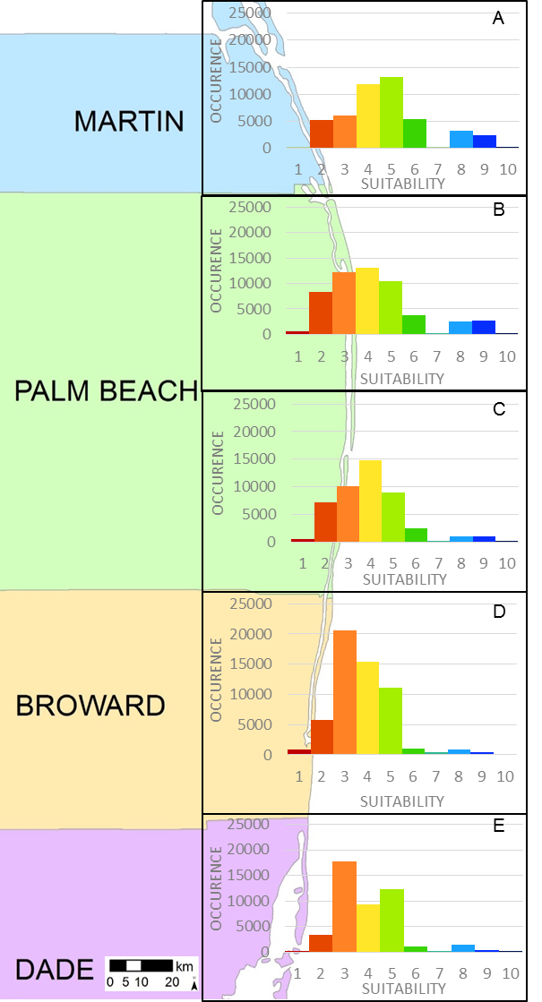
Model Results
Spatial interpretation of the nesting suitability
Cool colors – higher nesting suitability
Warm colors – lower nesting suitability
Notes:
Per area, the highest nesting suitability is modeled as occurring in Martin and Palm Beach Counties. This area of the coast has geomorphic features that align with the higher suitability in the model curves (Figure 3). While we know that nests occur in Broward and Dade counties, the results of the nesting suitability are a function of the morphological conditions that are shown to be less suitable than in the northern counties.

Slide 14
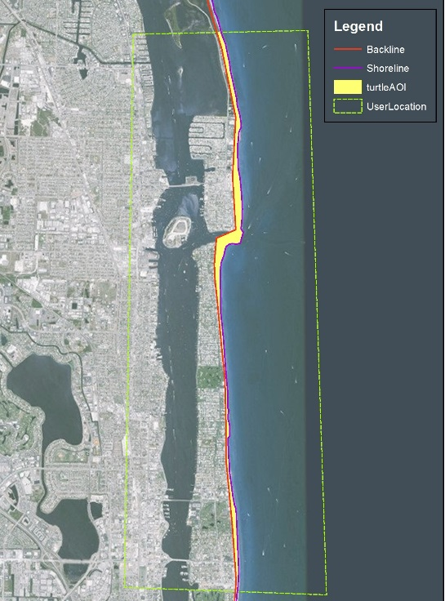
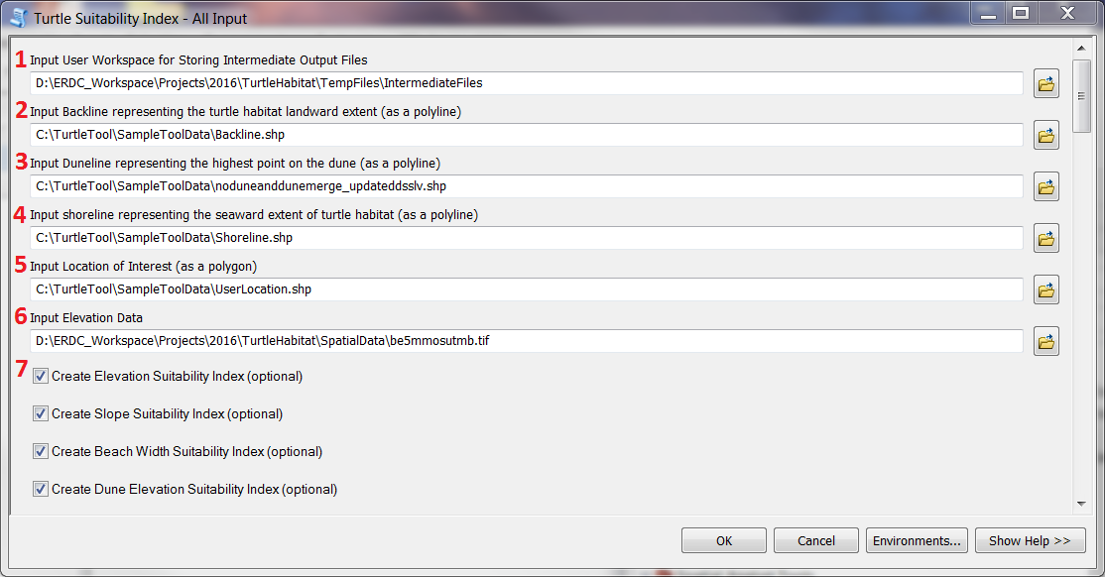
Nesting Habitat Toolbox
Tool to assist the user with assessing relative suitability in their particular region of interest
Geospatial methods streamlined
Beach width, slope, clip grid
Desktop interface

Slide 15
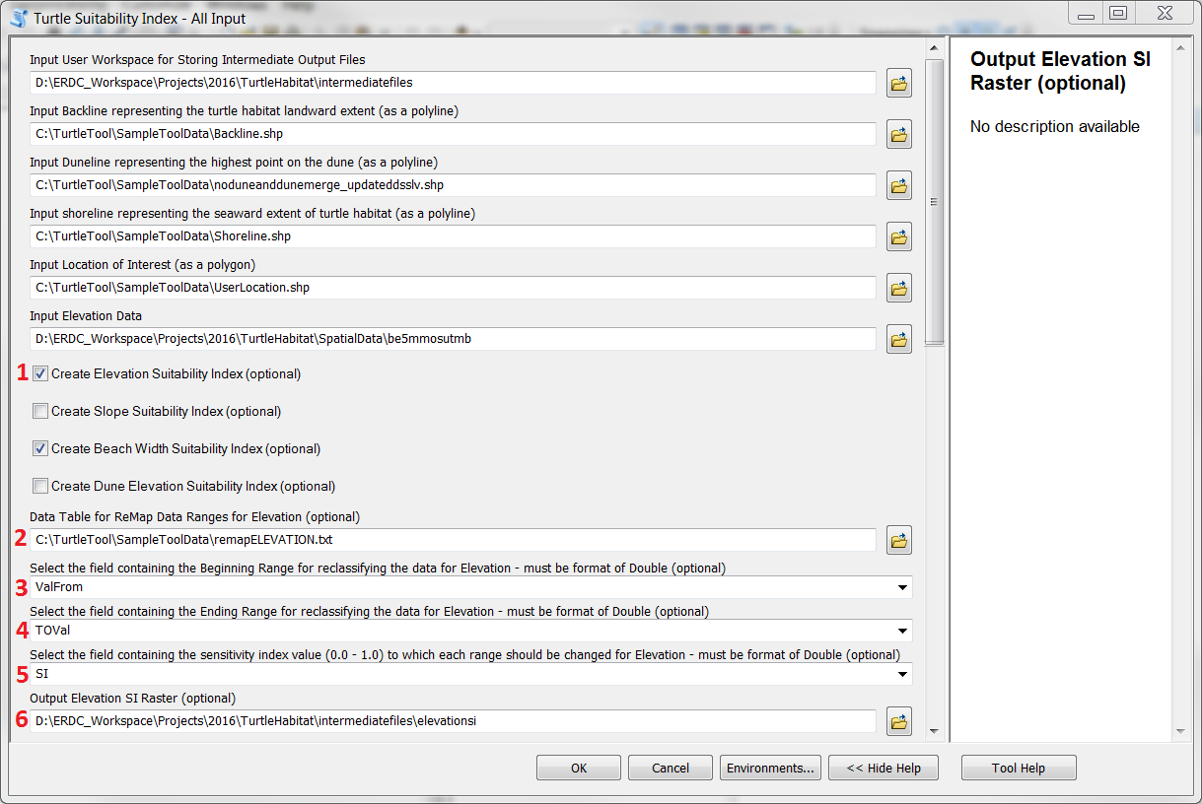
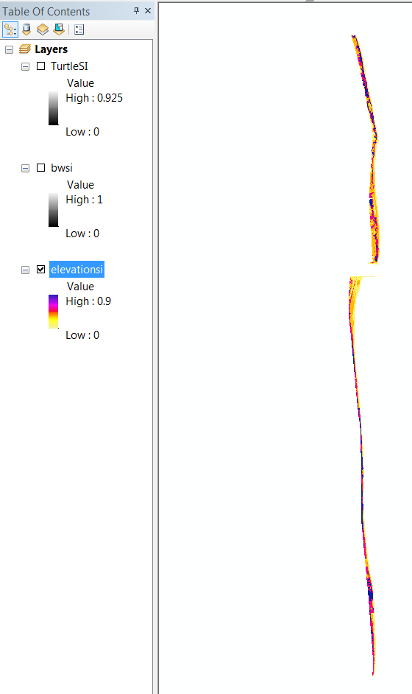
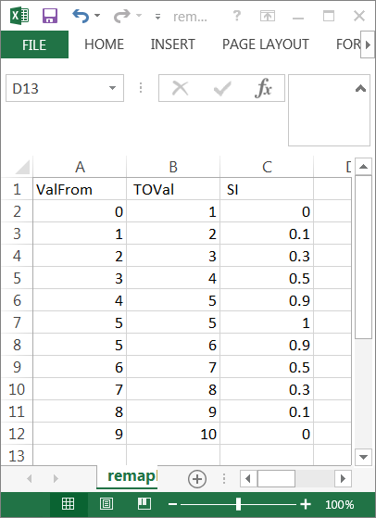
Nesting Habitat Toolbox
Suitability index grids
Create rasters used as input for weighted overlay model

Slide 16
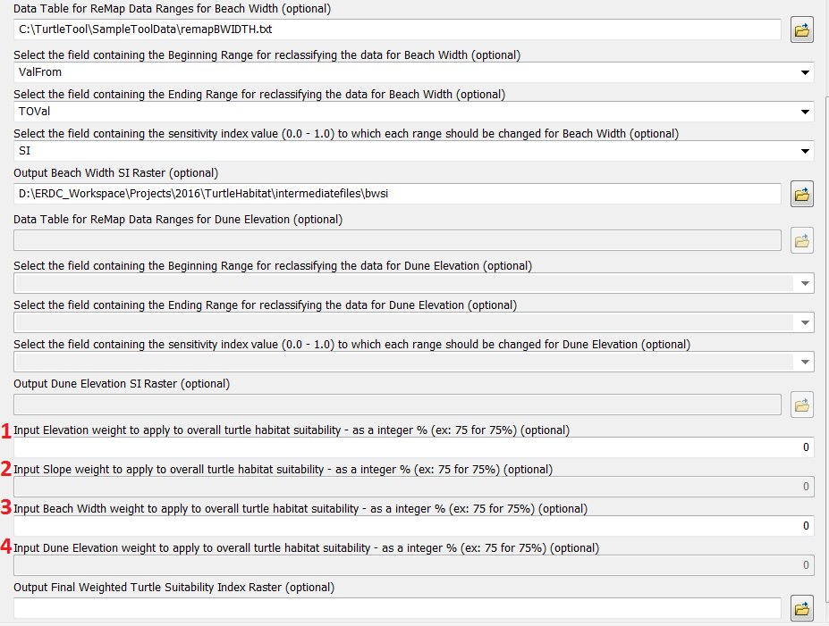
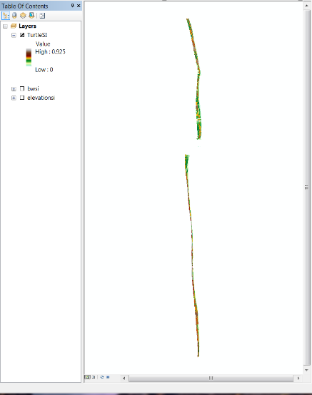
Nesting Habitat Toolbox
Weighted overlay model
Flexible weighting scheme

Slide 17
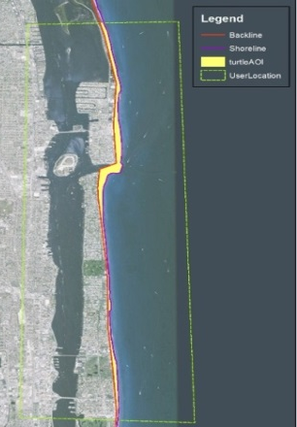
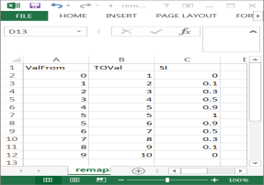
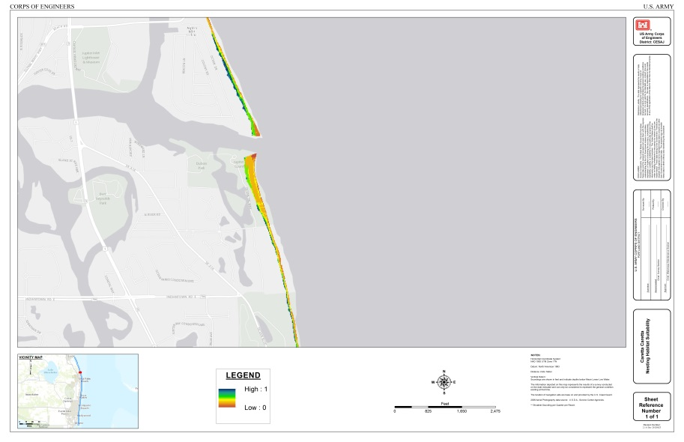
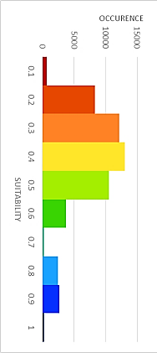
Nesting Habitat Toolbox
Tool to assist user with assessing relative nesting habitat suitability in ROI
Regional - Geospatial methods streamlined:
1) Beach width, 2) slope, 3) dune elevation,
4) clip grid to ROI
Multi-criteria model analyzed with user specified weighting scheme
Include additional parameters
Model Results: spatial representation of nesting habitat suitability
Monitor the changing status of the coast
Identify priority areas to improve the beach area and enhance nesting habitat suitability through beneficially managing sediment and other resources
Model Results – spatial representation of nesting habitat suitability
Cool colors – higher nesting suitability
Warm colors – lower nesting suitability
Notes:
high influence that elevation had on the sensitivity of the model for this study area. The importance of elevation lends more power to utilizing remote sensing data for nesting habitat suitability assessment since acquiring elevation data on a regional scale is better suited for remote sensing techniques. Additionally, the use of remote sensing data provide the regional focus for determining nesting site suitability by addressing the need for a flexible model that allows for the variability in regional values to be included as input. This allows for a flexible model that can incorporate regional value ranges for the various morphological parameters.
One of the key things to remember is that this approach uses remote sensing data so it can be done at a regional scale that goes beyond project boundaries. In addition, the final results will assist with coordination between agency partners.
Monitoring the changing status of the coast
Approach used to assess planned scenarios during the design phase
Identify ways to improve the beach area and enhance nesting habitat suitability through beneficially managing sediment and other resources
Future work
additional analyses of the model approach in other locations
improved spatial integration of environmental and anthropogenic parameters to determine influence in nesting suitability as well as for conducting specific prioritization analyses for identifying management hotspots and areas of concern.

Slide 18
Environmental & anthropogenic parameters
Identify opportunities for habitat enhancement and improvement with maximum benefit to the species
evaluating habitat characteristics or quality, impacting site preference and mortality rates
lack of dune vegetation or potential for light pollution in areas that are highly suitable
Notes:
high influence that elevation had on the sensitivity of the model for this study area. The importance of elevation lends more power to utilizing remote sensing data for nesting habitat suitability assessment since acquiring elevation data on a regional scale is better suited for remote sensing techniques. Additionally, the use of remote sensing data provide the regional focus for determining nesting site suitability by addressing the need for a flexible model that allows for the variability in regional values to be included as input. This allows for a flexible model that can incorporate regional value ranges for the various morphological parameters

Slide 19
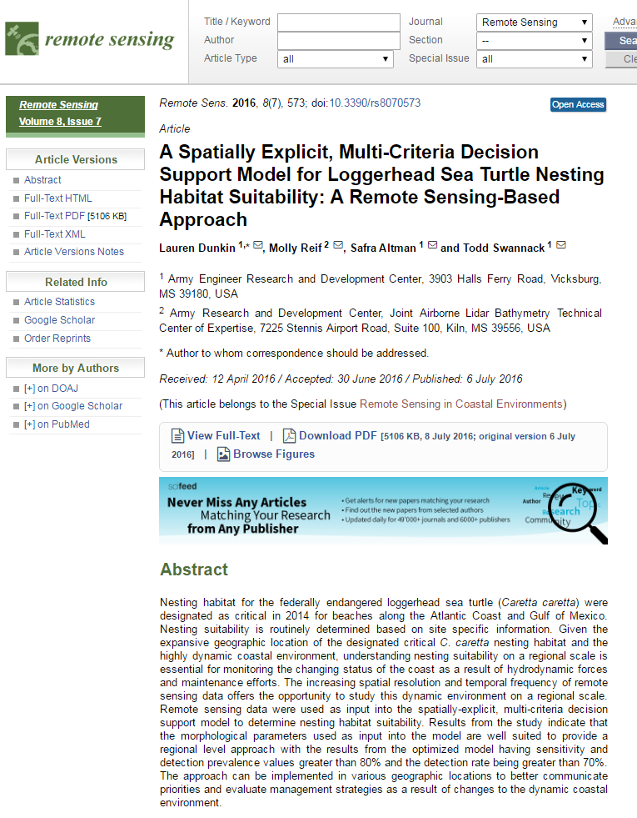
Project Value
doi:10.3390/rs8070573
Operations: evaluate potential impacts of operational activities to nesting habitat and track changes through time (Engineering with Nature, Regional Sediment Management)
Planning: improve coordination between agency partners to identify priority areas that would benefit from beneficially using sediment obtained through dredging activities
R&D: evaluate beaches for better understanding of physical parameters needed to support nesting habitat
.
Notes:
One of the key things to remember is that this approach uses remote sensing data so it can be done at a regional scale that goes beyond project boundaries. In addition, the final results will assist with coordination between agency partners.
Monitoring the changing status of the coast
Approach used to assess planned scenarios during the design phase
Identify ways to improve the beach area and enhance nesting habitat suitability through beneficially managing sediment and other resources
Future work
additional analyses of the model approach in other locations
improved spatial integration of environmental and anthropogenic parameters to determine influence in nesting suitability as well as for conducting specific prioritization analyses for identifying management hotspots and areas of concern.

Slide 20
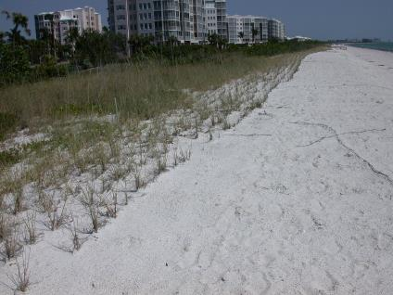
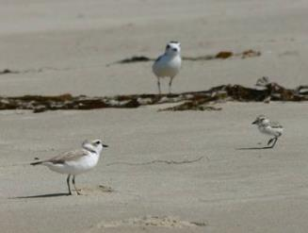
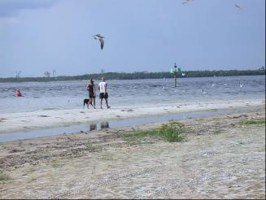
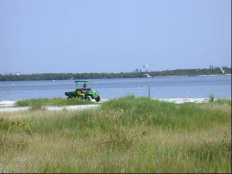
Gradient from habitat degradation to loss
Development and dune plantings focus birds AND people on front beach
Chicks cut off from bayside foraging areas
Front beach resources lost or unavailable due to disturbance

Slide 21
“Natural” areas with available habitat
Nesting, brood rearing, and non-breeding habitat are abundant and connected
Natural processes are allowed to occur
Management can focus on predators and disturbance
Rare across state- limited to mostly public lands
Actions leading to habitat loss must be avoided!

Slide 22
The Team
USACE – Molly Reif, Safra Altman, & Todd Swannack
Collaboration with NOAA¹, SAJ², FWC³, Broward County, FL⁴, Palm Beach County, FL, and Sea Turtle Conservancy
¹National Marine Fisheries Service, Southeast Fisheries Science Center
²Biologist and Coastal Engineer
³Florida Fish and Wildlife Conservation Commission
⁴Natural Resource Specialist

Slide 23
Low Nesting Density
Medium Nesting Density
High Nesting Density
Questions
lauren.m.dunking@usace.army.mil

