Slide 1
Galveston Bay Bottom Ecosystem System Features
Eddie Irigoyen
19 April 2017
CSEC Workshop

Slide 2
Galveston Bay Submerged Aquatic Habitat ER
Data are needed about previously mined holes from oyster shell mining operations in Galveston Bay.
Evaluate sediment and biological characteristics of previously mined pits in Galveston Bay
¿Questions have come up regarding the possibility of placing maintenance material dredged from the channel into these holes?
ER opportunity to identify, develop, and recommend a bay bottom habitat-restoration plan through application of innovative concepts and EWN-RSM principles

Slide 3
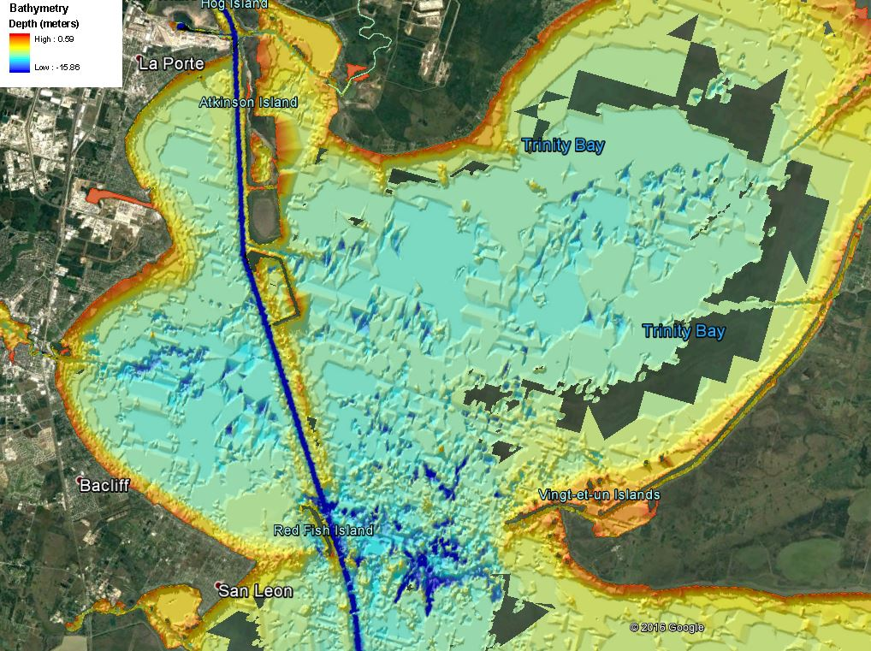
Galveston Bay Submerged Aquatic Habitat ER

Slide 4
TYPE OF Sediments and impacts
What kind of sediments exists in these holes?
Galveston Bay is a shallow brackish estuary with a large supply of mobile, fine-grained sediment.
What kind of impacts would result by open bay disposal of maintenance material in these holes?
These former holes are probably filled with material that is very similar to the proposed maintenance dredge material from the Houston Ship Channel.

Slide 5
Next Step
Does any information already exist regarding these areas?
No Current data exist. (Stay tuned for next presentation.)
Working with ERDC through a DOTS Request to gather data to quantify site conditions so that a project to fill or cap these mines can be developed
Working with Port of Houston & Houston Ship Channel Deepening project to quantify available placement volumes
What would be the procedure for filling holes?
Dredged materials would be harvested and placed at select bay bottom sites for restoration of bay bottom elevations and compositions conducive to habitat ER.
Restored submerged aquatic habitat would be suitable for colonization of oysters and seagrasses with return to functionality for fish and wildlife.

Slide 6
Galveston Bay Bottom ER Investigation Approach
An approved Sec 1135 project for construction would be coordinated with ongoing Operations and Maintenance to ensure consistency and compatibility
The plan will also be developed for consistency and compatibility with commercial navigation and existing recreation usage in the bay.
Estimated total project budget is $10 M.

Slide 7
Continue Authority Program
Program Authority | Description
Section 204 | Regional Sediment Management and beneficial uses of dredged material from new or existing Federal projects for ecosystem restoration, FRM, or HSDR purposes
Section 206 | Aquatic ecosystem restoration
Section 1135 | Modification of USACE-constructed water resources projects to improve the quality of the environment; also, restoration projects at locations where an existing Corps project contributed to the degradation

Slide 8
Cap authorities
Program Authority | Description
Section 14 | Emergency stream bank and shoreline protection for public facilities, such as roads, bridges, hospitals, schools, and water & sewage treatment plants, that are in imminent danger of failing
Section 103 | Protection of public and private properties and facilities against damages caused by storm-driven waves and currents with the construction of revetments, groins, and jetties and may also include periodic sand replenishment
Section 107 | Improvements to navigation, including dredging of channels and widening of turning basins
Section 111 | Prevention or mitigation of erosion damages to public or privately owned shores along the coastline when the damages are a result of a Federal navigation project
Section 204 | Regional Sediment Management and beneficial uses of dredged material from new or existing Federal projects for ecosystem restoration, FRM or HSDR purpose
Section 205 | Local protection from flooding by non-structural measures such as flood warning systems, or flood proofing; or by structural flood-damage-reduction features such as levees, diversion channels, or impoundments
Section 206 | Aquatic ecosystem restoration.
Section 208 | Local protection from flooding by channel clearing and excavation, with limited embankment construction by using materials from the clearing operation only
Section 1135 | Modification of USACE constructed water-resources projects to improve the quality of the environment; also, restoration projects at locations where an existing Corps project contributed to the degradation

Slide 9
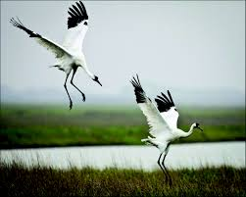
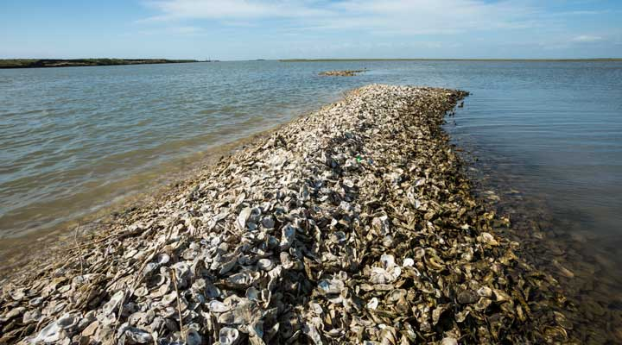
Eddie Irigoyen
Project Manager
US Army Corps of Engineers
Galveston District
eduardo.irigoyen@usace.army.mil
409-766-3130

Slide 10
Consolidating & capping oyster-mining pits
Thomas E. White, PhD, PE
(Thomas.E.White@usace.army.mil, 409-766-3109)
CSEC Workshop, Vicksburg, MS 19 April 2017
What we know:
Many deep pits were dug in the 1950s-60s (data: NOAA lead-line surveys)
The pits have filled up with something (data: recent NOAA acoustic surveys)
The stuff is very soft (data: boreholes with “Weight Of Rod” blows)
27 holes have been identified and investigated (boat deployment, Jan 2017)
Stuff is “fluid mud” with solids concentration of 0.60 by weight (data: Tom’s crude sediment tests)
Stuff is anoxic and stinks (sulfur dioxide) (data: our noses)
What we don’t know:
Consolidation, % silt, % organics
Depth & areal extent

Slide 11
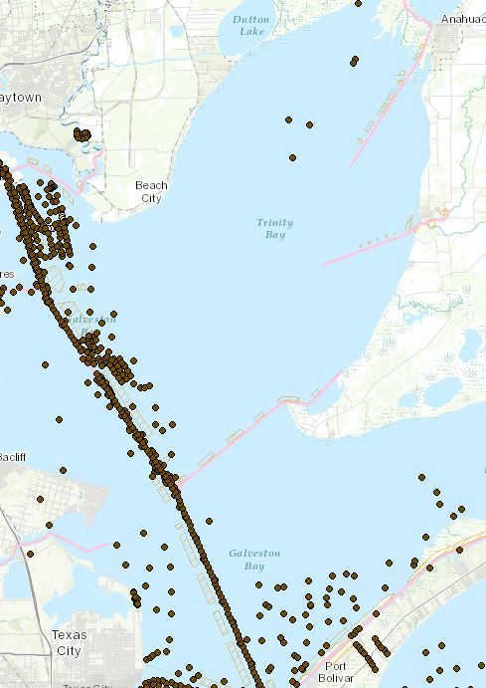
27 Sampling Sites & many borings (but mostly near the channel)

Slide 12
How we will answer our questions
Sediment Composition (Testing):
Particle size & grain-size distribution
Water content
Organic content
Atterberg plastic & liquid limits
Specific gravity
Consolidation
Depth & Areal Extent:
Past seismic acoustic tests
Superposition of NOAA lead-line & acoustic surveys
Goal (putting it all together):
(Areal extent) x (Depth) x (1- Consolidation) = cubic yards of space to fill

Slide 13
Brainstorming ideas on how to consolidate
By increasing complexity & cost ($):
(and also by chronological submission)
Be Patient: yes, when we dump our loads, the anoxic stuff will spill out and mess up sessile benthic biota. Once we fill that hole, we’ll cap it with good sediment and never fill there again. The biota will repopulate in a new oxygenated environment. (Tom White)
Collar & Fill: Temporarily surround the pit top with a collar. Dump on the pit. Will collar contain the fluid mud? (Coraggio Maglio)
Seal & Fill: Put both a collar & and a lid on top. Pump new fill through a funnel. After consolidation, remove the lid, and cap with good sediment. (Coraggio Maglio)
Suck & Treat & Fill: Pump the fluid mud into a treatment barge, treat with a non-toxic flocculant, compress, and pump back into the hole. Then cap with good sediment. (Paul Schroeder)

