Slide 1


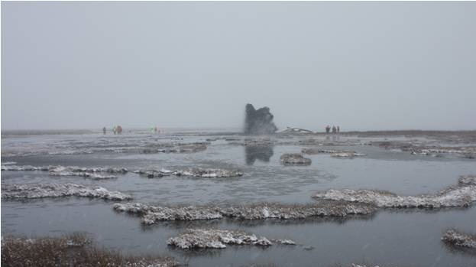
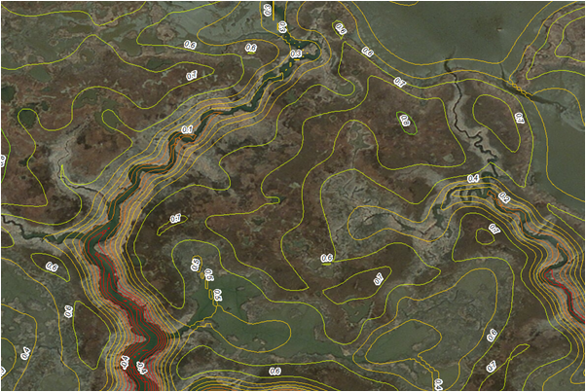
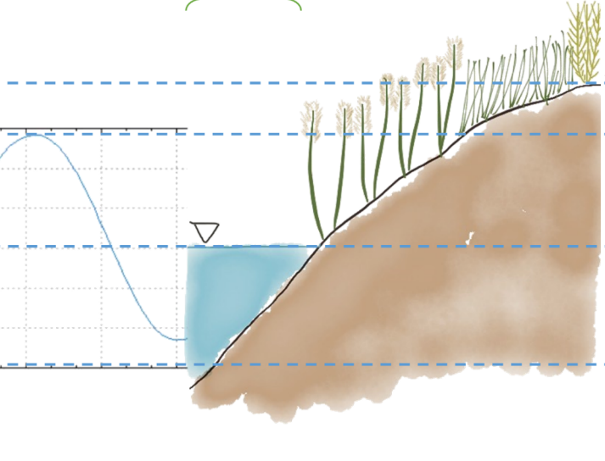




Simulating wetland thin layer placement with the Marsh Equilibrium Model
Candice D. Piercy¹, Jim Morris², Katherine Renken², Christine VanZomeren^{1,} and Tim Welp¹
¹USACE ERDC
²University of South Carolina

Slide 2
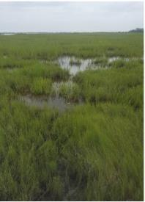
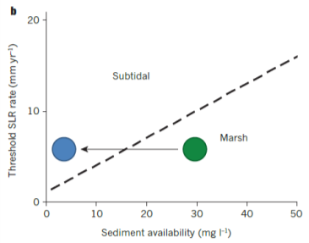
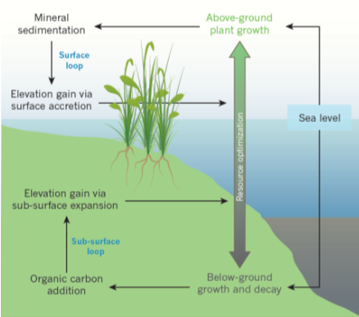
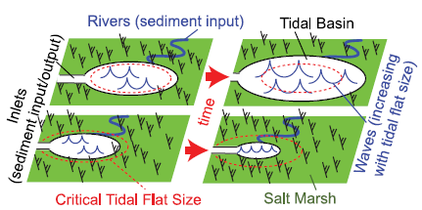
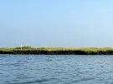
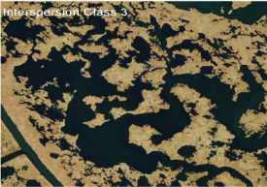
Primer: salt marsh dynamics
Kirwan & Megonigal 2016
Kirwan & Megonigal 2016
Submergence
Dynamic equilibrium
Edge erosion
Disruptions to ecological, hydrological, & sedimentation processes can alter the morphology & function of salt marshes
Signs of distress in salt marsh can manifest differently depending on the site
Mariotti 2016
Pond collapse
CWPRA

Slide 3
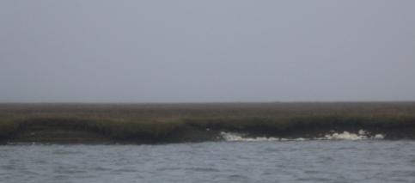
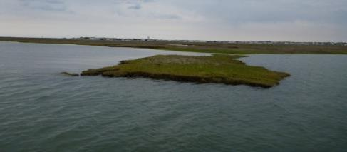
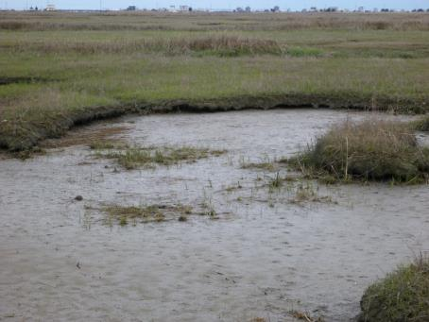
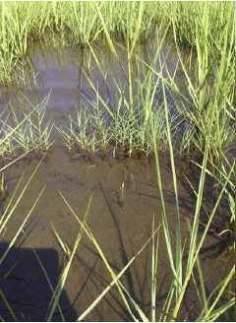
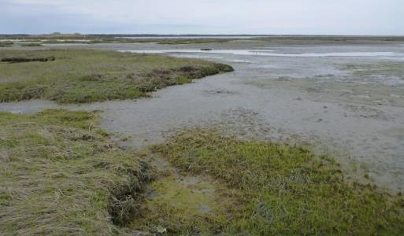
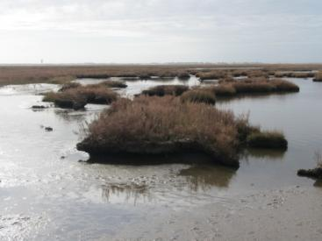
Salt marsh distress
Active edge erosion
Patches of subsidence in marsh interior – veg dieoff
Extensive pools and pannes – actively growing
Notes:
Photos taken in southern NJ but we see the same things in Barnegat Bay.
Similar to effects seen in southern LA. Is this SLR or is a symptom of some other change in environmental condition
Double threat: edge erosion from widening sounds and increasing open water and RSLR changing inundation on marsh platform. Typically see lower elevations and greatest deterioration in marsh interior. Could be waterlogging, perhaps herbivory but sudden vegetation die-off causes a dramatic decrease in the marsh elevation.

Slide 4
What are the underlying causes of marsh stress?
Potential stressors
Hydrological changes
  Rising sea levels
  Increased wave energy
  Physical barriers
Reduced sediment loading/deposition
Vegetation stress
  Waterlogging
  Loss of elevation
  Erosion
Leading to

Slide 5
How can we restore degraded marshes?
Remove barriers (culverts, levees, tide gates)
  Restore hydrologic connectivity
  Facilitate sediment transport into marsh
Remove ditches/depressions
  Restore natural hydrograph (overdrained marsh)
  Remove local sediment sinks
Raise elevation
  Decrease inundation
  Alleviates flooding and sulfide stress
  What about filling pools?

Slide 6
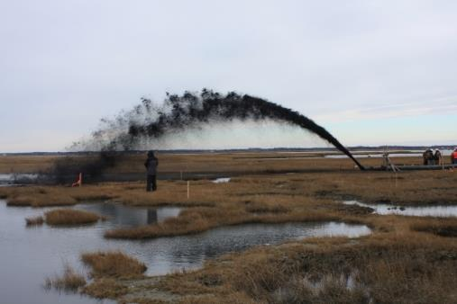
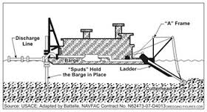
Thin-layer placement in wetlands
  Placement of a thickness of dredged material that does not transform the receiving habitat’s ecological function (Wilber, 1992)
  Has also been used to describe placements ranging in depth from cm to 1 m
  Developed and commonly used in Louisiana
  Few demonstration projects
      Blackwater NWR (Maryland)
      New Jersey – Avalon, Fortescue, Ring Island
      Seal Beach, CA
      Galveston Bay
Notes:
Marsh soil volume is made up of anywhere from 20% to 80% inorganic mineral sediment while DM is generally mostly mineral.

Slide 7
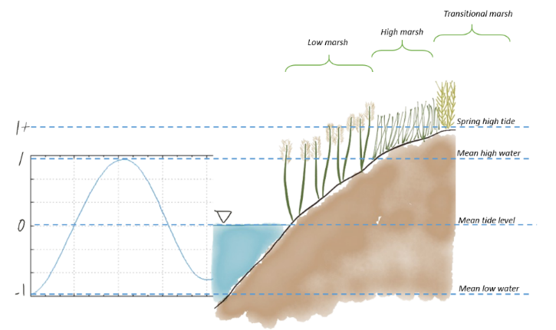
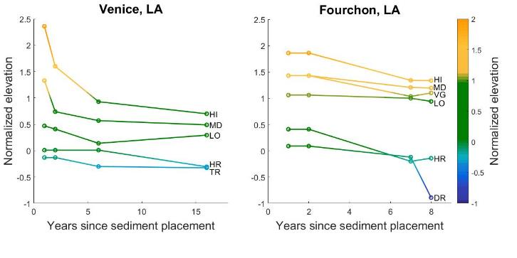
Enriching marshes with DM: how much do we add?
Biological vs. construction target elevations
  Meta-analysis of documented thin-layer sites shows upper intertidal range results in greatest marsh resilience
  Elevation relative to the tide changes over time
Determining goal elevation
  Goals for restoration (low versus high marsh)
  Relative sea level rise rate
  Predicted settling, consolidation, and compression

Slide 8
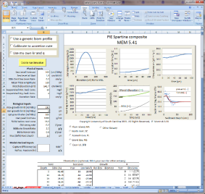
Long-term marsh elevation response to SLR
Marsh Equilibrium Model (MEM) projects future conditions based on known interactions between biomass and accretion
Developed at University of South Carolina by Dr. James Morris
Integrated with new versions of SLAMM to better predict accretion
1-D and 2-D versions available with web, Excel, and ArcGIS interfaces
Outputs include
  Marsh elevation
  Above and below ground biomass
  Soil OM
  Carbon sequestration

Slide 9
Project goal: update MEM to model the effects of TLP
Collaboration with ERDC and University of South Carolina (Jim Morris)
Key issues
  When do consolidation processes switch from being dominated by physical processes (modeled by PSDDF) to biologically-mediated processes?
  How to model TLP-induced mortality (proportional to placement thicknesses?
  How long does vegetation take to recover or recolonize?
  How to account for replanting/reseeding?

Slide 10
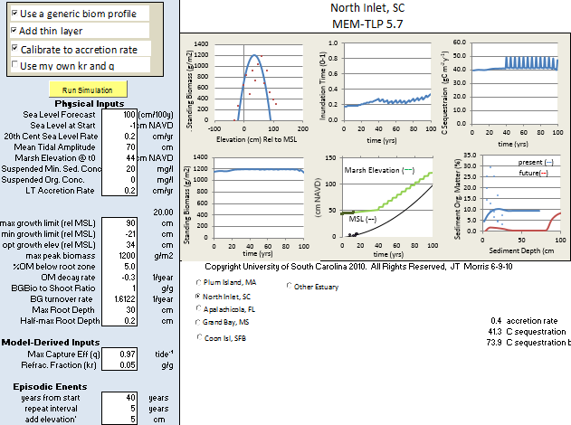
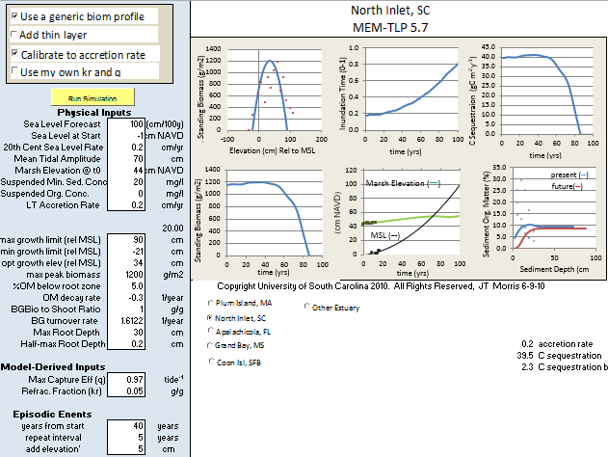
Initial functionality added: proof of concept that TLP can prevent collapse
With 5 cm thin layer starting in year 40 with 5-yr repeat intervals
Without any intervention.

Slide 11
Initial takeaways
TLP may become crucial in the future as SLR rates increase
Periodic TLP will be crucial because a 1-time placement only has an effect for a limited period of time
TLP appears to increase carbon sequestration because aboveground biomass is trapped between layers of sediment

