Slide 1
BENEFICIAL USE OF Dredge Material tHROUGH placement in the Nearshore/Beach
R. E. Randall
Center for Dredging Studies
Department of Ocean Engineering
Texas A&M University

Slide 2
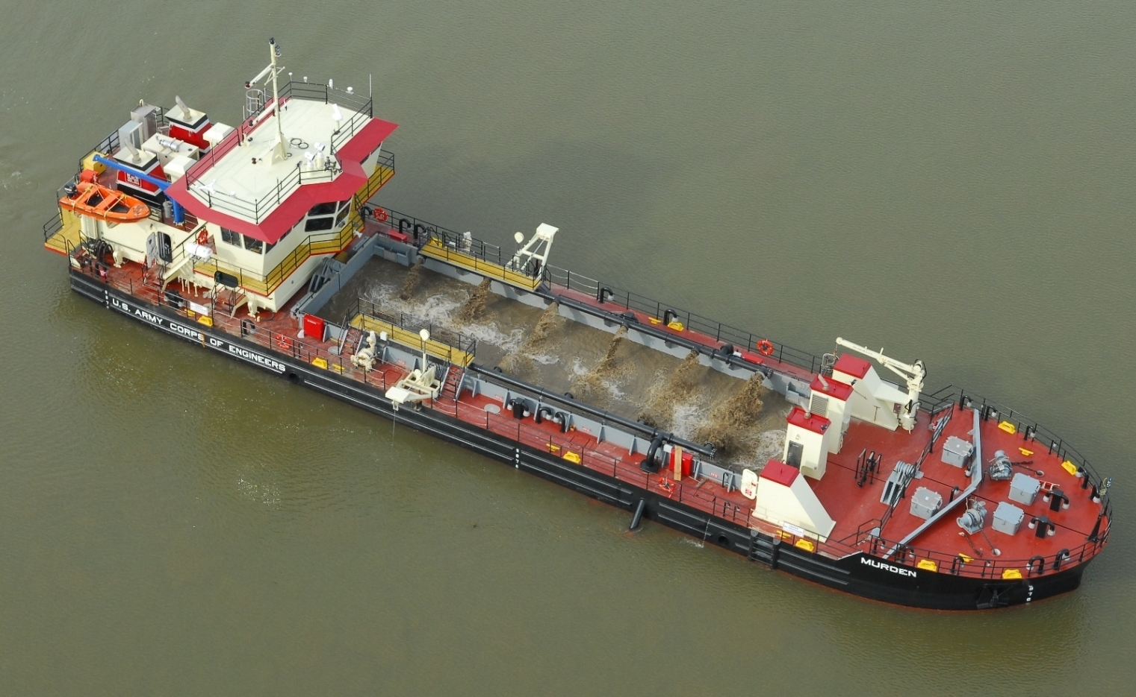
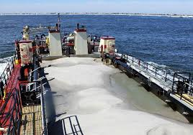
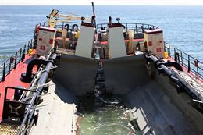
Underwater nearshore berms
Berms classified as sacrificial (feeder) , protection, and containment. Feeds shoreline, breaks waves, acts bar
South Padre Island (4000 ft long in 20 ft water depth)
Mobile Bay, Alabama
Shallow draft hopper dredge Murden (Length Overall: 156’, Hull Breadth: 35’, Hull Depth: 10’-9”, Draft: Bow 3’-10”, Stern 4’-7, Max Hopper Load: 512 cu yds
Shallow draft hopper dredge Currituck ( Length, Overall 150’-0”, Beam, Molded 30’-7”, Draft, Light 3’-4”, Draft, Loaded 7’-6”, Capacity 315 cubic yards

Slide 3
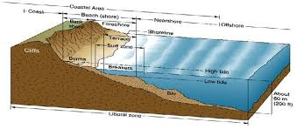
Placement in littoral current to maintain coast lines
Locate ODMDS in littoral zone
Regulate height of dredged material above original seafloor
Locate disposal area where the dredged material can be mobilized (dispersed)
Columbia River dredged material placement in littoral zone (out to 100 ft water depth)

Slide 4
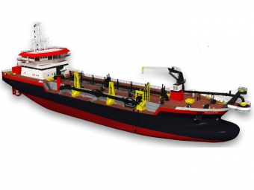
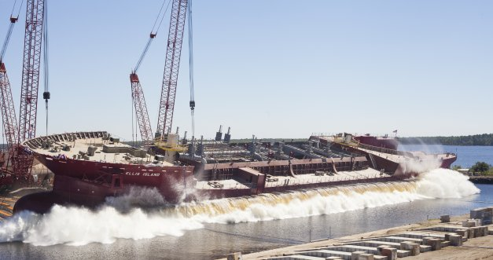
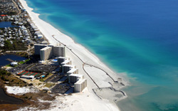
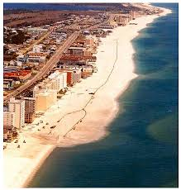
Beach nourishment & Land reclamation
Weeks Magdalen (8550 cy)
GLDD Ellis Island ( 15,000 cy)

Slide 5
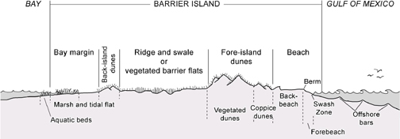
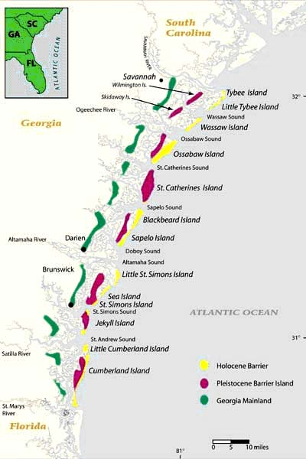
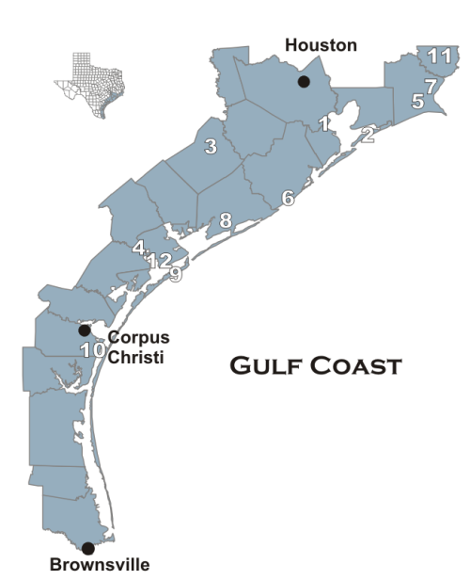
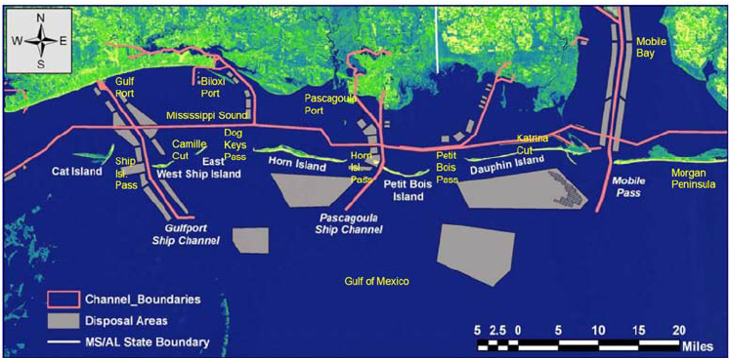
Maintenance of barrier islands

Slide 6
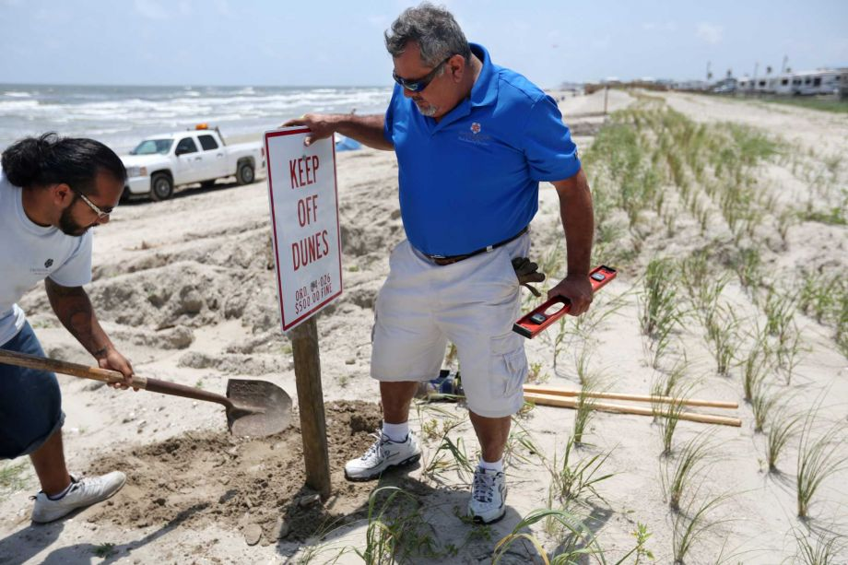
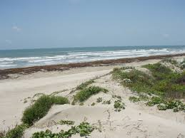
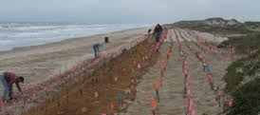
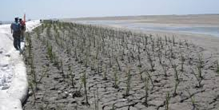
Building dunes & Resilience
Construct dunes with dredged material
Vegetate dunes
Develop regulations for public use of dunes and for maintaining dunes
Maintain dune structures for coastal communities
Elevate and vegetate dunes
Restrict access through dunes

Slide 7
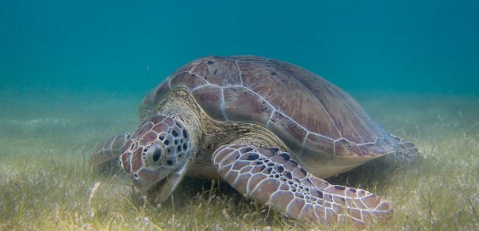
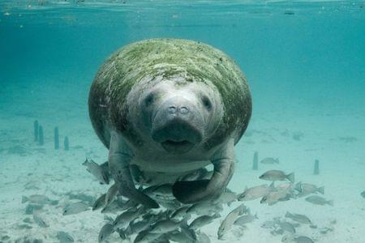
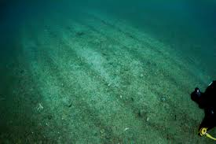
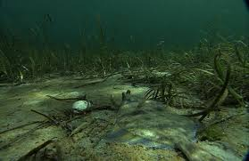
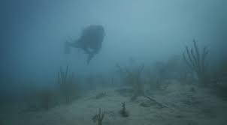
Underwater habitat for marine life

Slide 8
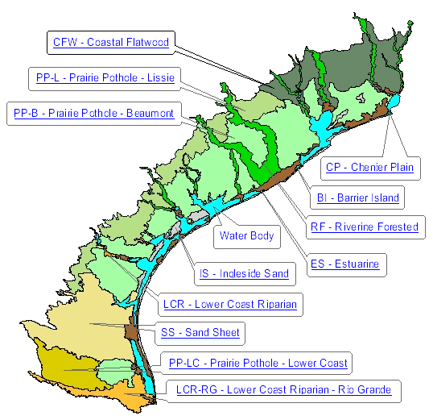
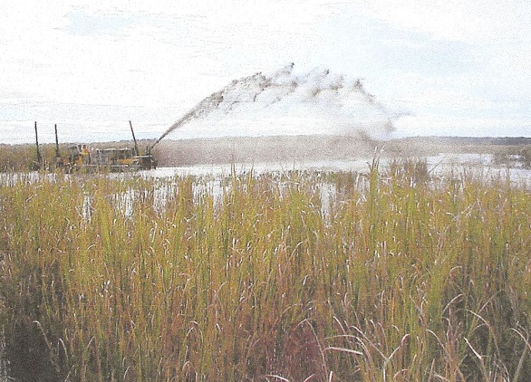

Wetlands Restoration & Thin Layer Placement
Fine grained dredged material from GIWW is excellent source
Thin layer (2-6 inches) placement
Dredged material jetted into the wetland area to replenish sediment

Slide 9
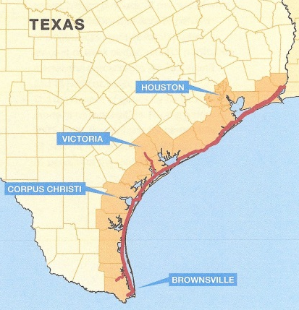
Texas GIWW
Randall et al (2000) report to TxDOT
~10 MCY dredged material (DM) removed from Texas GIWW each year. Total of ~25 MCY of DM removed from Texas waterways
Beneficial use possibilities
  Thin layer disposal for wetland restoration
  Manufactured soil
  Beach nourishment
  Erosion control along Texas GIWW
  Parks, recreation, port expansion
Courtesy TxDOT

Slide 10
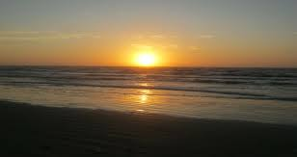
END

