Slide 1
Simulating fish response to biophysical features
Notes:
Our Role
What this means to you
One call get quick answer
More than two days effort requires reimbursement

Slide 2
Modeling to Understand Behavior?
In Physics-based disciplines;
replace natural system with equations
study mathematical behavior
draw conclusions about natural system
Consider the question of “Fish behavior in response to flow”
flow pattern description uses deterministic paradigm
fish mechano-sensory system tightly coupled to fluid variables
therefore, describing fish behavior in response to flow may be deterministic
Statistical studies of “fish behavior in response to flow” are seldom conclusive – need a fresh approach

Slide 3
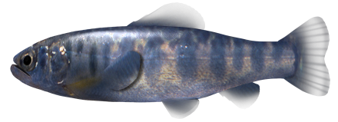
ELAMs: Understand & Forecast Fish Movement
Important Attributes of the ELAM
- capture temporal & spatial scales of complex biological processes
- venue for inter/trans-disciplinary education & integration
- information transformed to meet requirements of linked processes
Eulerian mesh node
Eulerian mesh
z
Sensory Point
y
Sensory Ovoid
x
*swim speed & size of sensory ovoid related to fish body length

Slide 4
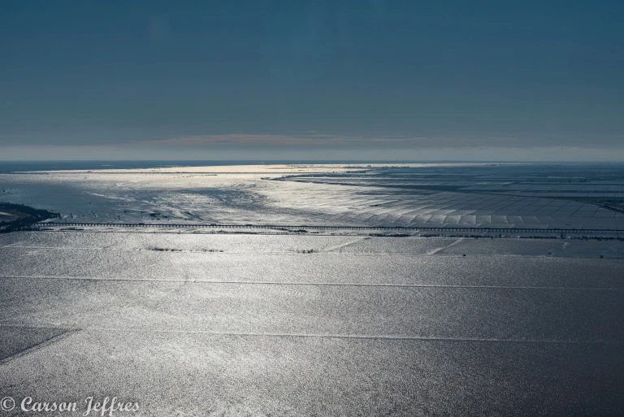
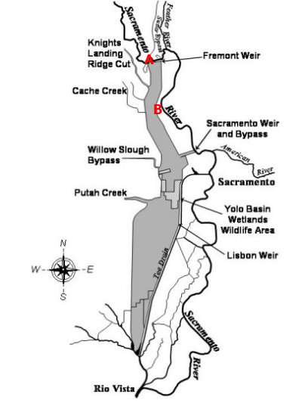
Yolo Bypass floodway
60,000 acre floodplain
40 miles long, 3 miles wide
500,000 cfs capacity
Historical floodplain
play

Slide 5
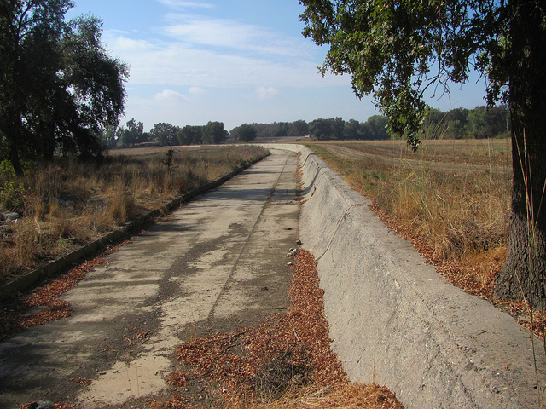
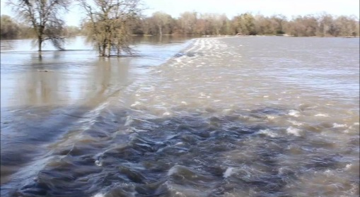
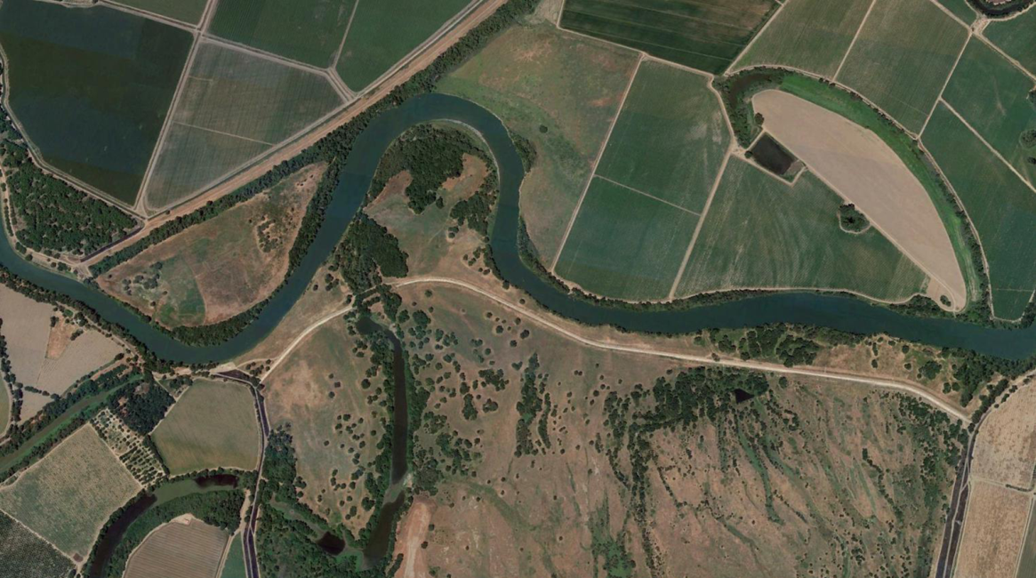
Fremont Weir
Separates Sacramento River from Yolo Bypass
2 miles long
Overflow from Sacramento River to Yolo Bypass
Fremont Weir

Slide 6
Project
Divert fish from river onto Yolo Bypass
Minimize water, maximize fish.
How big, what shape, location, where?
New notch
river

Slide 7
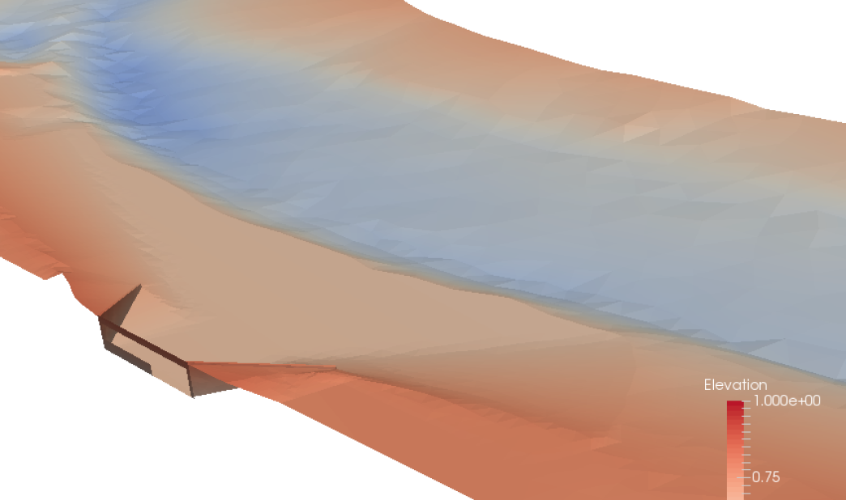
Approach
Numerical “mock-up” of a the Fremont Weir reach and alternative notch designs – hydraulic and topographic models
Compare movement simulations with measured data form 2015 and 2016
Estimate entrainment rates of proposed notches across range of conditions
Central shelf

Slide 8
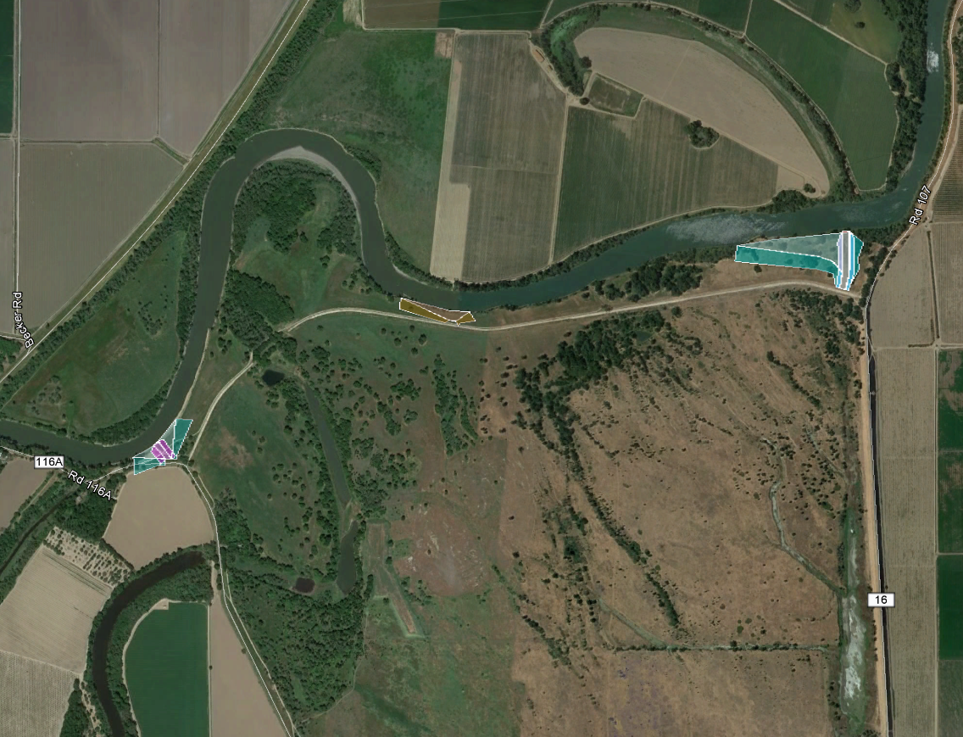
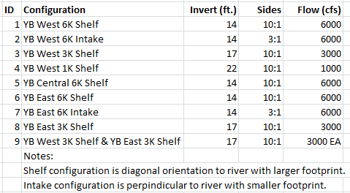
Fish Behavior Configurations
6 – 8, 9
5
1 – 4, 9
play
DRAFT for discussion purposes only

Slide 9
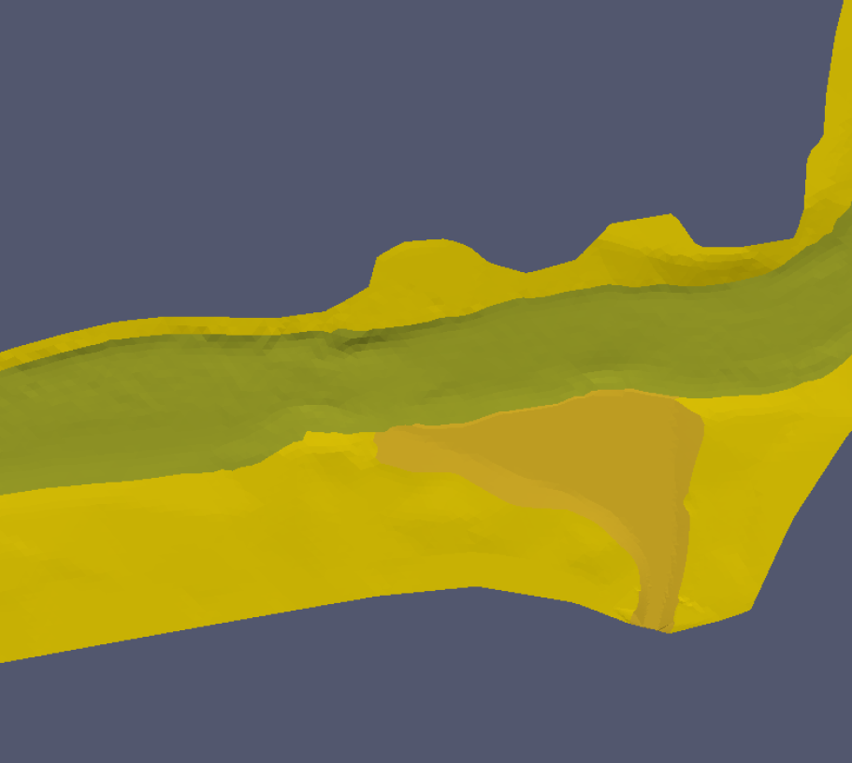
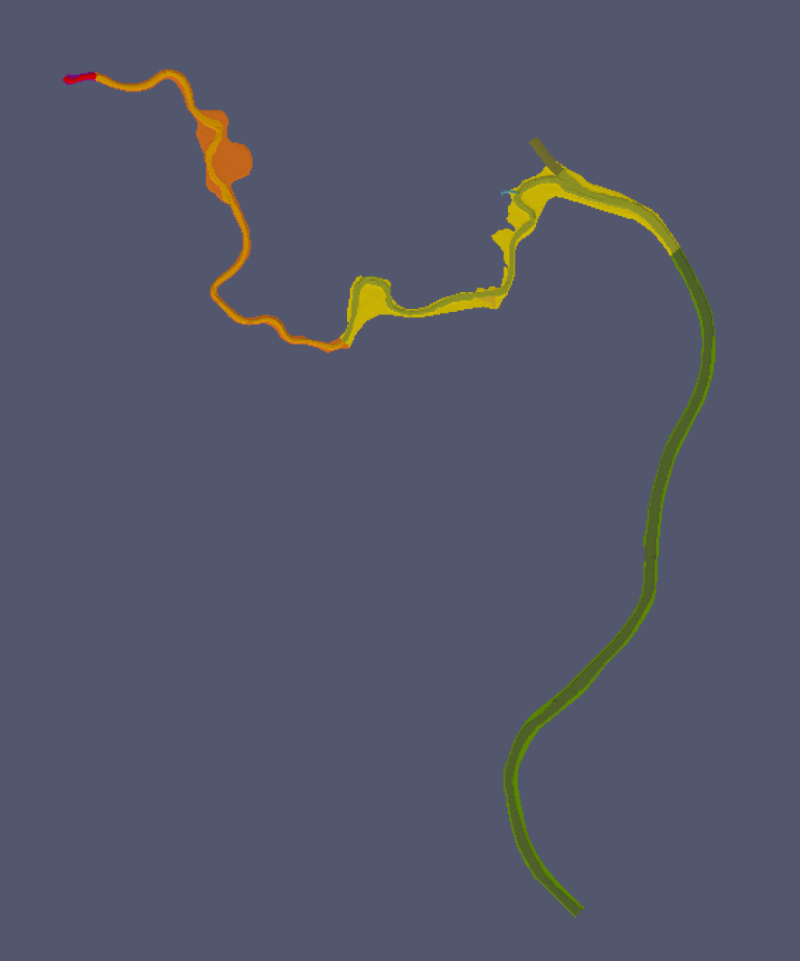
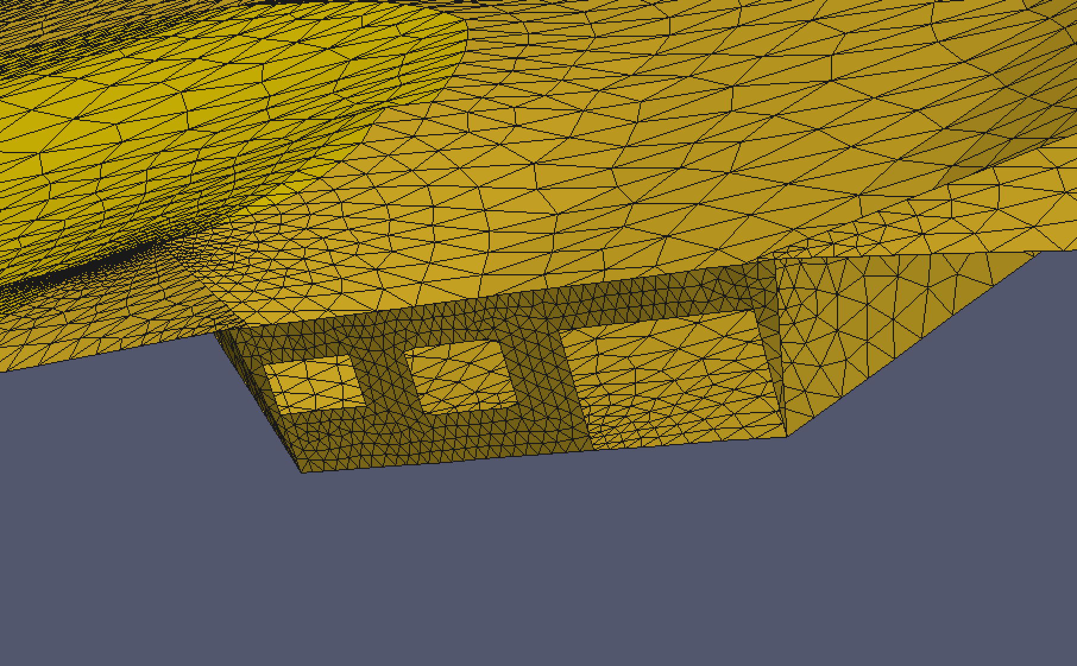
YB East 3K

Slide 10
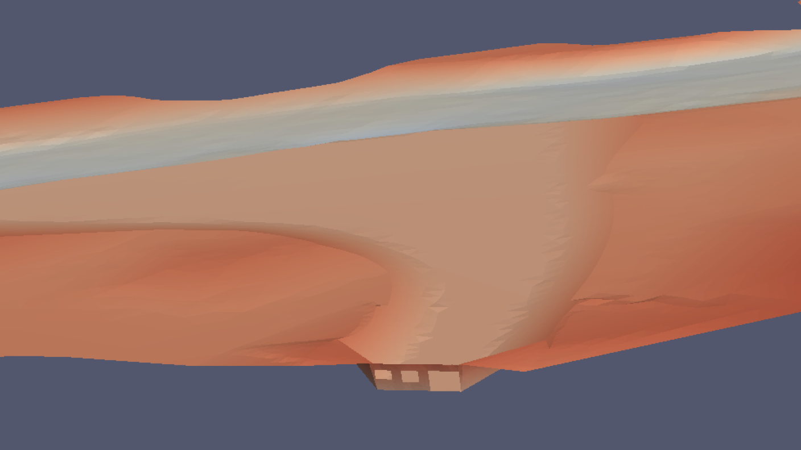
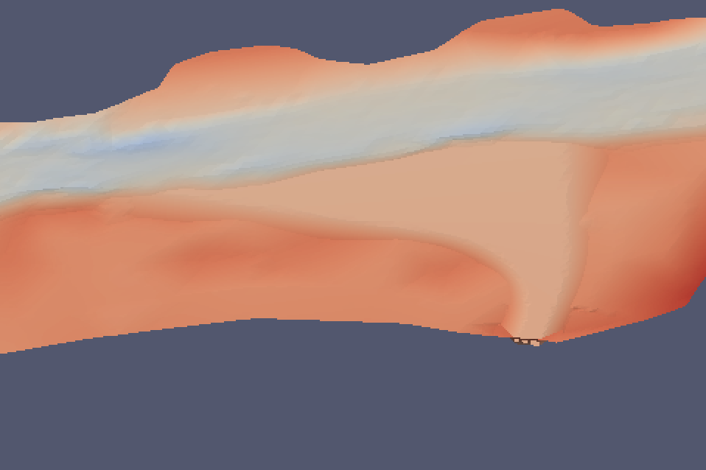
YB East 3K

Slide 11
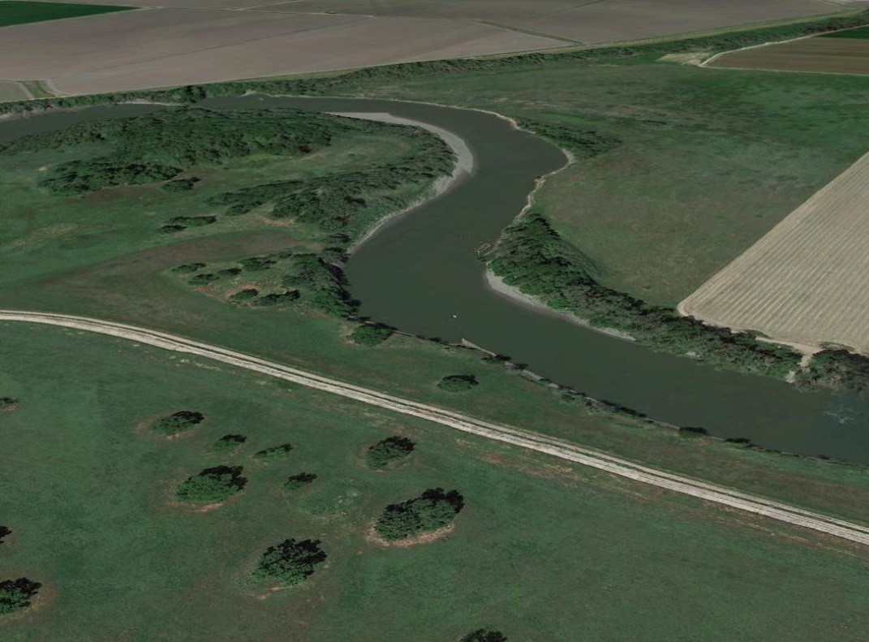
Central Shelf 6,000 cfs

Slide 12
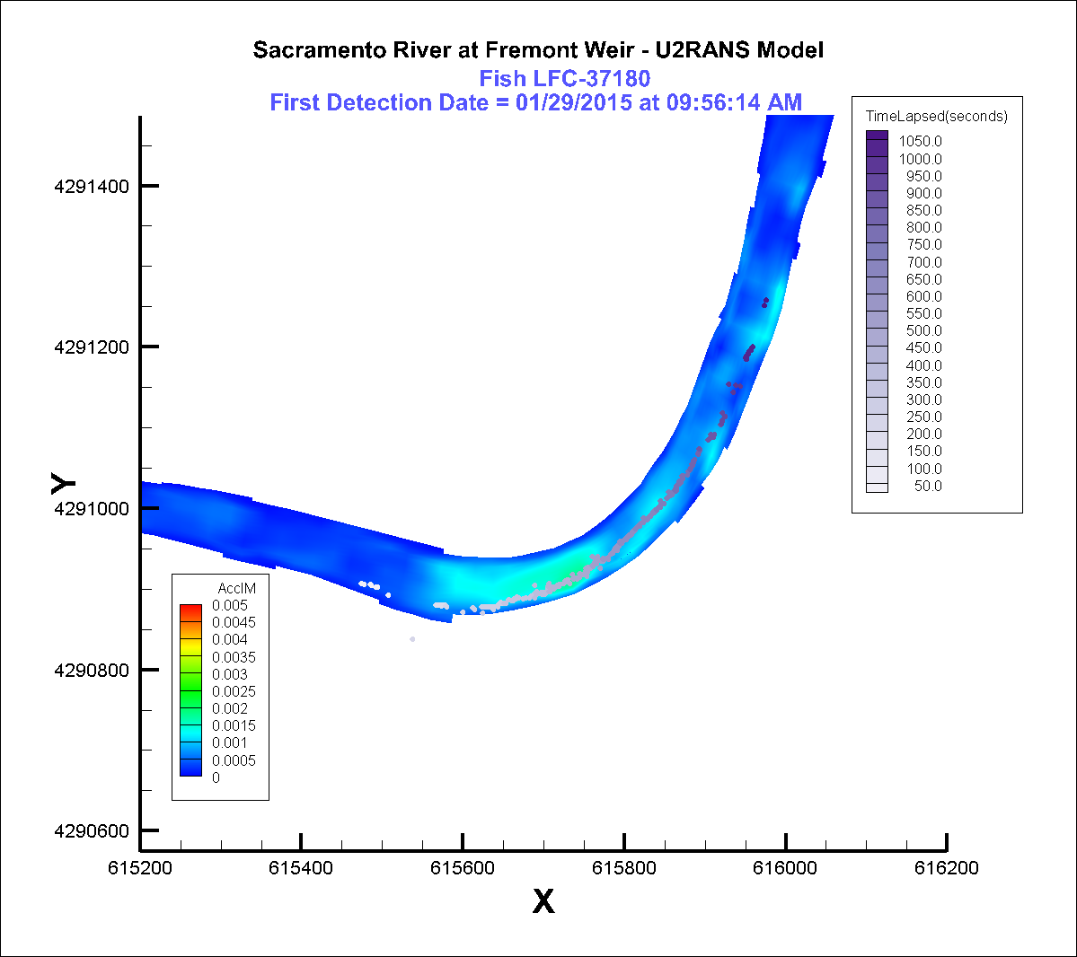
Fish Movement Model Calibration
Fish size and swim speeds
Some measured field data under existing conditions
2D simulation of existing conditions

Slide 13
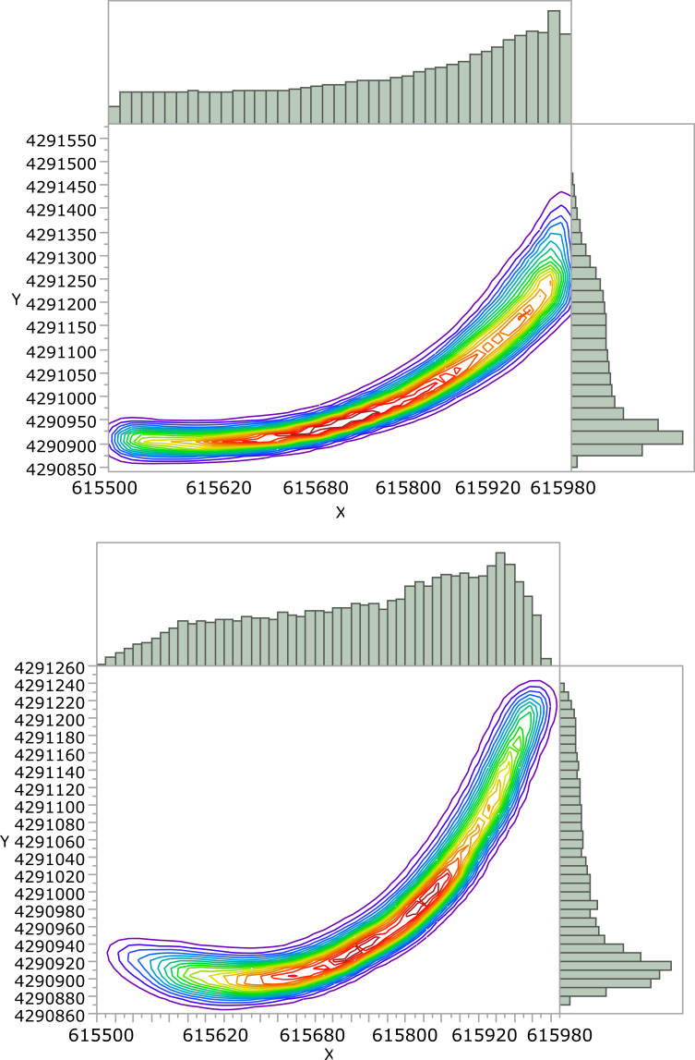
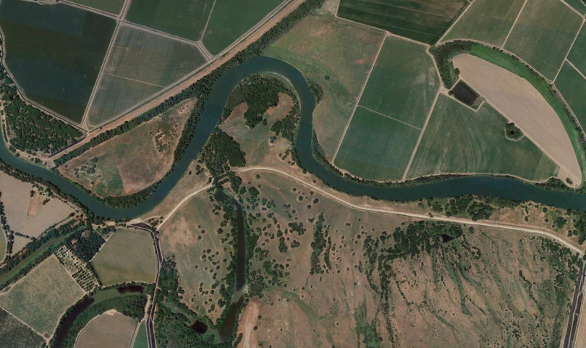
Spatial distribution
Modeled
N
White = measured fish locations
Orange = modeled fish locations
Measured
Fremont weir
Fremont weir

Slide 14
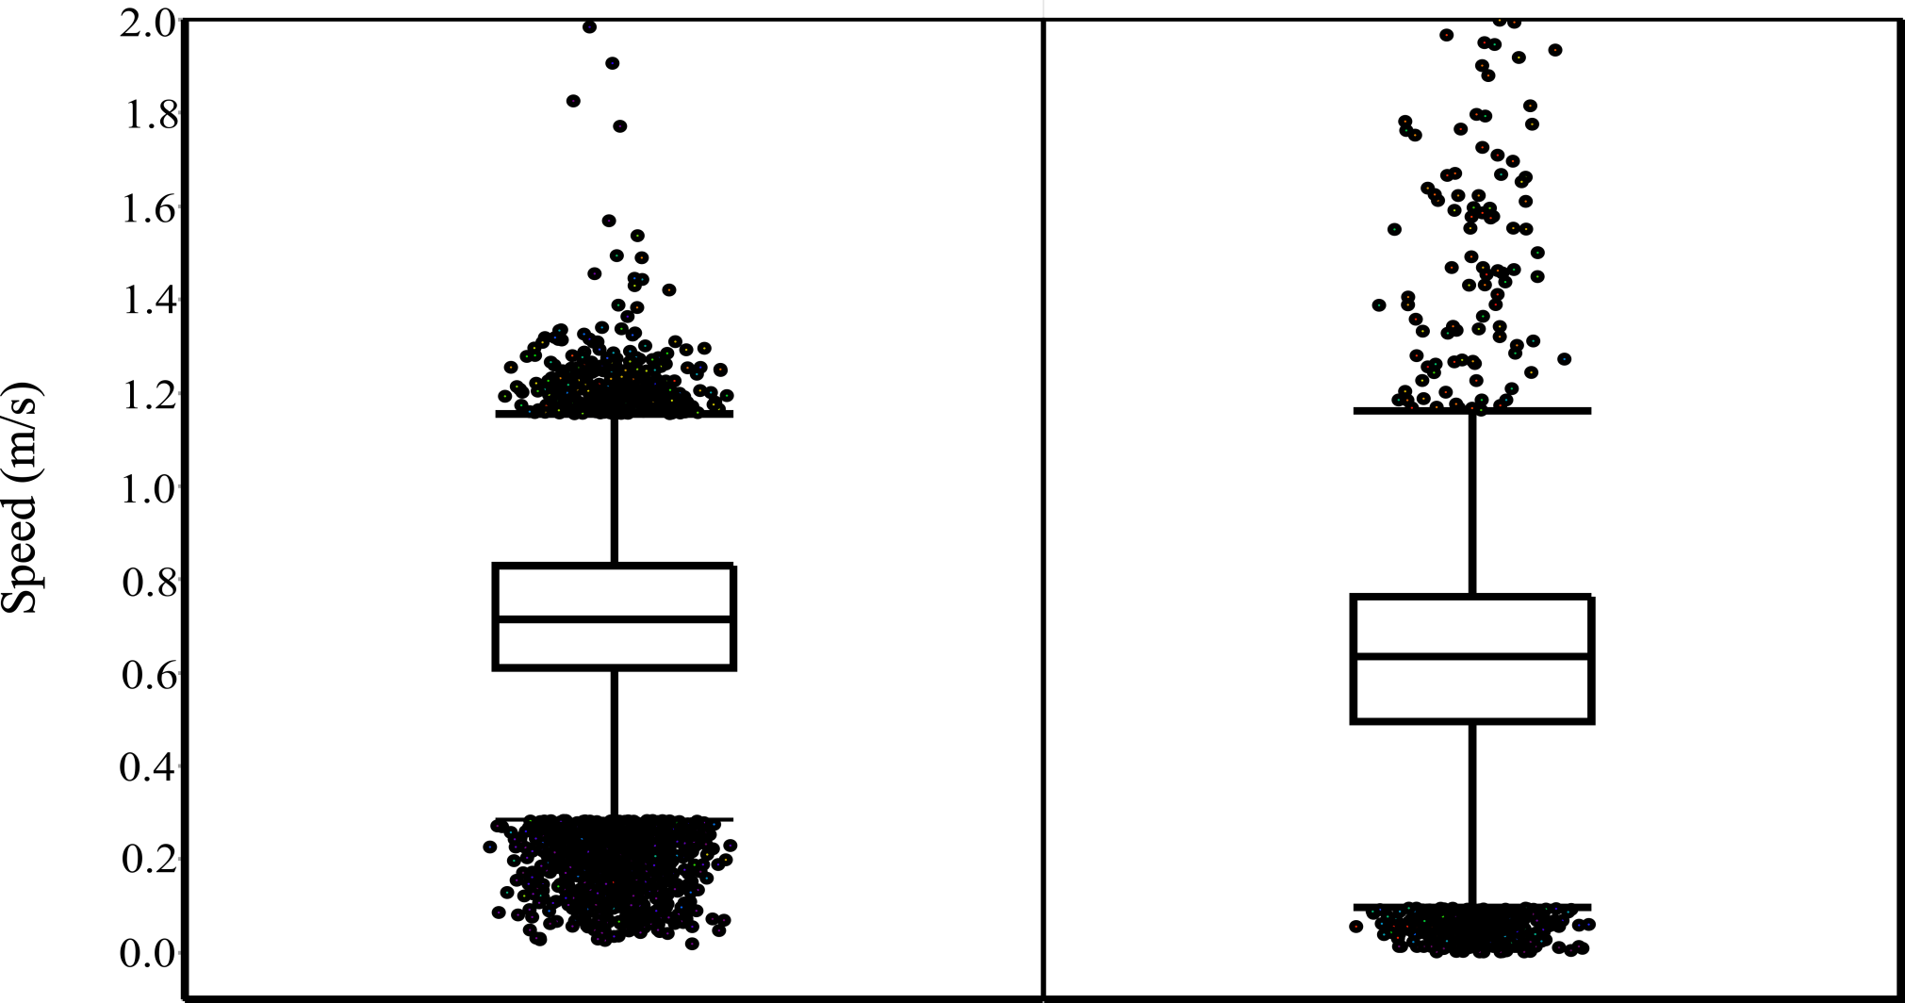
Observed and simulated movement speeds
Modeled
Measured

Slide 15
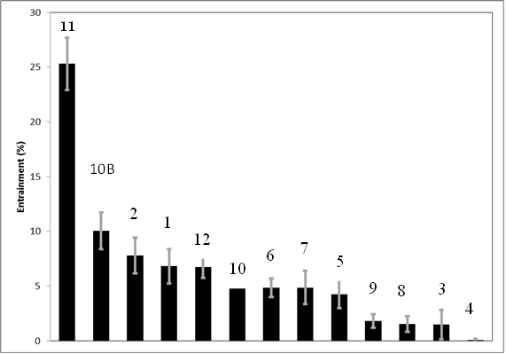
Results
Variation across alternatives
Variation within alternatives (ensemble estimates)
Number reflects rapid speed of fish, short time exposure to notch, center channel fish distribution and few flow lines being entrained

Slide 16
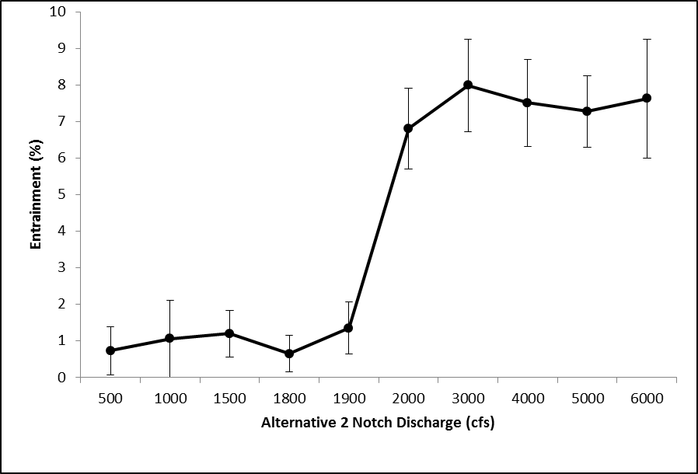
Alternative 2
Entrainment across notch flows is a step function.
Suggest that at ~2000 cfs change in flow pattern occurs
May highlight additional steps are possible to increase entrainment.
Preliminary explanation – Lower entrainment rates occur when only first step is active.
When both steps active critical streamline is moved approximately 20 ft further into the river.
Critical streakline moves 20 ft toward river center here

Slide 17
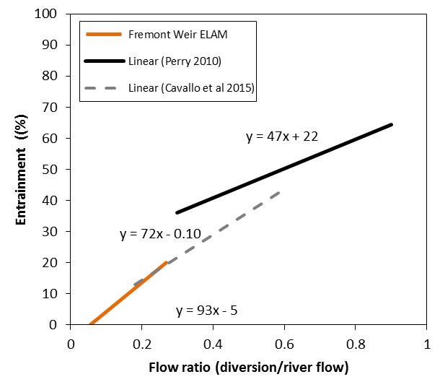
Validation
Model output compares favorably with measured values elsewhere in system

Slide 18
Conclusions
We implemented a physics (engineering) based approach to understanding biophysical outcomes
Developed movement (hypothesis) about movement behavior and tested in a 2D flow field
Matched existing measured data
Produced entrainment estimates useful for choosing final alternative to build.

